Slide 1

Click anywhere to get started…

Slide 2

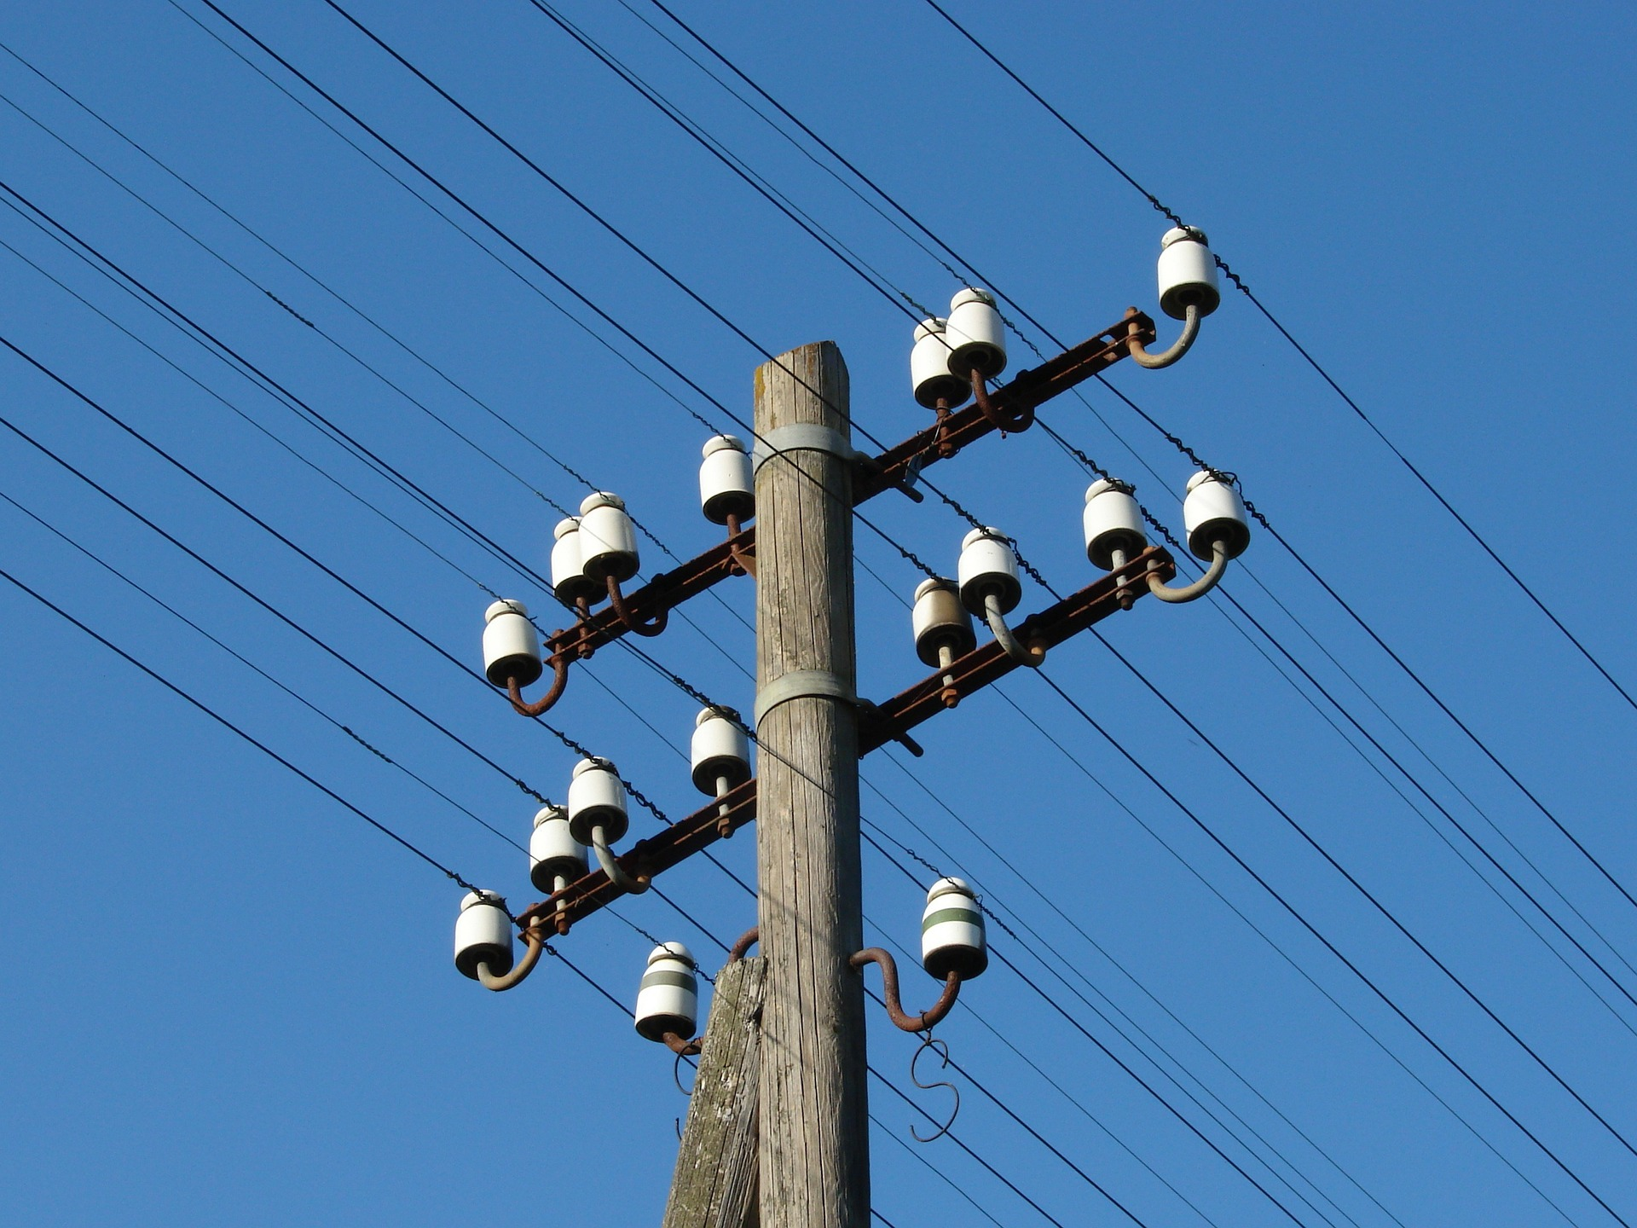

OVERHEAD WIRE SAFETY
Notes:
OVERHEAD WIRE SAFETY

Slide 3
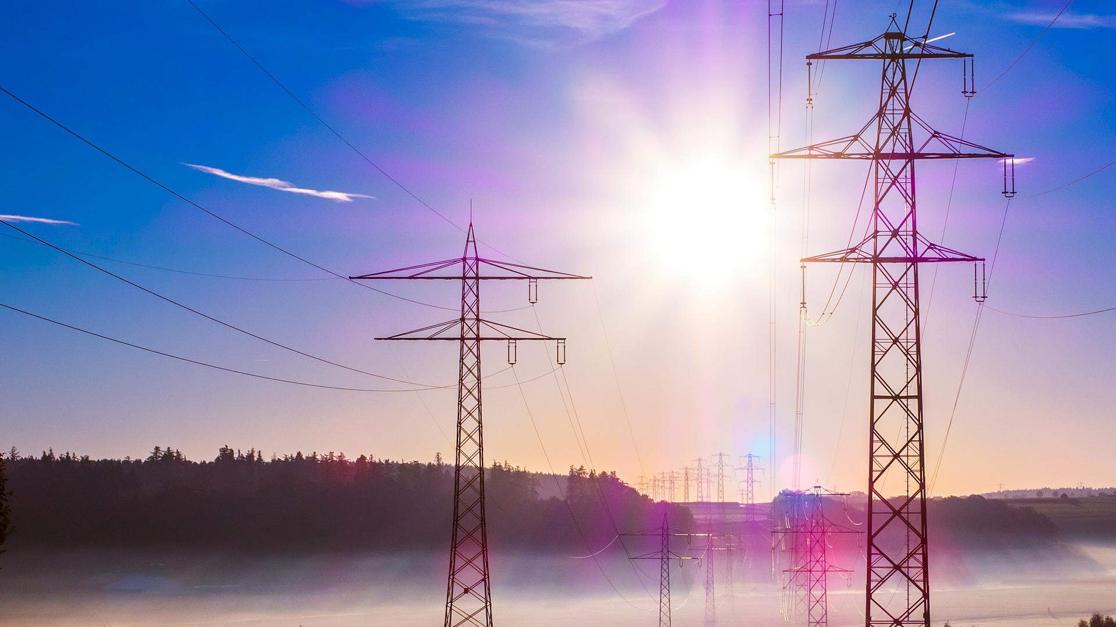
What’s at Stake?
Incidents involving high voltage power lines are preventable. But electricity is dangerous!!! Less than one amp of electricity flowing through the human body can shock, burn, severely injure or cause death.
Notes:
What’s at Stake?
Incidents involving high voltage power lines are preventable. But electricity is dangerous!!!
Electricity is dangerous! Less than one amps of electricity flowing through the human body can shock, burn, severely injure or cause death. Electricity travels at approximately 299,330 km per second – you’ll have no time to react. To be safe, never put yourself into electricity’s path. “Conductors “of electricity include metal, water, humans and even non-metallic materials such as equipment tires, trees, and rope.

Slide 4
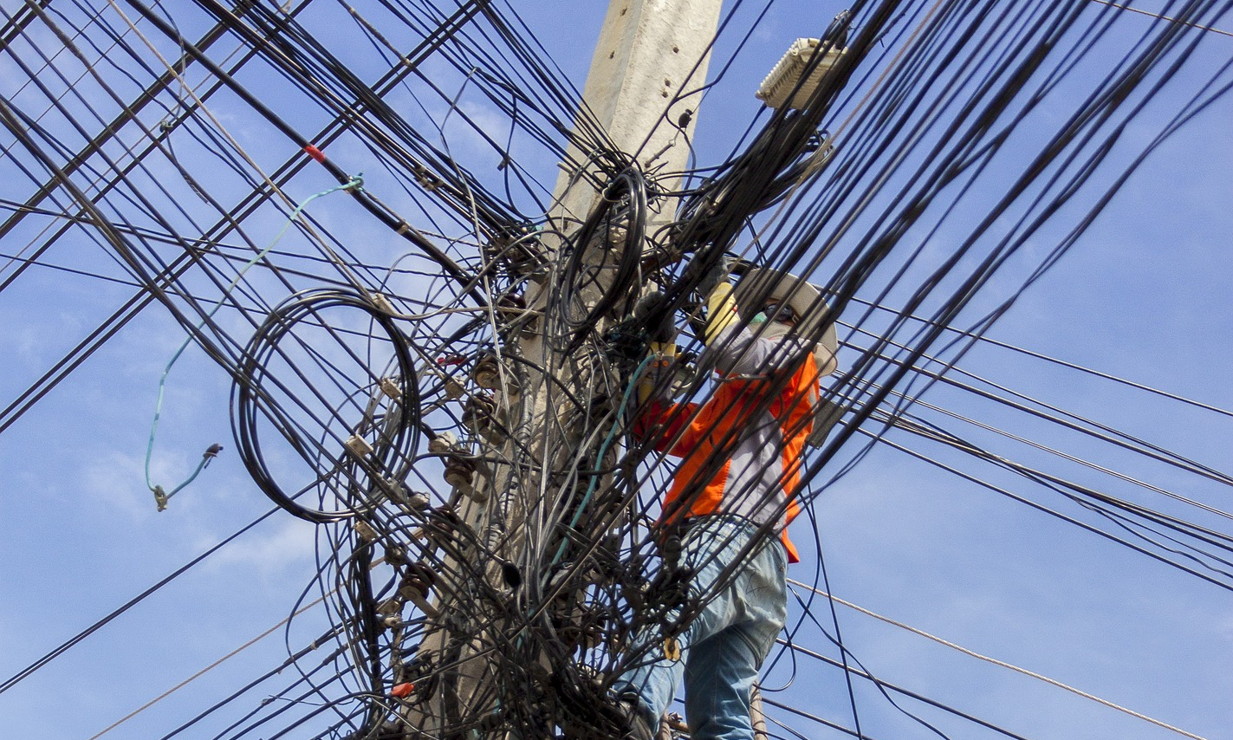
What’s the Danger?
OVERHEAD POWER LINES
Accidental contact with live overhead power lines kills people and causes many serious injuries every year. People are also harmed when a person or object gets too close to a line and a flashover occurs. Work involving high vehicles or long equipment is particularly high risk.
Notes:
What’s the Danger?
OVERHEAD POWER LINES
Accidental contact with live overhead power lines kills people and causes many serious injuries every year. People are also harmed when a person or object gets too close to a line and a flashover occurs. Work involving high vehicles or long equipment is particularly high risk, such as;
In Construction – Lorry mounted cranes (such as Hiabs or Palingers), Mobile Elevated Work Platforms (MEWP's), scaffold poles, tipper vehicles, cranes, ladders;
In Agriculture – combines, sprayer booms, materials handlers, tipper vehicles, ladders, irrigation pipes, polytunnels; Remember:
• going close to a live overhead line can result in a flashover that may kill. Touching a power line is not necessary for danger;
• voltages lower than 230 volts can kill and injure people;
• do not mistake overhead power lines on wooden poles for telephone wires; and
• electricity can bypass wood, plastic or rubber, if it is damp or dirty, and cause fatal shocks. Don't rely on gloves or rubber boots to protect you.

Slide 5
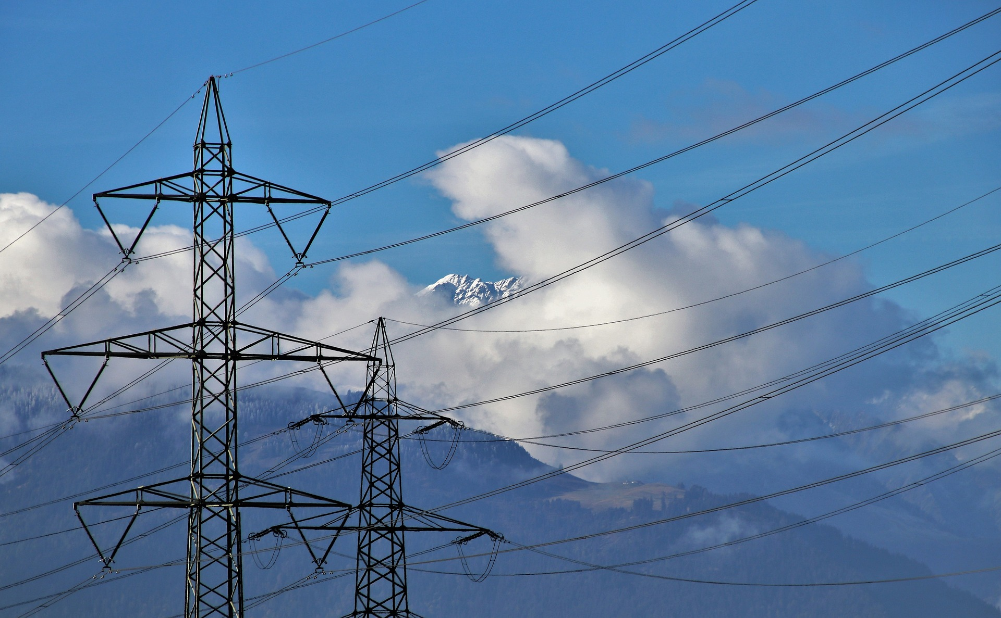
What’s the Danger?
ACCIDENTS AND OVERHEAD POWER LINES
A high proportion of accidents occur when vehicles or machinery make contact with overhead lines. If a vehicle or machine becomes “live” then anyone touching it is in mortal danger. Anyone in the cab may be in less danger but may be threatened by the vehicle or machine catching fire.
Notes:
What’s the Danger?
ACCIDENTS AND OVERHEAD POWER LINES
A high proportion of accidents occur when vehicles or machinery make contact with overhead lines. If a vehicle or machine becomes “live” then anyone touching it is in mortal danger. Anyone in the cab may be in less danger but may be threatened by the vehicle or machine catching fire.
Personnel are at serious risk if equipment they are driving tips off an overhead line. This may happen in a number of different scenarios:
• the equipment is high enough to reach the line while driving along in its normal configuration;
• a trailer is tipped up, making contact with the line, rendering the entire vehicle “live”;
• a hydraulic boom or jib, controlled from a cab, makes contact with an overhead line, e.g. a crane lifting a load;
• a hydraulic boom, jib, pipe or conveyor, controlled by an operator in a standing position, makes contact with a line while lifting or conveying material.
Because of the height of equipment used in agriculture, farmers and those in or close to tall agricultural equipment can be at high risk in the event of a hit on an overhead line.

Slide 6
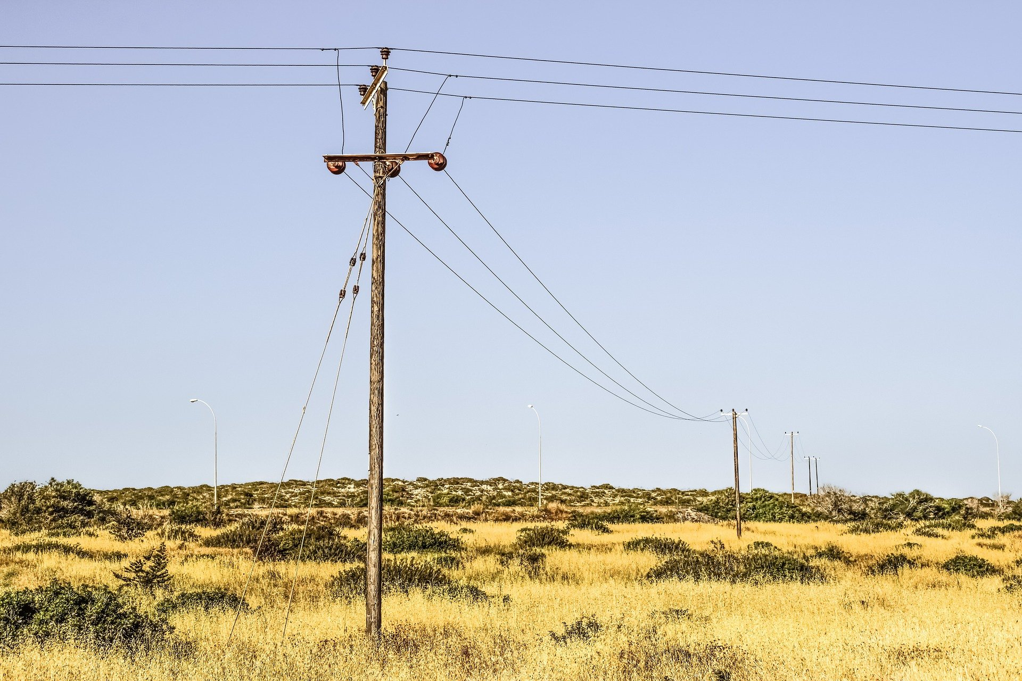
How to Protect Yourself
PREVENTIVE STEPS
Plan and manage work near electric overhead power lines so that risks from accidental contact or close proximity to the lines are adequately controlled.
Safety can be achieved by a combination of measures:
• Planning and preparation
• Eliminating the danger
• Controlling the access
• Controlling the work
Notes:
How to Protect Yourself
PREVENTIVE STEPS
Plan and manage work near electric overhead power lines so that risks from accidental contact or close proximity to the lines are adequately controlled.
Safety precautions will depend on the nature of the work and will be essential even when work near the line is of short duration.
Safety can be achieved by a combination of measures:
• Planning and preparation
• Eliminating the danger
• Controlling the access
• Controlling the work

Slide 7
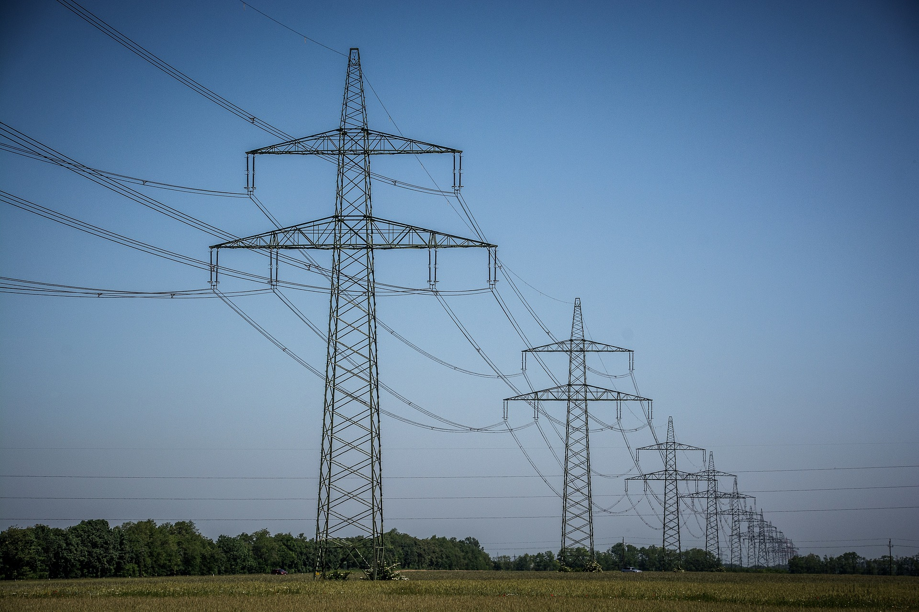
How to Protect Yourself
Planning and Preparation
The first step is to find out whether there is any overhead power line within or immediately next to the work area, or across any access route.
Eliminating the Danger
Eliminate the danger by:
Avoidance
Diversion
Notes:
How to Protect Yourself
Planning and Preparation
The first step is to find out whether there is any overhead power line within or immediately next to the work area, or across any access route.
Information will be available from the local electricity supplier or Distribution Network Operator (DNO). If any overhead lines are found, you should assume that they are live unless proved otherwise by their owners.
If there are any overhead lines over the work area, near the site boundaries, or over access roads to the work area, consult the owners of the lines so that the proposed plan of work can be discussed.
Allow sufficient time for lines to be diverted or made dead, or for other precautions to be taken as described below.
Eliminating the Danger
Eliminate the danger by:
Avoidance – find out if the work really has to be carried out under or near overhead lines, and can't be done somewhere else. Make sure materials (such as bales or spoil) are not placed near overhead lines, and temporary structures (such as polytunnels) are erected outside safe clearance distances;
Diversion – arrange for overhead lines to be diverted away from the work area; or Isolation – arrange for lines to be made dead while the work is being done.
In some cases you may need to use a suitable combination of these measures, particularly where overhead lines pass over permanent work areas.
If the danger cannot be eliminated, you should manage the risk by controlling access to, and work beneath, overhead power lines.

Slide 8
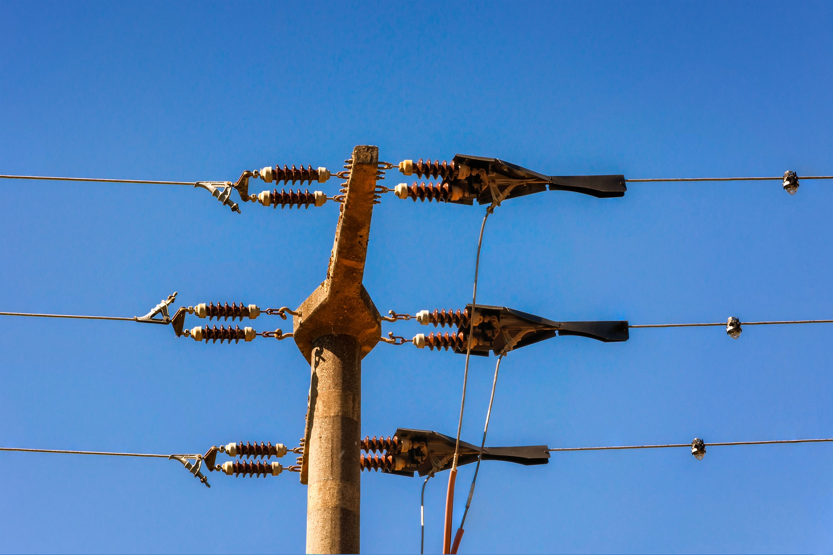
How to Protect Yourself
Controlling the Access
Where there is no scheduled work or requirement for access under the lines, barriers should be erected at the correct clearance distance away from the line to prevent close approach.
Controlling the Work
If work beneath live overhead power lines cannot be avoided, barriers, goal posts and warning notices should be provided.
The following precautions may also be needed to manage the risk:
Clearance
Exclusion
Modifications
Maintenance
Supervision
Notes:
How to Protect Yourself
Controlling the Access
Where there is no scheduled work or requirement for access under the lines, barriers should be erected at the correct clearance distance away from the line to prevent close approach. The safe clearance distance should be ascertained from the Distribution Network Operator (DNO). HSE guidance documents Avoidance of danger from overhead electric power lines and Electricity at Work: Forestry and Arboriculture also provide advice on safe clearance distances and how barriers should be constructed. Where there is a requirement to pass beneath the lines, defined passageways should be made.
The danger area should be made as small as possible by restricting the width of the passageway to the minimum needed for the safe crossing of plant. The passageway should cross the route of the overhead line at right angles if possible.
Controlling the Work
If work beneath live overhead power lines cannot be avoided, barriers, goal posts and warning notices should be provided. Where field work is taking place it may be impractical to erect barriers and goal posts around the overhead lines - these are more appropriate for use at gateways, on tracks and at access points to farm yards.
The following precautions may also be needed to manage the risk:
Clearance – the safe clearance required beneath the overhead lines should be found by contacting the Distribution Network Operator (DNO);
Exclusion – vehicles, plant, machinery, equipment, or materials that could reach beyond the safe clearance distance should not be taken near the line;
Modifications – Vehicles such as cranes, excavators and tele-handlers should be modified by the addition of suitable physical restraints so that they cannot reach beyond the safe clearance distances, measures should be put in place to ensure these restraints are effective and cannot be altered or tampered with;
Maintenance – operators of high machinery should be instructed not carry out any work on top of the machinery near overhead power lines;
Supervision – access for plant and materials and the working of plant should be under the direct supervision of a suitable person appointed to ensure that safety precautions are observed.

Slide 9
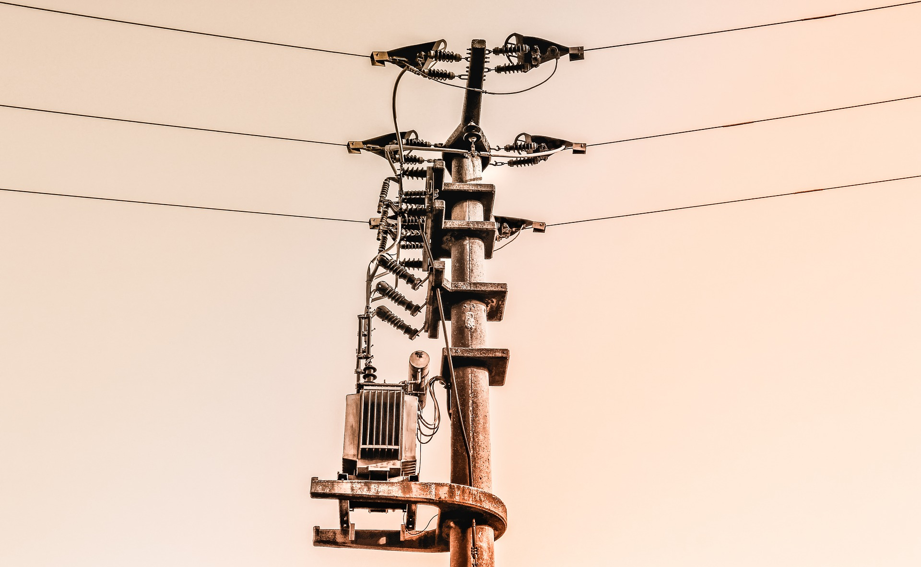
How to Protect Yourself
SAFETY CONSIDERATIONS FOR OVERHEAD POWER LINES (OHPL)
It is a given that work may be carried out in close proximity to live overhead lines only when there is no alternative and when the risks can be properly controlled.
Ideally the line should be isolated or temporarily diverted but this is not always possible.
Notes:
How to Protect Yourself
SAFETY CONSIDERATIONS FOR OVERHEAD POWER LINES (OHPL)
It is a given that work may be carried out in close proximity to live overhead lines only when there is no alternative and when the risks can be properly controlled.
Voltages less than 230v can kill and overhead powerlines (OHPL) run between 400v and 400kv. The higher voltage cables are not insulated but gloves and rubber boots are not adequate protection for voltages in OHPL. It is not necessary to touch the OHPL to receive a shock – regardless, close proximity can produce a fatal arc.
Risks/Precautions
If you are working within a distance of 10m (measured at ground level horizontally from below the nearest wire) you are classed as working in close proximity. Ideally the line should be isolated or temporarily diverted but this is not always possible. Therefore, employers need to take suitable precautions that protect the workforce. Employers and workers have a duty to ensure:
• Risks are assessed by a competent and experienced person;
• Safety precautions are always followed;
• Overhead line wires should never be touched;
• It is always assumed that the wires are live. Even if thought to be isolated or dead, they may be switched back on either automatically or remotely after a few seconds, minutes or even hours;
• If working in proximity to broken lines, they are to be isolated and earthed at a safe distance either side of the working area.

Slide 10
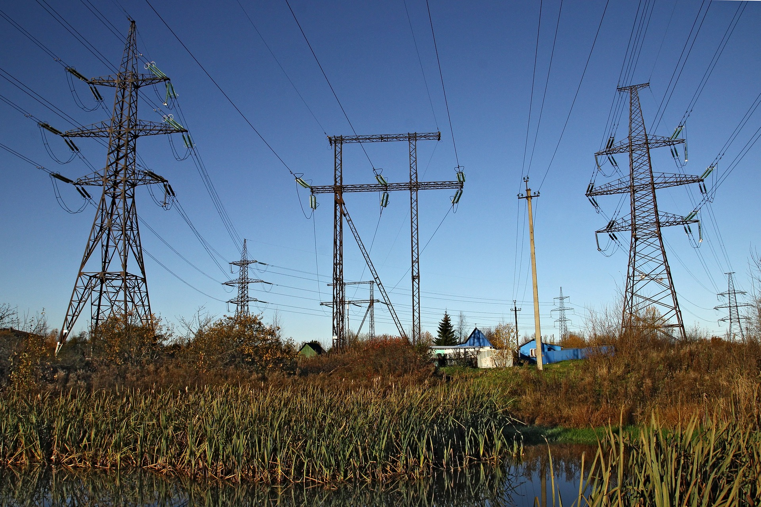
How to Protect Yourself
ACCIDENTS HAPPEN
Step potential: When voltage is higher nearer the source – as you step away one foot may be in contact with a lower voltage than the other. Current will flow through your body, as you lift one foot, and arc back to earth giving a shock likely to be fatal.
Touch potential: When you touch a live source and the voltage is higher than your feet. Current will flow through you to the floor delivering a shock that could be fatal due to high voltage.
Notes:
How to Protect Yourself
ACCIDENTS HAPPEN
However, accidents do happen. The following are safety crucial points to follow if you find yourself near broken power lines:
• If you are in a vehicle that has touched a wire you will be safer if you stay in the vehicle. If you face additional hazards by staying in the vehicle (e.g. fire) and you need to get out, jump out of it as far as you can and try to land with both feet together to avoid “step potential” (see below for definition).
• Do not touch the vehicle while standing on the ground as it is likely to have retained a substantial charge. A shock received in this manner is known as “touch potential” (see below for definition) and can be fatal.
• Do not return to the vehicle until it has been confirmed that it is safe to do so;
• If you can, call the emergency services. Give them your location, tell them what has happened and that electricity wires are involved, and ask them to contact the line’s owner;
• If you are in contact with, or close to, a damaged wire, move away as quickly as possible by shuffling and keeping both feet on the ground or by jumping with both feet together;
• If you see the accident from another area, do not approach within 10m of the broken line until the line’s owner advises that the situation has been made safe;
Step potential: When voltage is higher nearer the source – as you step away one foot may be in contact with a lower voltage than the other. Current will flow through your body, as you lift one foot, and arc back to earth giving a shock likely to be fatal.
Touch potential: When you touch a live source and the voltage is higher than your feet. Current will flow through you to the floor delivering a shock that could be fatal due to high voltage.

Slide 11
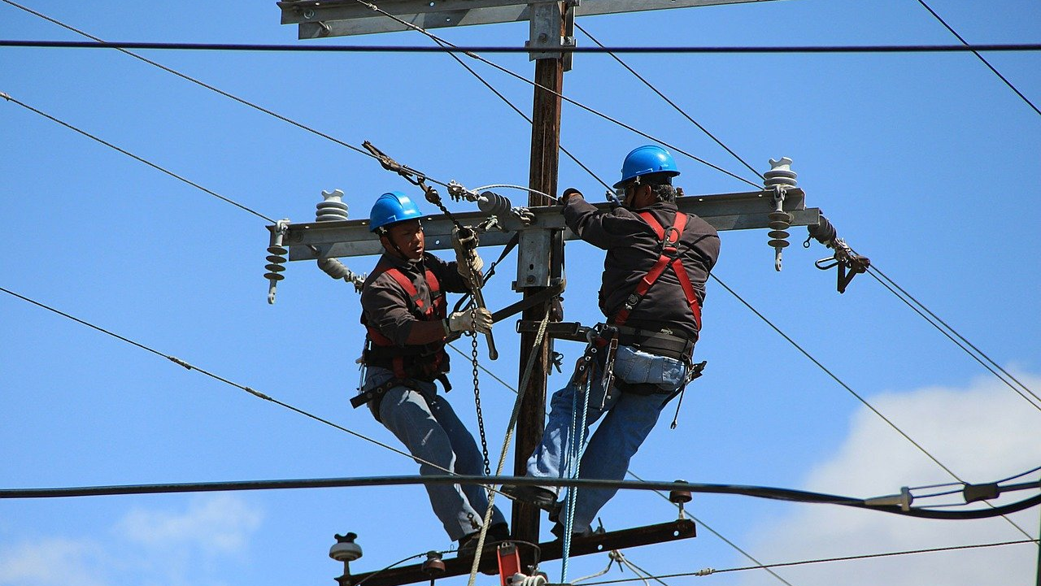
Final Word
Knowledge and respect for the power of electricity are two fundamental tenets for working safely and with any longevity in the world of overhead wire. The one without the other; will most certainly leave a wake of devastation.
Notes:
Final Word
Knowledge and respect for the power of electricity are two fundamental tenets for working safely and with any longevity in the world of overhead wire. The one without the other; will most certainly leave a wake of devastation.

