Slide 1

Click anywhere to get started…

Slide 2

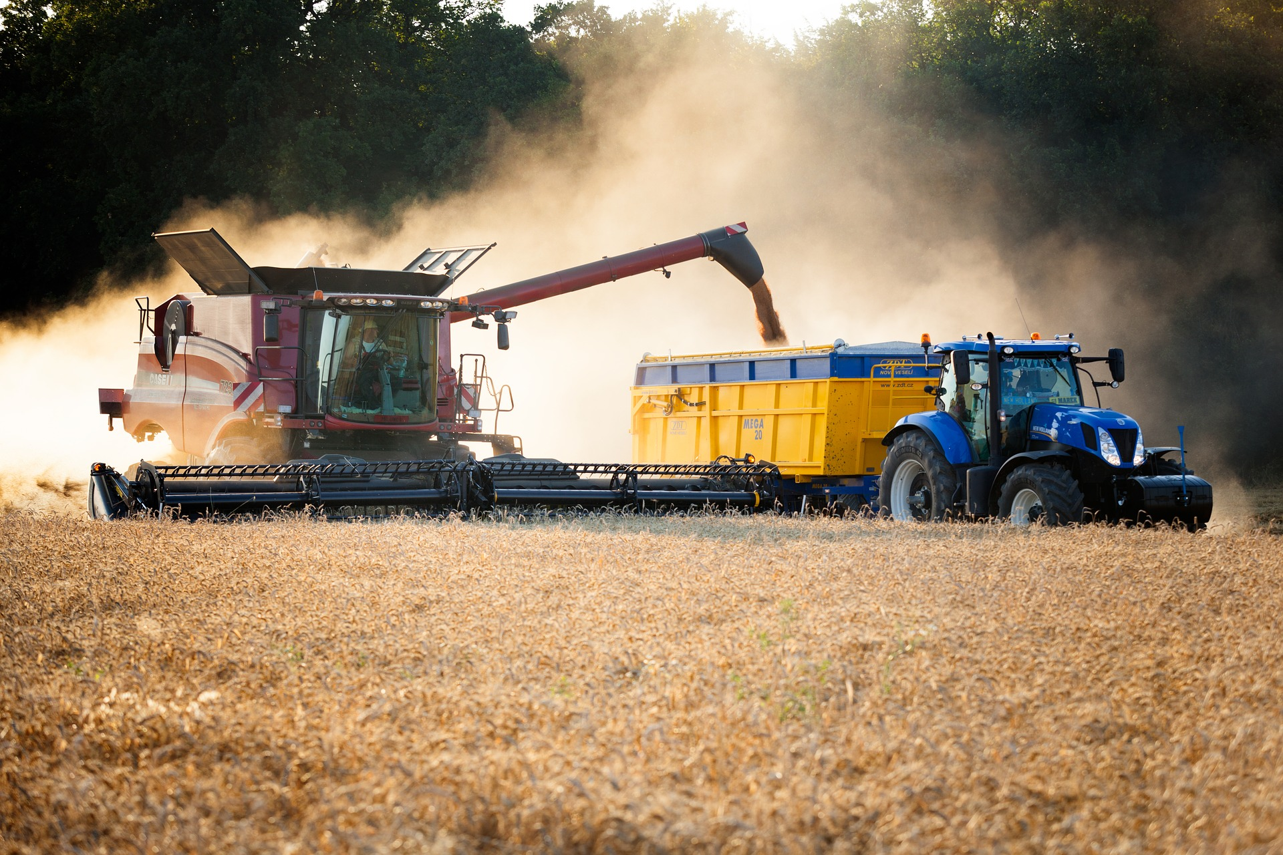

MANAGING GRAIN DUST
Notes:
MANAGING GRAIN DUST

Slide 3
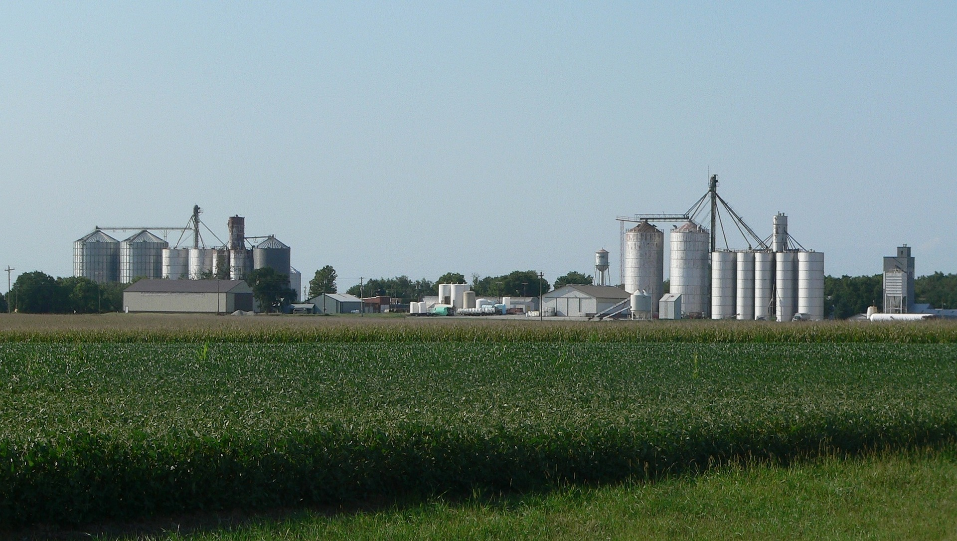
What’s at Stake?
GRAIN HANDLING FACILITIES
Grain handling facilities are facilities that may receive, handle, store, process and ship bulk raw agricultural commodities such as (but not limited to) corn, wheat, oats, barley, sunflower seeds, and soybeans.
Notes:
What’s at Stake?
GRAIN HANDLING FACILITIES
Grain handling facilities are facilities that may receive, handle, store, process and ship bulk raw agricultural commodities such as (but not limited to) corn, wheat, oats, barley, sunflower seeds, and soybeans. Grain handling facilities include grain elevators, feed mills, flour mills, rice mills, dust pelletizing plants, dry corn mills, facilities with soybean flaking operations, and facilities with dry grinding operations of soycake.

Slide 4
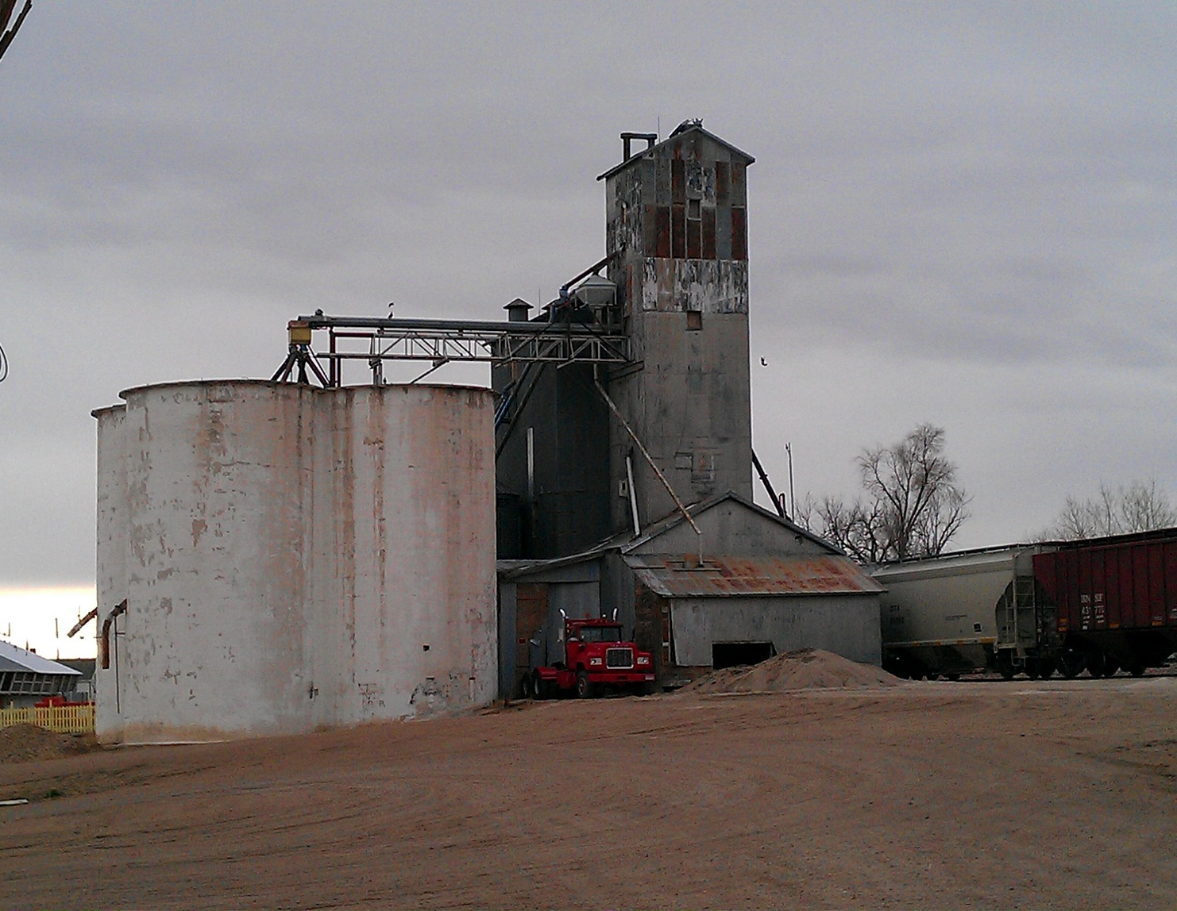
What’s the Danger?
HAZARDS/DANGERS OF GRAIN HANDLING FACILITIES
General
The grain handling industry is a high hazard industry where workers can be exposed to numerous serious and life threatening hazards.
More Suffocation
Suffocation is a leading cause of death in grain storage bins.
Grain Dust Explosion
Grain dust explosions are often severe, involving loss of life and substantial property damage.
Falls
Falls from height can occur from many walking/working surfaces throughout a grain handling facility.
Mechanized Equipment
Mechanical equipment within grain storage structures, such as augers and conveyors, present serious entanglement and amputation hazards.
Storage Structures
Storage structures can also develop hazardous atmospheres due to gases given off from spoiling grain or fumigation.
Notes:
What’s the Danger?
HAZARDS/DANGERS OF GRAIN HANDLING FACILITIES
General
The grain handling industry is a high hazard industry where workers can be exposed to numerous serious and life threatening hazards. These hazards include: fires and explosions from grain dust accumulation, suffocation from engulfment and entrapment in grain bins, falls from heights and crushing injuries and amputations from grain handling equipment.
More Suffocation
Suffocation is a leading cause of death in grain storage bins. Suffocation can occur when a worker becomes buried (engulfed) by grain as they walk on moving grain or attempt to clear grain built up on the inside of a bin. Moving grain acts like "quicksand" and can bury a worker in seconds. "Bridged" grain and vertical piles of stored grain can also collapse unexpectedly if a worker stands on or near it. The behavior and weight of the grain make it extremely difficult for a worker to get out of it without assistance.
Grain Dust Explosion
Grain dust explosions are often severe, involving loss of life and substantial property damage. Grain dust is the main source of fuel for explosions in grain handling. Grain dust is highly combustible and can burn or explode if enough becomes airborne or accumulates on a surface and finds an ignition source (such as hot bearing, overheated motor, misaligned conveyor belt, welding, cutting, and brazing). OSHA standards require that both grain dust and ignition sources must be controlled in grain elevators to prevent these often deadly explosions.
Falls
Falls from height can occur from many walking/working surfaces throughout a grain handling facility. Examples of such surfaces include (but are not limited to) floors, machinery, structures, roofs, skylights, unguarded holes, wall and floor openings, ladders, unguarded catwalks, platforms and manlifts. Falls can also occur as workers move from the vertical exterior ladders on grain bins to the bin roof or through a bin entrance.
Mechanized Equipment
Mechanical equipment within grain storage structures, such as augers and conveyors, present serious entanglement and amputation hazards. Workers can easily get their limbs caught in improperly guarded moving parts of such mechanical equipment.
Storage Structures
Storage structures can also develop hazardous atmospheres due to gases given off from spoiling grain or fumigation. Workers may be exposed to unhealthy levels of airborne contaminants, including molds, chemical fumigants (toxic chemicals), and gases associated with decaying and fermenting silage. Fumigants are commonly used for insect control on stored grain and many have inadequate warning properties. Exposure to fumigants may cause permanent central nervous system damage, heart and vascular disease, and lung edema as well as cancer. These gases may result in a worker passing out and falling into the grain, thus becoming engulfed and suffocating or otherwise injuring themselves.

Slide 5
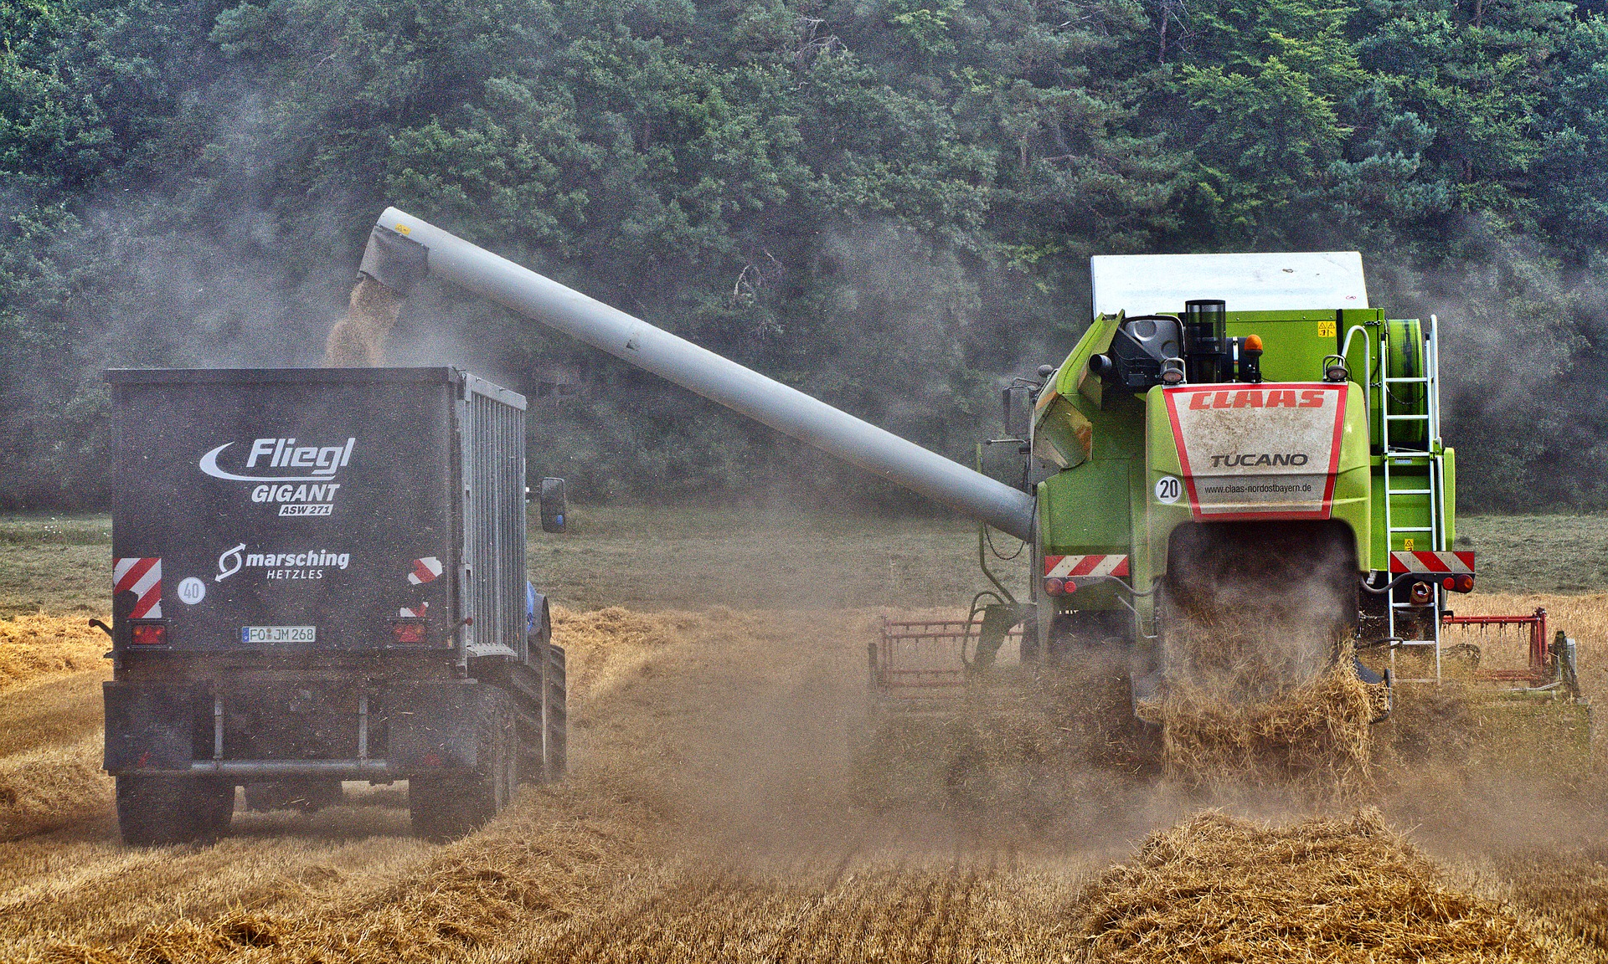
What`s the Danger?
GRAIN DUST PROBLEMS/HAZARDS
During harvest and when moving grain from combines into grain trucks or wagons
Moving grain from grain trucks or wagons into grain bins
Moving grain around in grain bins
Cleaning grain
Feeding livestock milled grain
Cleaning grain bins
Notes:
GRAIN DUST PROBLEMS/HAZARDS
• During harvest and when moving grain from combines into grain trucks or wagons
• Moving grain from grain trucks or wagons into grain bins
• Moving grain around in grain bins
• Cleaning grain
• Feeding livestock milled grain
• Cleaning grain bins

Slide 6
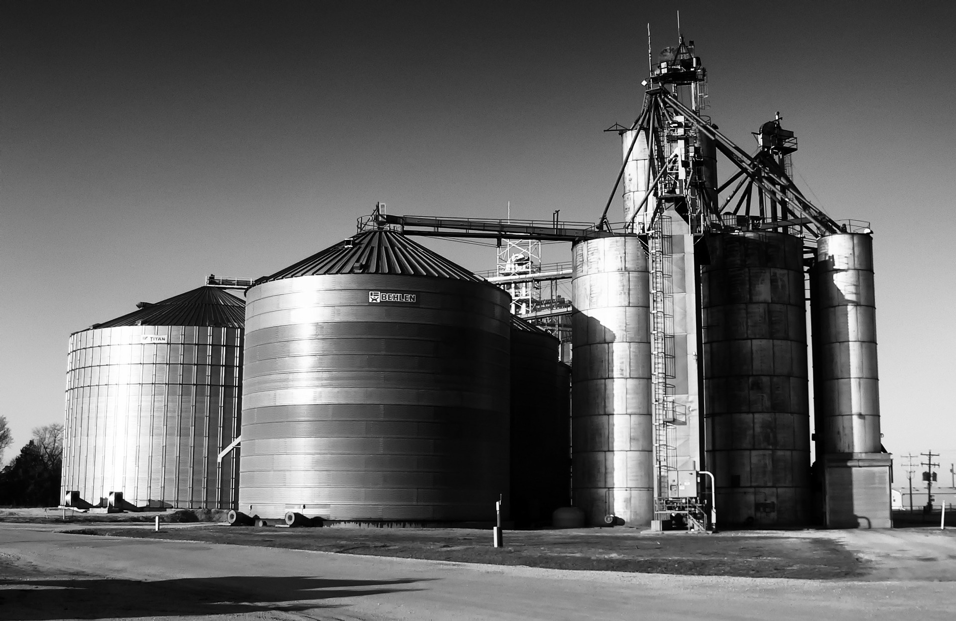
How to Protect Yourself
EMPLOYER RESPONSIBILITY
Employers must to do the following when employees enter storage bins
Turn off and lock out all powered equipment.
Prohibit walking down grain and similar practices.
Provide all employees a body harness with a lifeline, or a boatswains chair.
Notes:
How to Protect Yourself
EMPLOYER RESPONSIBILITY
Employers must to do the following when employees enter storage bins
1. Turn off and lock out all powered equipment associated with the bin, including augers used to help move the grain, so that the grain is not being emptied or moving out or into the bin. Standing on moving grain is deadly; the grain can act like "quicksand" and bury a worker in seconds. Moving grain out of a bin while a worker is in the bin creates a suction that can pull the workers into the grain in seconds.
2. Prohibit walking down grain and similar practices where an employee walks on grain to make it flow.
3. Provide all employees a body harness with a lifeline, or a boatswains chair, and ensure that it is secured prior to the employee entering the bin.
4. Provide an observer stationed outside the bin or silo being entered by an employee. Ensure the observer is equipped to provide assistance and that their only task is to continuously track the employee in the bin. Prohibit workers from entry into bins or silos underneath a bridging condition, or where a build-up of grain products on the sides could fall and bury them.
5. Train all workers for the specific hazardous work operations they are to perform when entering and working inside of grain bins.
6. Test the air within a bin or silo prior to entry for the presence of combustible and toxic gases, and to determine if there is sufficient oxygen.
7. If detected by testing, vent hazardous atmospheres to ensure that combustible and toxic gas levels are reduced to non-hazardous levels, and that sufficient oxygen levels are maintained.
8. Ensure a permit is issued for each instance a worker enters a bin or silo, certifying that the precautions listed above have been implemented.

Slide 7
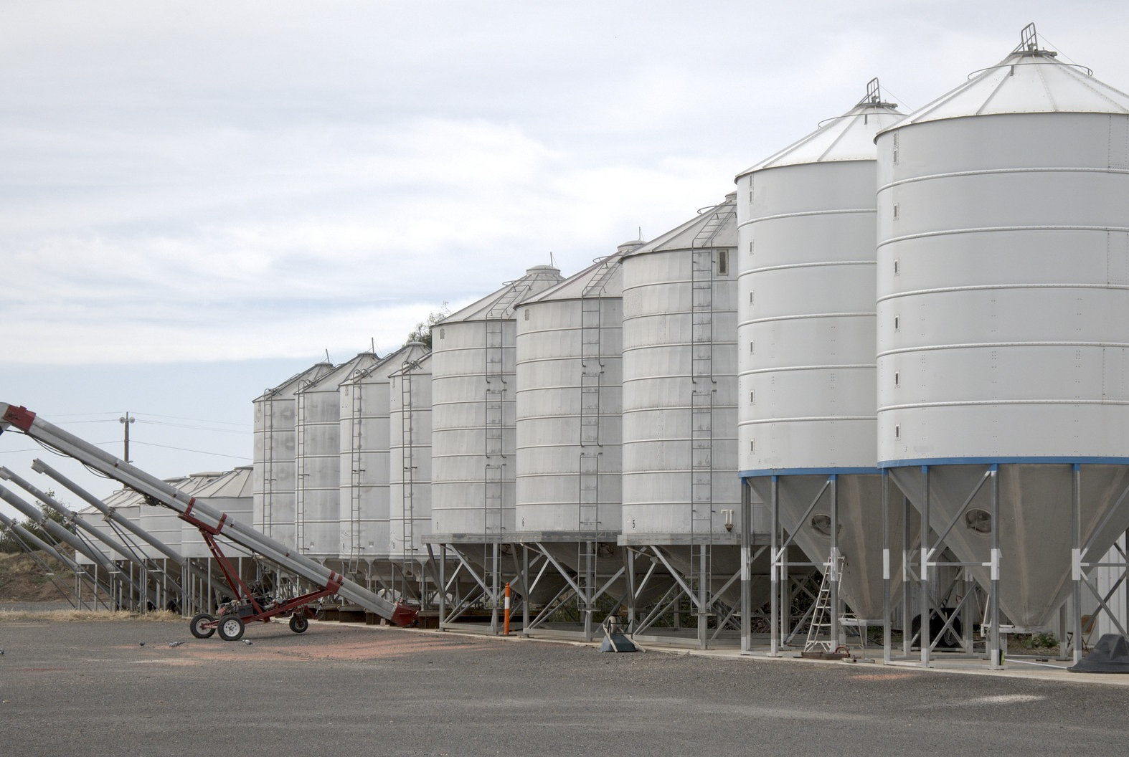
How to Protect Yourself
Final Thoughts On Grain Dust Inhalation
Be Aware. Understand what kind of tasks can expose your to grain dust.
Use respiratory protective equipment (RPE) provided. If you are having problems with your respiratory protective equipment, please tell a supervisor.
It is also your responsibility to maintain your respiratory protective equipment. Keep them clean and dry and away from chemical storage areas.
Notes:
How to Protect Yourself
Final Thoughts On Grain Dust Inhalation
• Be Aware. Understand what kind of tasks can expose your to grain dust.
• Use respiratory protective equipment (RPE) provided. If you are having problems with your respiratory protective equipment, please tell a supervisor.
• Make sure you are wearing the appropriate respiratory protective equipment for the job:
- Dust masks can help you avoid exposure to nuisance dust but does not protect you against organic vapors.
- Wear the N95 air-purifying disposable particulate respirator provided when working with grain.
• It’s employer responsibility to have your respirator properly fitted. It’s your responsibility to keep facial hair shaved (if applicable). Even a day’s worth of stubble can prevent a good seal. If you have gained or lost weight, please inform a supervisor to refit a RPE.
• It is also your responsibility to maintain your respiratory protective equipment. Keep them clean and dry and away from chemical storage areas.
• When working around grain dust, wear the other personal protective equipment. Coveralls will prevent dust from settling on personal clothing and eye protection will prevent dust from affecting your eyes. Make sure you remove dust from personal or protective clothing before you take off your respiratory protective equipment.

Slide 8
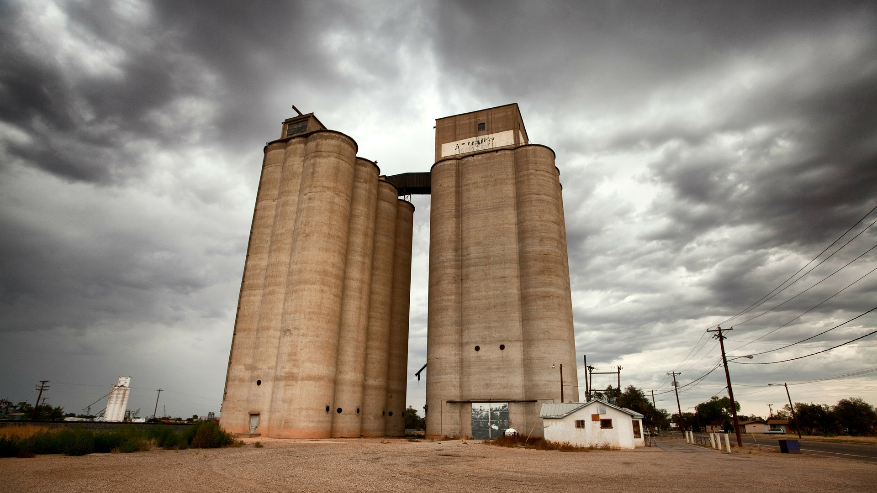
Final Word
Grain dust is produced when grain is harvested, dried, moved, stored and processed. The dust includes bacteria, fungi, insects, insect parts, animal droppings and possibly pesticide residues as well as dry plant particles.
Notes:
Final Word
Grain dust is produced when grain is harvested, dried, moved, stored and processed. The dust includes bacteria, fungi, insects, insect parts, animal droppings and possibly pesticide residues as well as dry plant particles.

