Slide 1

Click anywhere to get started…

Slide 2

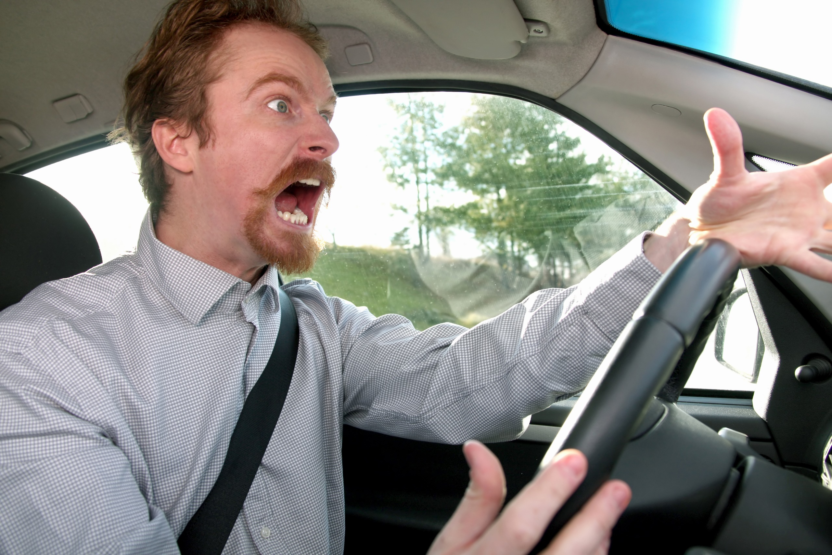

IRATE & FRUSTRATED MOTORISTS
Notes:
Irate & Frustrated Motorists

Slide 3
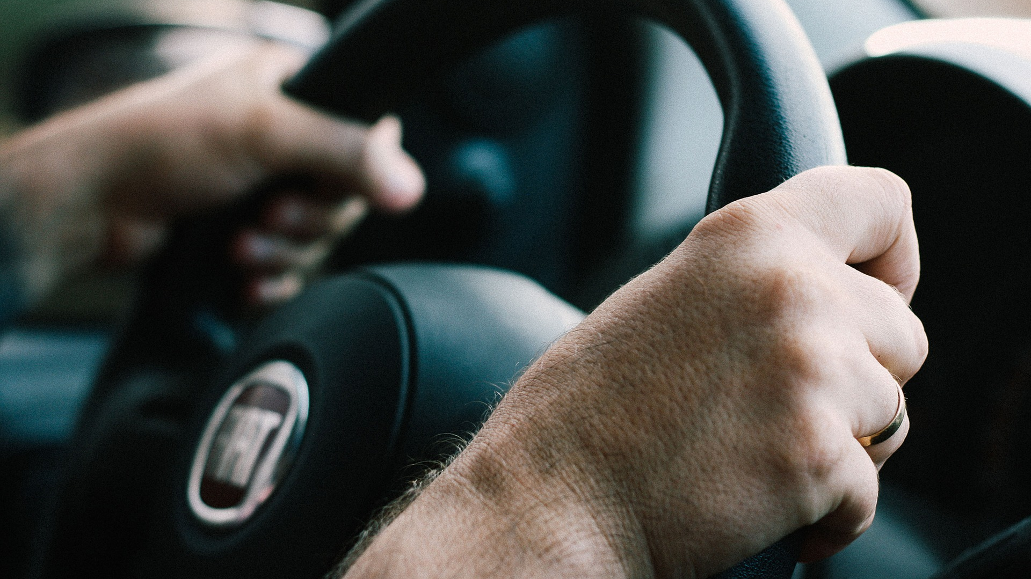
What’s at Stake?
Road rage may include rude gestures, verbal insults, physical threats or dangerous driving that is directed towards another driver.
Road rage is not just limited to motorists, but also to cyclists.
Notes:
What’s At Stake?
Road rage is a driver’s aggressive or angry behavior. Road rage may include rude gestures, verbal insults, physical threats or dangerous driving that is directed towards another driver.
Road rage is not just limited to motorists, but also to cyclists. In today’s society, cyclists occupy a large part of roadway traffic from commercial to recreational and sports cycling. This increasing sector is the object of scorn and dislike from some motorists.
Road rage has resulted in physical harm and even death.
Unfortunately, road rage is becoming a serious threat to Canadian drivers. You can do your part by exercising common sense and patience when you’re driving. The most important thing is that you and your passengers arrive safely.

Slide 4
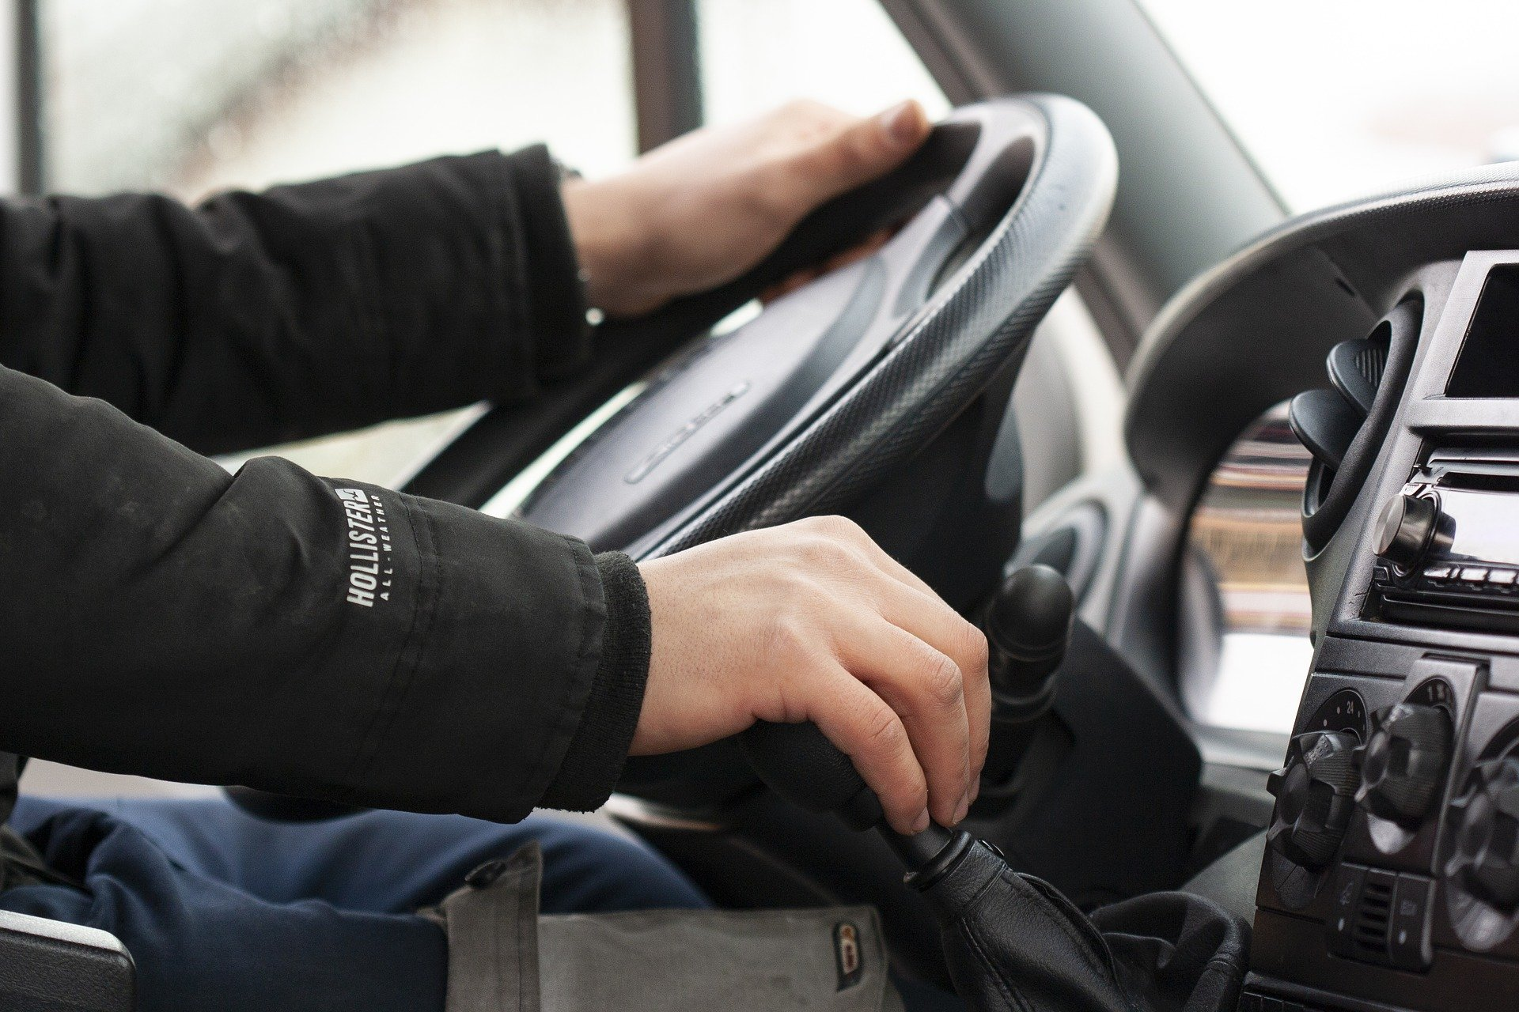
What’s the Danger?
According to a 2015 online survey a third of Canadians are victims of road rage at least once a month. Victims of road rage feel helpless, terrified – or angry, which can make a bad situation even worse.
Notes:
What’s the Danger?
According to a 2015 online survey a third of Canadians are victims of road rage at least once a month. Victims of road rage feel helpless, terrified – or angry, which can make a bad situation even worse.
While it can be hard to do, it’s important to stay calm and control your own anger when confronted with an aggressive driver.

Slide 5
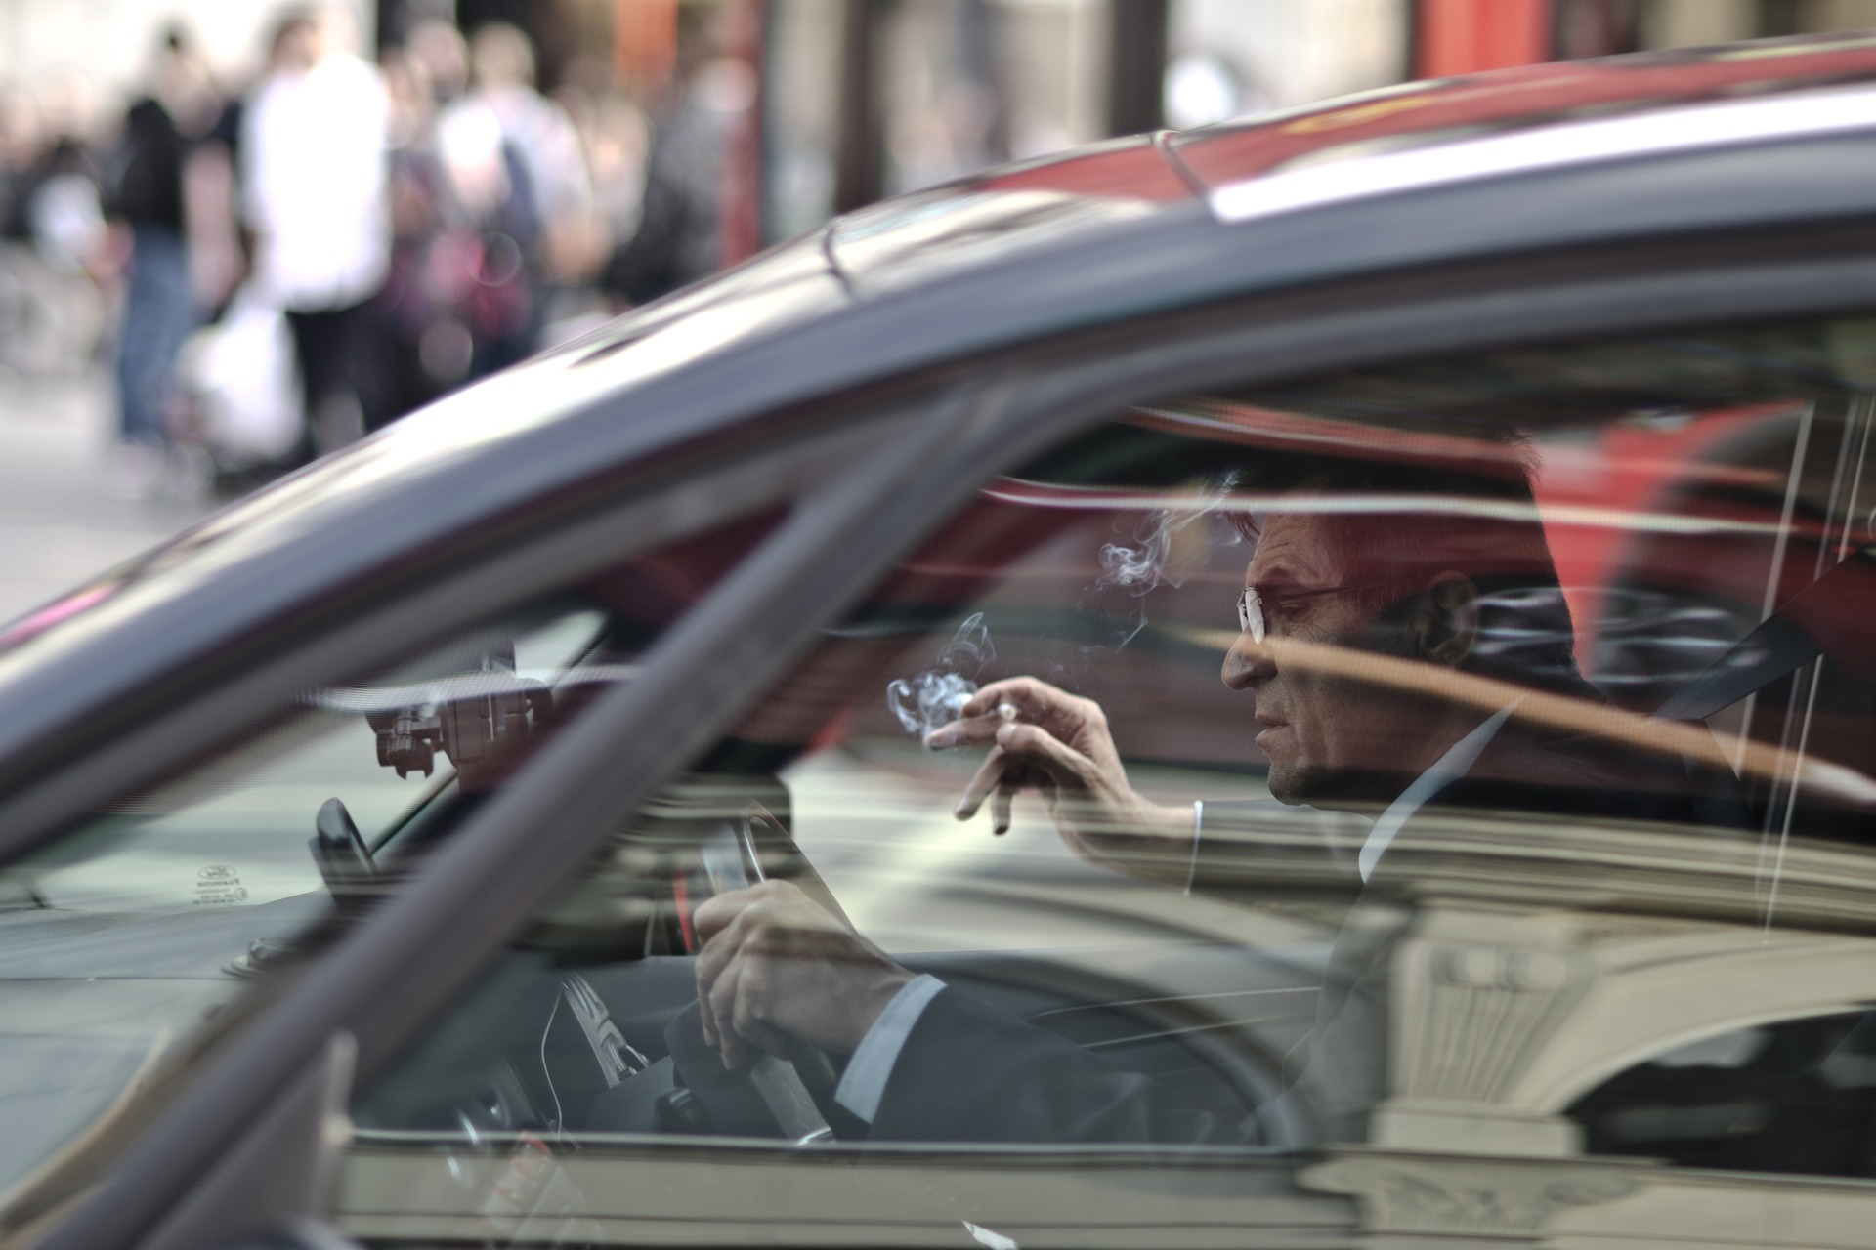
How to Protect Yourself
Lock your doors
Do not react to aggressive drivers.
Avoid escalation.
Get out of the way.
Find a safe place to stop.
Do not go home
Avoid eye contact
When stuck in traffic, leave lots of room between your vehicle and the one ahead.
Remember that it's not personal.
Grab vehicle information.
Use your cell phone if absolutely necessary.
Don’t offend other drivers
Notes:
How to Protect Yourself
Following these tips can help keep you and your passengers safe.
Lock your doors. If you sense that another driver is threatening you, make sure that all your car doors are locked.
Do not react to aggressive drivers. If a driver cuts you off, tailgates, or drives aggressively, you may be inclined to honk your horn, gesture to the driver or otherwise engage with him/her. It is best to ignore the situation entirely.
Avoid escalation. If the other driver yells at you, or gestures rudely out the window, don't shout or gesture back. An angry person can’t be in an altercation if another isn’t willing to join in. Keep your cool and carry on.
Get out of the way. Put your turn signal on, and move over as soon as it is safe to do so to allow the other vehicle to pass. Put as much distance as possible between your vehicle and the angry driver’s vehicle.
Find a safe place to stop. Don’t pull over the side of the road. The other car may follow you, and you could get into an altercation. Instead, drive to a safe place such as a police station, convenience store, shopping centre or even a hospital. If the angry driver follows, use your horn to attract attention. This will usually discourage an aggressor. Do not get out of your car.
Do not go home – You may be followed. Continue to drive until you lose the other car, or can pull into a safe place where there are other people.
Avoid eye contact. For drivers who express anger and frustration through their driving, eye contact can further upset them. Keep your eyes on the road, and try not to make eye contact with the enraged driver.
When stuck in traffic, leave lots of room between your vehicle and the one ahead. Traffic jams can make even the most patient drivers frustrated. If you’re stuck in traffic, you may be inclined to creep up close to the vehicle in front of you. Instead, leave lots of room. If an aggressive driver confronts you, you want to be able to change lanes and get out of the way.
Remember that it's not personal. Even though it may feel very personal, the angry driver doesn’t know you at all. He or she is angry at the situation and looking for an outlet for their rage.
Grab vehicle information. If you are able, get the driver’s license plate number, make, and model of the vehicle in case the situation escalates and there is damage to your vehicle.
Use your cell phone if absolutely necessary. Your mobile phone can be your best friend if your safety is threatened. If you're being followed or you feel an encounter is unavoidable, call 911 for help. They will send a police car to help, or advise you on what to do.
Don’t offend other drivers. Often you don’t realize it, but you may have engaged in driving behaviour that sends a driver over the edge. Common road rage triggers are tailgating, using a cell phone while driving, being cut off, taking up two parking spots, and driving with pets on a lap.

Slide 6
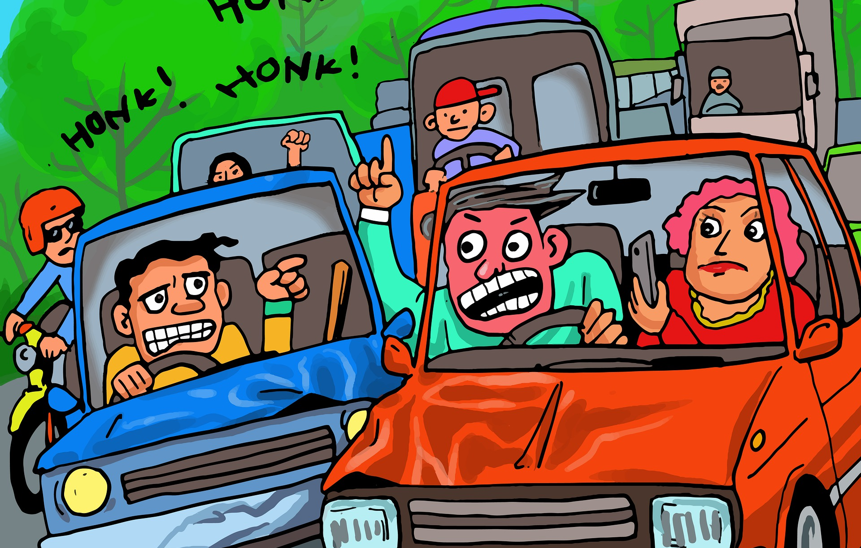
How to Protect Yourself
You are in the car with an angry driver and you feel like a hostage.
Step1: try to calm the driver down.
Step2: admit to driver you are scared.
Step3: try to change the driver’s focus.
Step4: talk about the destination.
Step5: Find a new radio station.
Notes:
How to Protect Yourself
What To Do Situations
Passenger in a Car with Enraged Driver
You are in the car with an angry driver and you feel like a hostage.
Step1: try to calm the driver down.
Step2: admit to driver you are scared.
Step3: try to change the driver’s focus.
Step4: talk about the destination.
Step5: Find a new radio station.
Cycling Prevention Techniques
Situation: “Get Off the Road”
Is the driver exhibiting aggression or is there a possibility you will be hit? Then do what he says and get off the road—for your safety and not to acquiesce to him. Then get out a pen and paper, make note of the vehicle and driver’s identifying features, and prepare to report it to the police.
Do not shout back. Do not gesture at the driver in any way. Breathe, think, and ride away in one piece. If this person is (as you’re likely thinking) an absolute idiot, don’t you want them further way from you? If they’re continuing to drive, they’re answering your wish—let them continue on their way.
What is the Goal?
When we choose to respond to someone who has affronted us, it’s important to think through just what it is we are hoping to accomplish. Do we want to pass along important information? Do we want to vent our frustrations? (hint: this is what the motorist just did, and how well did that go over with us?). Do we want to retaliate and cause the same amount of hurt/fear/irritation we went through? Do we want to be able to continue on our way safely, and get back to the riding we were doing before the altercation took place?
Each desired action will require a very different approach, and each has a widely varying likelihood of success. Think about it.
There are times when a motorist expresses an intent to harass or injure a cyclist. When this happens, just get off the road. Do you really want to call their bluff? Cyclists have been hit, and when that happens, it is often after the motorist has given some kind of clue as to their intent. Take that clue at face value and take yourself out of the range of conflict.

Slide 7

Final Word
There are no winners in confrontations with enraged drivers who exhibit the road rage characteristics. It is always the best strategy to employ tactics that de-escalate irrational behavior to ensure safety of all parties.
Notes:
Final Word
There are no winners in confrontations with enraged drivers who exhibit the road rage characteristics. It is always the best strategy to employ tactics that de-escalate irrational behavior to ensure safety of all parties.

