Slide 1

Click anywhere to get started…

Slide 2

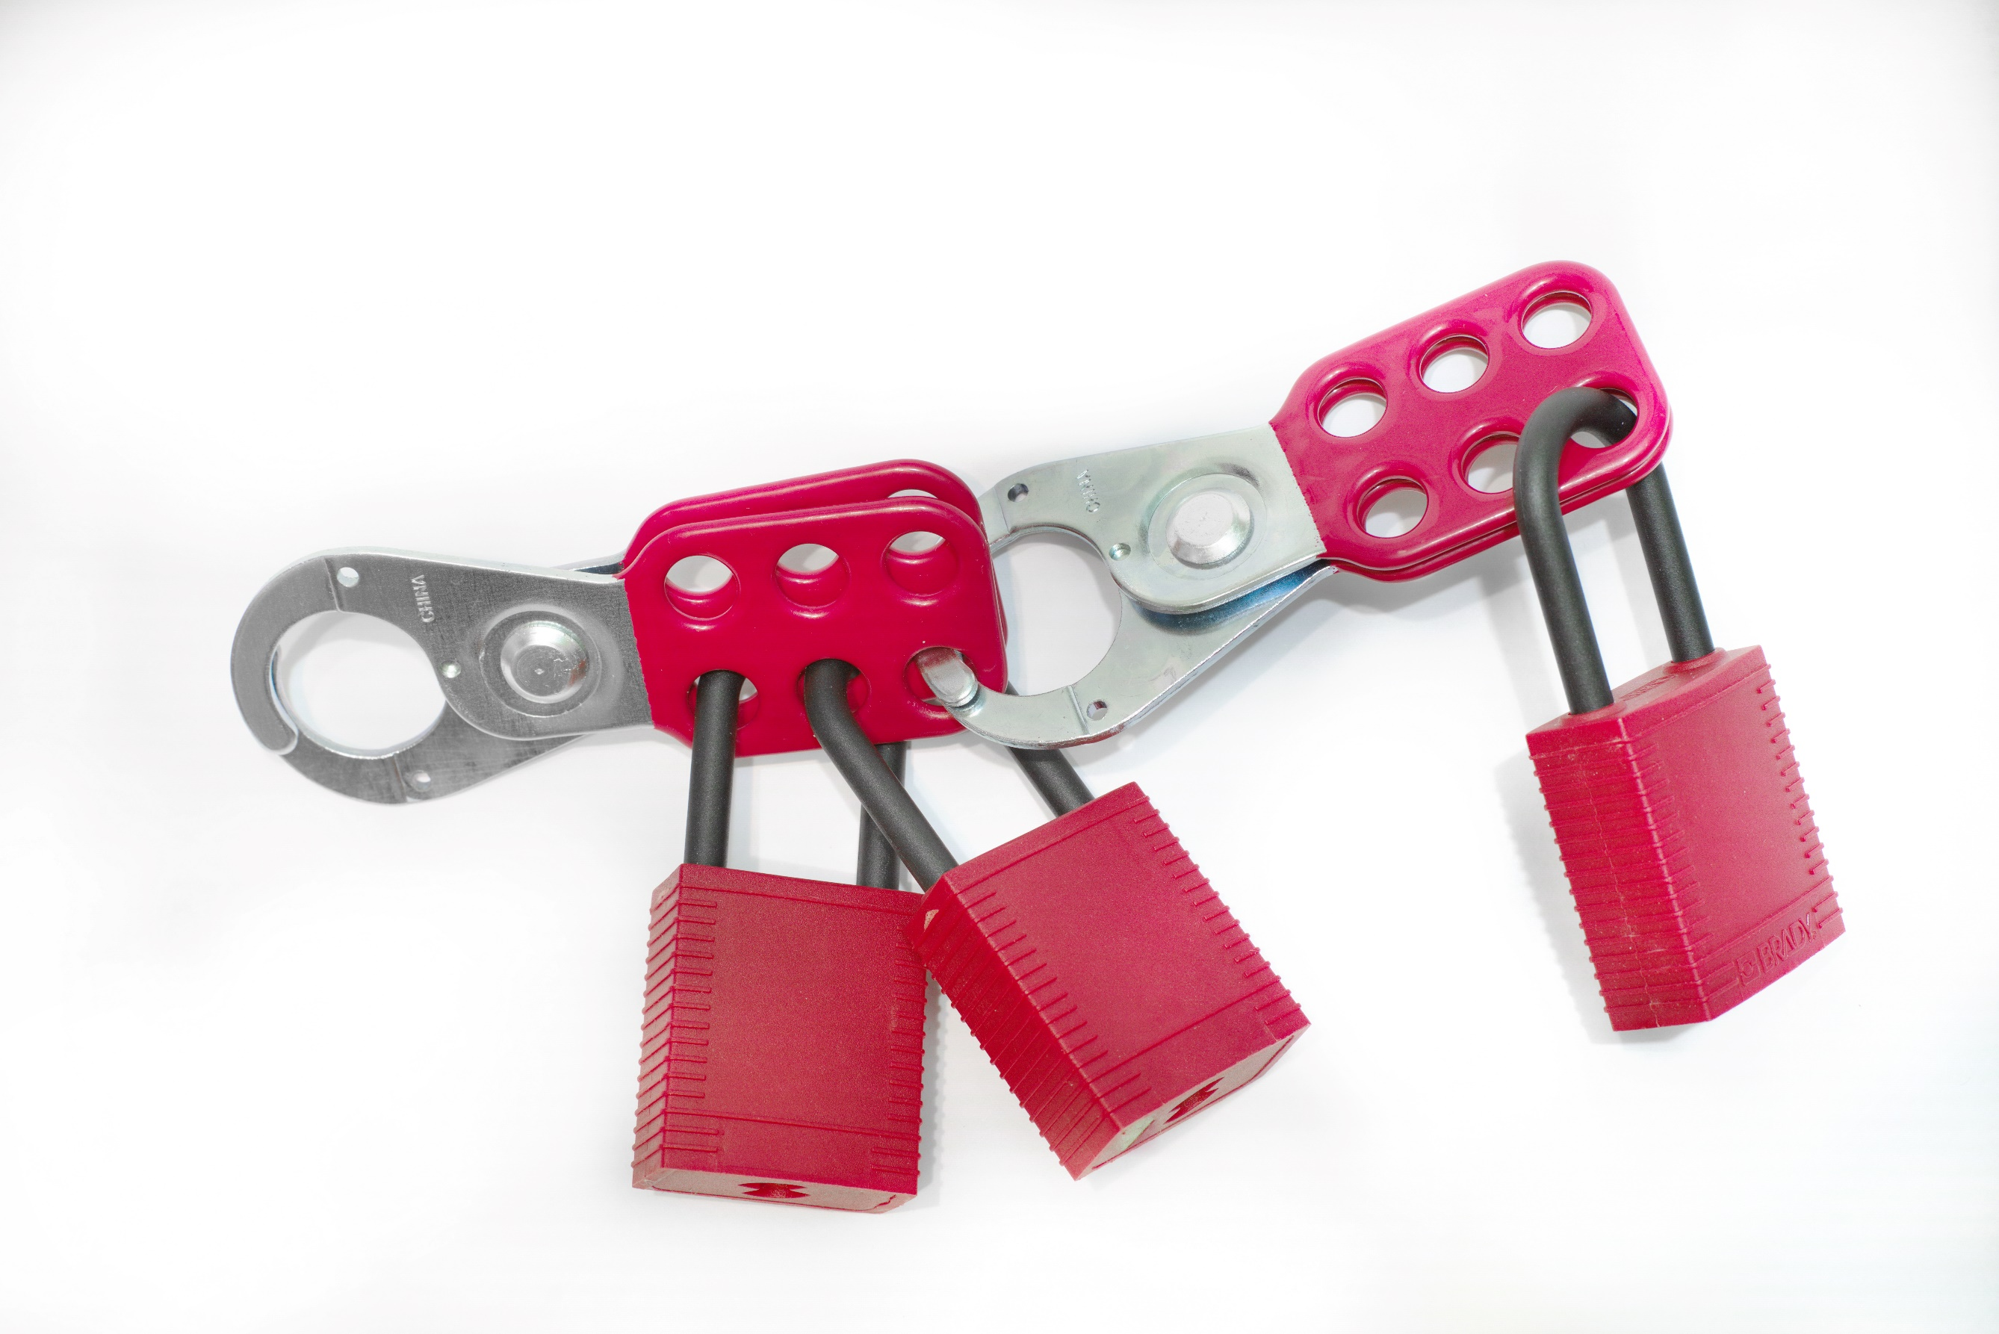

LOCK-OUT / TAG-OUT
Notes:
LOCK-OUT / TAG-OUT

Slide 3
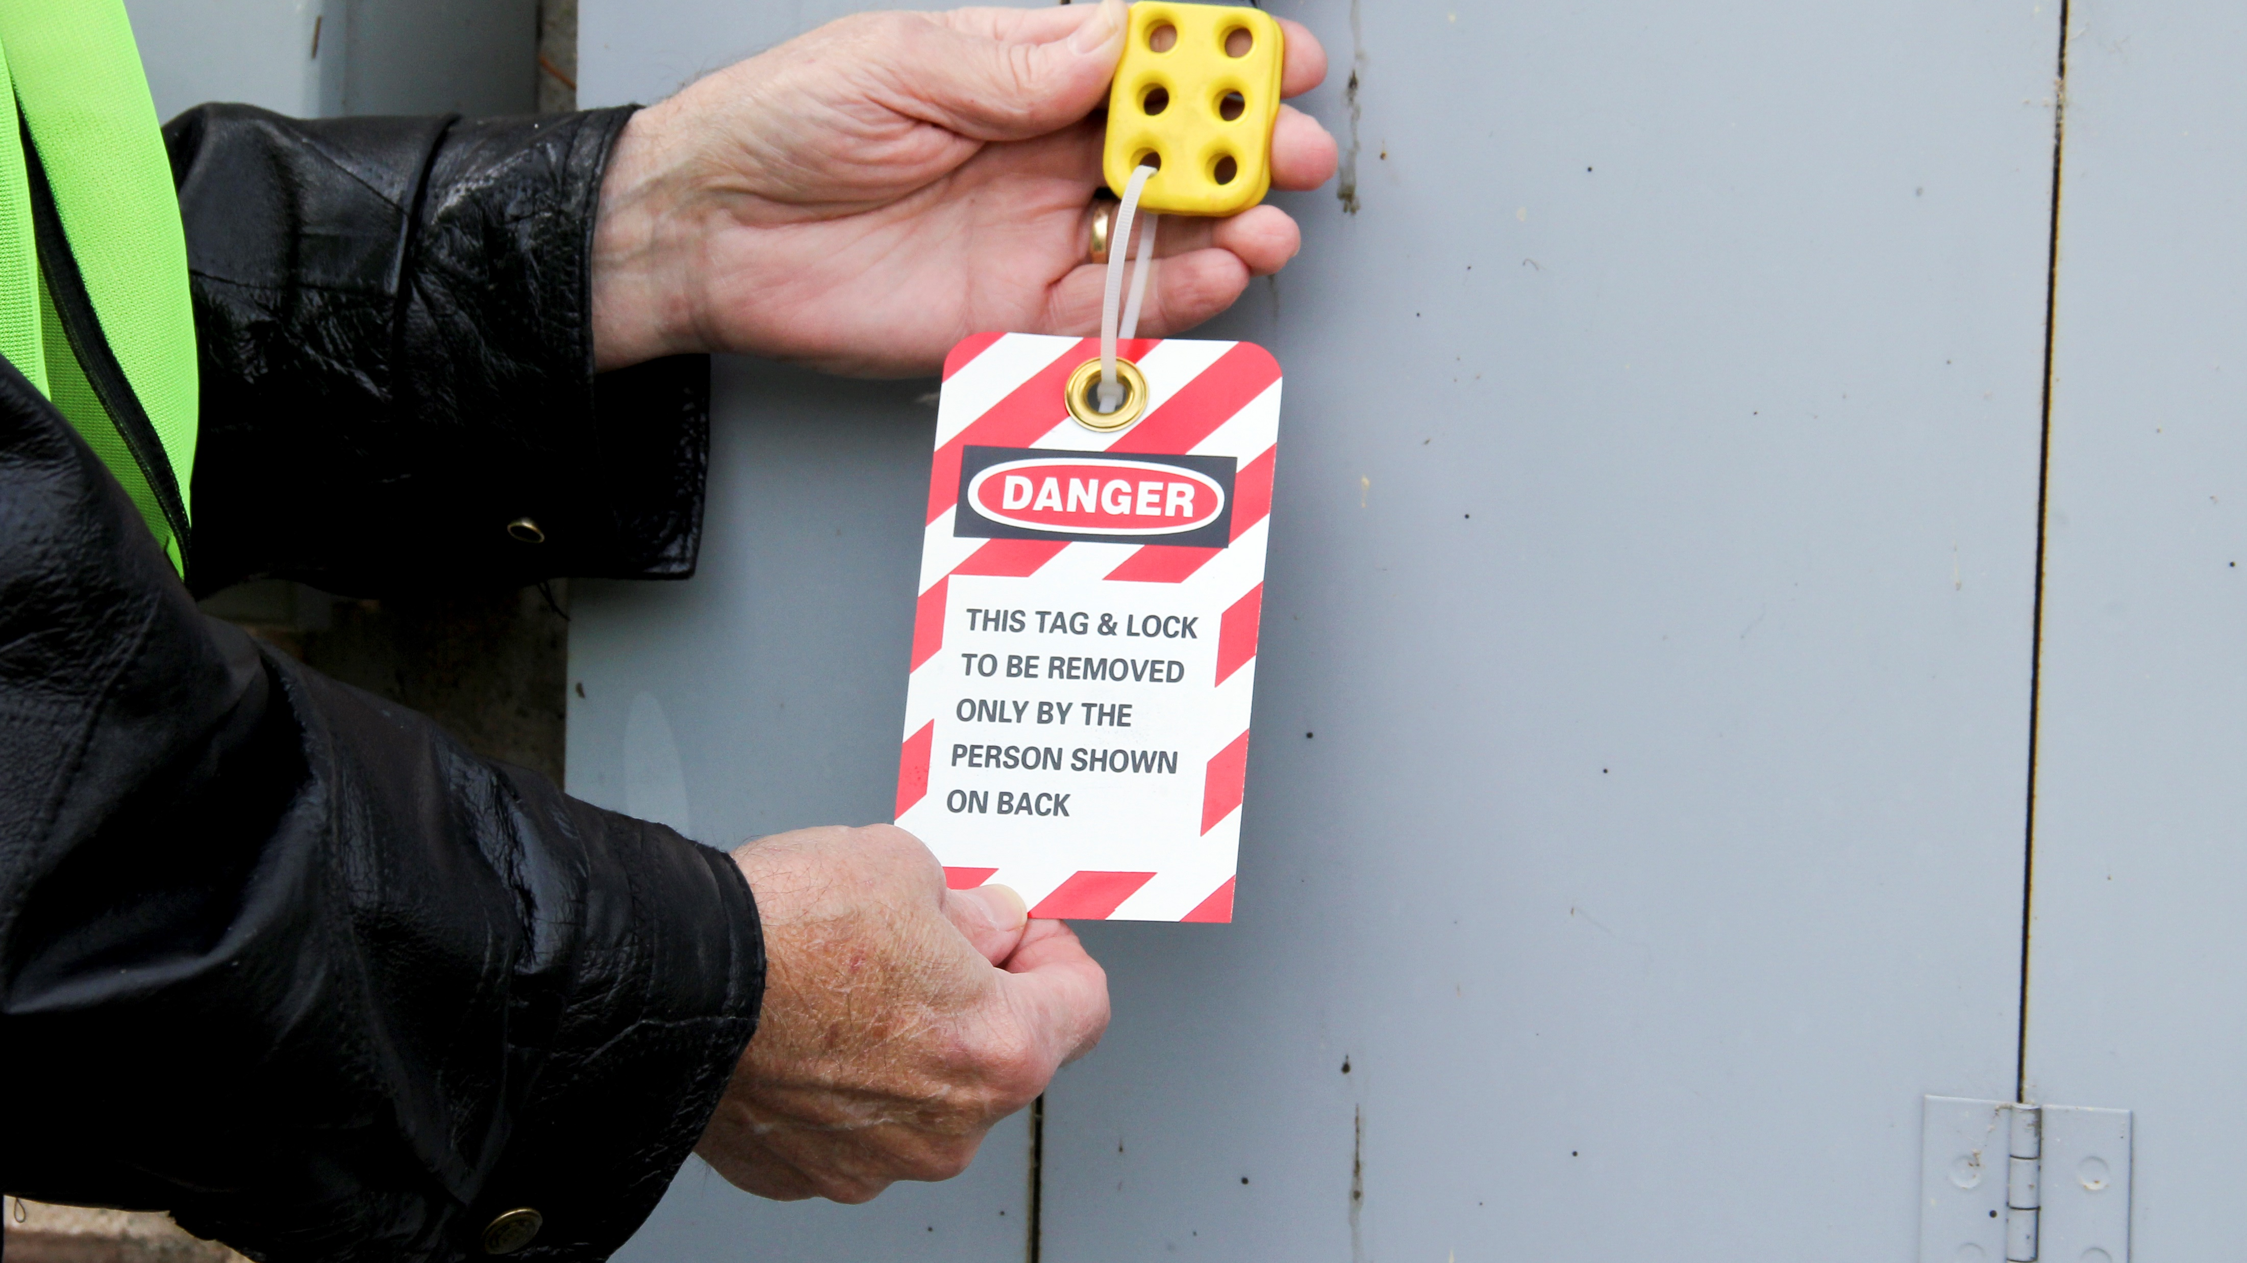
What’s at Stake?
Lockout
There are many types of potentially hazardous energy including electrical, thermal, chemical, pneumatic, hydraulic, mechanical and gravitational energy. Lock-out is a way to make sure electricity or other energy is not turned on (or released) while someone is working on machinery
Notes:
What’s at Stake?
Lockout
There are many types of potentially hazardous energy including electrical, thermal, chemical, pneumatic, hydraulic, mechanical and gravitational energy. Lock-out is a way to make sure electricity or other energy is not turned on (or released) while someone is working on machinery. Turning off a power switch is not enough. You must de-energize to prevent equipment from starting or moving. Release stored energy, for example, bleed air from a pneumatic hose, and test to make sure the energy is off before doing installations, repairs or maintenance.

Slide 4
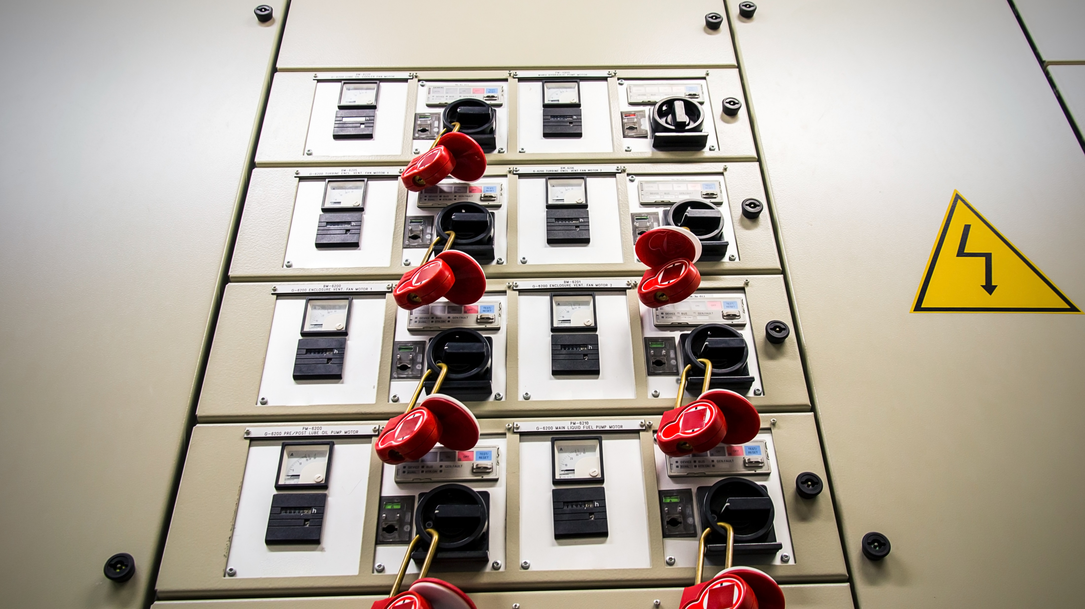
What’s at Stake?
Tagout
Tag out is a labelling process that is always used when lockout is required. The process of tagging out a system involves attaching or using an information tag or indicator (usually a standardized label) that includes the following information.
Notes:
What’s at Stake?
Tagout
Tag out is a labelling process that is always used when lockout is required. The process of tagging out a system involves attaching or using an information tag or indicator (usually a standardized label) that includes the following information:
•Why the lockout/tag out is required (repair, maintenance, etc.).
•Time of application of the lock/tag.
•The name of the authorized person who attached the tag and lock to the system.
Note: ONLY the authorized individual who placed the lock and tag onto the system is the one who is permitted to remove them. This procedure helps make sure the system cannot be started up without the authorized individual's knowledge.

Slide 5
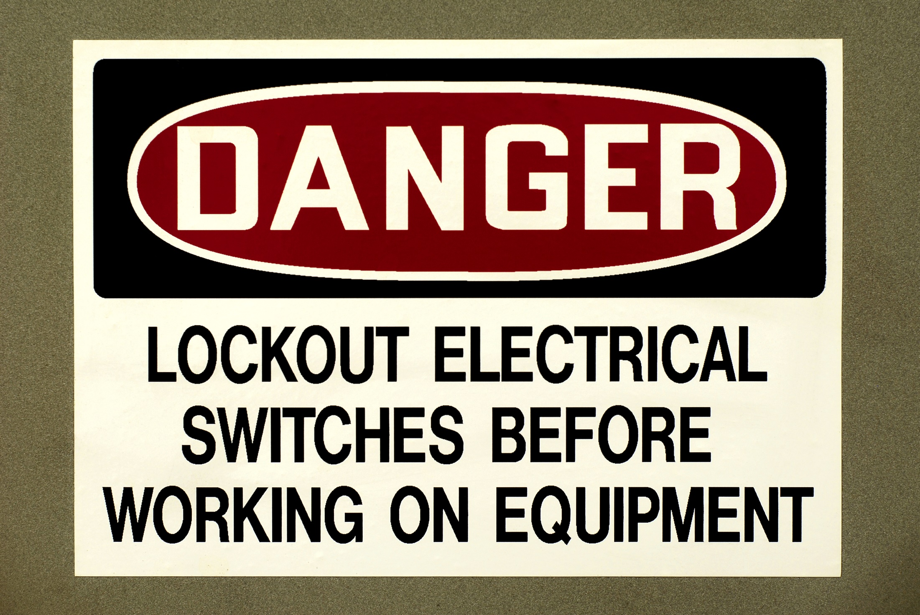
What’s the Danger?
Importance of Lockout/Tagout
Safety devices such as barrier guards or guarding devices are installed on systems to maintain worker safety while these systems are being operated.
Inherent Dangers
Lockout / Tagout / is series of safety procedures designed to prevent accidents causing serious injuries including fatalities to employees on the unexpected startup of the equipment or energy while servicing.
Notes:
What’s the Danger?
Importance of Lockout/Tagout
Safety devices such as barrier guards or guarding devices are installed on systems to maintain worker safety while these systems are being operated. When non-routine activities such as maintenance, repair, or set-up; or the removal of jams, clogs or misaligned feeds are performed, these safety devices may be removed provided there are alternative methods in place to protect workers from the increased risk of injury of exposure to the unintended or inadvertent release of energy.
Inherent Dangers
Lockout / Tagout / is series of safety procedures designed to prevent accidents causing serious injuries including fatalities to employees on the unexpected startup of the equipment or energy while servicing.
Employees servicing or maintaining machines or equipment may be exposed to serious physical harm or death if hazardous energy is not properly controlled. Craft workers, machine operators, and laborers are among the 3 million workers who service equipment and face the greatest risk.
The four-page general industry standard (29 CFR 1910.147), published in September 1989, was designed to prevent the accidental start-up of machines or other equipment during maintenance and servicing. Under the rule, hazardous energy sources must be "isolated and rendered inoperative" before work can begin. Hazardous energy sources include electrical, mechanical, hydraulic, pneumatic, chemical and thermal.
Anyone who operates, cleans, services, adjusts, and repairs machinery or equipment should be aware of the hazards associated with that machinery. Failure to lock out or tag power sources on equipment can result in electrocutions, amputations, and other serious-sometimes fatal-accidents.

Slide 6
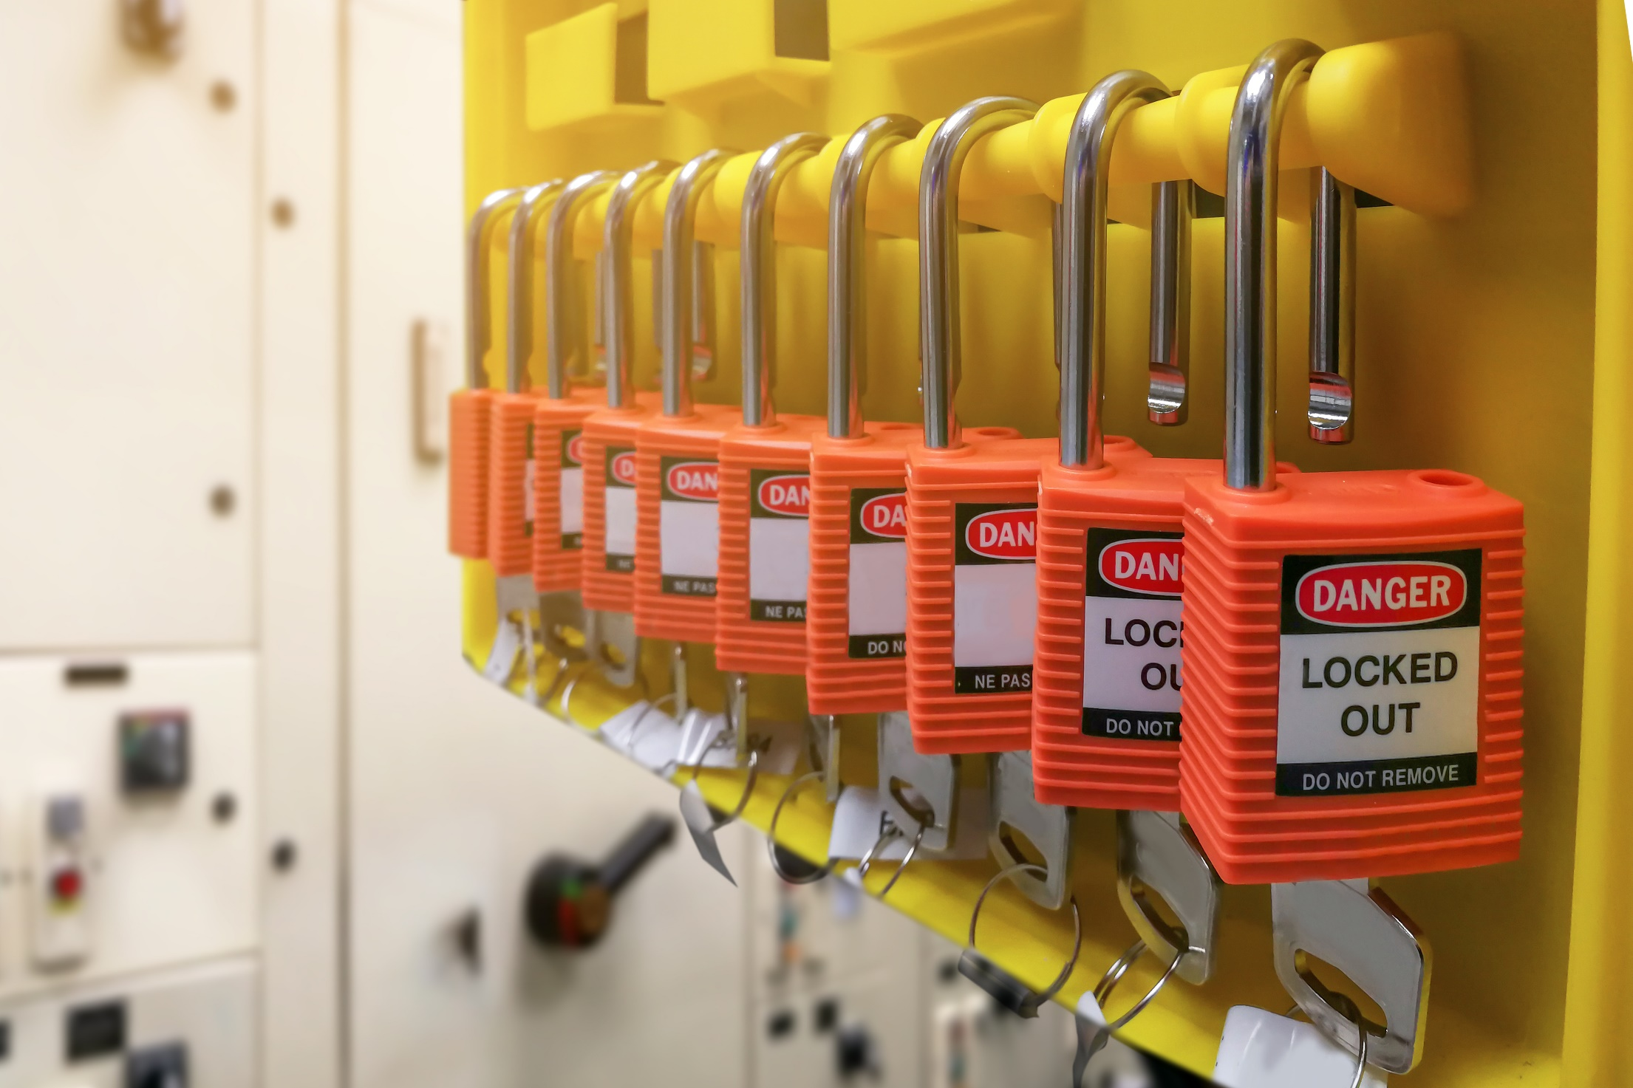
What’s the Danger?
Some of the causes of accidents;
The machine or piece of equipment was not completely shut off before a maintenance or repair operation.
The machine was turned on accidentally, either out of carelessness or because the person who turned it on did not realize that another worker was there and could get hurt.
The machine was not working correctly but was not fixed, turned off, locked or tagged, and someone who did not know about the problem used it.
Moving equipment was not blocked.
Safety procedures were inadequate or had not been properly explained.
Notes:
What’s the Danger?
Some of the causes of accidents:
The machine or piece of equipment was not completely shut off before a maintenance or repair operation. Not only must the machine be turned off but also the power source that goes to it.
The machine was turned on accidentally, either out of carelessness or because the person who turned it on did not realize that another worker was there and could get hurt.
The machine was not working correctly but was not fixed, turned off, locked or tagged, and someone who did not know about the problem used it.
Moving equipment was not blocked.
Safety procedures were inadequate or had not been properly explained.
OVERVIEW
Why Lockout is Necessary
Often power sources are inadvertently turned on, or valves opened mistakenly before the work is completed, resulting in serious injuries and fatalities. Therefore, it is important not only to ensure that all energies are properly locked out, but also that they remain locked out until the work is completed.

Slide 7
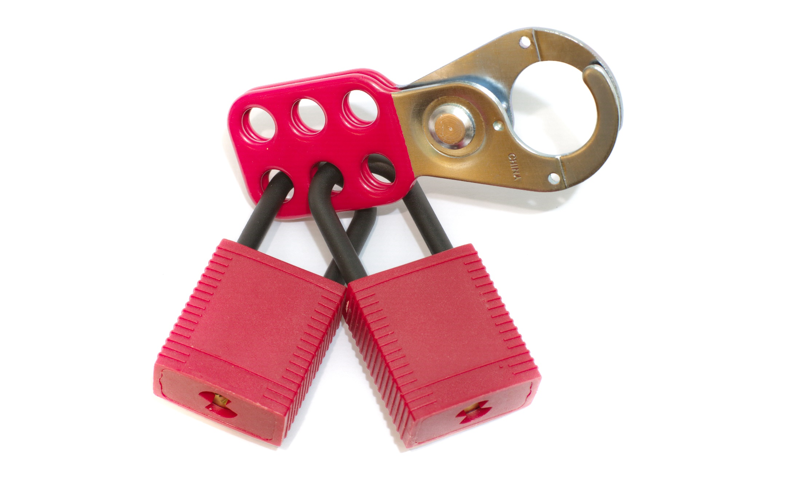
How to Protect Yourself
PREVENTION STEPS
Employer Responsibility
The lockout/tagout standard establishes the employer’s responsibility to protect employees from hazardous energy sources on machines and equipment during service and maintenance.
Employee Training
The training must cover at least three areas:
How Do Employers Protect Workers?
Notes:
How to Protect Yourself
PREVENTION STEPS
Employer Responsibility
The lockout/tagout standard establishes the employer’s responsibility to protect employees from hazardous energy sources on machines and equipment during service and maintenance.
This is generally done by affixing the appropriate lockout or tagout devices to energy-isolating devices and by deenergizing machines and equipment.
Employee Training
The training must cover at least three areas:
•aspects of the employer’s energy control program;
•elements of the energy control procedure relevant to the employee’s duties or assignment; and
•the various requirements of the OSHA standards related to lockout/tagout.
How Do Employers Protect Workers?
•Develop, implement, and enforce an energy control program.
•Use lockout devices for equipment that can be locked out. Tagout devices may be used in lieu of lockout devices only if the tagout program provides employee protection equivalent to that provided through a lockout program.
•Ensure that new or overhauled equipment is capable of being locked out.
•Develop, implement, and enforce an effective tagout program if machines or equipment are not capable of being locked out.
•Develop, document, implement, and enforce energy control procedures.
•Use only lockout/tagout devices authorized for the particular equipment or machinery and ensure that they are durable, standardized, and substantial.
•Ensure that lockout/tagout devices identify the individual users.
•Establish a policy that permits only the employee who applied a lockout/tagout device to remove it.
•Inspect energy control procedures at least annually.
•Provide effective training as mandated for all employees covered by the standard.
•Comply with the additional energy control provisions in OSHA standards when machines or equipment must be tested or repositioned, when outside contractors work at the site, in group lockout situations, and during shift or personnel changes.

Slide 8
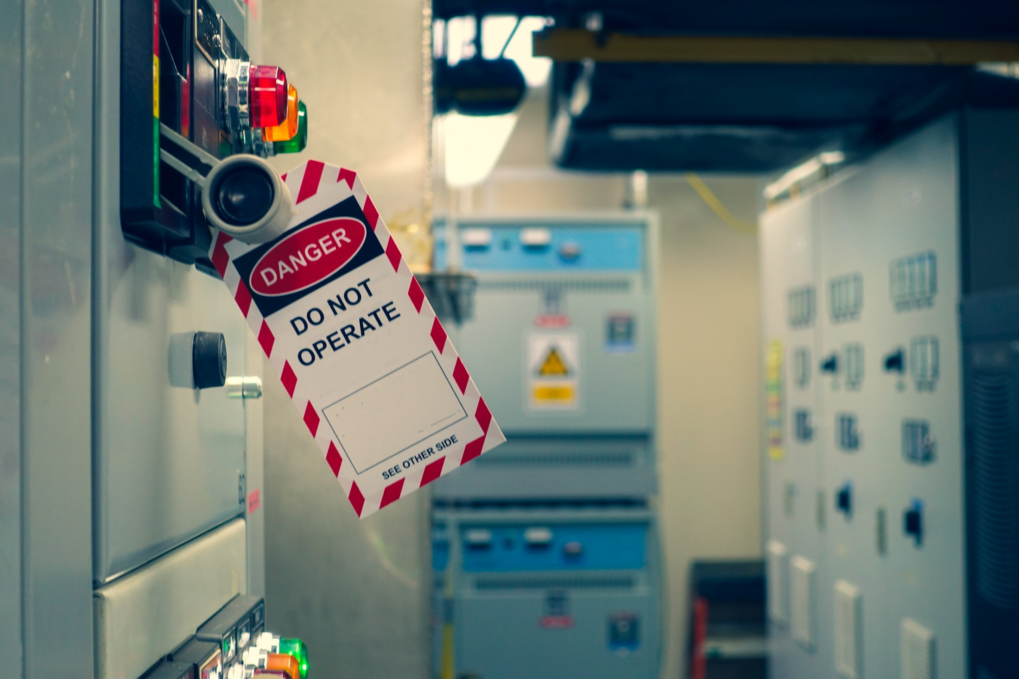
How to Protect Yourself
Six Ways to Improve Lockout/Tagout Procedures
1. Choose the Right Devices
Industrial machines, circuit breakers, plugs, switches, push buttons, and valves are just some of the items that often require lockout devices.
2. Thoroughly Document Procedures
Lockout procedures need to be formally documented.
3. Clearly Mark All Isolation Points
All energy control points should be clearly and permanently marked with standardized tags or labels.
Notes:
How to Protect Yourself
Six Ways to Improve Lockout/Tagout Procedures
1. Choose the Right Devices
Industrial machines, circuit breakers, plugs, switches, push buttons, and valves are just some of the items that often require lockout devices. There are two considerations that will help: necessity (knowing exactly what you need) and organization (using standardized devices and tools to help keep your devices organized).
First, determine exactly what you need. Create a list of all machines or electrical components that may need lockout devices.
Second, standardize and organize your lockout devices. Lockout Stations are one effective way to store and organize necessary devices.
2. Thoroughly Document Procedures
Lockout procedures need to be formally documented. This will keep workers and management on the same page and help to eliminate any potential confusion. Formal documentation is required by OSHA but, given the differences in workplaces and machines, not every procedure will be the same.
Procedures should thoroughly detail the steps needed to shut down and isolate hazardous energy. The procedures also should describe how to safely place and remove all relevant lockout/tagout devices.
Procedures should be posted near the relevant machine. Machine-specific photographs detailing each step are highly recommended.
3. Clearly Mark All Isolation Points
All energy control points should be clearly and permanently marked with standardized tags or labels.
Tags and labels should be easily visible. It is also very important to make sure all energy isolation points are consistent with the machine-specific procedures.

Slide 9
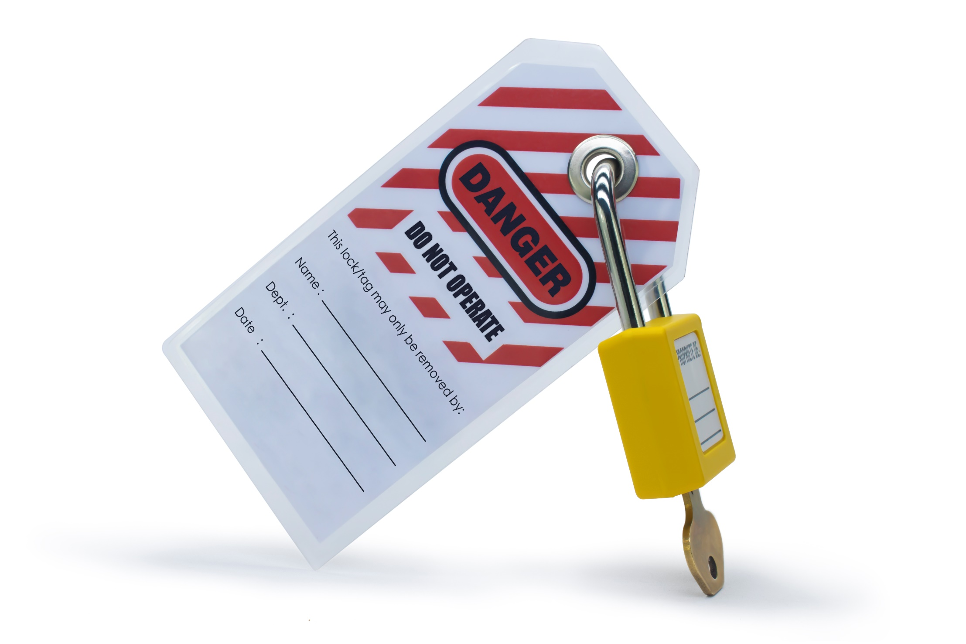
How to Protect Yourself
4. Develop a Rigorous Training Program
Effective training is an indispensable part of a successful lockout program.
5. Evaluate
Careful evaluation is an invaluable tool for improvement. Evaluation is necessary to make sure that the training exercises, procedures, and devices are working properly.
6. Evolve
A good lockout program should always be able to evolve; OSHA may introduce more requirements or more stringent guidelines.
Notes:
How to Protect Yourself
4. Develop a Rigorous Training Program
Effective training is an indispensable part of a successful lockout program.
First, it is important for each worker to know exactly what his role is. Tasks should be clearly defined and clearly assigned to the appropriate worker. There are three types of workers involved in lockout operation: authorized, affected, or other. An authorized employee is directly involved in locking out equipment or machinery. An affected employee means any employee whose work is affected by a lockout. Usually, this means an employee who is working on locked out equipment. An employee is classified as other if he or she does not work on the machine receiving maintenance or repair but still works in the same area.
Each worker needs to know what type of employee he is, and strong communication needs to be developed among all workers. Authorized employees must clearly alert all affected employees when a lockout device is placed or removed. In order to prevent unsafe removal of devices, only authorized employees can remove devices that they have placed. Lockout padlocks have room for workers to clearly write their names in permanent ink, which underscores the strong need for clear assignments and individual responsibility.
As with procedures and isolation points, Documentation is an important component of training. Recording exactly what types of training have occurred is helpful on several levels. First, it helps management make sure that all workers have been trained, as well as trained in the right tasks. Any gap in training can be easily found and corrected. Second, it documents when training took place. If you know when your last training session took place, it is easier to plan when the next one should take place. Last, looking at documentation of lockout training can help one see one's program from a new, more objective perspective. Suggestions can then be taken into account and improvements can be made.
OSHA requires that lockout/tagout training occur at least annually. Yearly training should be seen as a bare minimum rather than an ideal. In many cases, it would be helpful to revisit training exercises more frequently than yearly in order to ensure that critical repairs and maintenance are still being done safely. Also, repeat training helps workforces keep a "safety first" mentality.
5. Evaluate
Careful evaluation is an invaluable tool for improvement. Evaluation is necessary to make sure that the training exercises, procedures, and devices are working properly.
Inspections need to occur at least annually and should be performed by an Authorized Employee who is not involved in the procedure being inspected. Any and all deviations must be corrected and all roles must be thoroughly reviewed.
The date of inspection, procedures, the machines and equipment involved, and the names of all workers involved in the inspection must be recorded.
6. Evolve
A good lockout program should always be able to evolve; OSHA may introduce more requirements or more stringent guidelines.

Slide 10

Final Word
Improper or failure to use lock-out / tag-out procedures may result in property damage, injury or death. Only authorized and trained employees may engage in tasks that require use of lock-out / tag-out procedures, however ALL employees must know what the lock-out / tagout program is and not to touch any machine, equipment or energy source that has been locked or tagged out.
Notes:
Final Word
Improper or failure to use lockout / tagout procedures may result in property damage, injury or death. Only authorized and trained employees may engage in tasks that require use of lockout / tagout procedures, however ALL employees must know what the lockout / tagout program is and not to touch any machine, equipment or energy source that has been locked or tagged out.

