Slide 1

Click anywhere to get started…

Slide 2

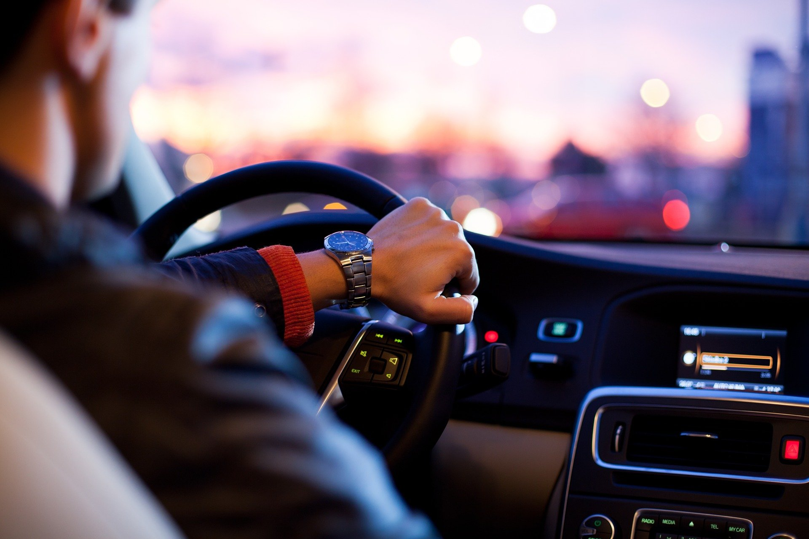

Check your following distance
Notes:
Check your following distance

Slide 3
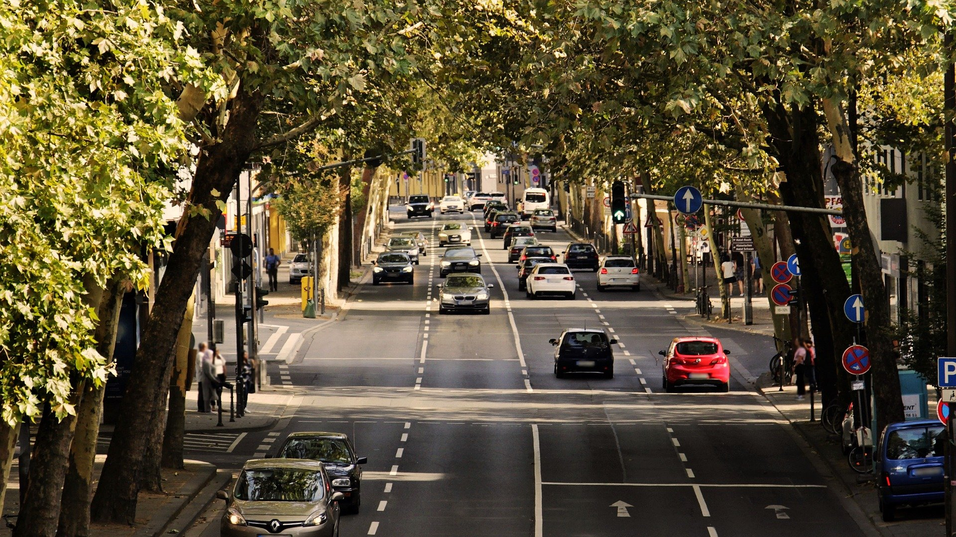
What’s at Stake?
Driving for work may include drivers of company or personal vehicles, those travelling from site to site, driving to an off-site meeting, picking up office supplies, etc.
Notes:
What’s At Stake?
Driving for work may include drivers of company or personal vehicles, those travelling from site to site, driving to an off-site meeting, picking up office supplies, etc. There are many individuals who drive as a major portion of their occupation – first response crews, surveyors, road repair and maintenance workers, sales, home care, trades, taxis, bus/van, public transit, school buses, tow trucks, and transports. Driving is a task that may be a part of many occupations.
Drivers must operate vehicles safely at all times. They may or may not be delivering goods or passengers. Drivers are often responsible for doing pre-trip inspections, route planning, and scheduling.

Slide 4
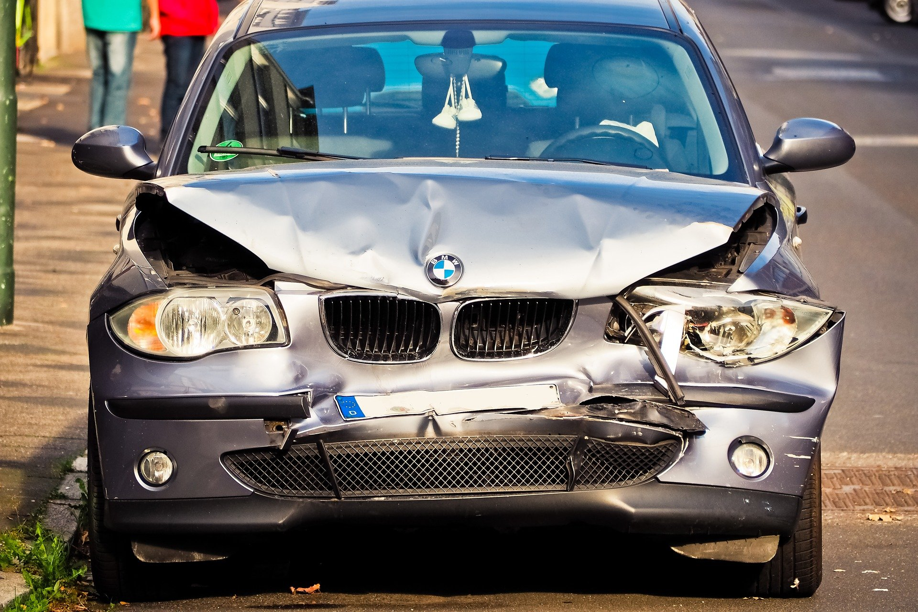
What’s the Danger?
Every 12 minutes someone dies in a motor vehicle crash, every 10 seconds an injury occurs and every 5 seconds a crash occurs. Many of these incidents occur during the workday or during the commute to and from work.
Notes:
What’s The Danger?
Every 12 minutes someone dies in a motor vehicle crash, every 10 seconds an injury occurs and every 5 seconds a crash occurs. Many of these incidents occur during the workday or during the commute to and from work. Employers bear the cost for injuries that occur both on and off the job. Whether you manage a fleet of vehicles, oversee a mobile sales force or simply employ commuters, by implementing a driver safety program in the workplace you can greatly reduce the risks faced by your employees and their families

Slide 5
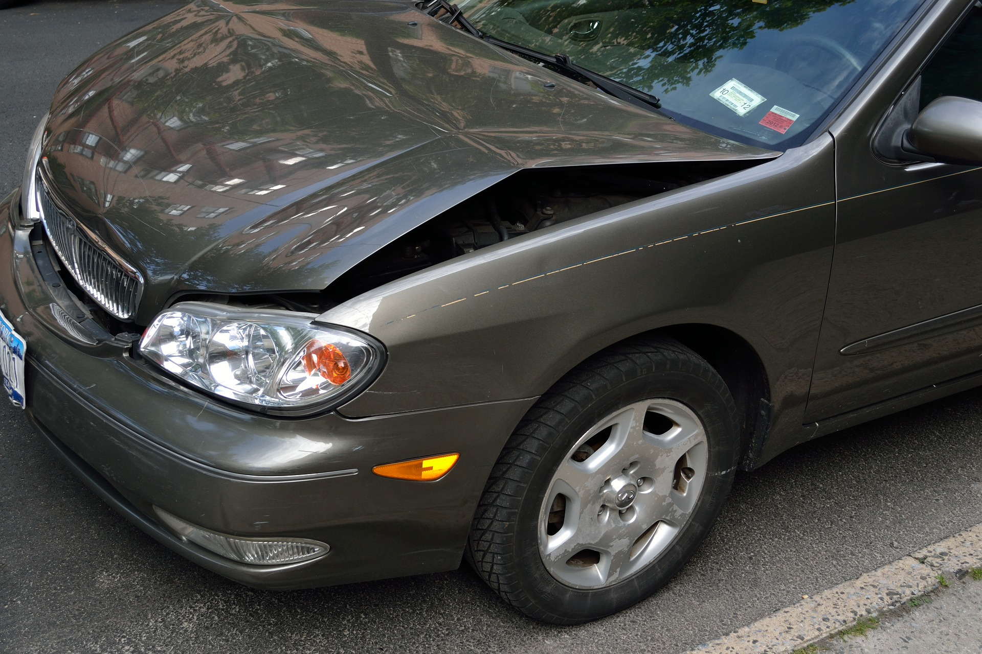
How to Protect Yourself
CRASH AVOIDANCE SPACE
Safe low risk drivers experienced in maintaining a three-second following distance are able to mentally judge a three-second crash avoidance space in front of their vehicle.
Notes:
How To Protect Yourself
Crash Avoidance Space
To reduce the risk of driving into the rear of a vehicle, the three-second crash avoidance space is essential, as the vehicle in front has the potential to stop very quickly if it collides with another vehicle or stationary object.The three second gap will change depending on your speed.
Potential for something to move into the crash avoidance space
The three-second gap can also be used for situations where there is potential for something to move into your crash avoidance space; for example a car in an adjacent street could fail to give way and pull out in front of you.
A safe low risk driver maintains a crash avoidance space completely around the vehicle. The crash avoidance space is managed by adjusting the vehicle’s speed and road position.
To determine the crash avoidance space to the front of the vehicle you need to take into account two key factors – Reaction Time and Response Time.
Reaction Time is the time the driver needs to:
See the information.
Perceive what it means.
Decide on a response.
Instigate that response.
A driver who is fit, concentrating, alert and not affected by alcohol, drugs, fatigue or a distraction, will still require about one and a half seconds to react to a hazard.
Response Time is the time required to take action. Generally, a minimum of one and a half seconds is needed to respond. In many situations braking may be the only possible response. Swerving is rarely appropriate and can result in a more severe crash, for example a head-on collision.
A total of three seconds crash avoidance space is needed to react and respond to a situation in front of you. You may need even longer in poor conditions such as in rain or darkness.

Slide 6
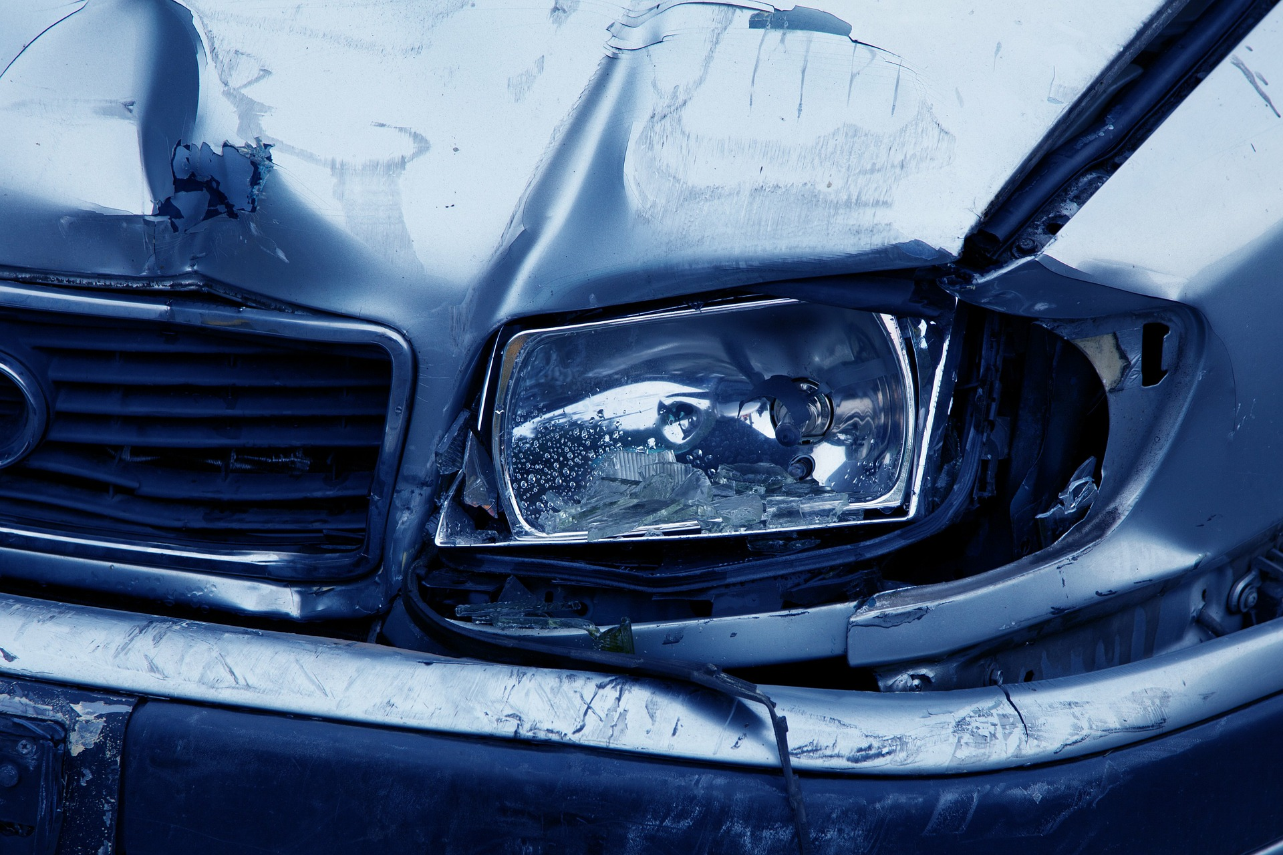
How to Protect Yourself
Following Another Vehicle
To calculate a three-second crash avoidance space when following another vehicle use this basic technique. As the rear of the vehicle in front of you passes an object at the side of the road such as a power pole, tree or sign, start a three-second count ‘one thousand and one, one thousand and two, one thousand and three’.
Notes:
How to Protect Yourself
Following Another Vehicle
To calculate a three-second crash avoidance space when following another vehicle use this basic technique. As the rear of the vehicle in front of you passes an object at the side of the road such as a power pole, tree or sign, start a three-second count ‘one thousand and one, one thousand and two, one thousand and three’.
If your car passes the object you picked before you finish the three-second count, you are following too closely. Your crash avoidance space is not large enough. Slow down, and repeat the count again until the three-second crash avoidance space is achieved.
In poor driving conditions, such as rain, night and gravel roads, it may be necessary to increase your crash avoidance space to four or more seconds.
The only way to accurately check your following distance is by using the 'Time Interval Formula' which works by picking a fixed landmark, like a sign or some other stationary object, and counting seconds as the vehicle in front of you passes it. The number of seconds that you count is your time interval.
Under the best conditions, the minimum number of seconds needs to be 2 or more as conditions change or deteriorate.
The Importance
Stopping distance is a combination of reaction distance and braking distance. Reaction distance is the distance that your vehicle travels from the time you see a reason to apply brakes to when you actually move your foot to the brake pedal and begin to slow down. If you are too close to the vehicle in front, you will hit them NO MATTER HOW GOOD A DRIVER YOU ARE because you can only get to the brake as fast as a human can move and by the time you get there, if the guy in front is already breaking hard, you don't have a chance.
Conditions which require an increase in following distance
Weather conditions; like rain, snow or other weather problems
Road condition; such as gravel or broken up pavement or other problems with the road. In slippery conditions, such as snow, ice or on wet pavement, much more space is advisable.
Lighting condition; at night or if you are looking into reflected sun or glare, you need more space because you will not see things as easily.
Traffic conditions; as traffic gets heavier, you need to stay aware of much more than in light traffic, this occupies your attention so more space in front buys you more time to react.
YOUR condition; if you are tired or otherwise not 100%, leave more space because your reactions may not be as quick.

Slide 7
Final Word
Employers have the power and opportunity to improve the safety vehicle performance of their employees. The first step is the implementation and enforcement of a Company sponsored driver safety program. The next step is to hire capable drivers, only allow eligible drivers to drive on company business, train them, supervise them, and maintain company vehicles properly.
Notes:
Final Word
Employers have the power and opportunity to improve the safety vehicle performance of their employees. The first step is the implementation and enforcement of a Company sponsored driver safety program. The next step is to hire capable drivers, only allow eligible drivers to drive on company business, train them, supervise them, and maintain company vehicles properly.

