Slide 1

Click anywhere to get started…

Slide 2

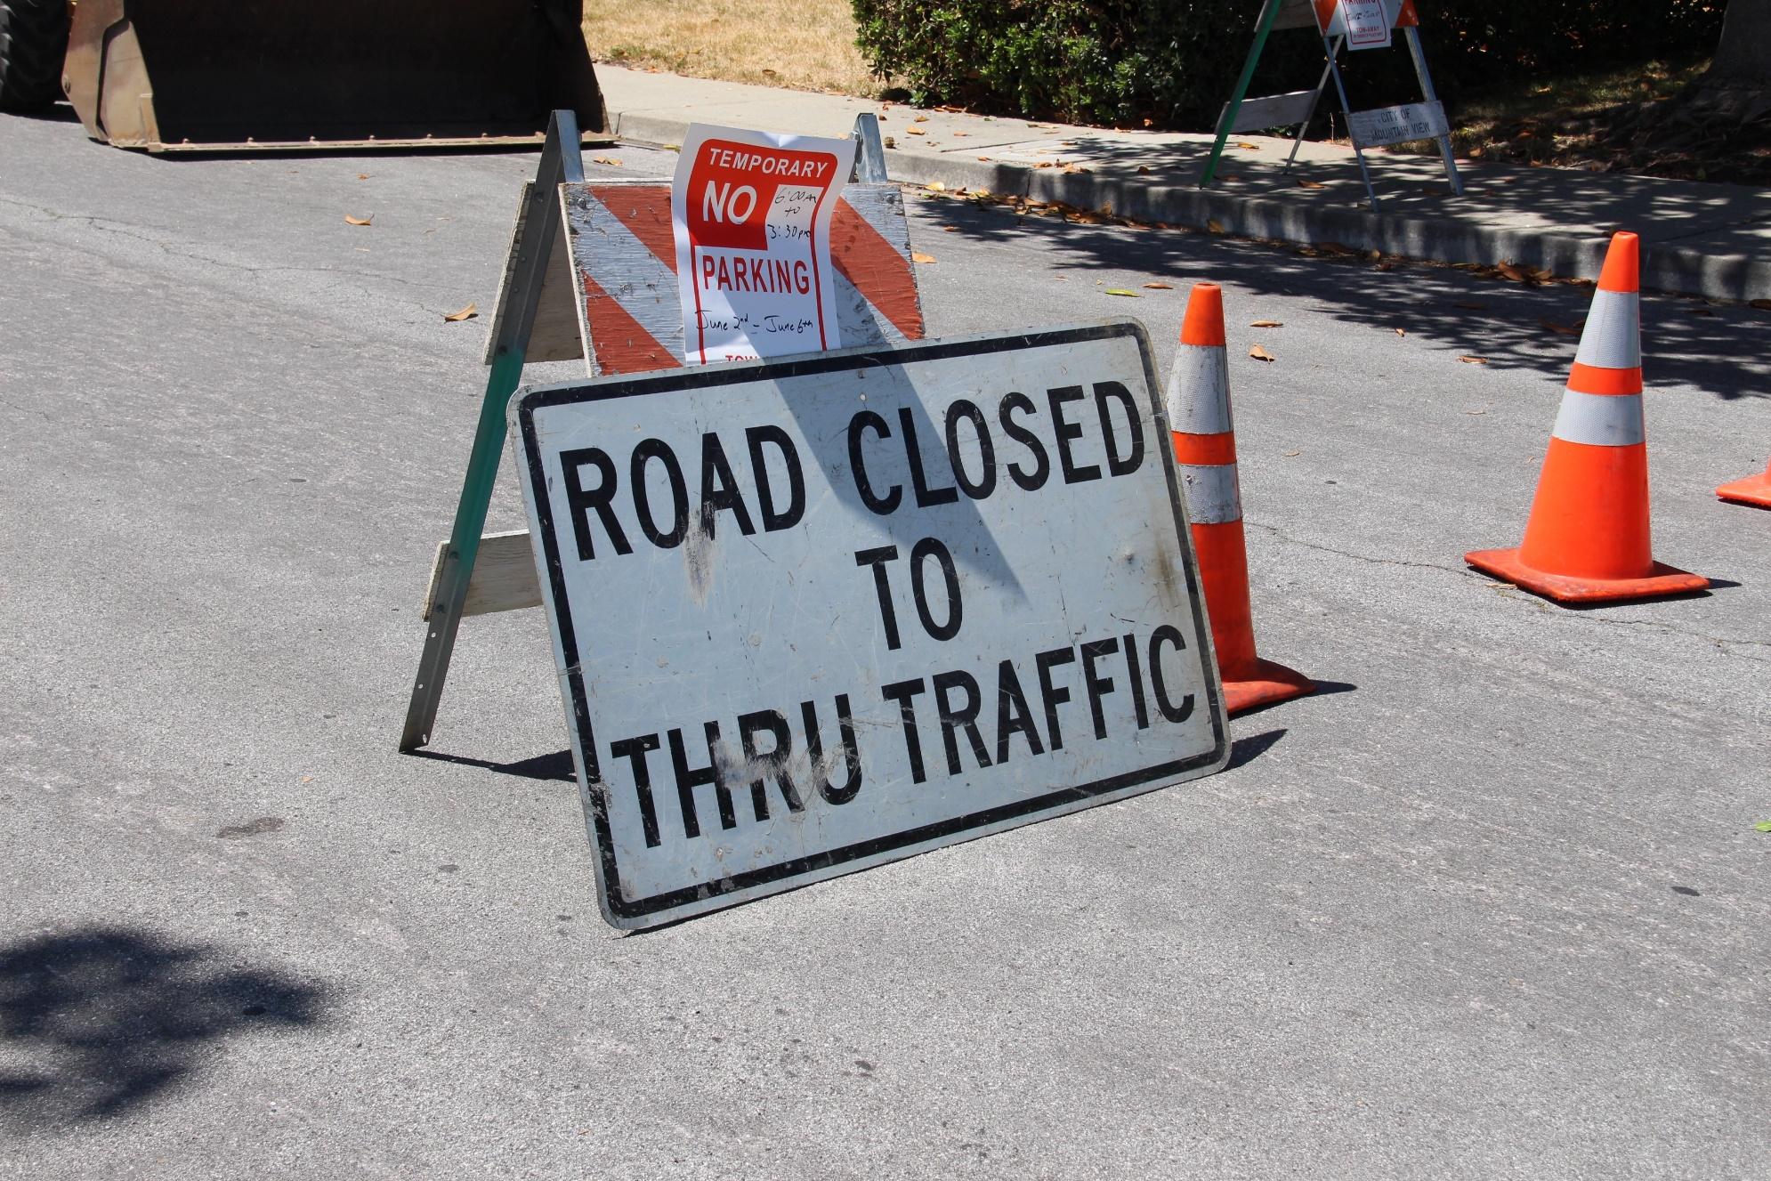

TRAFFIC CONTROL – WHEN A TCP IS REQUIRED
Notes:
Traffic Control – When a TCP is Required

Slide 3
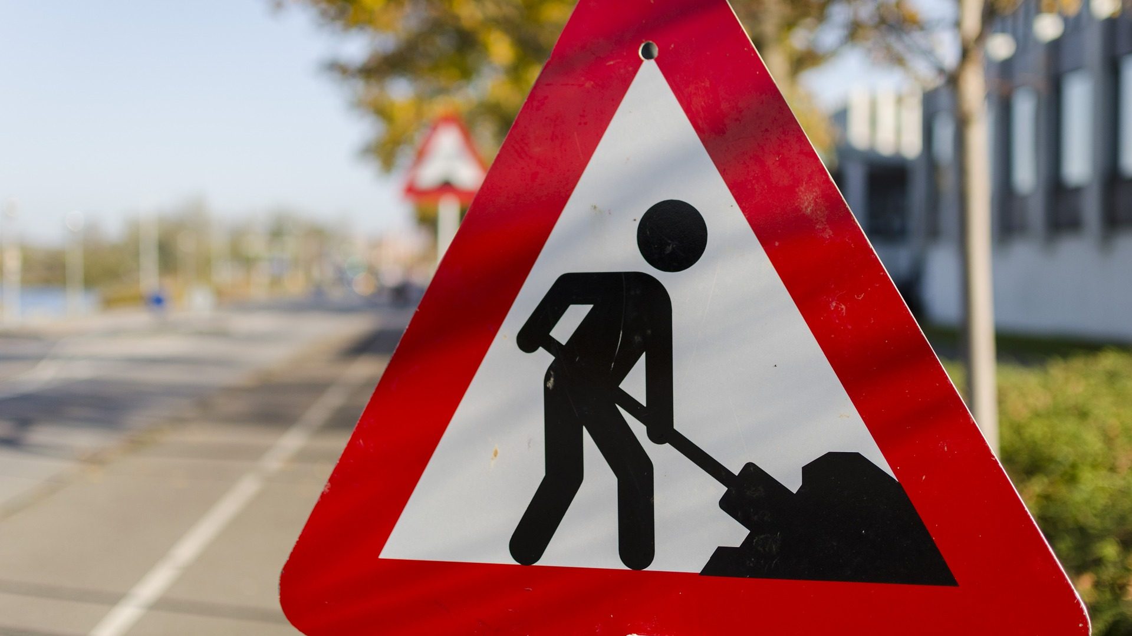
What’s at Stake?
Regulation establishes that traffic control arrangements for a workplace may use a traffic control person (TCP) only when the use of signs, devices and/or procedures is not sufficient to provide effective traffic control.
Notes:
What’s At Stake?
Regulation establishes that traffic control arrangements for a workplace may use a traffic control person (TCP) only when the use of signs, devices and/or procedures is not sufficient to provide effective traffic control.

Slide 4
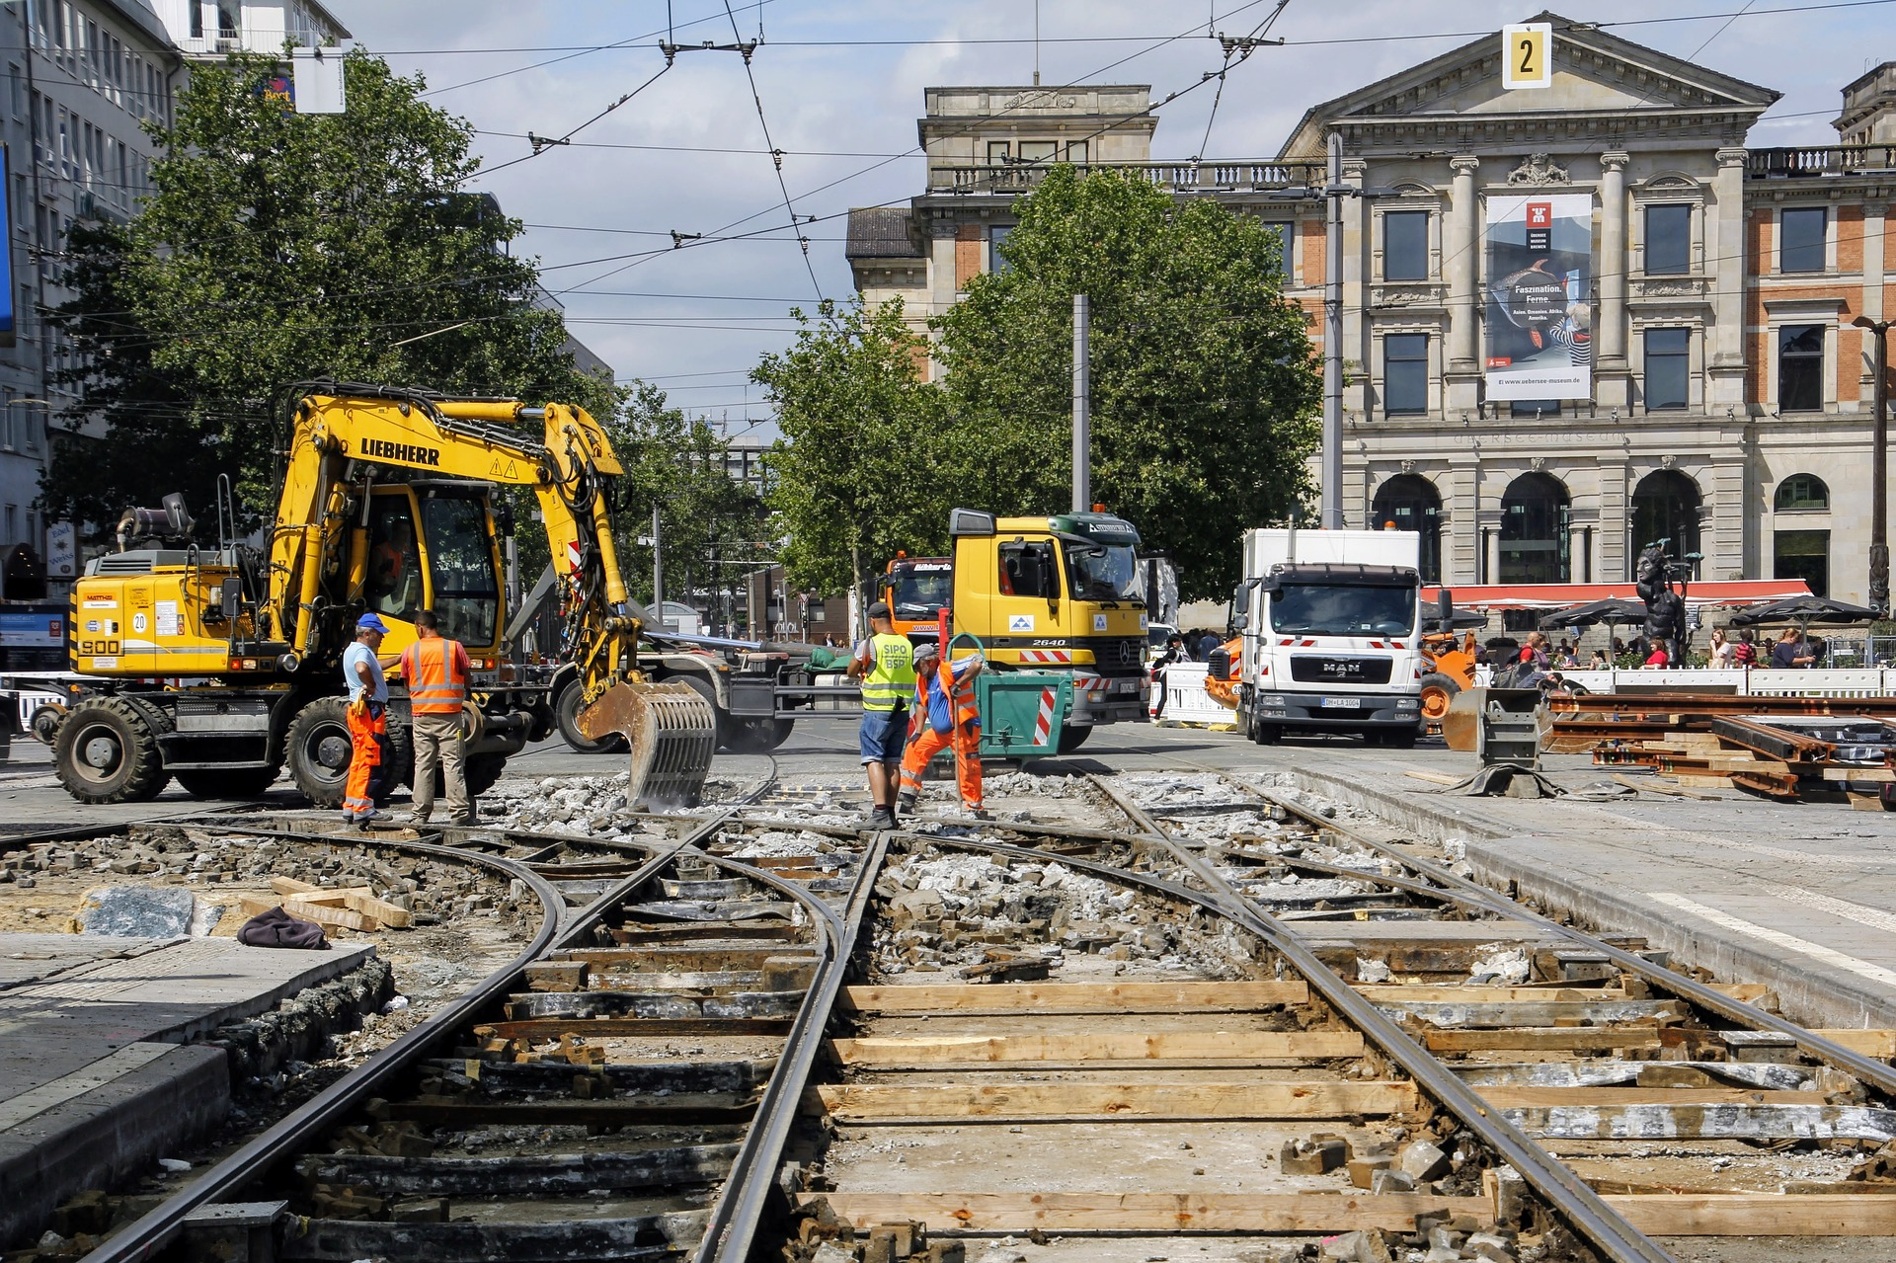
What’s the Danger?
HAZARDS/DANGERS
Dust Control
Long Periods of Delay
Towing and Recovery Operations
Workers/General Public
Notes:
What’s The Danger?
Hazards/Dangers
Dust Control
If traffic causes airborne dust to the extent visibility is reduced and interferes with effective traffic control or creates a hazard to workers, the employer must control the dust by the periodic application of water or other acceptable material to the grade surface to suppress dust.
Long Periods of Delay
If traffic control operations will result in long periods of traffic delay, appropriate signs or other effective means must be used to inform the traffic of the situation.
Towing and Recovery Operations
If the recovery of a disabled or damaged vehicle prevents the safe passage of other vehicles or if a passing vehicle is a danger to the workers engaged in the recovery operation, the person in charge must
warn traffic of the recovery operation by displaying appropriate signs and a 360° flashing light,
ensure that workers wear appropriate personal protective equipment, and
ensure that any other procedures required by the Traffic Control Manual are followed if the activity exceeds the limits for emergency or brief duration work.
Construction, maintenance, utilities workers, landscaping, emergency workers, and all other occupations who may conduct activities on or along the road are exposed to hazards such as:
collision with traffic or work vehicle, especially at high speeds
weather conditions
exposure to vehicle exhaust
moving machinery and equipment
angry motorists

Slide 5
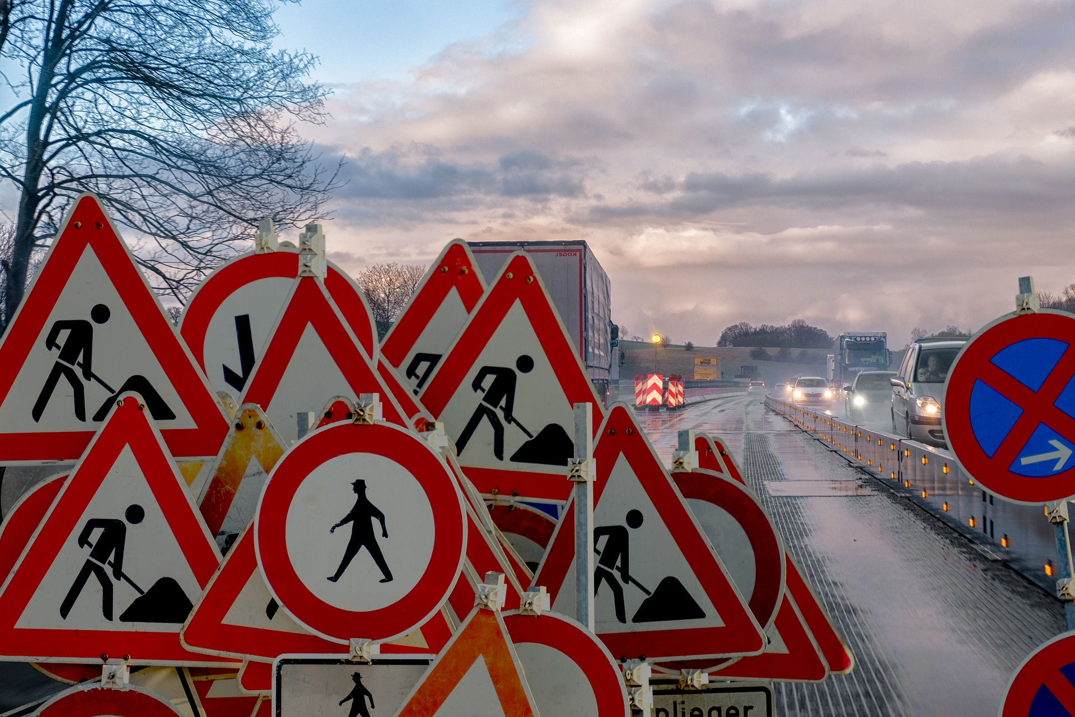
What’s the Danger?
Fatalities/Causes
The primary causes of roadside worker fatalities are:
Runover and backover injuries (48%)
Vehicle Collisions (19%)
Miscellaneous Construction Hazards (17%)
Caught in between or struck by an object accident (16%)
Notes:
What’s the Danger?
Fatalities/Causes
Approximately 20,000 workers are injured as a direct result of road construction each year due to traffic-related accidents and hazards within the construction activity area. In 2016 alone, 25,713 crashes occurred in Texas work zones. These collisions resulted in 181 fatalities. Although the number of accidents has decreased over the past years, injuries and deaths have increased by over 27 percent.
The primary causes of roadside worker fatalities are:
Runover and backover injuries (48%). Almost half of worker fatalities are a direct result of a worker being run over or backed over by vehicles or mobile equipment. Nearly 25% of these incidents are caused by construction vehicles.
Vehicle collisions (19%). The second most common cause of worker fatalities is a collision between construction equipment and traffic. When traffic fails to slow down or remain in their lane, the driver of the construction machinery may be left with little to no maneuverability, thus increasing the risk for a collision.
Miscellaneous construction hazards (17%). The third most dangerous aspect of roadside construction is the project site itself. Grounds can collapse, equipment can fail or lose control, and changing weather can all pose a significant threat to workers.
Caught in between or struck by an object accident (16%): The fourth most common cause of worker fatalities occur when workers get caught between construction equipment and other objects (mounds of dirt or medians), or when they’re struck by construction equipment or other vehicles.

Slide 6
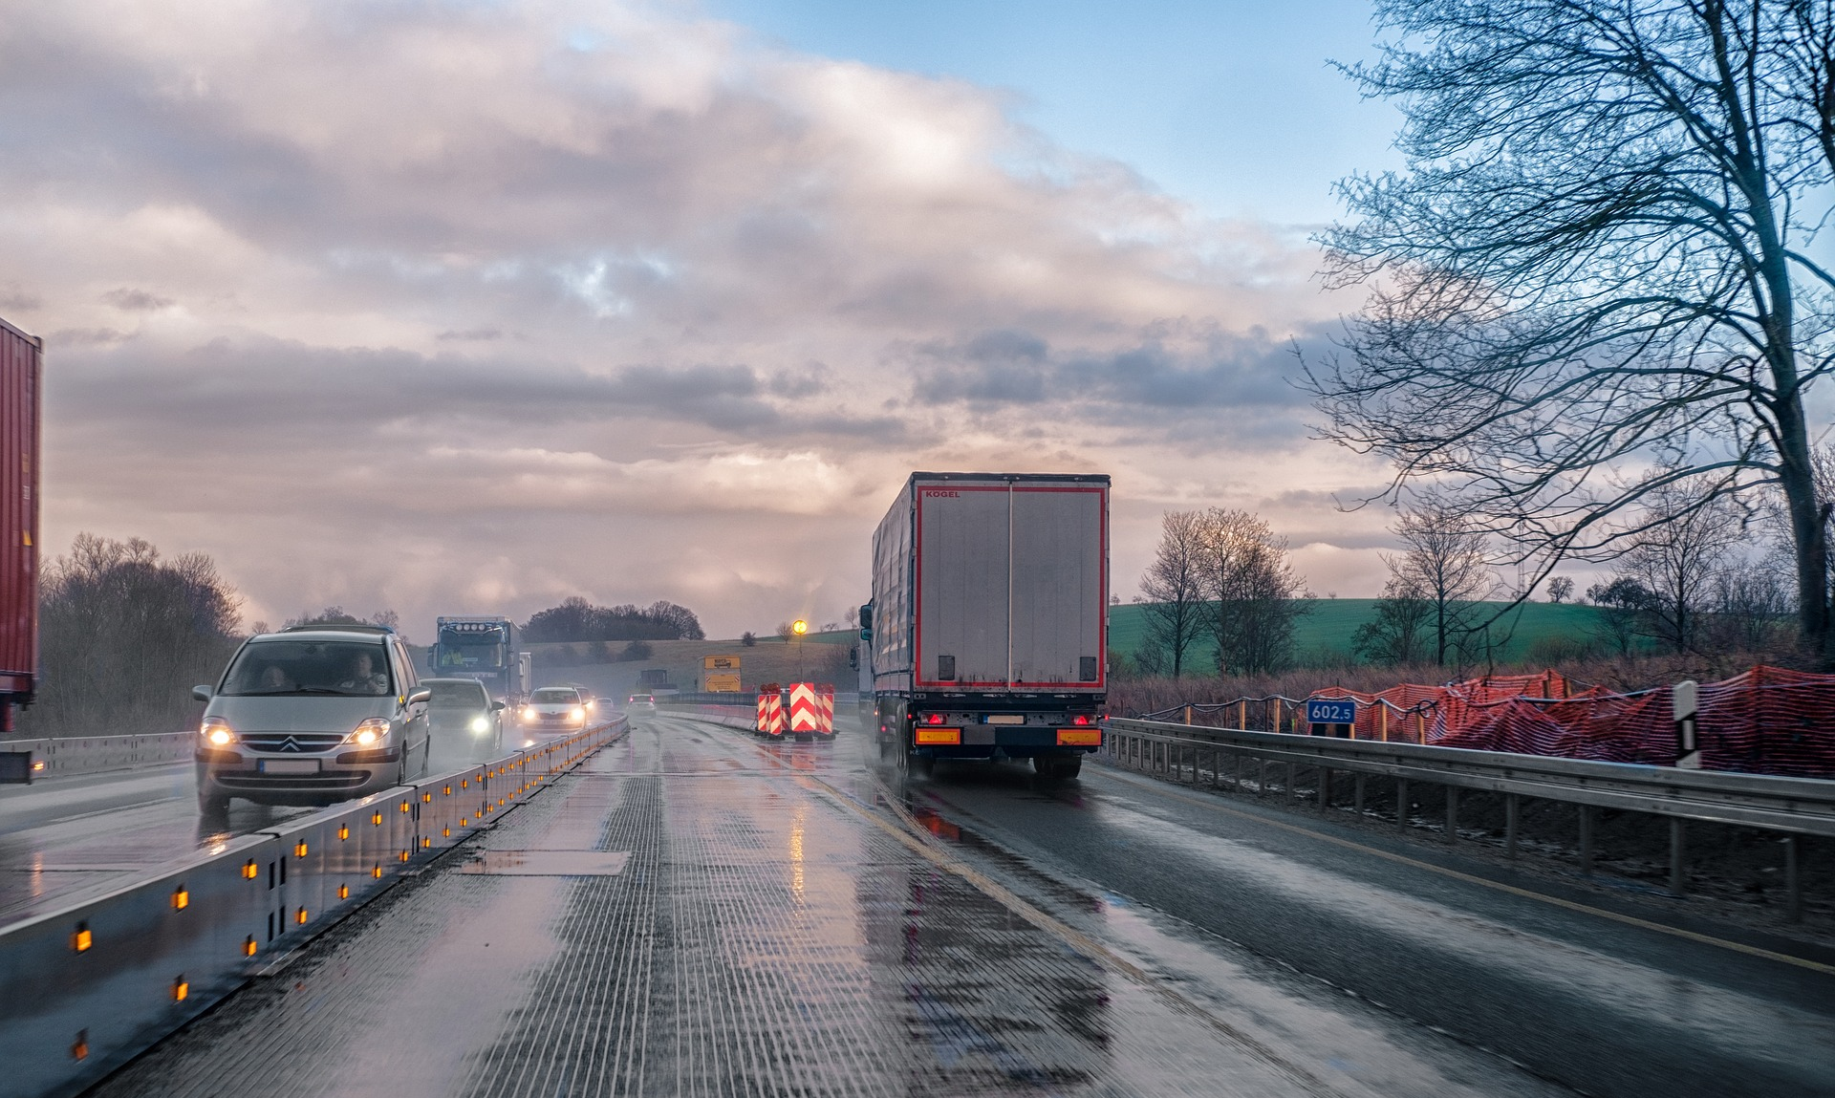
How to Protect Yourself
ROLE OF TRAFFIC CONTROL PERSON
A traffic control person may be used only:
One or more traffic control persons must be used if:
Traffic control person to remain on duty
Notes:
How to Protect Yourself
Role Of Traffic Control Person
A traffic control person may be used only
if the use of signs and other traffic control devices and procedures alone cannot provide effective traffic control, or
during emergency or brief duration work if it is not practicable to control traffic with signs and other devices and procedures.
One or more traffic control persons must be used if
it is necessary to institute a one-way traffic system by or through a work zone and the circumstances do not allow self-regulating single lane traffic controlled by signs and other devices as specified in the Traffic Control Manual, and a traffic signal system is not used,
work-related traffic cannot safely self-regulate to move in or out of the work area or safely coordinate with other traffic,
an existing traffic control system, or an existing traffic signal light system, is not adequate to regulate traffic,
the work encroaches into an intersection so as to interfere with regular traffic movement,
traffic speed or volume is a hazard to workers while setting up or removing other traffic control devices, or
other traffic control devices are not available in an emergency situation.
Traffic control person to remain on duty
The employer must ensure that a traffic control person is on duty at the assigned station whenever a traffic control person is required as part of the traffic control plan for the work.
A traffic control person must:
stand in a safe position, preferably on the driver's side of the lane under the TCP's control, be clearly visible, and have an unobstructed view of approaching traffic, and
be positioned at least 25 m (80 ft) away from the work area unless circumstances or space requirements, such as working at or near an intersection, dictate otherwise.

Slide 7

Final Word
Motorist, employers, workers and general public must appreciate work zones on public roads is fraught with danger. The work and service of TCP is recognized as one of the main bulwarks protecting these groups in dangerous circumstances.
Notes:
Final Word
Motorist, employers, workers and general public must appreciate work zones on public roads is fraught with danger. The work and service of TCP is recognized as one of the main bulwarks protecting these groups in dangerous circumstances.

