Slide 1

Click anywhere to get started…

Slide 2

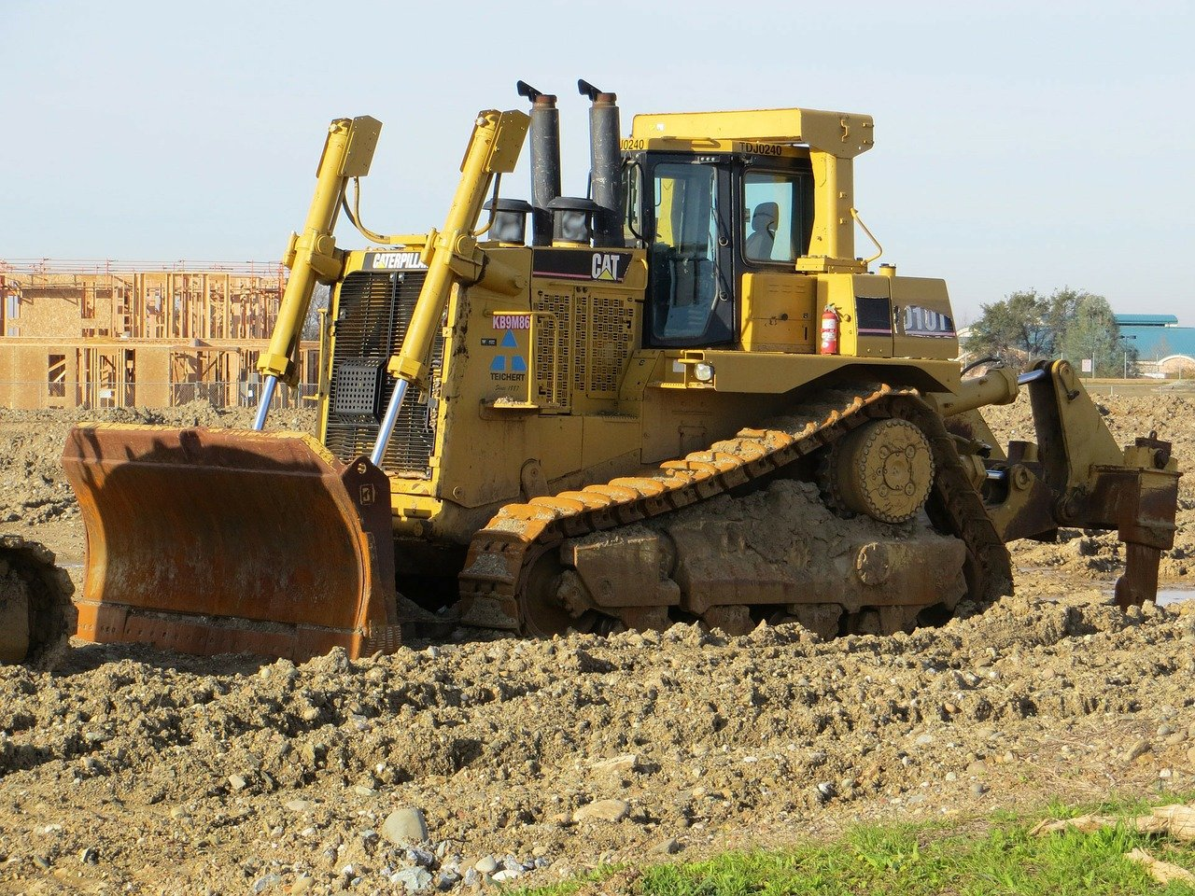

OPERATOR VISIBILITY AROUND HEAVY EQUIPMENT
Notes:
Operator Visibility Around Heavy Equipment

Slide 3
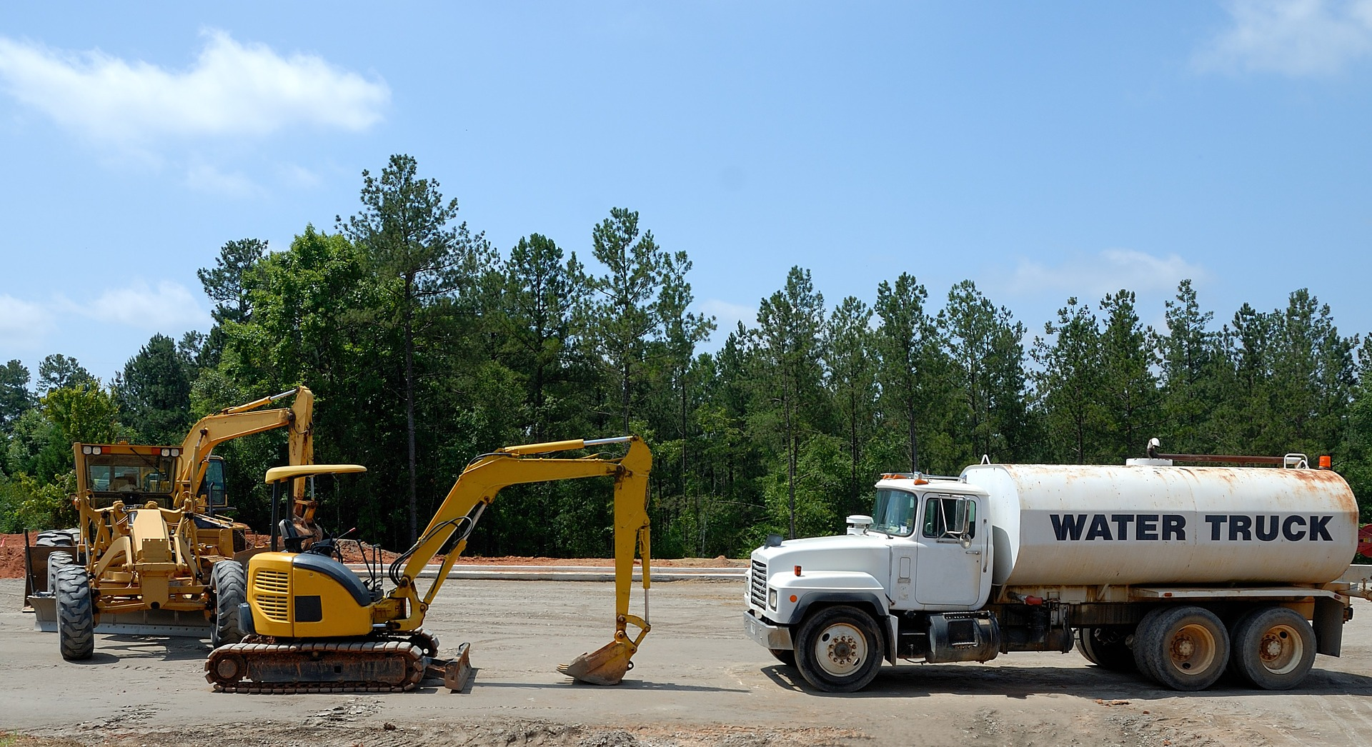
What’s at Stake?
In some cases, it is nearly impossible for an operator to see a person standing next to the equipment. An operator must always remain patient and cautious. Never proceed or use reverse to back into an area without knowing what is there.
Notes:
What’s At Stake?
In some cases, it is nearly impossible for an operator to see a person standing next to the equipment. An operator must always remain patient and cautious. Never proceed or use reverse to back into an area without knowing what is there.
The heavy equipment workplace is fraught with danger without the implementation and execution of well-thought out safety protocols and practices.

Slide 4
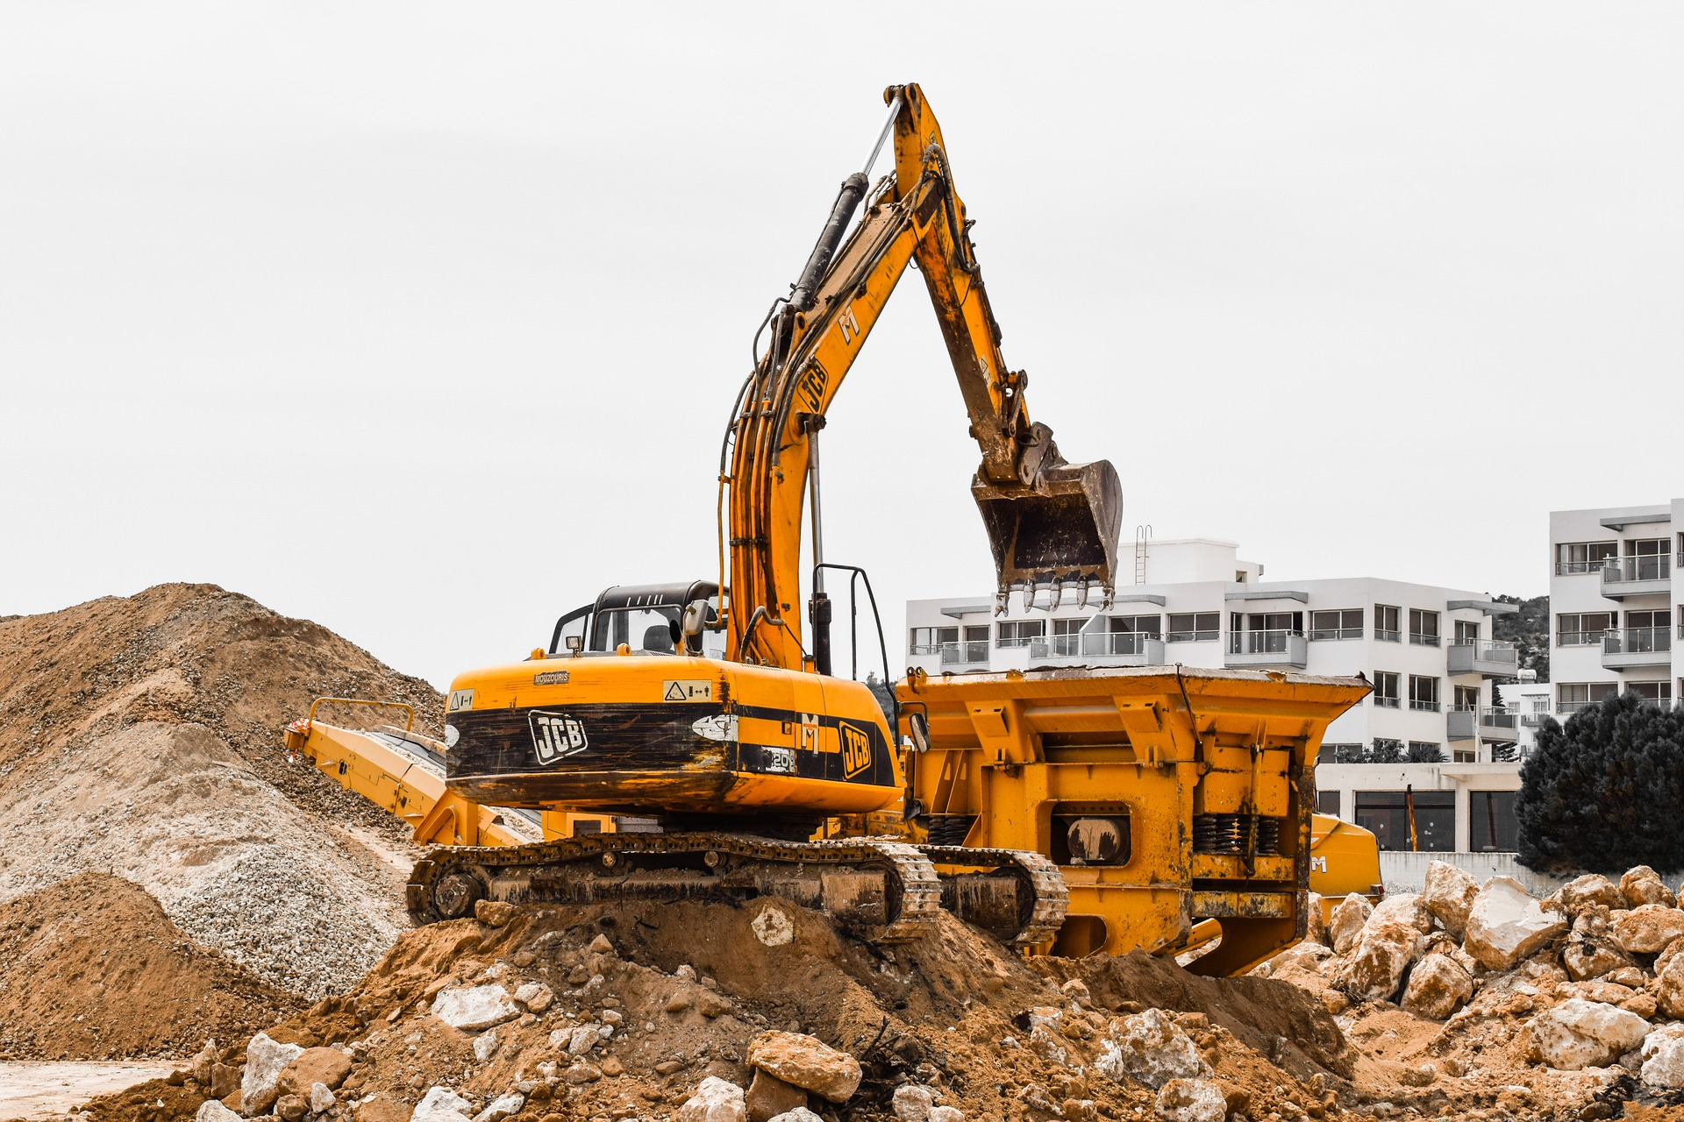
What’s the Danger?
HAZARDS WHEN WORKING WITH CONSTRUCTION EQUIPMENT
There are three potential hazards on a construction site:
Access
Mechanical
Non-Mechanical.
Notes:
What’s The Danger?
Hazards When Working With Construction Equipment
There are three potential hazards on a construction site: access, mechanical and non-mechanical. When operators, ground workers and project managers are situationally aware, it can decrease the effects of the fatal four from reaching your sites.
Access Dangers
An access hazard is when there is unsafe entry to machinery on a job site. Workers can become trapped or exposed to hazards that are both mechanical and non-mechanical. If you conduct proper planning, put safeguards in place and boost your workers’ awareness, you can help them avoid getting stuck between objects or caught in other severe situations.
The best way to diminish access hazards is to communicate information regarding each type of danger around heavy machines and where particular people have access.
Mechanical Dangers
Because construction equipment can harbor enormous amounts of power, capable of destroying buildings and uprooting the Earth, imagine its effects on a human being. While it may not be the best picture to imagine, it’s a concern you must think about as a manager.
Mechanical hazards that can affect workers include colliding surfaces, sharp edges, rotating shafts, scissor actions, crushing, cutting, severing and puncturing. Slips and falls can even occur if someone is attempting to dodge a moving part.
Non-Mechanical Dangers
Hazards can also result from non-moving components. Machines have stored energy in the form of pressurized gasses and fluids, along with hot surfaces and electrical charges. A non-mechanical danger can involve harmful substances like chemicals and emissions. Engines also put off loud noises that can damage hearing. Operators and mechanics should assess their machines for non-mechanical hazards before and after each usage.
Common non-mechanical dangers on a construction site include:
High-intensity lights like welding flashes and lasers
Flammable substances
Lead, cadmium and mercury
Steam
Conducted or radiated heat
Radiation like X-rays and microwaves
Dust
From these various hazards, people can suffer from lung damage, burns, blindness, hearing impairments and even an increased risk of cancer-related illnesses.

Slide 5
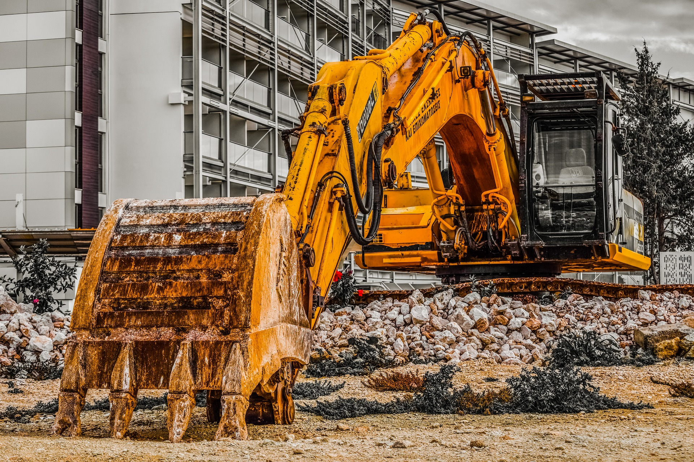
How to Protect Yourself
SPOTTERS
GROUND-WORKER AWARENESS AND SAFE WORK PRACTICES
Notes:
How To Protect Yourself
Spotters
Blind spots can be a significant operator issue. A spotter, trained in hand signals, can help provide safety guidance and communication between the operator, workers and nearby pedestrians to compensate for blind spots.
Spotters should wear high-visibility clothing and stand clear of equipment at all times.
Ground-worker Awareness And Safe Work Practices
Ground workers also play an important role to help minimize the risk of heavy equipment-related injury.
Wear high-visibility clothing when working around heavy mobile equipment.
Avoid positioning themselves in a blind spot or riding on moving equipment.
Avoid setting up their work area near heavy mobile equipment. The operator may not see them if they are bending over to work or grab a tool.
Avoid walking or working under a suspended load.
Make eye contact with and alert the operator—and ensure the operator sees you—before approaching a vehicle.
Ride only in approved seats and wear a seat belt.
Construction workers are around heavy equipment every day, and they can become accustomed to the presence of heavy equipment, not giving much thought to the risks. Taking some time to understand and follow safety rules—and staying alert while on the job—can help construction workers stay safe.

Slide 6
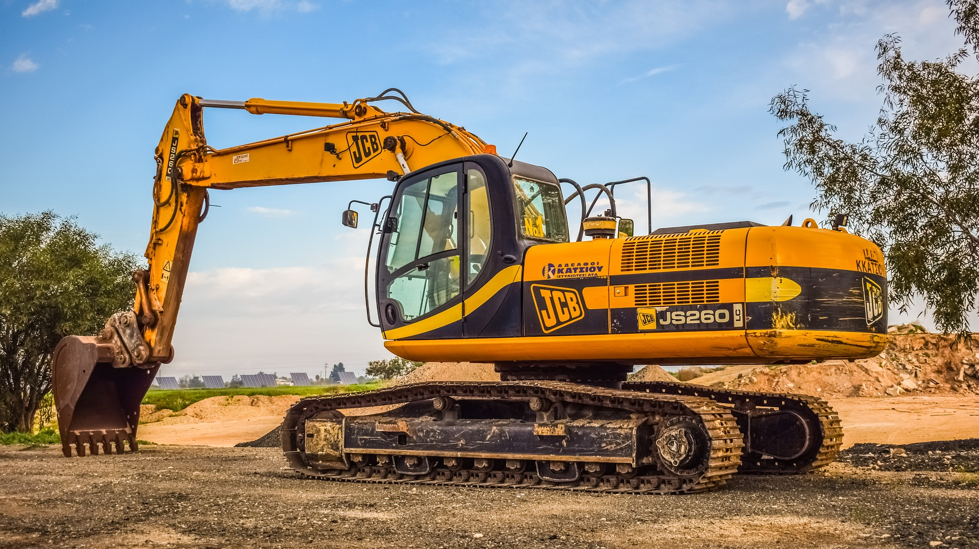
How to Protect Yourself
OPERATOR SAFE WORK PRACTICES
In addition to being trained and familiar with the equipment being operated, operators can help reduce the risk of injury or fatality associated with heavy equipment through safe practices.
Notes:
How to Protect Yourself
Operator Safe Work Practices
In addition to being trained and familiar with the equipment being operated, operators can help reduce the risk of injury or fatality associated with heavy equipment through safe practices.
Be familiar with the equipment and the operator’s manual.
Inspect the equipment at the start of each shift, including the brake system, headlights, taillights, brake lights, windshield wipers and audible warning devices, such as the horn and the back-up alarm.
Adjust all side and back mirrors to help compensate for blind spots.
Ensure workers are clear of equipment before operating.
Acknowledge and allow safe passage to workers who alert you that they are approaching.
Avoid operating equipment parallel to slopes or embankments.
Turn off the engine and engage brakes before leaving equipment.
Face the equipment, maintaining three points of contact, while getting on and off the equipment.
Always wear the seat belt.
Avoid overloading vehicles.
Top loading vehicles must have cab shields and canopy protection.
NO RIDERS! Only equipment that is designed to carry multiple persons shall have more than one occupant!
Wear high visibility clothing and Personal Protective Equipment
Never work under a suspended or overhead load
Watch for shifting or unstable loads and working surfaces
The use of cell phones is prohibited except for job-related or emergency situations
Always stay alert
Many times, when workers think the can be seen by the operators of heavy equipment they can’t. You may be in a blind spot or the operator has been driving in a designated travel path for a period of time and the only thing that has changed is you! Make eye contact with operators!

Slide 7
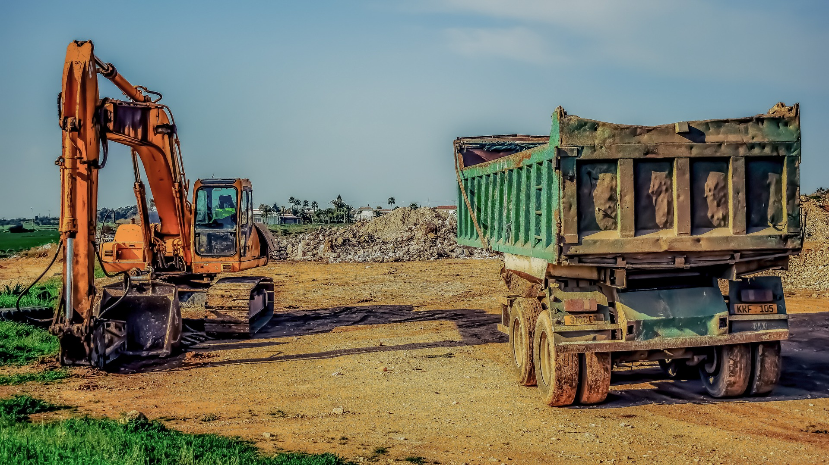
Final Word
One of the best things a manager/supervisor can do is to introduce a culture that puts worker safety first. When the company does not give a full throated commitment to worker safety, the entire crew is at risk.
Notes:
Final Word
One of the best things a manager/supervisor can do is to introduce a culture that puts worker safety first. When the company does not give a full throated commitment to worker safety, the entire crew is at risk.

