Slide 1

Click anywhere to get started…

Slide 2

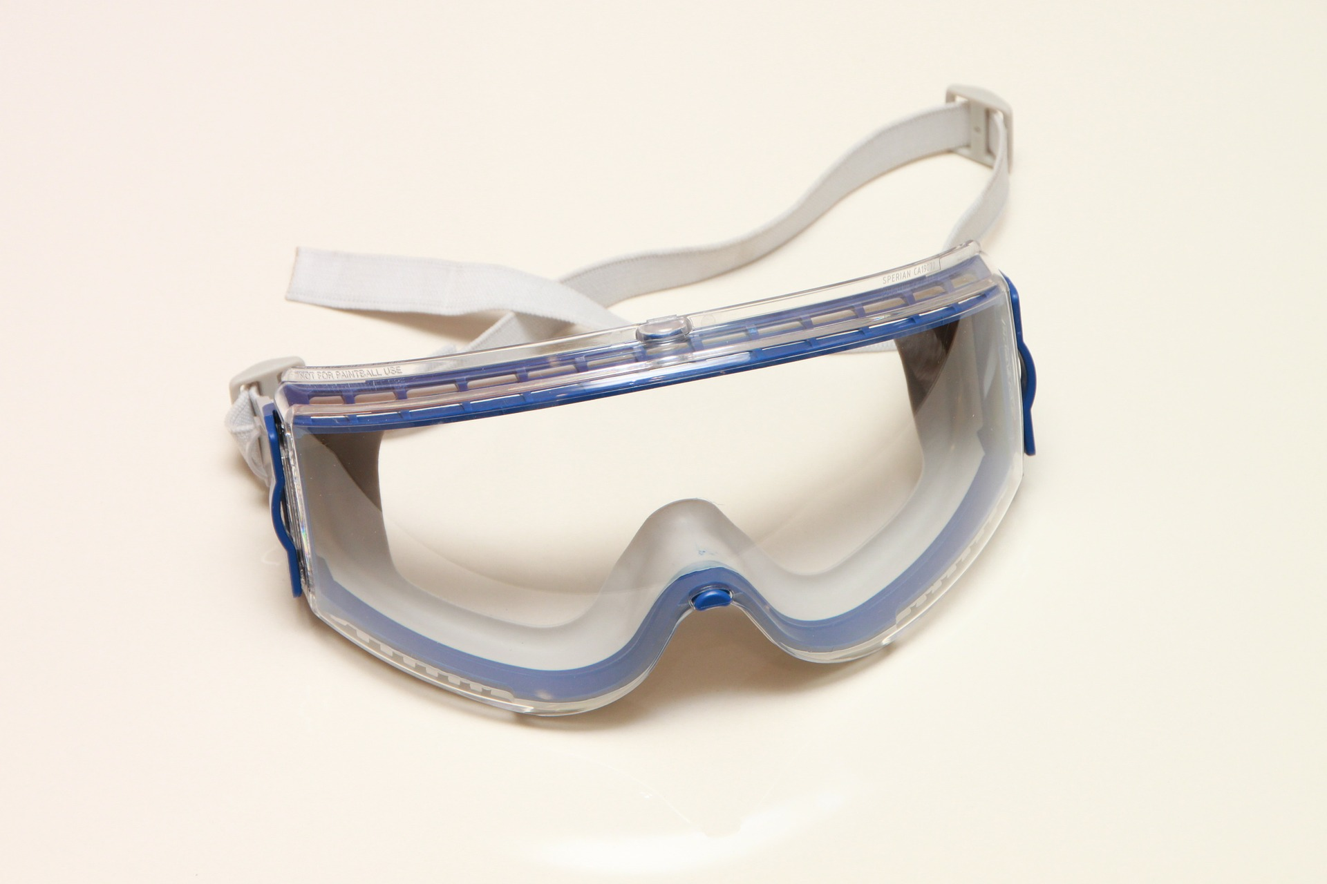

Hazards and Eye Protection on the Farm
Notes:
Hazards and Eye Protection on the Farm

Slide 3

What’s at Stake?
Eye injuries can translate into pain, loss of time, money and even loss of your eyesight.
Notes:
What’s at Stake?
Eye injuries can translate into pain, loss of time, money and even loss of your eyesight. Even a slight loss or impairment of your vision is a tremendous price to pay for a moment of carelessness. Review the first aid treatment for eye injuries, you learned through your first aid course. Use that information and seek medical attention if there is an eye injury.

Slide 4

What’s the Danger?
Personal Protective Equipment (PPE) is important for agricultural procedures to reduce the risk of injury and death.
Injuries to the eye can be expensive, painful, and may cause partial or total blindness.
Notes:
What’s the Danger?
Personal Protective Equipment (PPE) is important for agricultural procedures to reduce the risk of injury and death.
It is important to remember how important your eyes are. You only have two and they are irreplaceable.
Dangers/Risks
Injuries to the eye can be expensive, painful, and may cause partial or total blindness. Proper eye protection is the best strategy in preventing eye injuries because most eye injuries are a result of flying particles. The eye has its own built-in protection from the surrounding bone structure, eyelashes, tearing, and blinking; but they are no match for particles entering the eye at a high rate of speed. Eye protection should be worn when completing the following types of jobs: feed grinding, handling chemicals, haying, welding, repairing equipment, and any task completed in a dusty environment.

Slide 5

How to Protect Yourself
EYE PROTECTION
There are 5 types of eye protection.
1. Basic Safety Glasses
A pair of basic safety glasses provides protection when there is potential for particles to enter the eye from the front.
2. Prescription Safety Glasses
Prescription safety glasses are made of either plastic or metal and are available in both bifocals and tinted lenses.
Notes:
How to Protect Yourself
EYE PROTECTION
There are 5 types of eye protection. Choose the type that best suits your vision and provides the best protection for the job that you are completing.
Basic Safety Glasses
A pair of basic safety glasses provides protection when there is potential for particles to enter the eye from the front. Safety lenses in regular eyeglass frames are not considered suitable safety glasses. Most basic safety glasses do not provide side protection, but side protection is available on some safety glasses through either permanent or detachable side shields to protect the eye from above, below and on the sides. When choosing safety glasses with side protection, make sure that the sides do not interfere with your peripheral vision.
Prescription Safety Glasses
Prescription safety glasses are made of either plastic or metal and are available in both bifocals and tinted lenses. Use caution when choosing tinted lenses because these lenses take time for the tinting to disappear which can be hazardous when frequently going between inside and outside work areas. Choose tint lenses when activities may include bright flashes of light.

Slide 6
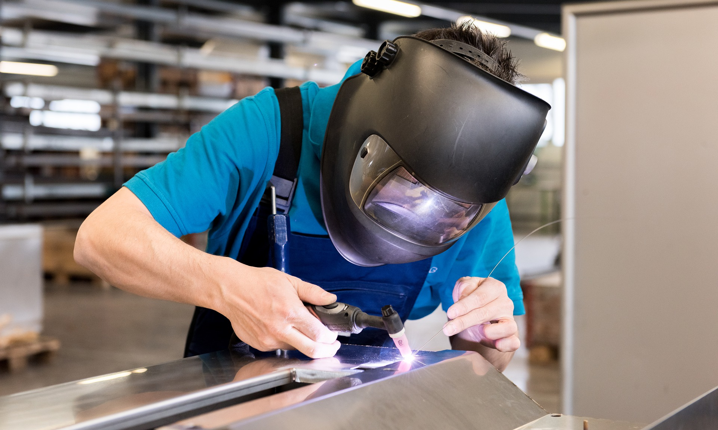
How to Protect Yourself
3. Goggles
This type of eye protection is especially good for jobs such as chainsaw operation, grinding, and riveting.
4. Face Shields
This type of eye protection is especially designed to protect the user from heat, glare, and flying objects.
5. Welding Helmets and Goggles
A welding helmet is equipped with special filtering lenses that protect the eyes from the strong ultraviolet and infrared rays that can permanently damage eyes and cause blindness.
Notes:
How to Protect Yourself
Goggles
Goggles provide inexpensive protection from all angles because they fit snugly around the eyes. This type of eye protection is especially good for jobs such as chainsaw operation, grinding, and riveting. Goggles are especially useful because they typically fit over most prescription eyeglasses and are usually ventilated with an anti-fog solution. Two of the most common models of goggles are eyecup or wire mesh. If working around chemicals, choose goggles with off-set ventilation ports.
Face Shields
Face shields are secondary protection and must be worn in conjunction with either glasses or goggles. This type of eye protection is especially designed to protect the user from heat, glare, and flying objects. Face shields can be attached to hard hats for those jobs that also require head protection.
Welding Helmets and Goggles
A welding helmet is equipped with special filtering lenses that protect the eyes from the strong ultraviolet and infrared rays that can permanently damage eyes and cause blindness. Welding goggles have various filter lens shades to protect against sparks, rays, and flying particles. Talk with your local dealer to determine the filter lens shade that you need for the various types of welding. Stationary or lift-front lenses are available for both welding helmets and goggles.

Slide 7
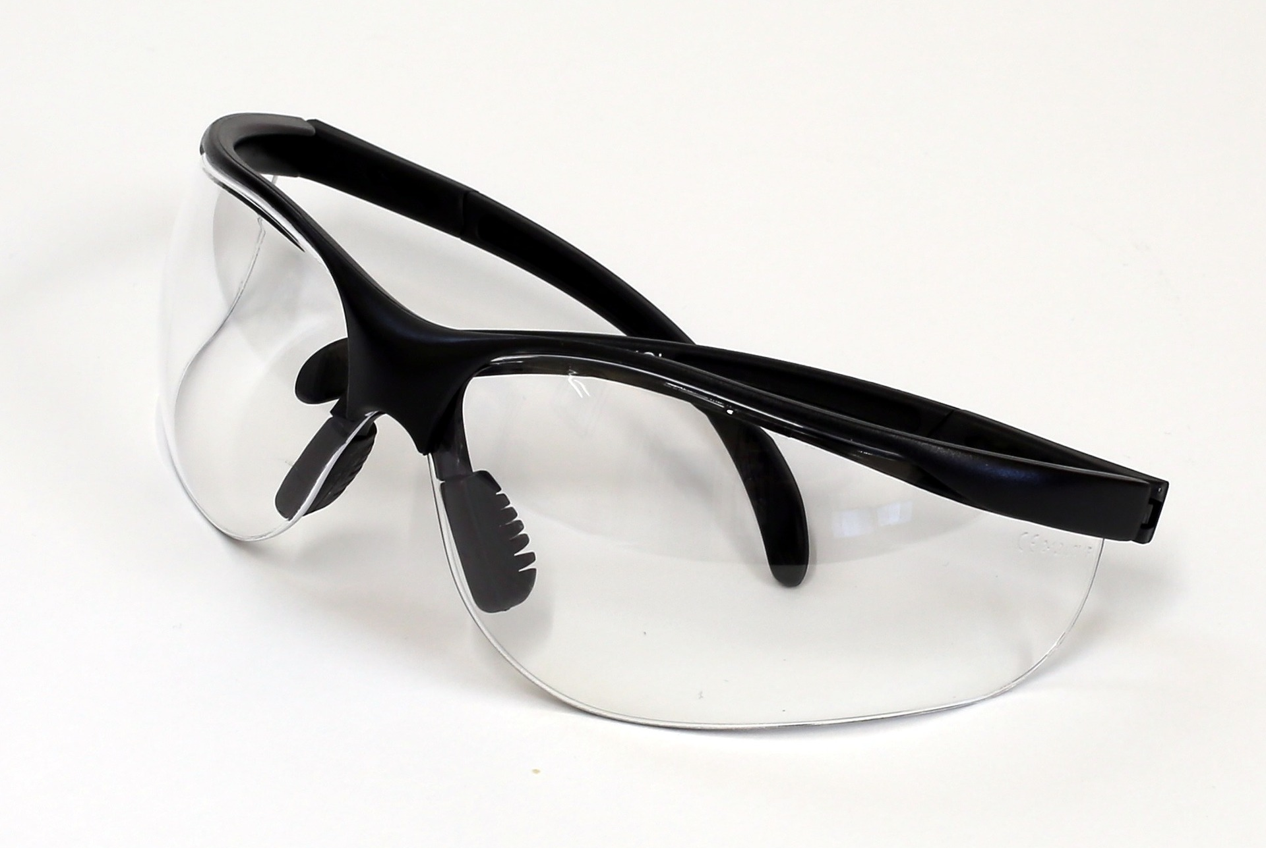
How to Protect Yourself
Eye Protection Standards
These are recommendations from the American Academy of Ophthalmology (AAO) for eye protection in the workplace
Select, Fit, Clean Eyewear
Protective eyewear should be carefully selected, fitted and cleaned. Protective eyewear should be reasonably comfortably and fit snugly without interfering with the movements or vision of the wearer
Notes:
How to Protect Yourself
Eye Protection Standards
These are recommendations from the American Academy of Ophthalmology (AAO) for eye protection in the workplace:
Protective eyewear should include side protection unless there is no possible chance of injury from side impact, splashes or sparks.
Always put on protective eyewear before entering an area where hazards may be present.
Eye protection must fit properly and comfortably, including when worn over prescription eyeglasses.
Protective eyewear should be regularly checked for damage and replaced if there is any defect.
When in doubt, assume that eye hazards are present.
The AAO estimates that 90% of all eye injuries are preventable by using protective eyewear.
Other Eye Protection Standards
Standards for eye protection are determined based on the identified hazard in the workplace.
Additional recommendations concerning eye protection include the following:
Do not share eye protection to reduce the risk of contracting a contagious eye disease from another worker.
Even though sunglasses are important for working outdoors, they are not considered to be eye protection.
Select, Fit, Clean Eyewear
Protective eyewear should be carefully selected, fitted and cleaned. Protective eyewear should be reasonably comfortably and fit snugly without interfering with the movements or vision of the wearer. Protective eyewear should be durable, easily cleaned and capable of being disinfected. It should be kept clean and in good repair. To shield eyes from flying objects, wear industrial-rated glasses or sun glasses and flexible or cushion-fitting ventilated plastic goggles that fit over ordinary eyeglasses. Adding side shields increases protection. Wear splash goggles when handling and applying agricultural chemicals. Farmers can also wear welding goggles to protect their eyes from intense light and sparks. Full face shields are another option for eye protection and can be worn comfortable. Never wear contact lenses when handling ammonia or other farm chemicals. Store eye protection in clean, dust-proof containers.
Basic eye protection for the glasses or sunglasses wearer is a must. The glasses wearer should wear a face shield, goggles or spectacles with protective lenses. The glasses should be of industrial-quality with flame-resistant frames. Wearing outdated glasses or sunglasses offers no protection and may even be dangerous as they tend to splinter or shatter on impact.
Maintenance of Eye Protection
Regularly clean your protective eyewear in warm, soapy water because looking through dirty lenses can strain your eyes. Use a soft tissue or cloth to dry the lenses to reduce the risk of scratches because deep scratches or pitting may weaken the lenses. Goggles should fit snuggly over your eyes so replace elastic goggle headbands when they become stretched. Store your protective eyewear in a rigid case to reduce dust build-up and potential damage to delicate parts.
Maintain proper vision by having your eyes examined annually. Vision changes can occur that may require a prescription change or the need for prescription eye protection. If you wear contacts, always wear protective eyewear in work areas. The recommendation is to wear prescription eye protection instead of contacts especially in dusty environments because contact lenses may trap particles in the eye.

Slide 8

How to Protect Yourself
Causes of Eye Injuries
Spray cans are an increasing source of chemical eye injury, compounded by the force of contact.
Basic First Aid
Proper first aid for eye injuries is critical. The method of first aid needed depends upon the type of injury sustained.
Notes:
How to Protect Yourself
Causes of Eye Injuries
Spray cans are an increasing source of chemical eye injury, compounded by the force of contact. Whether containing caustics or irritants, spray cans must be carefully used and kept away from children.
Particles of rocks, soil, crop material or other foreign objects thrown from farm equipment that chops or grinds can cause unexpected eye injury to the operator or bystander. Keep machinery properly shielded. Keep away from the discharge path.
Eye injuries are more likely to occur when servicing farm equipment than when operating it. Simple hand tools can cause severe eye injuries. Wear industrial strength eye protection when using hand tools. Select the right tool for the job.
Basic First Aid
Proper first aid for eye injuries is critical. The method of first aid needed depends upon the type of injury sustained. Let natural tears wash out specks or particles in the eye. Try not to rub the eyes if possible. If this does not work, see a physician. For blows to the eye, apply cold compresses for 15 minutes and again each hour as needed to reduce pain and swelling. If the blow was hard enough to cause discoloration, see a physician. Internal damage could have occurred. For cuts and punctures to the eye, do not do anything to the eye but bandage it lightly and see a physician at once.
Chemical burns on the eyes can be minor to very serious. Fresh water should be available for irrigating eyes anywhere chemicals are used. If the eye comes in contact with any chemical, it should be continuously flooded with water for at least 15 minutes. Do not put anything else in the eye. See a physician and take the label or container of the chemical involved.

Slide 9

Final Word
Many farming activities carry the risk of eye damage. Moving grain, fixing equipment, operating grinders and chemical handling are all examples of activities that can result in an eye injury if proper precautions aren’t observed. Never take your eyesight for granted!
Notes:
Final Word
Many farming activities carry the risk of eye damage. Moving grain, fixing equipment, operating grinders and chemical handling are all examples of activities that can result in an eye injury if proper precautions aren’t observed. Never take your eyesight for granted

