Slide 1

Click anywhere to get started…

Slide 2

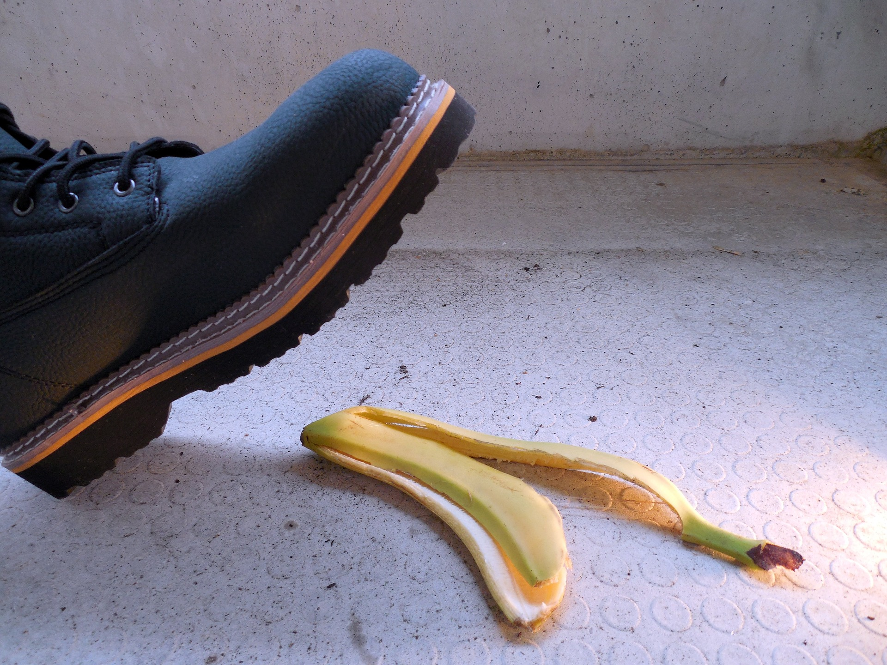

HOUSEKEEPING
Notes:
Housekeeping

Slide 3
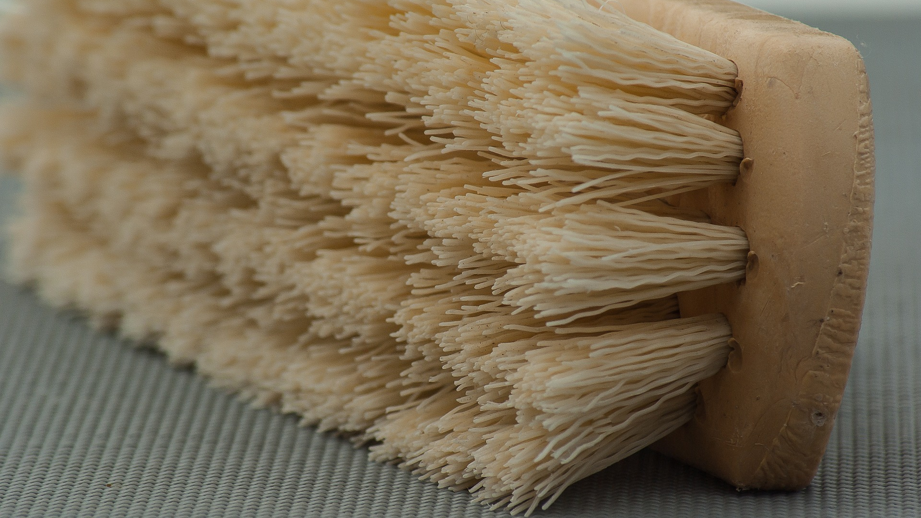
What’s at Stake?
Good housekeeping not only results in a cleaner workplace, but makes it safer as well. Good housekeeping reduces illnesses and injuries and promotes positive behaviors, habits, and attitudes.
Notes:
What’s At Stake?
Good housekeeping not only results in a cleaner workplace, but makes it safer as well. Good housekeeping reduces illnesses and injuries and promotes positive behaviors, habits, and attitudes. Employers are responsible for assessing each workplace before work begins to identify the potential hazards present, and determine ways to eliminate the hazards. An effective housekeeping program is an important element in workplace safety and health management systems.

Slide 4
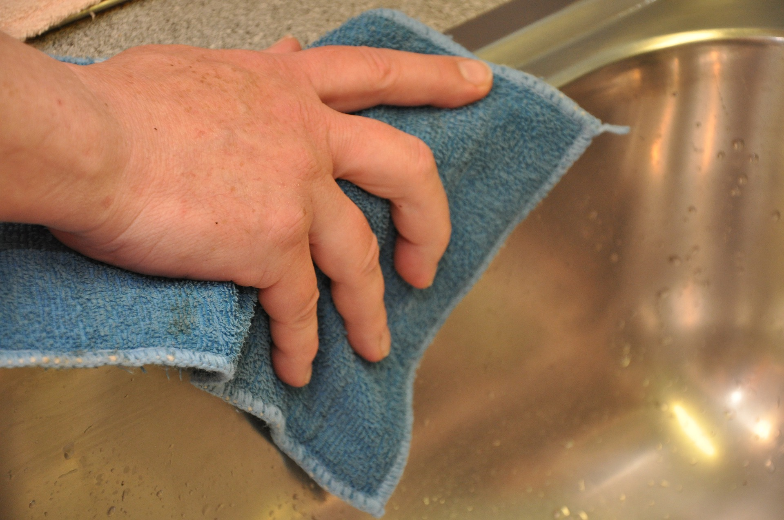
What’s the Danger?
EFFECTS OF POOR HOUSEKEEPING
TYPES OF HAZARDS RESULTING FROM POOR HOUSEKEEPING
Notes:
What’s The Danger?
Effects Of Poor Housekeeping
Housekeeping at work is as important as it is at home, especially if you want a safe workplace. People who must function every day in a messy, disorderly work environment have lower morale, although they may not be aware of the cause. But the safety ramifications of poor housekeeping in the workplace are even more important.
Poor housekeeping may result in employee injuries or even death, citations by the Occupational Safety and Health Administration (OSHA) (or another regulatory agency) and even difficulty in securing future work. How can such a seemingly “minor” issue such as housekeeping have such serious consequences?
Types Of Hazards Resulting From Poor Housekeeping
The injuries that result from poor work area conditions simply do not have to occur. These types of injuries are 100% preventable. Take time to evaluate your work areas today. Look for these three common hazard types. Take action to eliminate them so they do not have the chance to injure you or a coworker.

Slide 5
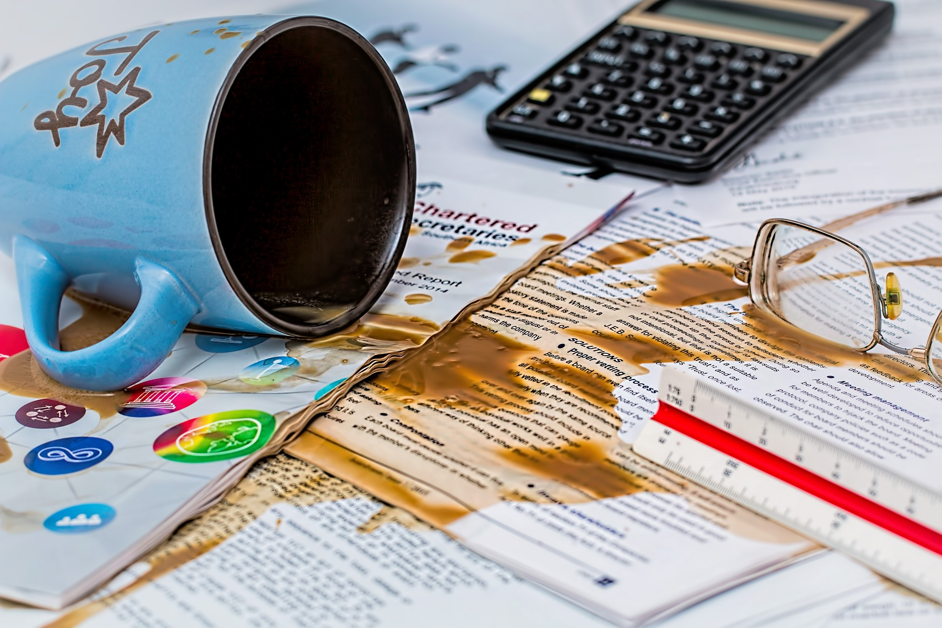
What’s the Danger?
THE HAZARDS
Slip, trip and fall hazards
Strain and sprain hazards
Laceration Hazards
Notes:
What’s the Danger?
The Hazards
Slip, trip, and fall hazards- One of the most common type of hazards created by poor housekeeping are slip, trip, and fall hazards. When objects, materials, tools, and equipment are not properly stored workers are bound to trip over them. Slippery conditions are created when water, moisture, oils, grease, etc. are left on the floor in work areas. Fall hazards are created when employees have to stand on make shift surfaces to reach items stored at higher levels.
Strain and sprain hazards- Sprain and strain injuries can result from slip, trip, and fall incidents. They also can occur when heavy items are not properly put away. When heavy or awkward objects are placed on the floor and need to be picked up by a worker it creates a risk for injury. Too often items have to be moved when there is poor housekeeping in a work area just for the sake of getting them out of the way. Because of unnecessary lifting, sprains and strains can occur.
Laceration hazards- Whether you are working in a construction or a manufacturing setting, there are plenty of sharp objects that can cut your hand or body. When items are not properly stored this creates a huge risk for laceration injuries. Sharp tools, jagged metal, sharp edged material, etc. can all easily cut through a glove or clothing and injure a worker

Slide 6
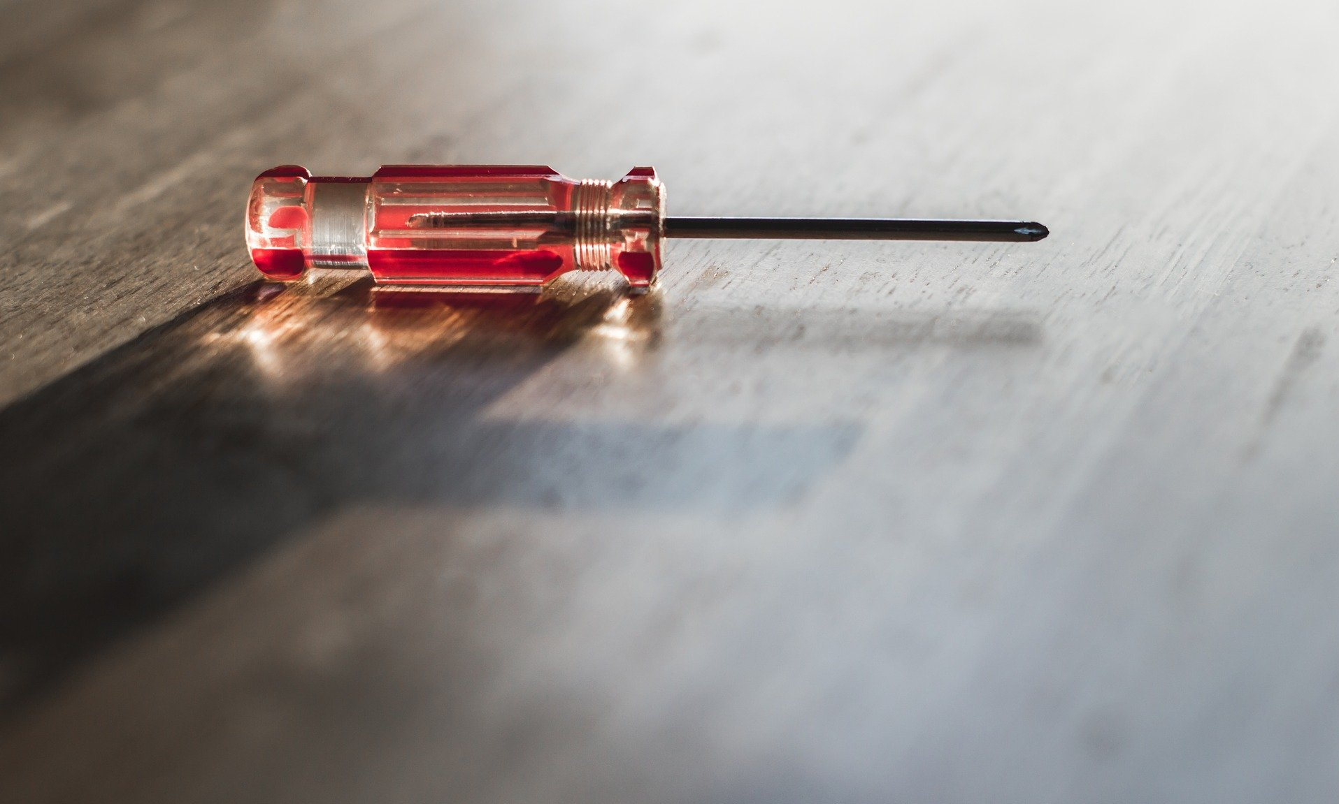
How to Protect Yourself
WHAT ARE THE ELEMENTS OF AN EFFECTIVE HOUSEKEEPING PROGRAM?
Maintenance
Dust and Dirt Removal
Employee Facilities
Surfaces
Maintain Light Fixtures
Notes:
How To Protect Yourself
What Are The Elements Of An Effective Housekeeping Program?
Maintenance
The maintenance of buildings and equipment may be the most important element of good housekeeping. Maintenance involves keeping buildings, equipment and machinery in safe, efficient working order and in good repair.
Dust and Dirt Removal
Enclosures and exhaust ventilation systems may fail to collect dust, dirt and chips adequately. Vacuum cleaners are suitable for removing light dust and dirt that is not otherwise hazardous. Special-purpose vacuums are useful for removing hazardous products.
Employee Facilities
Employee facilities need to be adequate, clean and well maintained. Lockers may be necessary for storing employees' personal belongings. Washroom facilities require cleaning once or more each shift. They also need to have a good supply of soap, towels plus disinfectants, if needed.
Surfaces
Floors: Poor floor conditions are a leading cause of incidents so cleaning up spilled oil and other liquids at once is important.
Walls: Light-coloured walls reflect light while dirty or dark-coloured walls absorb light. Contrasting colours warn of physical hazards and mark obstructions such as pillars.
Maintain Light Fixtures
Dirty light fixtures reduce essential light levels. Clean light fixtures can improve lighting efficiency significantly.

Slide 7
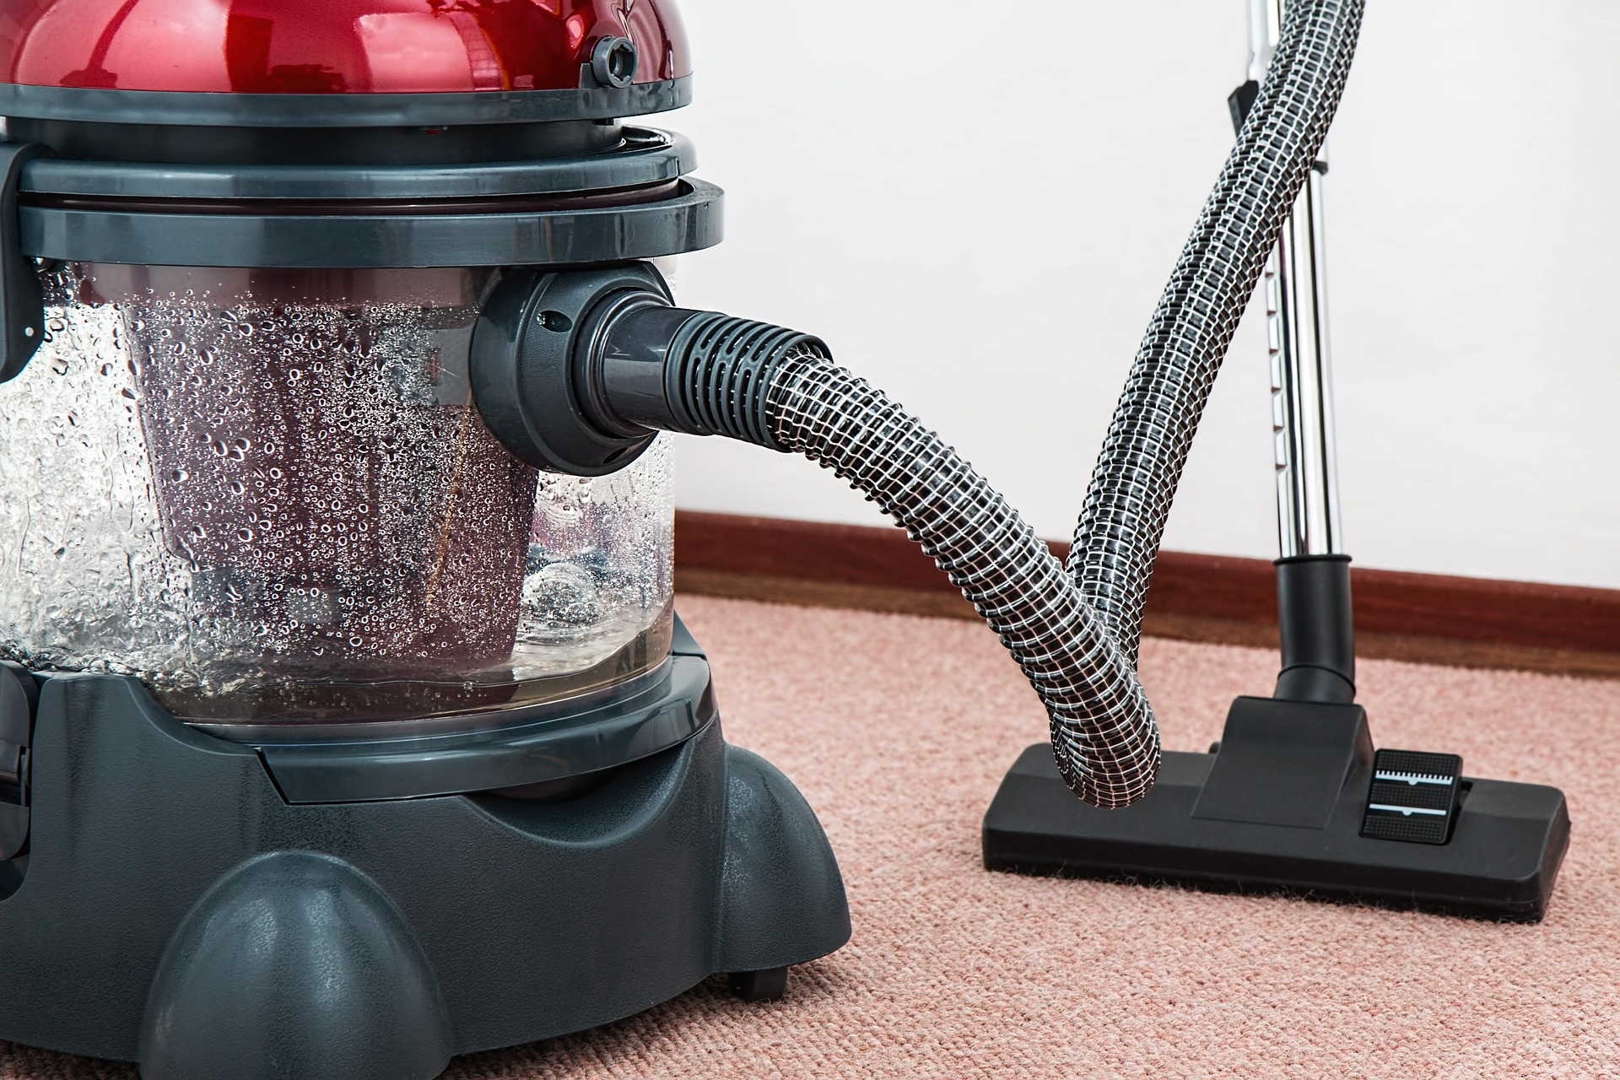
How to Protect Yourself
WHAT ARE THE ELEMENTS OF AN EFFECTIVE HOUSEKEEPING PROGRAM?
Aisles and Stairways
Spill Control
Tools and Equipment
Waste Disposal
Storage
Notes:
How to Protect Yourself
Aisles and Stairways
Aisles should be wide enough to accommodate people and vehicles comfortably and safely. Aisle space allows for the movement of people, products and materials. Warning signs and mirrors can improve sight-lines in blind corners. Arranging aisles properly encourages people to use them so that they do not take shortcuts through hazardous areas.
Spill Control
The best way to control spills is to stop them before they happen. Regularly cleaning and maintaining machines and equipment is one way. When spills do occur, it is important to clean them up immediately.
Tools and Equipment
Tool housekeeping is very important, whether in the tool room, on the rack, in the yard, or on the bench. Tools require suitable fixtures with marked locations to provide an orderly arrangement.
Waste Disposal
The regular collection, grading and sorting of scrap contribute to good housekeeping practices. It also makes it possible to separate materials that can be recycled from those going to waste disposal facilities.
Storage
Good organization of stored materials is essential for overcoming material storage problems whether on a temporary or permanent basis. There will also be fewer strain injuries if the amount of handling is reduced, especially if less manual material handling is required.
Stacking cartons and drums on a firm foundation and cross tying them, where necessary, reduces the chance of their movement. All storage areas should be clearly marked.
Flammable, combustible, toxic and other hazardous materials should be stored in approved containers in designated areas that are appropriate for the different hazards that they pose.

Slide 8
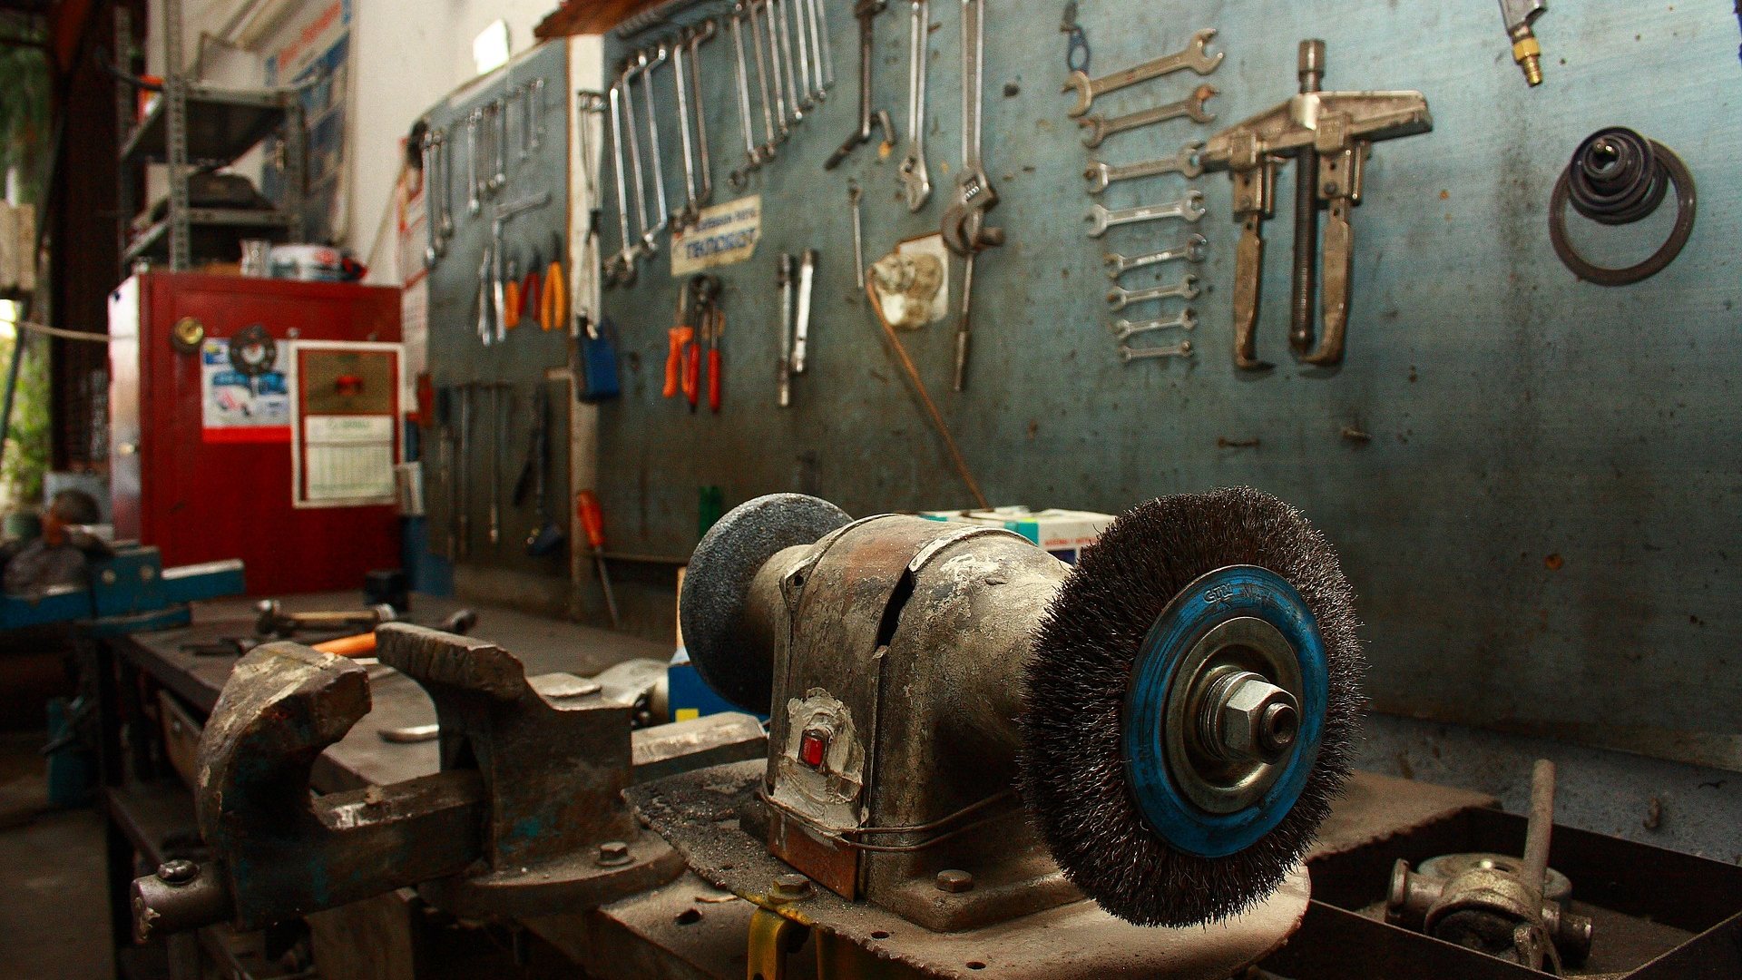
Final Word
Housekeeping is important in ensuring safety and productivity in the workplace. By keeping your workplace clean, you will be able to work easier and you will not have to deal with the frustrations of tripping over tools, equipment, or wasting time searching for something that was not put away in its proper place. Everyone must do their part if this is to succeed, so remember to help out and keep things clean.
Notes:
Final Word
Housekeeping is important in ensuring safety and productivity in the workplace. By keeping your workplace clean, you will be able to work easier and you will not have to deal with the frustrations of tripping over tools, equipment, or wasting time searching for something that was not put away in its proper place. Everyone must do their part if this is to succeed, so remember to help out and keep things clean.

