Slide 1

Click anywhere to get started…

Slide 2



HAZARD POINTS AND GUARDING ON FARM EQUIPMENT
Notes:
Hazard Points and Guarding on Farm Equipment

Slide 3
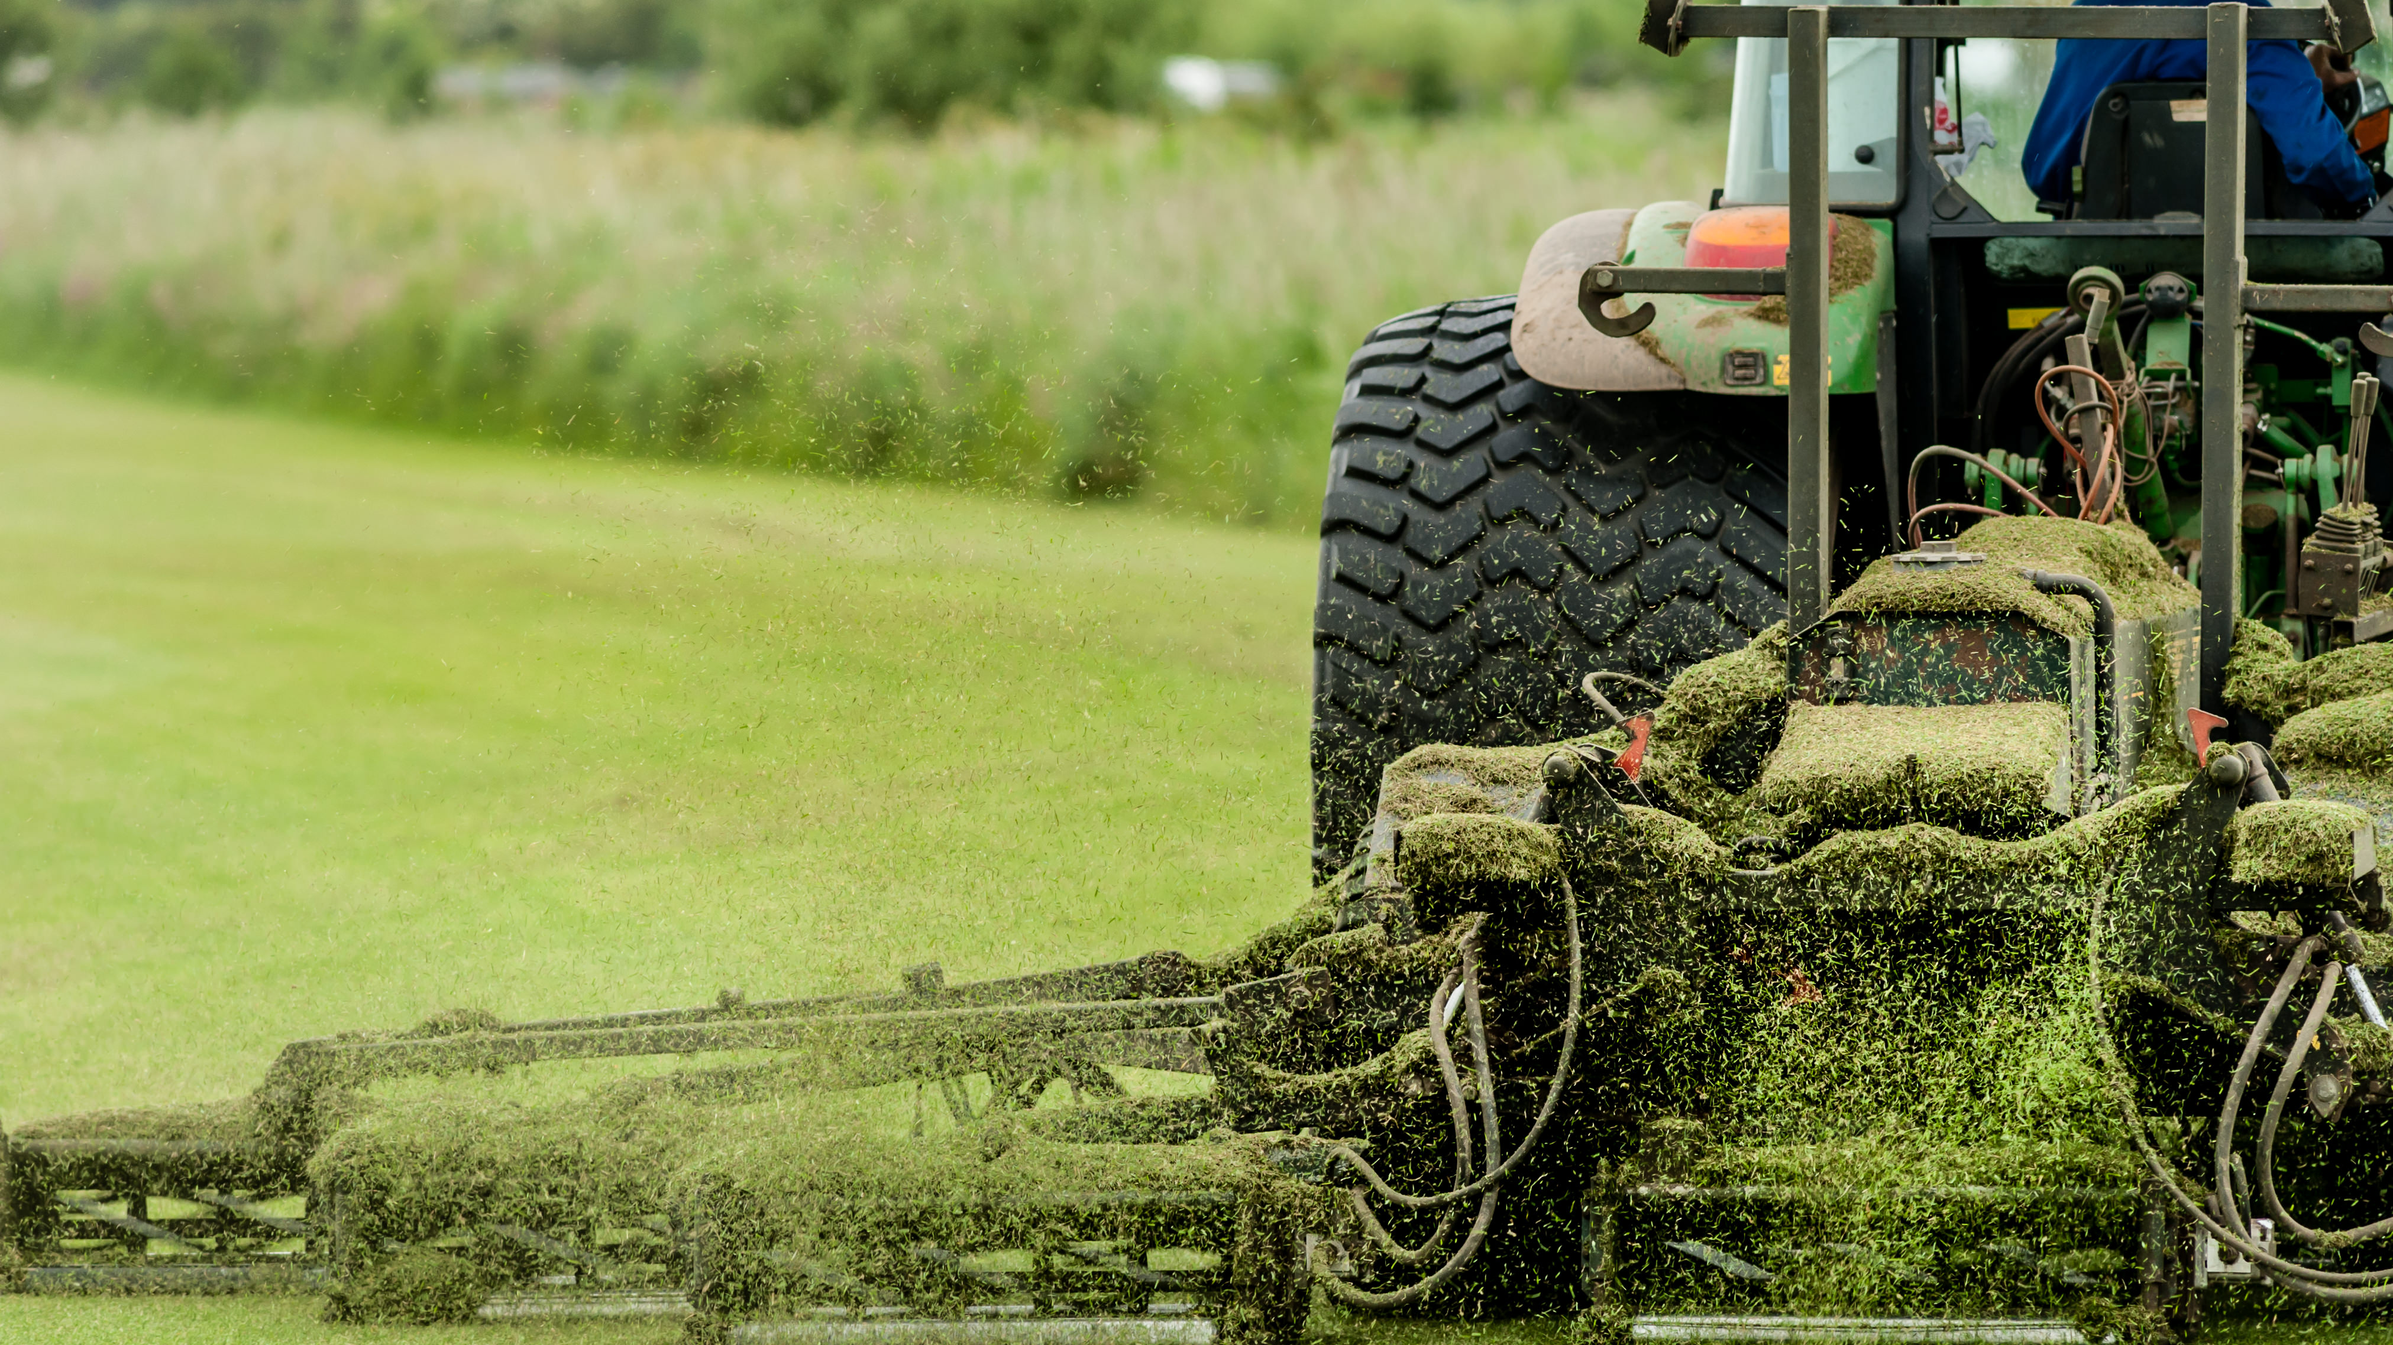
What’s at Stake?
Numerous farmers and farm workers have been injured or killed because guards were not installed or were improperly used. Guards and decals which identify the danger must be kept in place whenever the machine is operated.
Notes:
What’s at Stake?
Numerous farmers and farm workers have been injured or killed because guards were not installed or were improperly used. Guards and decals which identify the danger must be kept in place whenever the machine is operated. Guards or shields removed for maintenance must be properly replaced before use.

Slide 4
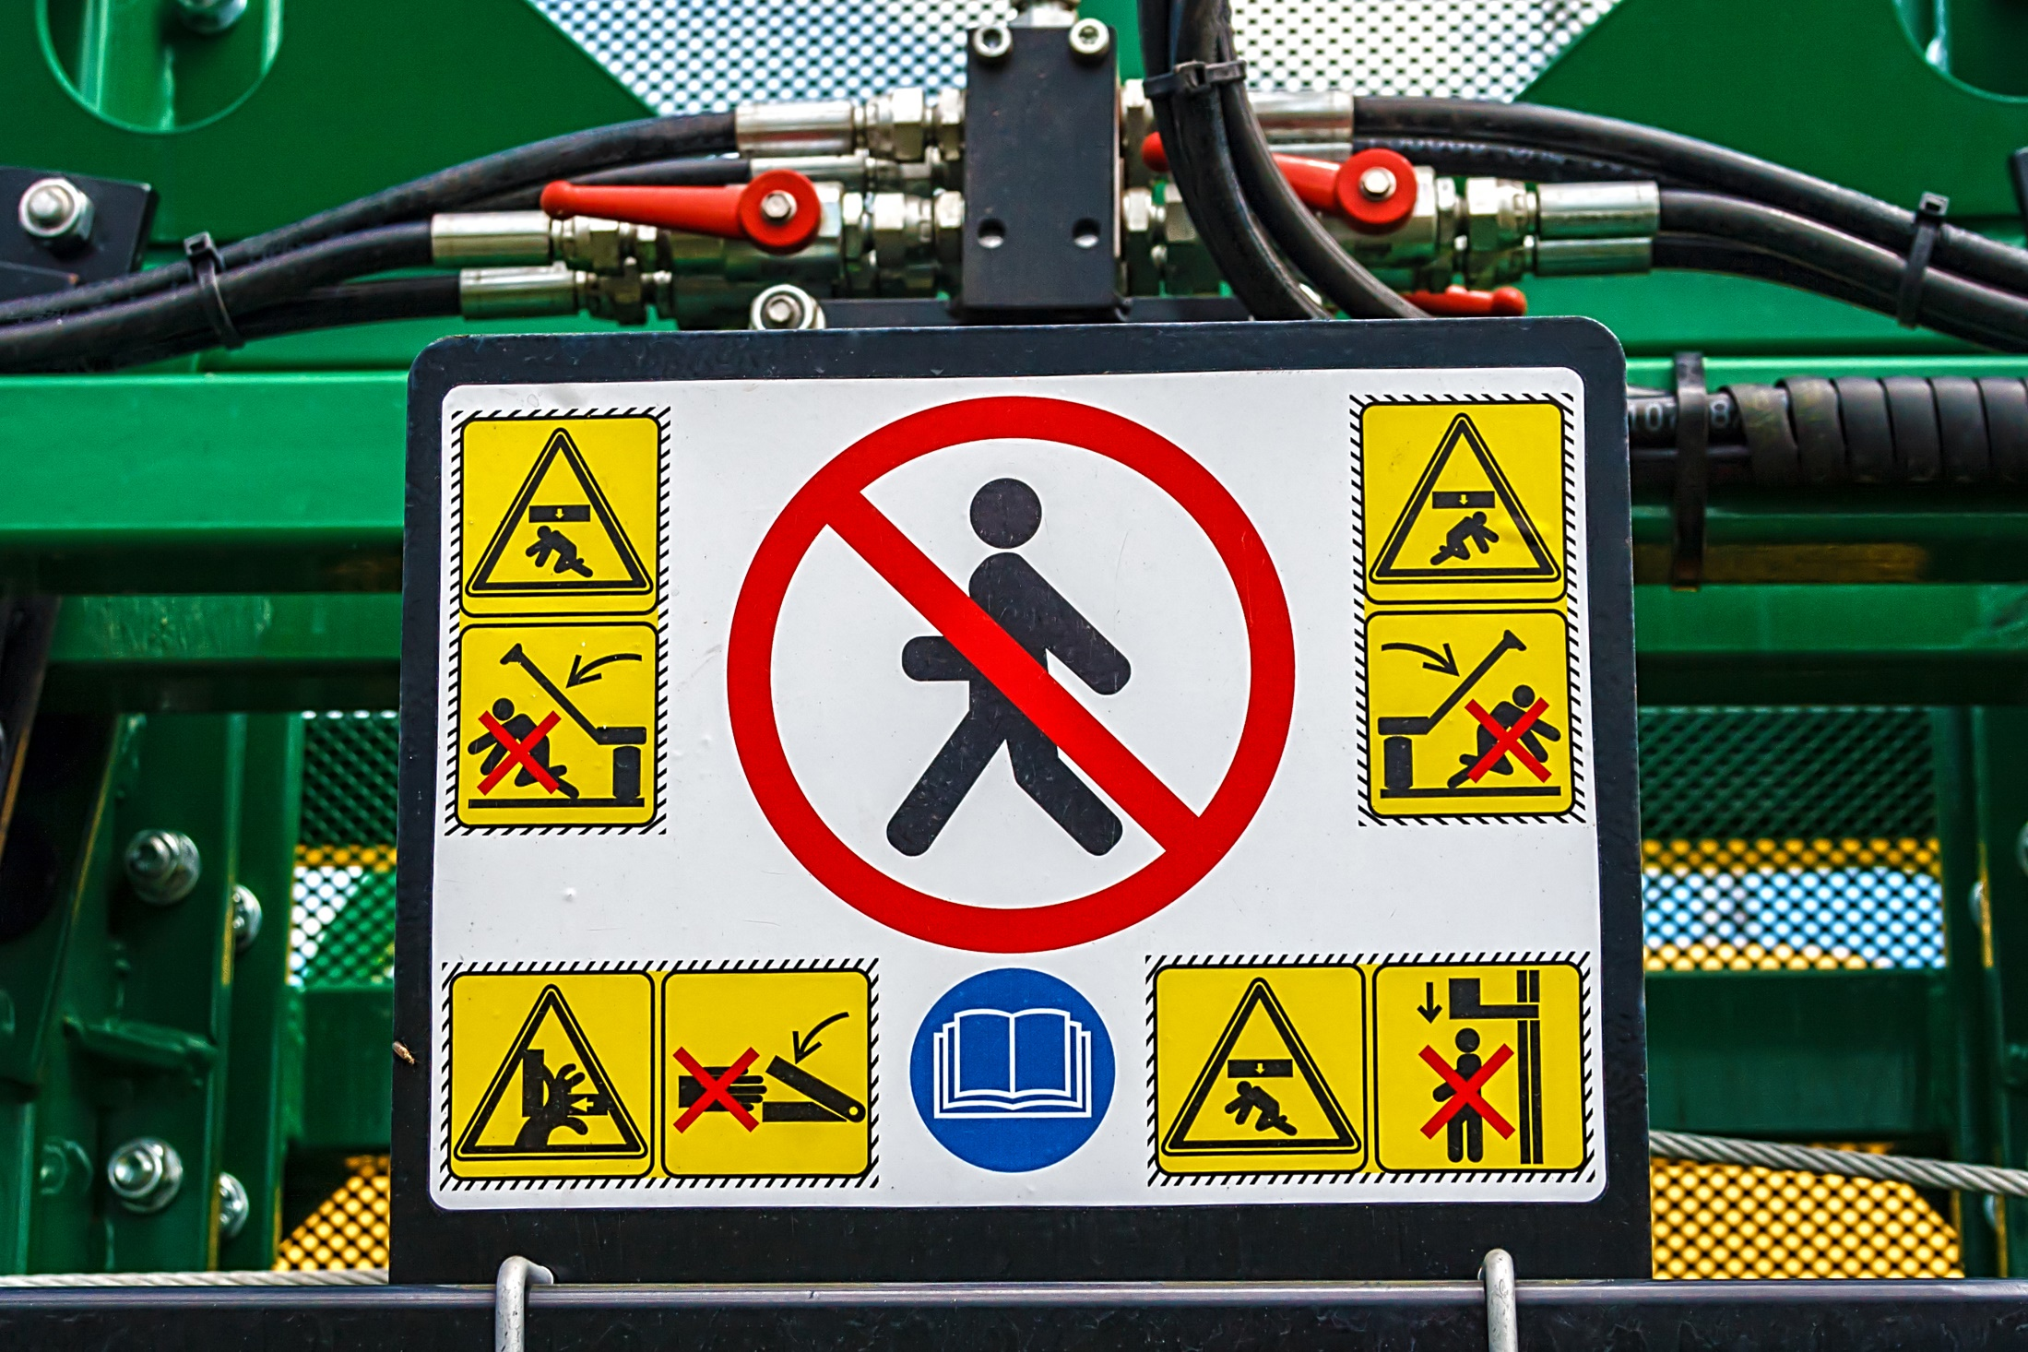
What’s the Danger?
HAZARDS / DANGERS OF FARM EQUIPMENT
THE MAIN HAZARDS ASSOCIATED WILL EXPOSURE TO THESE PARTS INCLUDE THE FOLLOWING:
Shear/cutting points
Pinch points
Wrap points
Crush points
Pull-in points
Free-wheeling parts
Springs
Hydraulic systems
Notes:
What’s the Danger?
HAZARDS / DANGERS OF FARM EQUIPMENT
cutting edges
gears
chains
levers
revolving shafts
rotating blades
THE MAIN HAZARDS ASSOCIATED WILL EXPOSURE TO THESE PARTS INCLUDE THE FOLLOWING:
Shear/cutting points
Shear points are created when the edges of two objects are moved close enough together to cut a material, as in the case of a pair of shears or an auger. Cutting points are created when a single object moves forcefully or rapidly enough to cut, as in the case of a sickle blade.
Shear points and cutting points are hazards because of their cutting force, and because they often move so rapidly that they may not be visible. Workers should be aware of shear points and shields or use guards to prevent exposure or access.
Pinch points
Pinch points form when two objects move together and at least one of them is moving in a circle. For example, the point at which a belt runs onto a pulley is a pinch point. Belt drives, chain drives and gear drives are other examples of pinch points in power transmission devices.
Body parts such as fingers, hands and feet can be caught directly in pinch points, or they may be drawn into the pinch points by loose clothing that becomes entangled. Workers should be aware of pinch points and shields or use guards to prevent exposure or access.
Wrap points
Rotating shafts are the most common source of wrap point accidents, although any exposed machine part that rotates can be a wrap point. Clothing or hair can catch on a rotating part.
The ends of shafts that protrude beyond bearings are also dangerous. Universal joints, keys and fastening devices can also snag clothing. Entanglement with a wrap point can pull a worker into the machine, or clothing may become tightly wrapped, crushing or suffocating a worker.
Workers who operate machinery should be aware of wrap points and should not wear loose clothing. In addition, operators should use shields or guards where possible to prevent access.
Crush points
Two objects can create crush points when they move toward each other or one object moves toward a stationary one. For example, hitching a tractor to an attachment may create a potential crush point and failure to block up equipment safely can result in a crushing injury.
Crushing injuries most commonly occur to fingers. To prevent a crushing injury, workers should be aware of crush points and wait until a tractor has stopped before stepping into the hitching area. Workers should also arrange the hitch point to back the tractor into position without a worker being in the path and should block any machine that can move before doing any work under or near it.
Pull-in points
Pull-in points usually occur when plant material or other obstacles become stuck in feed rolls or other machinery parts, preventing the mechanism from operating. A worker trying to free such material without shutting down or locking out the power can be rapidly pulled into the mechanism when the material is freed.
Free-wheeling parts
Many machine parts continue to spin after the power is either shut off or locked out. Workers should not start repair or maintenance work until all parts have stopped moving, even if equipment is locked out. This may take a few minutes.
Examples of free-wheeling parts include:
cutter heads of forage harvesters
hammer mills of feed grinders
rotary mower blades/fans
flywheels
Springs
Springs are commonly used to help lift equipment such as shock absorbers and to keep belts tight and may harbour potentially dangerous stored energy. Springs under compression will expand with great force when released while stretched springs will contract rapidly when released.
A worker should know in which direction a spring will move and how it might affect another machine part when released and stay out of its path.
Hydraulic systems
Hydraulic systems store considerable energy and are used to:
lift and change the position of attachments
operate hydraulic motors
assist in steering and braking
Leaks from hydraulic systems are a serious hazard because of the high pressure and temperature of the fluid contained in the system. Even fine jets of hydraulic fluid can burn or pierce skin and tissue.

Slide 5
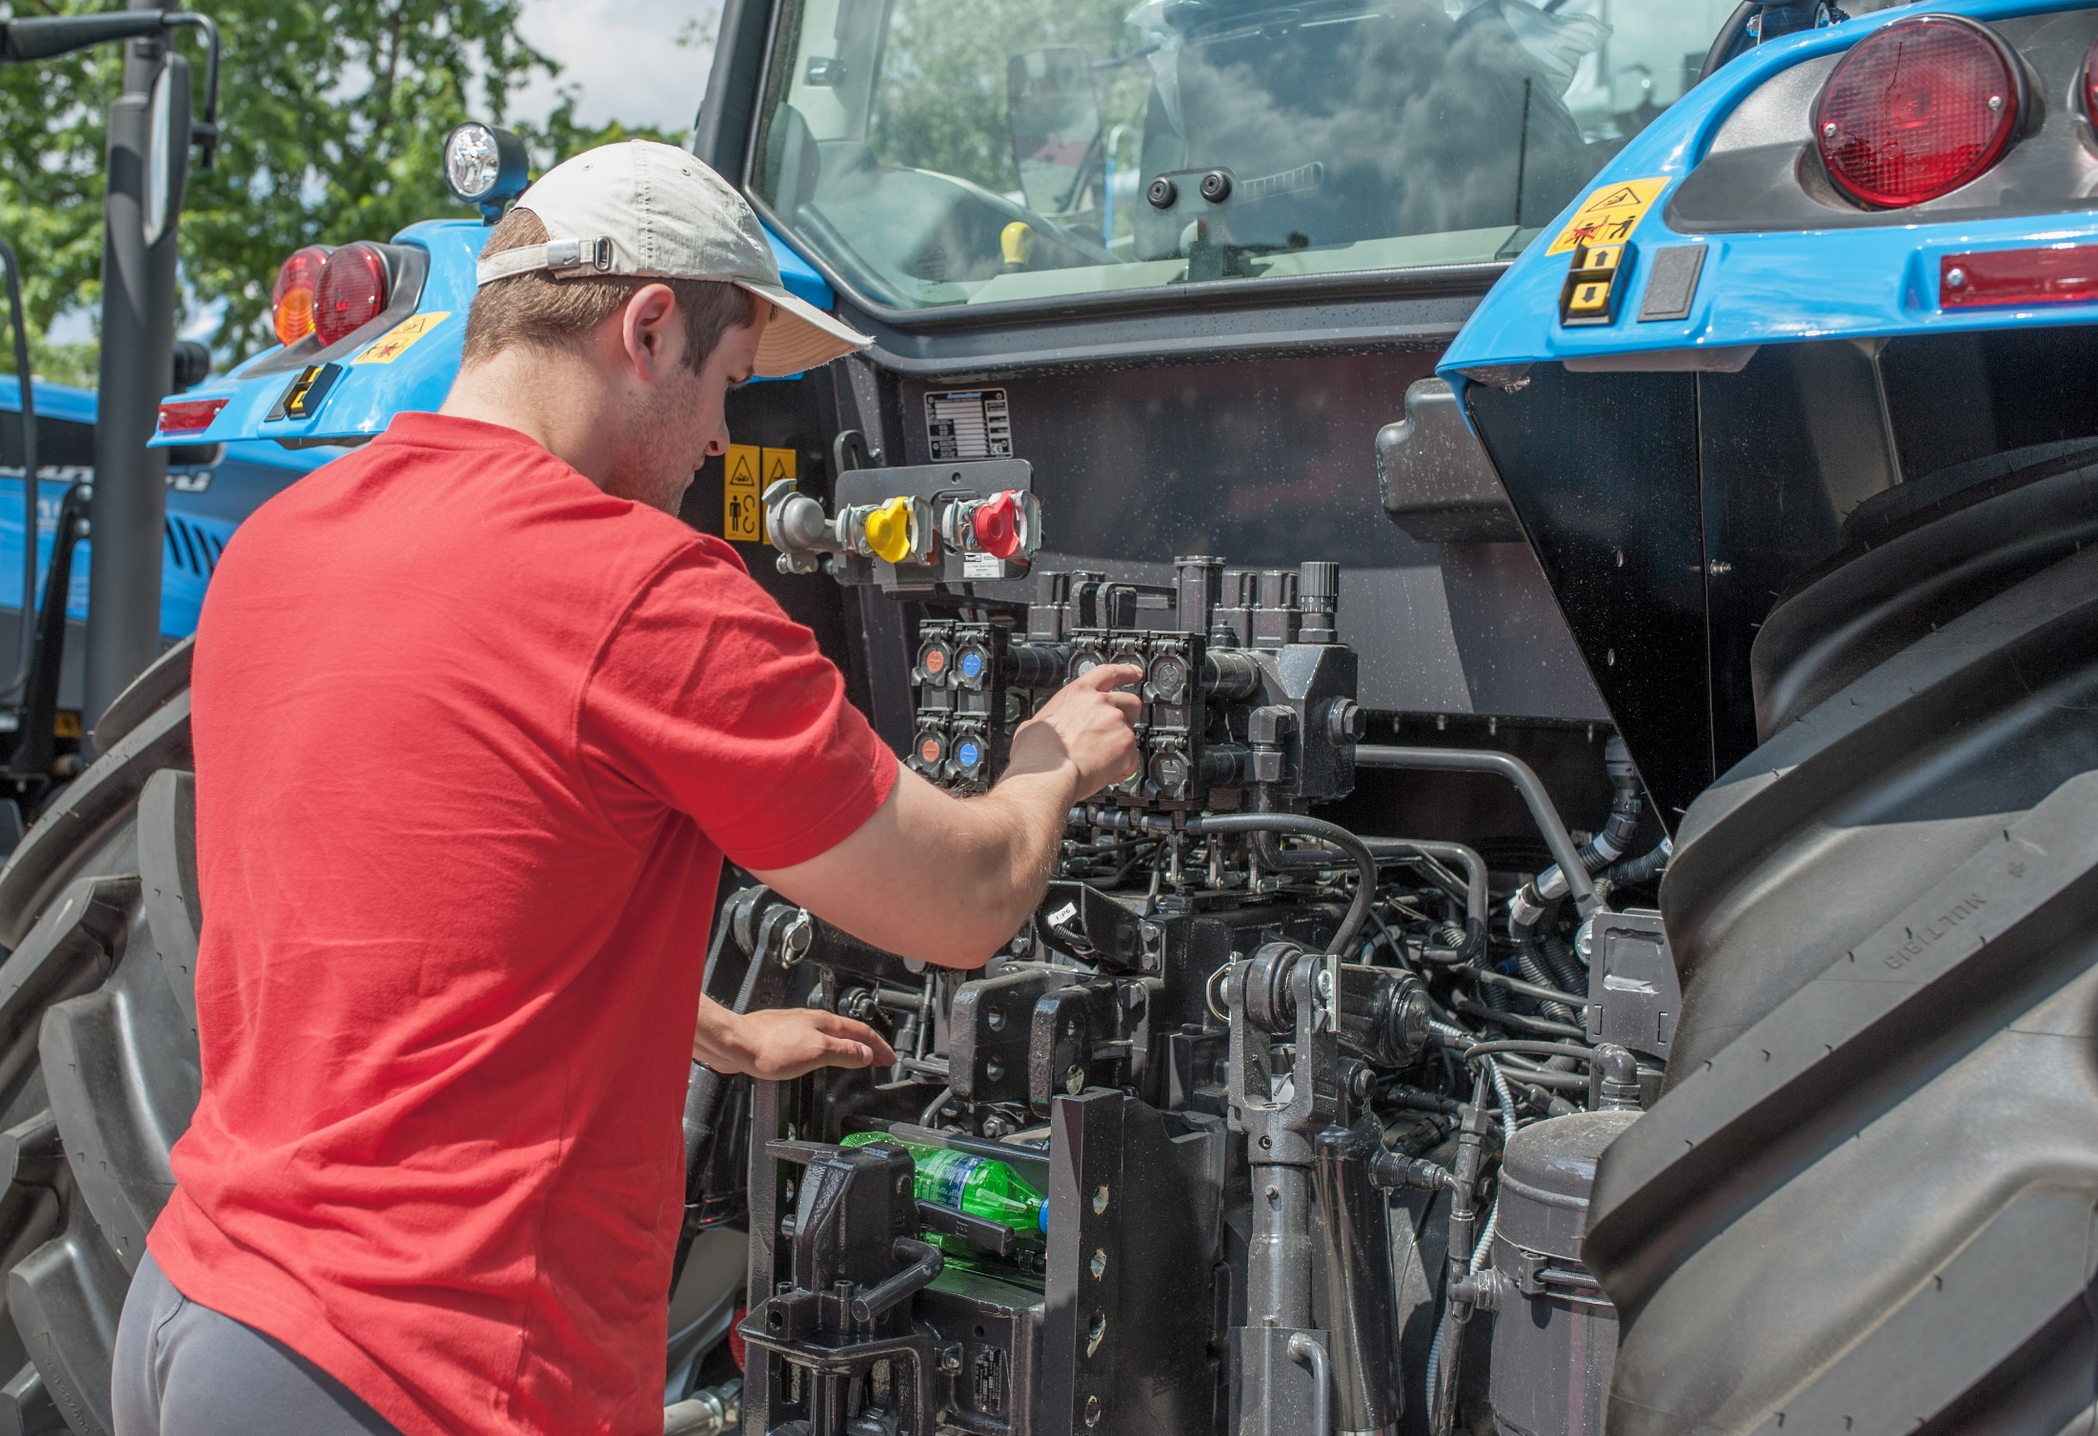
How to Protect Yourself
THE CDC FARM CHECKLIST FOR GUARDING EQUIPMENT
A. Guarding Farm Equipment
The Questions
Note: Exceptions to this requirement are as follows:
The equipment must be running to be properly serviced or maintained.
The equipment cannot be serviced or maintained while a guard or guards required by this standard are in place.
The servicing or maintenance can be safely performed.
Notes:
How to Protect Yourself
THE CDC FARM CHECKLIST FOR GUARDING EQUIPMENT
A. Guarding Farm Equipment
The Questions
Have operating instructions been provided at the time of initial assignment and at least annually thereafter to all who come in contact with covered equipment? Do instructions discuss the safe operation and servicing of all farm equipment and include at least the following practices?
Keep all guards in place when the machine is in operation.
Permit no riders on farm field equipment other than those required for instruction or assistance in machine operation.
Stop engine, disconnect the power source and wait for all machine movement to stop before servicing, adjusting, cleaning or unclogging the equipment.
Make sure everyone is clear of machinery before starting the engine, engaging power or operating the machine.
Lock out electrical power before performing maintenance or service work on farmstead equipment.
Have all workers been protected against contact with the hazards created by moving machine parts by either of the following methods?
Through the installation and use of a guard or shield or guarding by location.
By a guardrail or fence whenever a guard or shield or guarding by location is not possible.
When guards are used to provide protection required by this section, are they designed and located to protect against contact with the hazard being guarded?
Unless otherwise specified, is each guard and its support capable of withstanding the force that a 250-pound person, leaning on or falling against the guard, would exert on that guard?
Are all guards free from burrs, sharp edges and sharp corners, and securely fastened to the equipment or building?
Whenever a moving machinery part presents a hazard during servicing or maintenance, is the engine stopped, the power source disconnected, and all machine movement stopped before servicing or maintenance is performed?
Note: Exceptions to this requirement are as follows:
The equipment must be running to be properly serviced or maintained.
The equipment cannot be serviced or maintained while a guard or guards required by this standard are in place.
The servicing or maintenance can be safely performed.

Slide 6
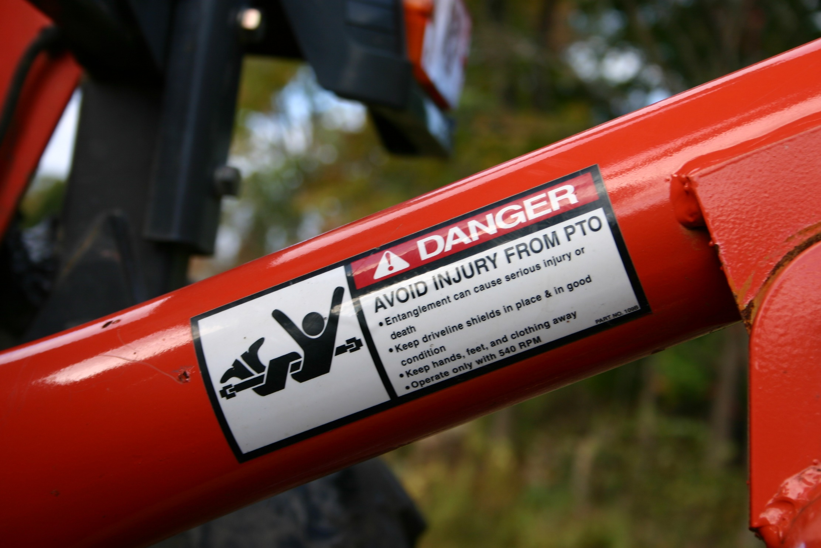
How to Protect Yourself
B. Farm Field Equipment
The Questions
C. Farmstead Equipment
The Questions
Employer responsibilities
As an employer on a farming operation, you have an obligation to protect the health and safety of your workers.
More Responsibilities
Employers should develop and use Lockout procedures for each piece of equipment to ensure that power is disconnected during repairs or adjustments to the equipment.
Notes:
How to Protect Yourself
B. Farm Field Equipment
The Questions
Are all power take-off shafts, including rear-, mid- and side- mounted shafts, guarded either by a master shield or by other protective guarding?
Are all tractors equipped with an agricultural tractor master shield on the rear power take-off, except when the design of the power take-off driven equipment requires removal of the shield?
Does the master shield have sufficient strength to prevent permanent deformation of the shield when a 250-pound operator mounts or dismounts the tractor using the shield as a step?
Is power take-off-driven equipment guarded to protect against employee contact with positively driven rotating members of the power-drive system, including the portion of the tractor power take-off shaft that protrudes from the tractor if the master shield is removed?
Do signs placed at prominent locations on tractors and power take-off-driven equipment specify that power take-off-driven system safety shields must be kept in place?
Is the mesh or nip points of all power-driven gears, belts, chains, sheaves, pulleys, sprockets and idlers guarded?
Are all revolving shafts, including projections such as bolts, keys or set screws guarded, except smooth shaft ends protruding less than one-half the outside diameter of the shaft and its locking means?
Are ground-driven components guarded?
Are the following components, which must be exposed for proper function, guarded as much as possible in a manner that will not interfere with normal functioning of the component? Choppers, snapping or husking rolls, straw spreaders and choppers, cutterbars, flail rotors, rotary beaters, mixing augers, feed rolls, conveying augers, rotary tillers, rotary beaters, mixing augers, feed rolls, conveying augers, grain spreaders, stirring augers, sweep augers and feed augers.
Are guards, shields and access doors in place when equipment is in operation?
If removal of a guard or access door will expose a person to any component that continues to rotate after the power is disengaged, has the employer provided, in the immediate area, the following?
A readily visible or audible warning of rotation.
A safety sign warning the worker to:
Look and listen for evidence of rotation, and
Not remove the guard or access door until all components have stopped.
C. Farmstead Equipment
The Questions
Are all power take-off shafts, including rear-, mid- and side-mounted shafts, guarded either by a master shield or other protective guarding?
Is power take-off-driven equipment guarded to protect against contact with positively driven rotating members of the power-drive system?
If power take-off-driven equipment is of a design requiring removal of the tractor master shield, does the equipment also include protection for that portion of the tractor take-off shaft that protrudes from the tractor?
Are signs placed at prominent locations on power take-off-driven equipment specifying that power-driven system safety shields must be kept in place?
Are all revolving shafts, including projections such as bolts, keys and set screws, guarded?
Are sweep-arm material-gathering mechanisms used on top surfaces of materials within silo structures guarded?
Is the lower or leading edge of the guard located no more than 12 inches above the material surface and no less than 6 inches in front of the leading edge of a rotating member of the gathering mechanism?
Is the guard parallel to, and extended to the fullest practical length of, the material-gathering mechanism?
Is exposed auger flighting on portable grain augers guarded with either grating type guards or solid baffle-style covers as follows?
The largest dimension or opening in grating-type guards through which materials are required to flow shall be 4 ¾ inches. The area of each opening shall be no larger than 10 square inches. The opening shall be located no closer to the rotating flighting than 2 ½ inches.
Slotted openings in solid baffle-style covers shall be no wider than 1 ½ inches or closer than 3 ½ inches to the exposed flighting.
Are guards, shields and access doors in place when the equipment is in operation?
Is the application of electrical power from a location not under the immediate and exclusive control of the person maintaining or servicing the equipment prevented by one of the following methods?
Providing an exclusive, positive locking means on the main switch that can be operated only by the worker or workers performing the maintenance or servicing.
In the case of material handling equipment located in a bulk storage structure, by physically locating on the equipment an electrical or mechanical means to disconnect the power.
Employer responsibilities
As an employer on a farming operation, you have an obligation to protect the health and safety of your workers. If you have workers operating farm equipment this obligation includes:
providing information, instruction and supervision to workers
maintaining equipment in good condition
making sure all safety devices are operational
maintain records of inspection of safety devices
advise the operator to use farm equipment for its intended purpose, as specified by the manufacturer and outlined in the operator's manual
If farm equipment is modified, you and your operator should consider how the modifications affect the safe operation of the equipment.
All safety decals attached to a tractor should be visible and easy to read. Replace damaged or missing safety decals with new ones, if available.
More Responsibilities
Employers should develop and use Lockout procedures for each piece of equipment to ensure that power is disconnected during repairs or adjustments to the equipment. Equipment should be locked out before shields or guards are removed for maintenance purposes. Shields and guards should be re-installed before work is started again.
Guards
If using a shield or guard prevents a piece of farm equipment from performing its intended purpose, employers should guard against the hazard as much as possible and use additional measures to protect workers. Examples of additional measures include:
installing a warning device such as an alarm
developing alternate work procedures that allow workers to perform the task safely
providing personal protective equipment

Slide 7
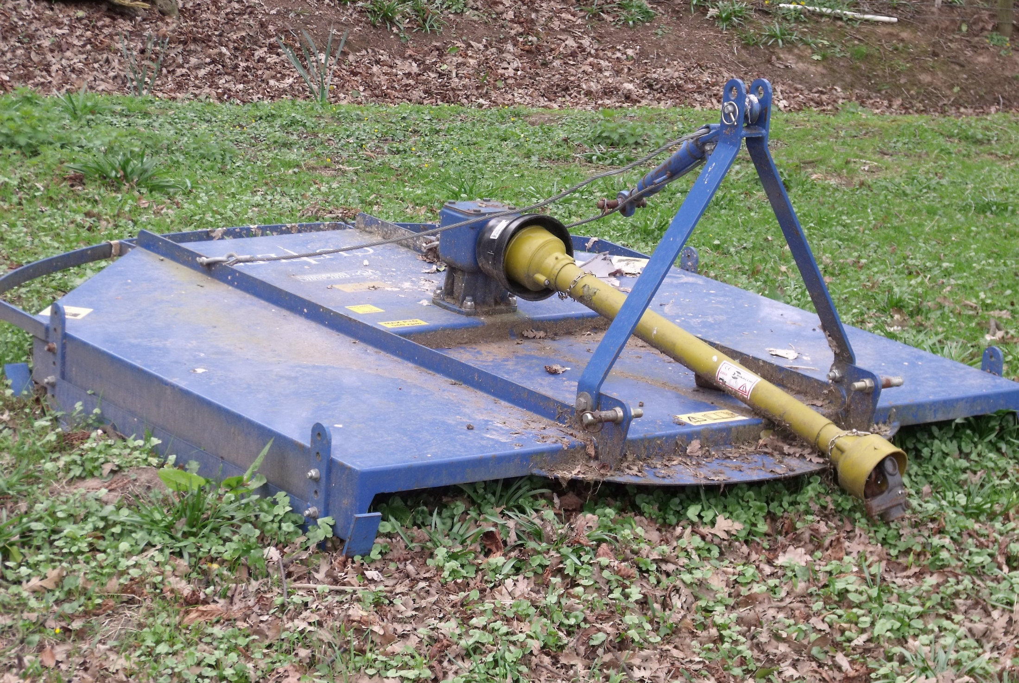
How to Protect Yourself
Workers Responsibilities
never inspect hydraulic hoses with their hands
wear long sleeves, heavy gloves and safety glasses when checking for leaks
always follow the instructions in the operator's manual because the specific procedures for servicing these systems are very important for one's safety
Notes:
How to Protect Yourself
Workers Responsibilities
never inspect hydraulic hoses with their hands
wear long sleeves, heavy gloves and safety glasses when checking for leaks
always follow the instructions in the operator's manual because the specific procedures for servicing these systems are very important for one's safety
Where appropriate, a properly qualified and certified mechanic should perform repairs and maintenance. Workers should not perform work under raised hydraulic equipment.

Slide 8
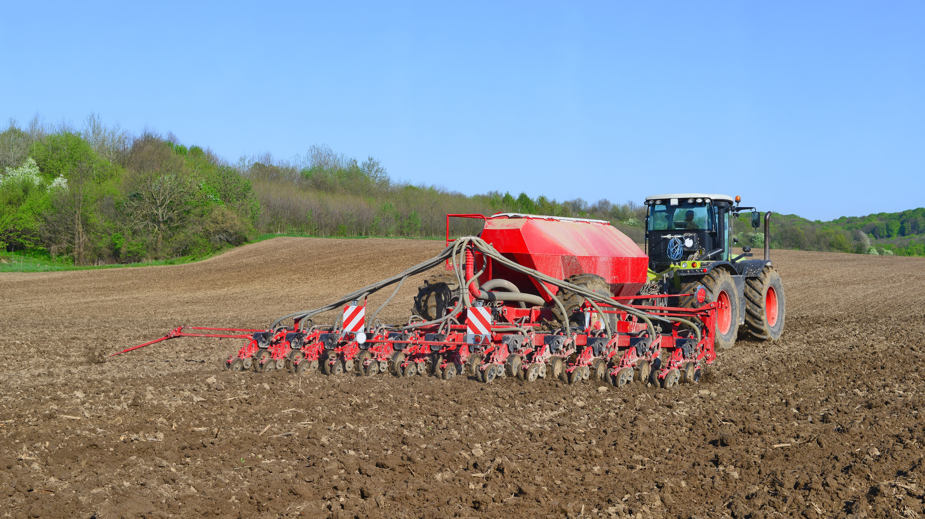
Final Word
Working around moving parts on farm equipment can be very dangerous if safe work procedures are not followed. Machinery guards when they are in place and properly maintained, provide a physical barrier to the hazard points and reduce the risk of injury.
Notes:
Final Word
Working around moving parts on farm equipment can be very dangerous if safe work procedures are not followed. Machinery guards when they are in place and properly maintained, provide a physical barrier to the hazard points and reduce the risk of injury.

