Slide 1

Click anywhere to get started…

Slide 2

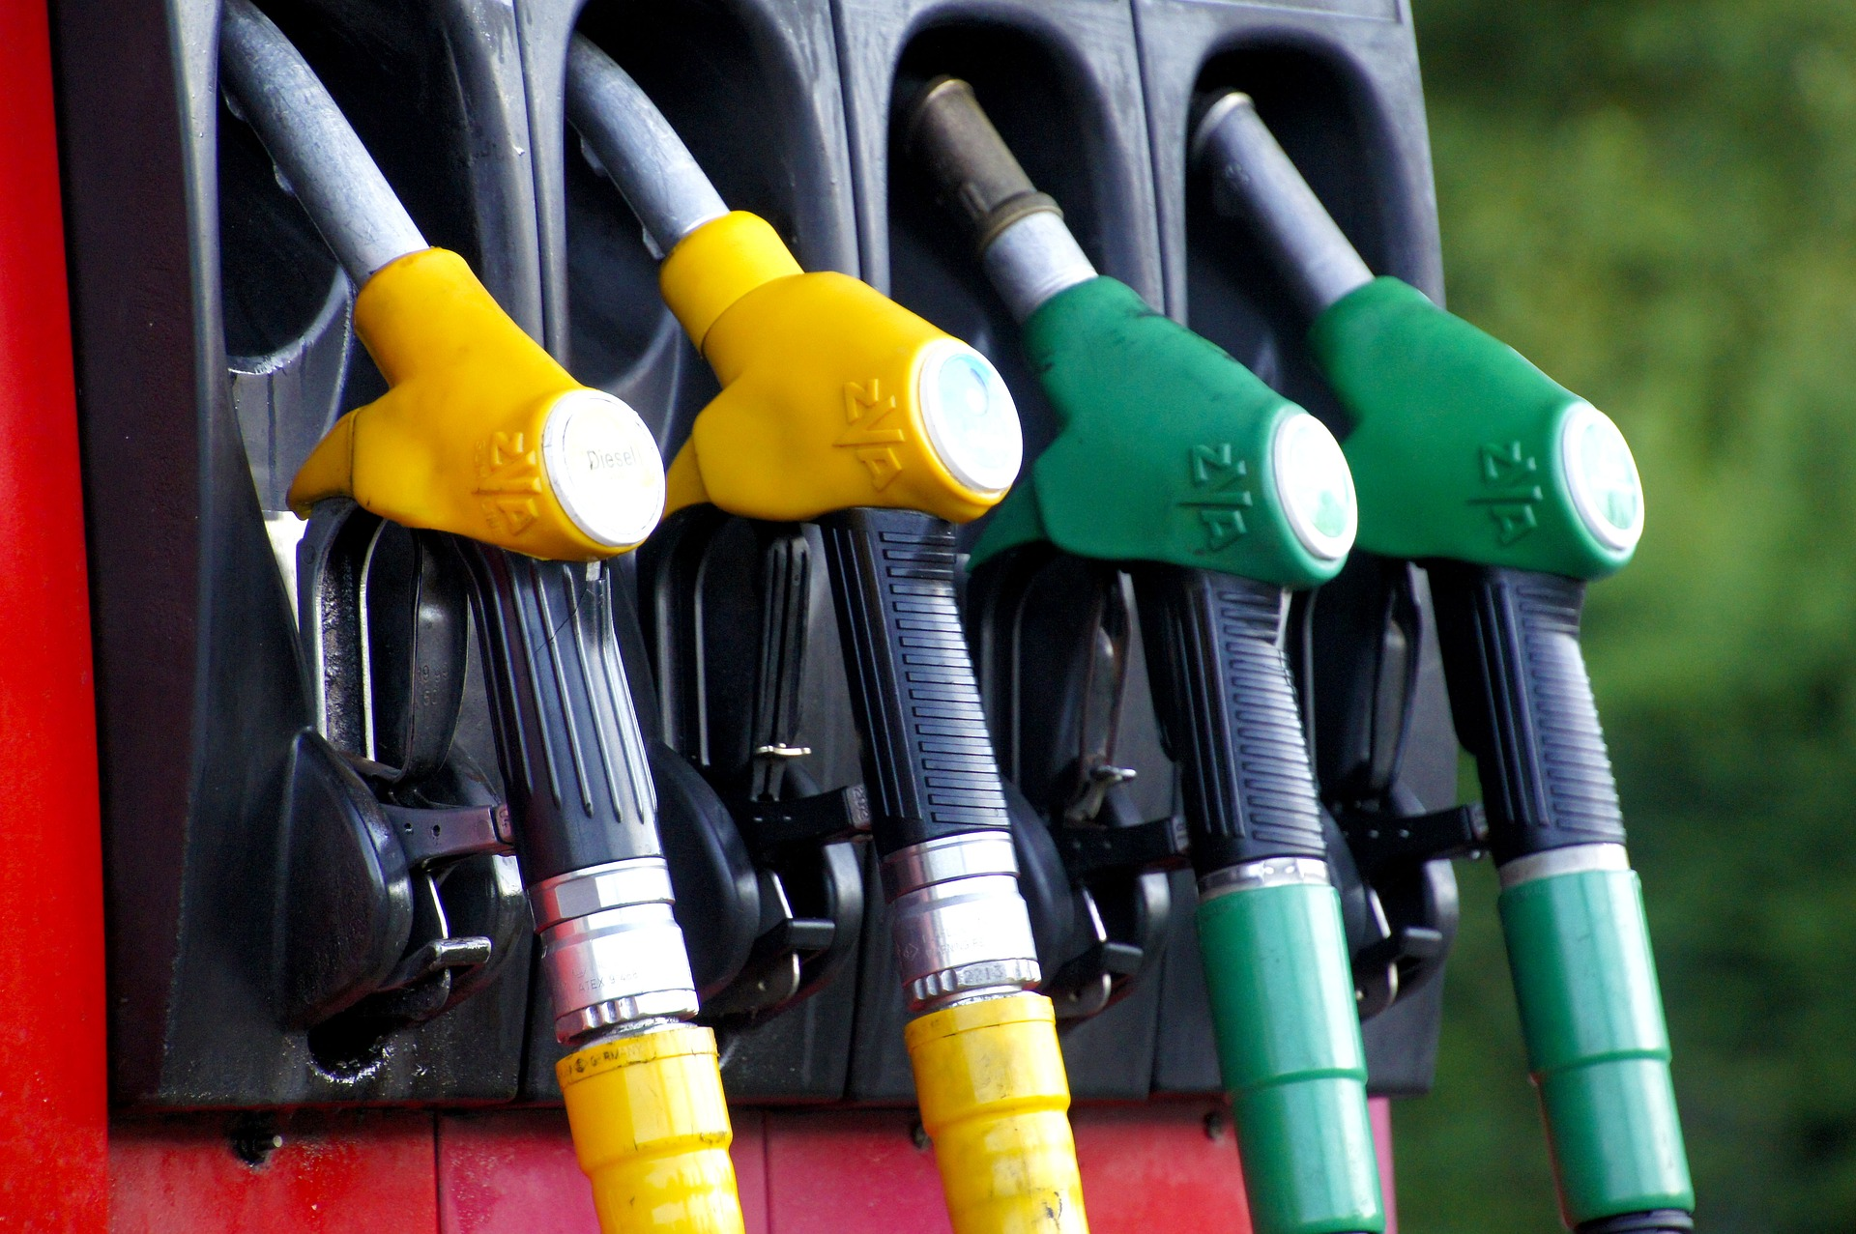

IGNITION SOURCES DURING FUELING
Notes:
Ignition Sources During Fueling

Slide 3
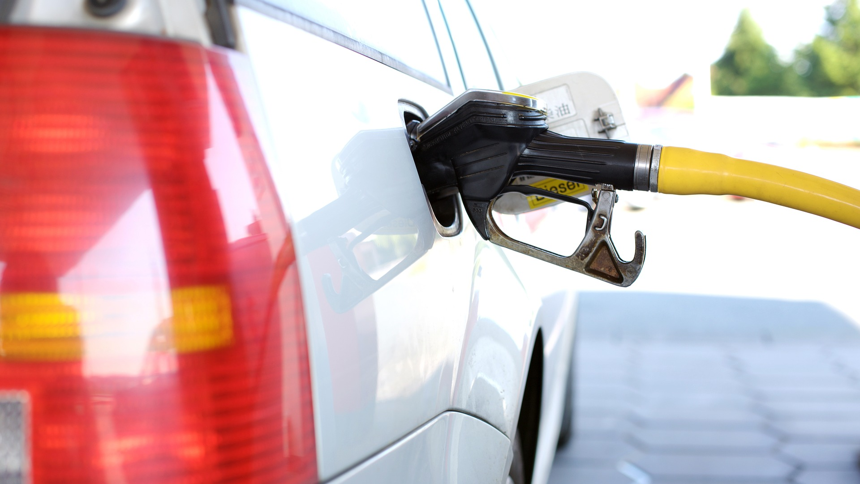
What’s at Stake?
Workplaces have flammable liquids. They include fuel, common cleaning agents, solvents, paints, coxes and polishes. Naked flames or burning cigarettes are obvious ignition sources, but it's important to be mindful of other sources, like static electricity generated from electronics.
Notes:
What’s at Stake?
Workplaces have flammable liquids. They include fuel, common cleaning agents, solvents, points, coxes and polishes. Naked flames or burning cigarettes are obvious ignition sources but it can include static electricity generated from electronics including cellphones.

Slide 4

What’s the Danger?
Internal combustion engines, whether fueled by gasoline, diesel, propane, natural gas, or other fuels, can act as ignition sources.
Examples:
Other Ignition Sources – Mobile Phones
Notes:
What’s the Danger?
Internal combustion engines, whether fueled by gasoline, diesel, propane, natural gas, or other fuels, can act as ignition sources.
Examples:
Stationary engines such as compressors, generators and pumps.
Mobile equipment or transports such as vans, trucks, forklifts, cranes, well servicing equipment, drilling rigs, excavators, portable generators and welding trucks.
Contractor vehicles and motorized equipment.
Emergency response vehicles such as fire engines and ambulances.
Vehicle-mounted engines on vacuum trucks, tanker trucks and waste haulers.
Small portable engines such as mowers, blowers, generators, compressors, welders and pumps. This includes hand tools unrelated to a process, such as chain saws, brought in by contractors.
Cell phone use in operating areas, propylene oxide handling and storage area, propane, gas and refueling areas.
Fuel-rich conditions in an engine can result in incomplete combustion.
When uncombusted fuel from the cylinders enters the exhaust system, it can ignite due to the hot surface, discharging sparks and flames (backfire). These can ignite flammable vapors and gases in the surrounding area.
Other Ignition Sources – Mobile Phones
Mobile phones that light up when switched on or when they ring release enough energy to provide a spark for ignition
Mobile phones should not be used in filling stations, or when fueling lawn mowers, boat, etc.
Mobile phones should not be used, or should be turned off, around other materials that generate flammable or explosive fumes or dust, (I.e., solvents, chemicals, gases, grain dust, etc...)

Slide 5
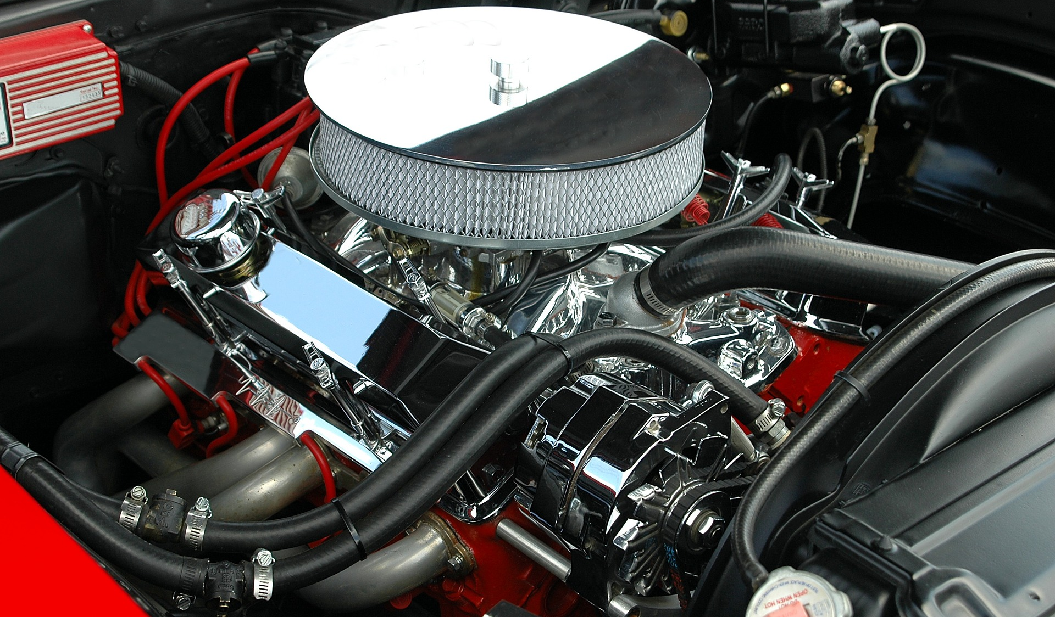
What’s the Danger?
INTERNAL COMBUSTION ENGINES
Changes in the fuelto-air ratio create ignition hazards by
Elevating engine operating temperatures
Notes:
INTERNAL COMBUSTION ENGINES
Internal combustion engines require a specific fuelto-air ratio to work properly. Air enters the engine through the intake that leads to the combustion chambers (cylinders). If employers allow internal combustion engines in areas where flammable vapors or gases exist, then the vapors and gases can enter the cylinders of the engine along with the air. Additional flammable material in the cylinders provides an external fuel source and increases the fuel-to-air ratio in the engine.
Changes in the fuelto-air ratio create ignition hazards by:
Elevating engine operating temperatures.
Increasing the fuel-to-air ratio causes an increase in the energy output which results in increased surface and exhaust temperatures. Internal Combustion Engines as Ignition Sources Internal combustion engines present an ignition hazard when used in facilities processing flammable liquids and gases. If flammable vapors or gases are released in these facilities, an internal combustion engine could ignite the flammable materials with catastrophic consequences. Investigations by OSHA and the U.S. Chemical Safety Board (CSB) document a history of fires and explosions at workplaces (oilfields, refineries, chemical plants, and other facilities) where an internal combustion engine was identified as or suspected to be the source of ignition.1 Increasing the fuel-to-air ratio also causes pre-ignition within internal combustion engines. Pre-ignition occurs when a fuel-rich mixture in the cylinder ignites before the spark plug fires. Pre-ignition creates damaging pressure surges and higher engine surface and exhaust system temperatures. If the temperature of the surface of the engine in contact with the fuel/air mixture reaches the autoignition temperature of that mixture, a fire or explosion will occur.

Slide 6
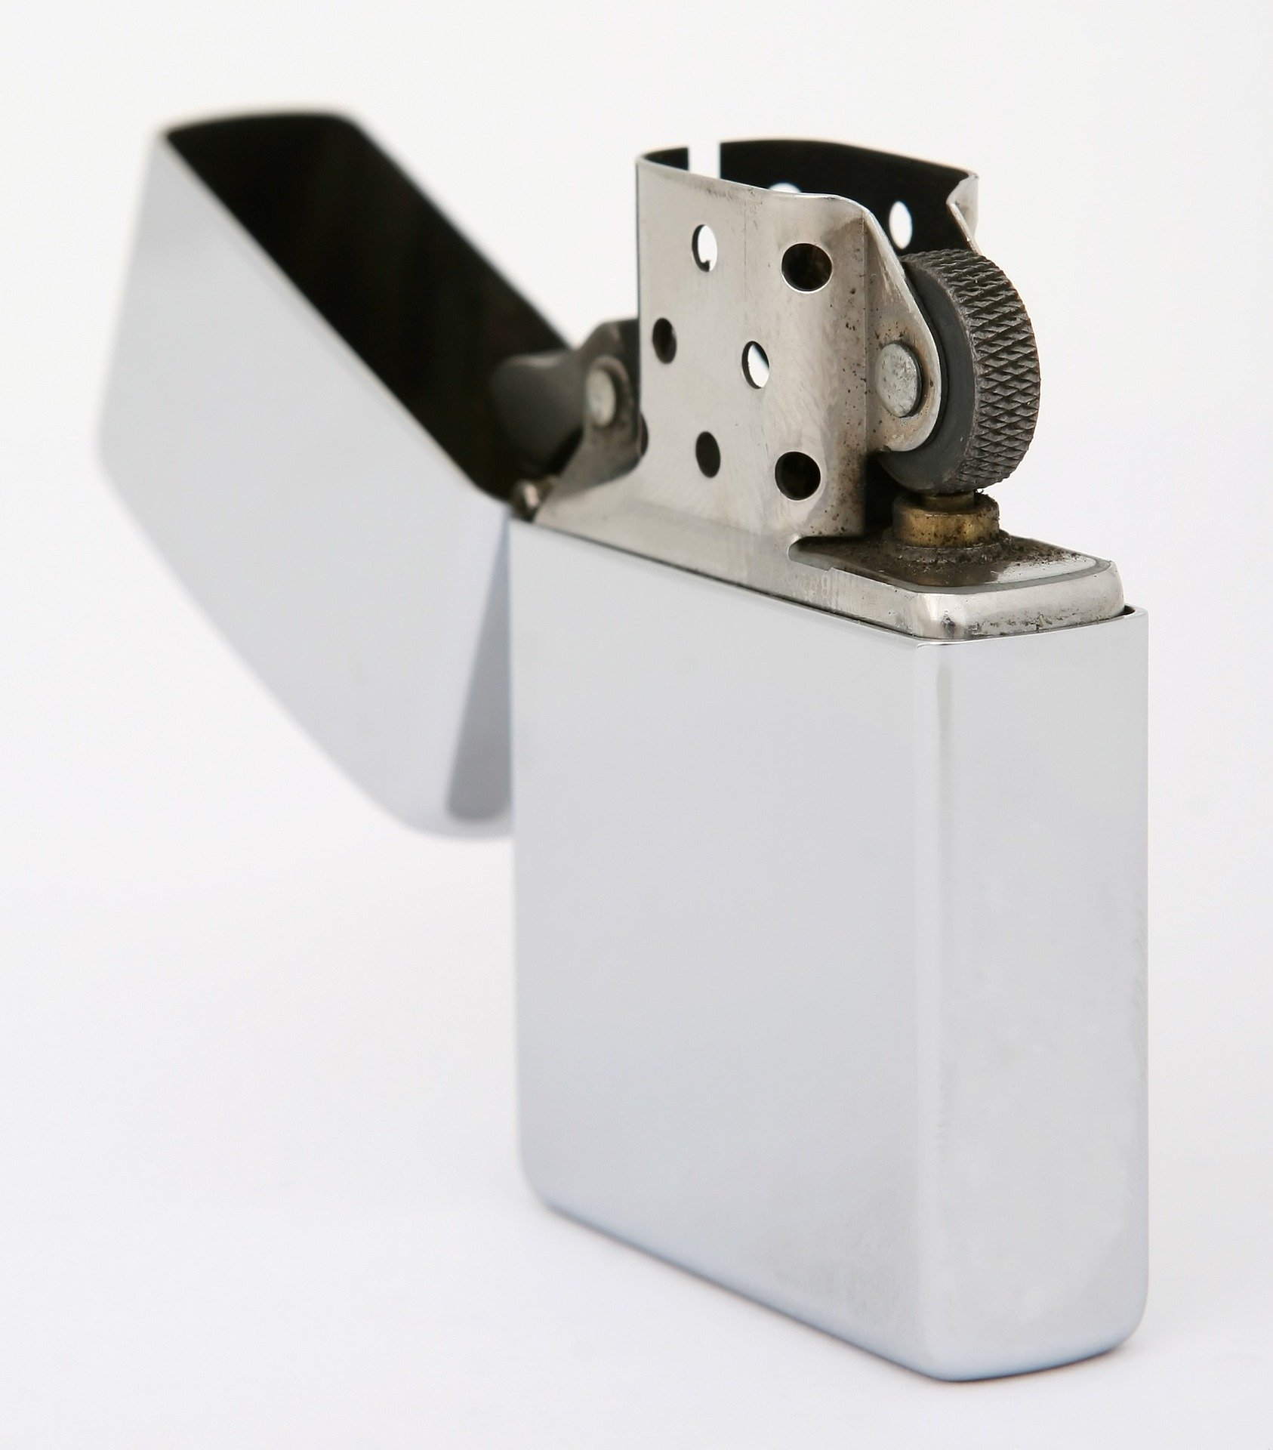
How to Protect Yourself
Identify Ignition Sources
Four Rules For Safe Refueling
Final Takeaway
Notes:
How to Protect Yourself
Identify Ignition Sources
A list of the different types of ignition sources that identify ignition and fire hazards at your own worksite.
Matches, cigarettes, cigarette lighters, flames, blow torches, gas appliances and heaters
Welding and flame cutting equipment
Static electricity generated by during fuel decanting and dispensing, clothing, or electronic equipment like mobile phones, thermostats, keyless remotes, light switches.
Hand tools, machinery and equipment that generate sparks eg, grinders
Operating plant and machinery that generates heat: boilers, steam pipes, engines, furnaces.
Prevent Engines from Becoming Ignition Workplace Sources
Identify areas where flammable liquids or gases are used or stored.
Evaluate where internal combustion engines are located.
Assess contractor use of internal combustion engines in flammable material areas. Whenever possible, do not install permanently-mounted internal combustion engines in areas where flammable vapors or gases could be present.
Four Rules for Safe Refueling:
Turn off engine
Don't smoke
Don't use your cell phone - leave it inside the vehicle or turn it off
Don't re-enter your vehicle during fueling.
FINAL TAKEAWAY
If employers cannot remove internal combustion engines from areas processing flammable materials, then preventive measures should be used. Which include administrative procedures for the safe use of portable or mobile equipment with internal combustion engines.

Slide 7
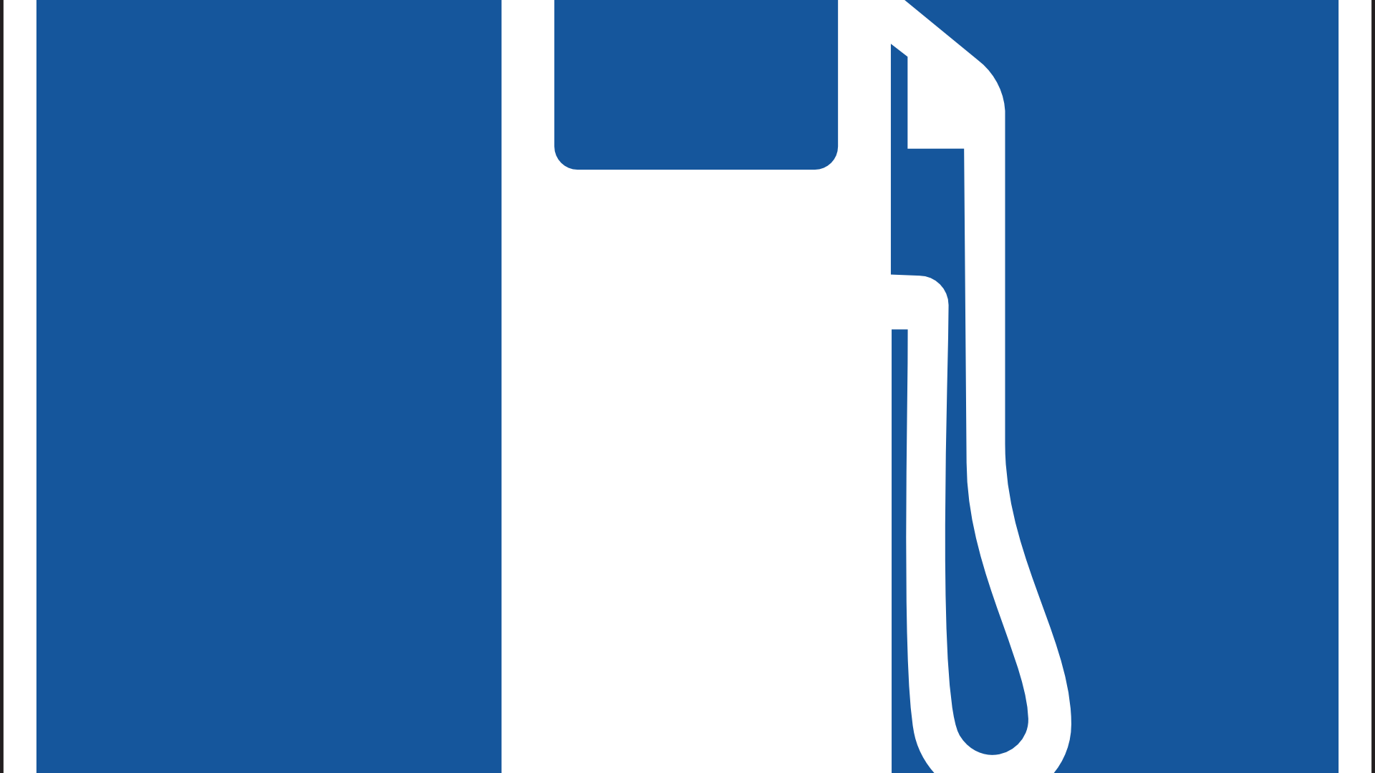
Final Word
Naked flames and burning cigarettes are clearly ignition sources. But the use of mobile or cell phones may be the worst culprit because the cell phone is attached to the “hip” as an appendage to many people.
Notes:
Final Word
Naked flames and burning cigarettes are clearly ignition sources. But the use of mobile or cell phones may be the worst culprit because the cell phone / mobile phone is attached to the “hip” as an appendage to people.

