Slide 1

Click anywhere to get started…

Slide 2
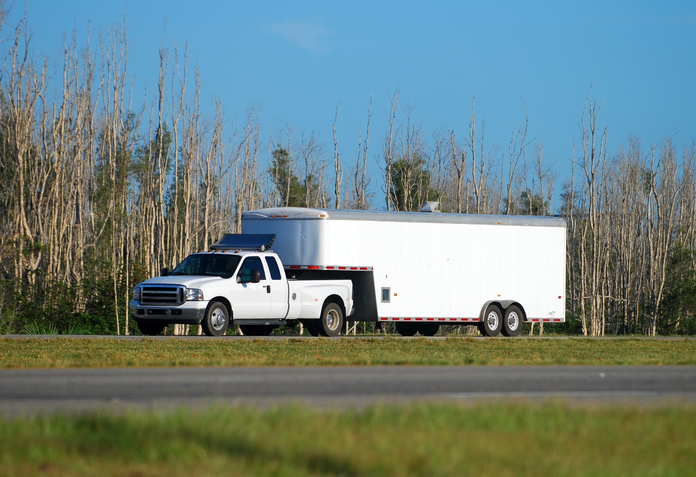


GENERAL HITCHING AND HAULING
Notes:
General Hitching and Hauling

Slide 3
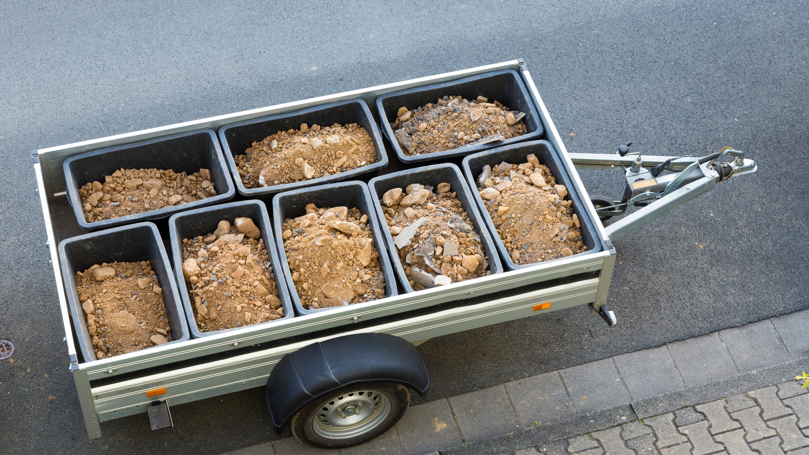
What’s at Stake?
Hitching and hauling cause countless injuries on Canadian farms every year. It only takes a few moments longer to do a job safely, rather than spending a lifetime regretting an injury to yourself or someone else.
The following are TERMS to help understand Hitching and Hauling procedures:
Hitches and Receivers
Ball Mount
Trailer Coupler
Tongue
Notes:
What’s at Stake?
Hitching and hauling cause countless injuries on Canadian farms every year. It only takes a few moments longer to do a job safely, rather than spending a lifetime regretting an injury to yourself or someone else.
The following are TERMS to help understand Hitching and Hauling procedures:
Hitches and Receivers- Refer to the device attached to the tow vehicle which adapts it to pull a trailer.
Ball Mount- A ball shaped attachment that connects the tow vehicle hitch/receiver and the trailer’s coupler.
Trailer Coupler- Device attached to the trailer tongue that connects to the ball mount.
Tongue- The arm that extends from the front of the trailer that includes the coupler.

Slide 4
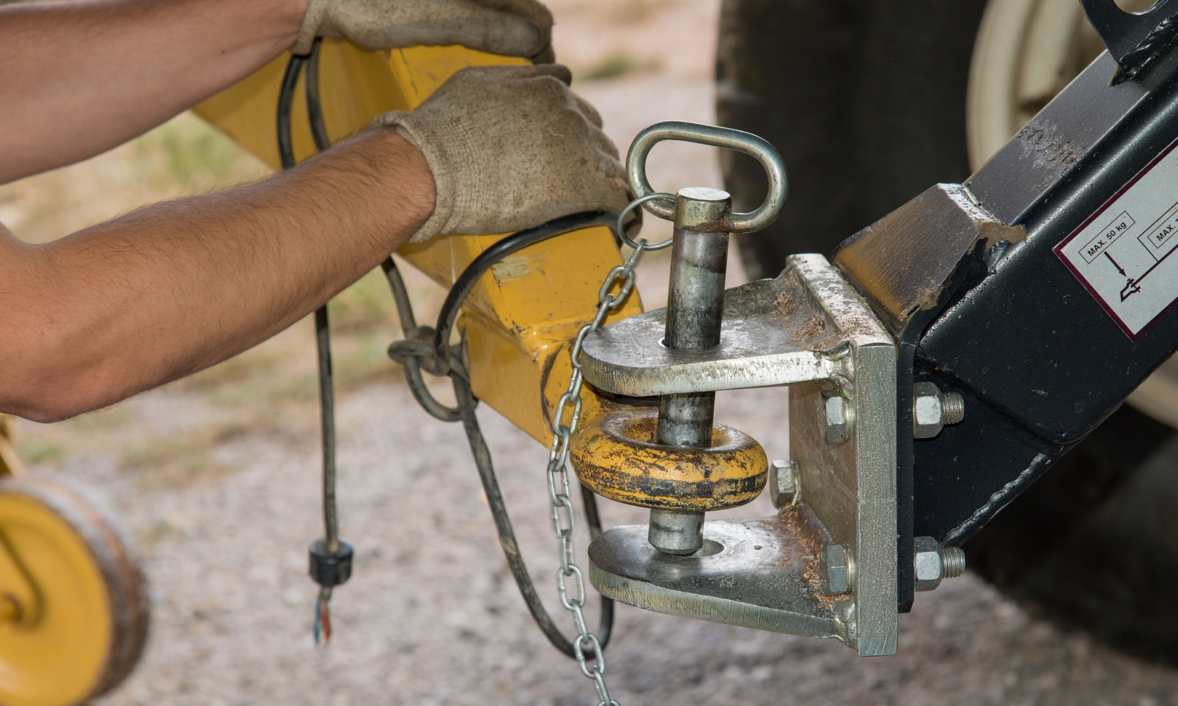
What’s the Danger?
DANGERS/RISKS BEFORE TOWING
Stability/Sway Control of Trailers
Factors of Dangerous Trailer Sway
Mitigate the Sway
Notes:
What’s the Danger?
DANGERS/RISKS BEFORE TOWING
Check the coupler or kingpin for fatigue, damage, cracks or missing parts before towing.
Test the lock mechanism for complete and correct latching so the trailer will not come unhooked.
For ball type couplers, make sure the coupler and ball size match.
If you are using a bumper hitch type coupler, it is recommended to put a bolt or similar device through the latch mechanism when hooking to the tow vehicle for safety.
Ensure hitch ball is the correct size and capacity for the trailer and load. Improper ball size or capacity could cause the trailer to separate from the tow vehicle causing property damage, injuries or death.
Stability/Sway Control of Trailers
Factors of Dangerous Trailer Sway
Weight of the tow vehicle relative to the trailer.
Hitch load, the tongue weight being too light.
Towing speed is too fast.
Tire inflation.
Design of the trailers, specifically placement of axles.
Mitigate the Sway
Ensure you have the proper hitching mechanisms.
Properly load the trailer.
Follow the instructions in the tow vehicle and trailer owner’s manuals.
Use the driving tips found here.
You may also add a sway control device for additional security related to factors such as sudden maneuvers, wind gusts, and the like. A number of sway control devices are available on the market. You will want to ensure with your trailer dealer that the device is appropriate for your application.

Slide 5
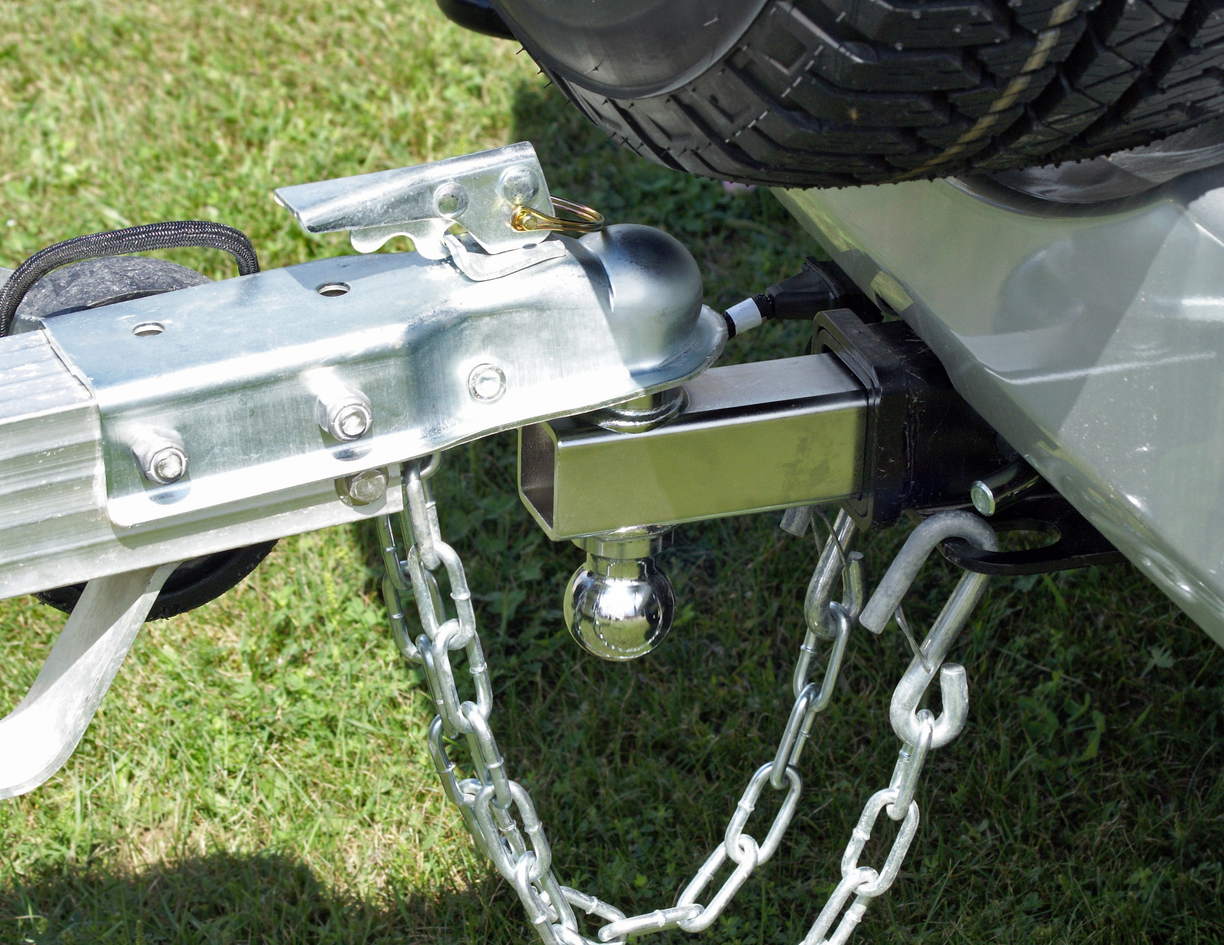
How to Protect Yourself
First Line of Defense/Safety Chains
Safety chains are your first line of defense if the trailer detaches. Safety chains are strongly recommended.
Driving Tips
Towing involves the interaction of a number of components: the driver, tow vehicle and trailer.
Hitching Tips
There are various devices used to hitch a trailer to a tow vehicle. Understanding hitches and the proper hitch for the trailer and load is important to ensuring a safe and smooth towing experience.
Hitching Know-How
No matter which type of hitch system used, the hitch needs to have a strength rating equal to or greater than the GVWR of your trailer.
Notes:
How to Protect Yourself
First Line of Defense/Safety Chains
All hitches or tow bumpers must provide a secure location for the attachment of safety chains. Safety chains are your first line of defense if the trailer detaches. Safety chains are strongly recommended.
Crisscross the chains to form an X beneath the trailer tongue so that it would catch the tongue should the trailer disconnect from the tow vehicle. Only enough slack to allow turning should exist.
If possible, the chains should be looped back to hook onto themselves
Do not hang an S hook on the opening of the receiver hitch, it might bounce off while driving, but loop it through the opening and connect it to the chain.
Driving Tips
Towing involves the interaction of a number of components: the driver, tow vehicle and trailer. Each of these contributes to the towing experience and safety of the combination. The driver is responsible for selecting the right tow vehicle and trailer for the load, hitching the unit, loading, steering, speed, and braking. All components of the tow vehicle and trailer effect towing. Safe and proper driving is a critical piece of trailer safety. Drivers should be focused and limit or eradicate distractions.
Hitching Tips
There are various devices used to hitch a trailer to a tow vehicle. Understanding hitches and the proper hitch for the trailer and load is important to ensuring a safe and smooth towing experience. After deciding the appropriate hitch system, properly hitching the trailer to the tow vehicle will help to ensure the combination remains attached, and should the coupler fail, correctly attached safety chains should be your next line of defense.
Hitching Know-How
No matter which type of hitch system used, the hitch needs to have a strength rating equal to or greater than the GVWR of your trailer. Your trailer’s maximum capacity is never greater than the lowest rated part in the trailer/towing system. You also want to ensure your hitch system is in good working condition and matches the type of tongue on the trailer.

Slide 6
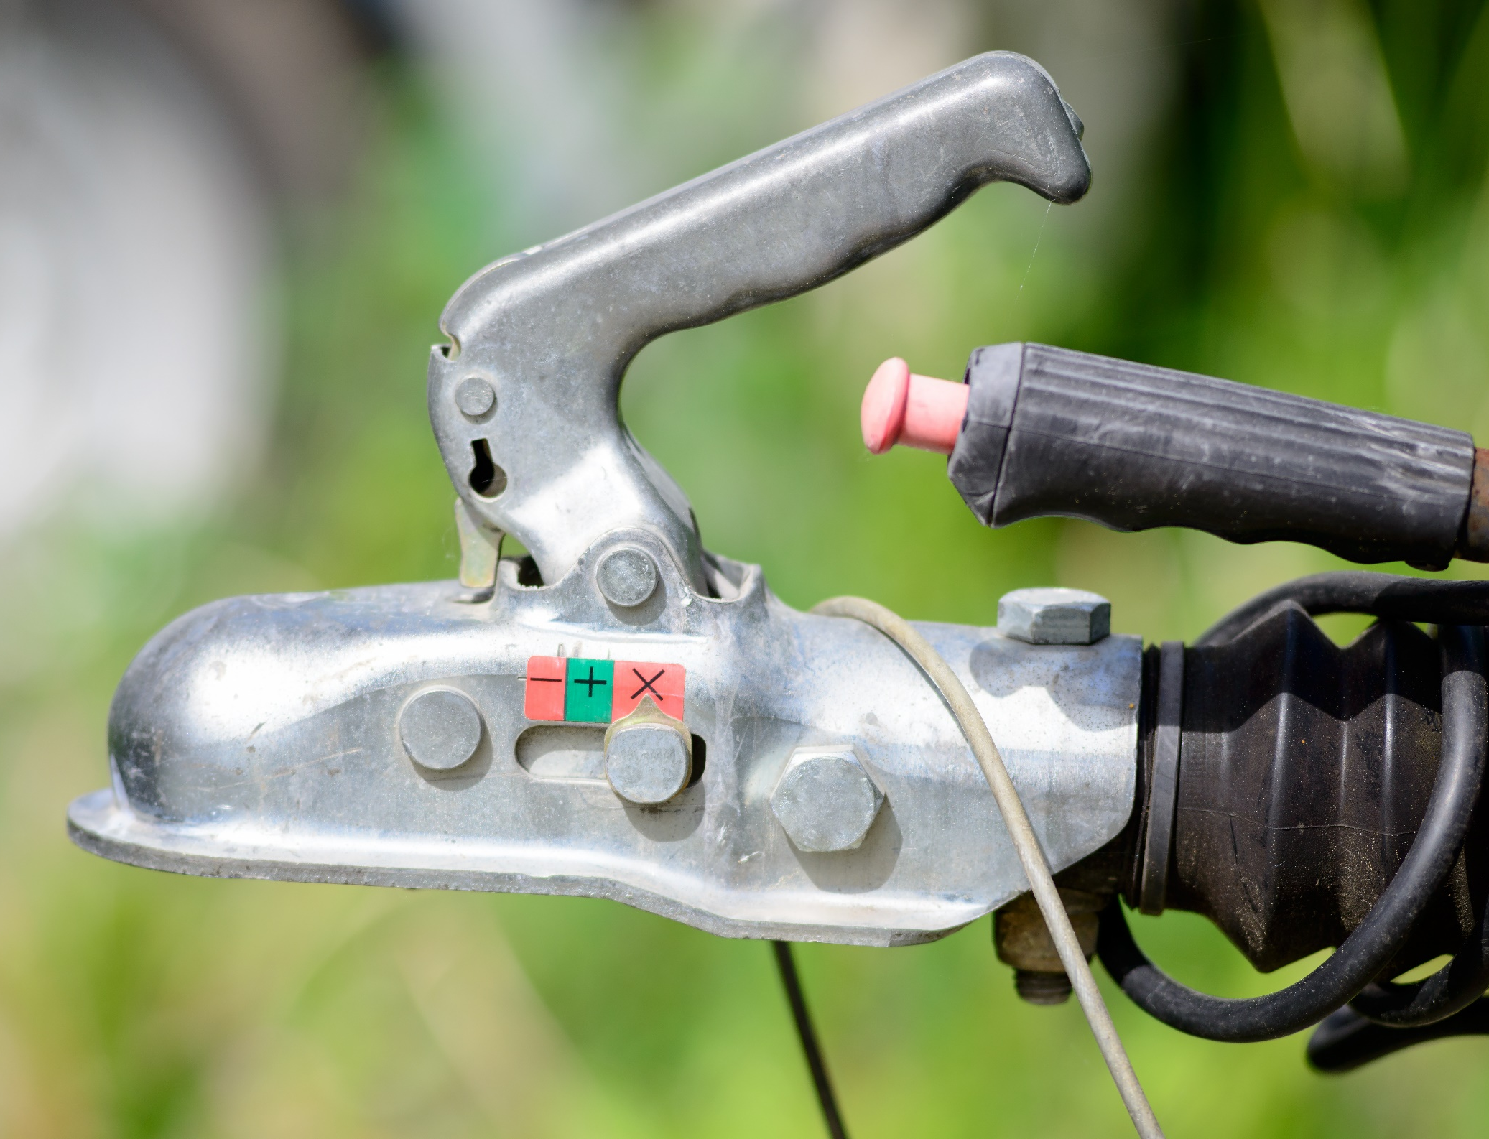
How to Protect Yourself
HITCHING BASIC STEPS
HITCH TYPES
While there are a number of hitch types, their function falls into three main categories:
Weight Carrying
Weight Distributing
Fifth Wheel/Gooseneck
Ball Mount Height
The trailer will need to ride parallel to the ground when being towed. This is important for stability, proper tire wear, and appropriate stress on the towing combination. As such, the ball mount will need to be raised or lowered as tow vehicles and trailers are often at different heights.
Notes:
How to Protect Yourself
HITCHING BASIC STEPS
Back your tow vehicle as close as possible to the trailer. It is easier and safer to do this than it is to pick up and pull the trailer to your car or truck.
Release the coupler locking device.
Raise the front end of the trailer. Place coupler directly over the hitch ball then lower it until it is seated on the hitch ball, covering it completely.
Check under the coupling to ensure the ball clamp is below the ball and not riding on top of it.
Latch the coupler to the hitch ball. Make sure it is locked in place by lifting up the trailer tongue. If the coupler comes loose from the ball, unlatch it and go back to Step 3.
Make sure your jack is fully raised.
If you have a weight distributing hitch with spring bars, follow the above procedures. Then attach the spring bar chain to the trailer and tighten it until your trailer and car are in normal, level position.
If your trailer has a surge brake breakaway cable or chain, attach the cable or chain to your tow vehicle, allowing enough slack for you to make tight turns.
Attach the safety chains.
Connect the trailer wiring harness to the lighting system of your tow vehicle and check its operation.
HITCH TYPES
While there are a number of hitch types, their function falls into three main categories:
Weight Carrying- Generally used in applications with smaller loads, weight carrying hitches carry all of the tongue weight. Because this weight affects the truck’s handling and braking ability and adds stress to the rear axle, this is not typically the best for heavier load applications.
Weight Distributing- Used in heavy-duty applications, the purpose of this system is to prevent sag due to excessive weight or stress on the rear of the tow vehicle. Rather than merely supporting the trailer tongue weight, weight distributing hitches apply leverage between the towing vehicle and trailer causing the tongue weight to be carried by all axles of the tow vehicle and trailer.
It is important to note that weight distributing hitches do not lend themselves to the proper operation of surge or hydraulic brakes.
3. Fifth Wheel/Gooseneck- Used in heavier-duty load application, this system located the hitch system over or before the rear axle of the tow vehicle.
A gooseneck hitch looks like a ball mount in the truck bed.
A 5th wheel hitch is a horseshoe shaped attachment.
Ball Mount Height
The trailer will need to ride parallel to the ground when being towed. This is important for stability, proper tire wear, and appropriate stress on the towing combination. As such, the ball mount will need to be raised or lowered as tow vehicles and trailers are often at different heights.
To determine the appropriate rise or drop you will need to measure, on a flat surface, from the ground to the top of the hitch receiver opening and from the ground to the bottom of the coupler on the trailer. The difference between the two provides the necessary rise or drop for a ball mount.
Ensuring the hitch ball is the proper size
Hitch Balls are stamped with their maximum weight capacities
They are purchased based on weight capacities, but also the size of the ball to ensure proper coupler fit, as well as shank width for mounting to the draw bar.

Slide 7
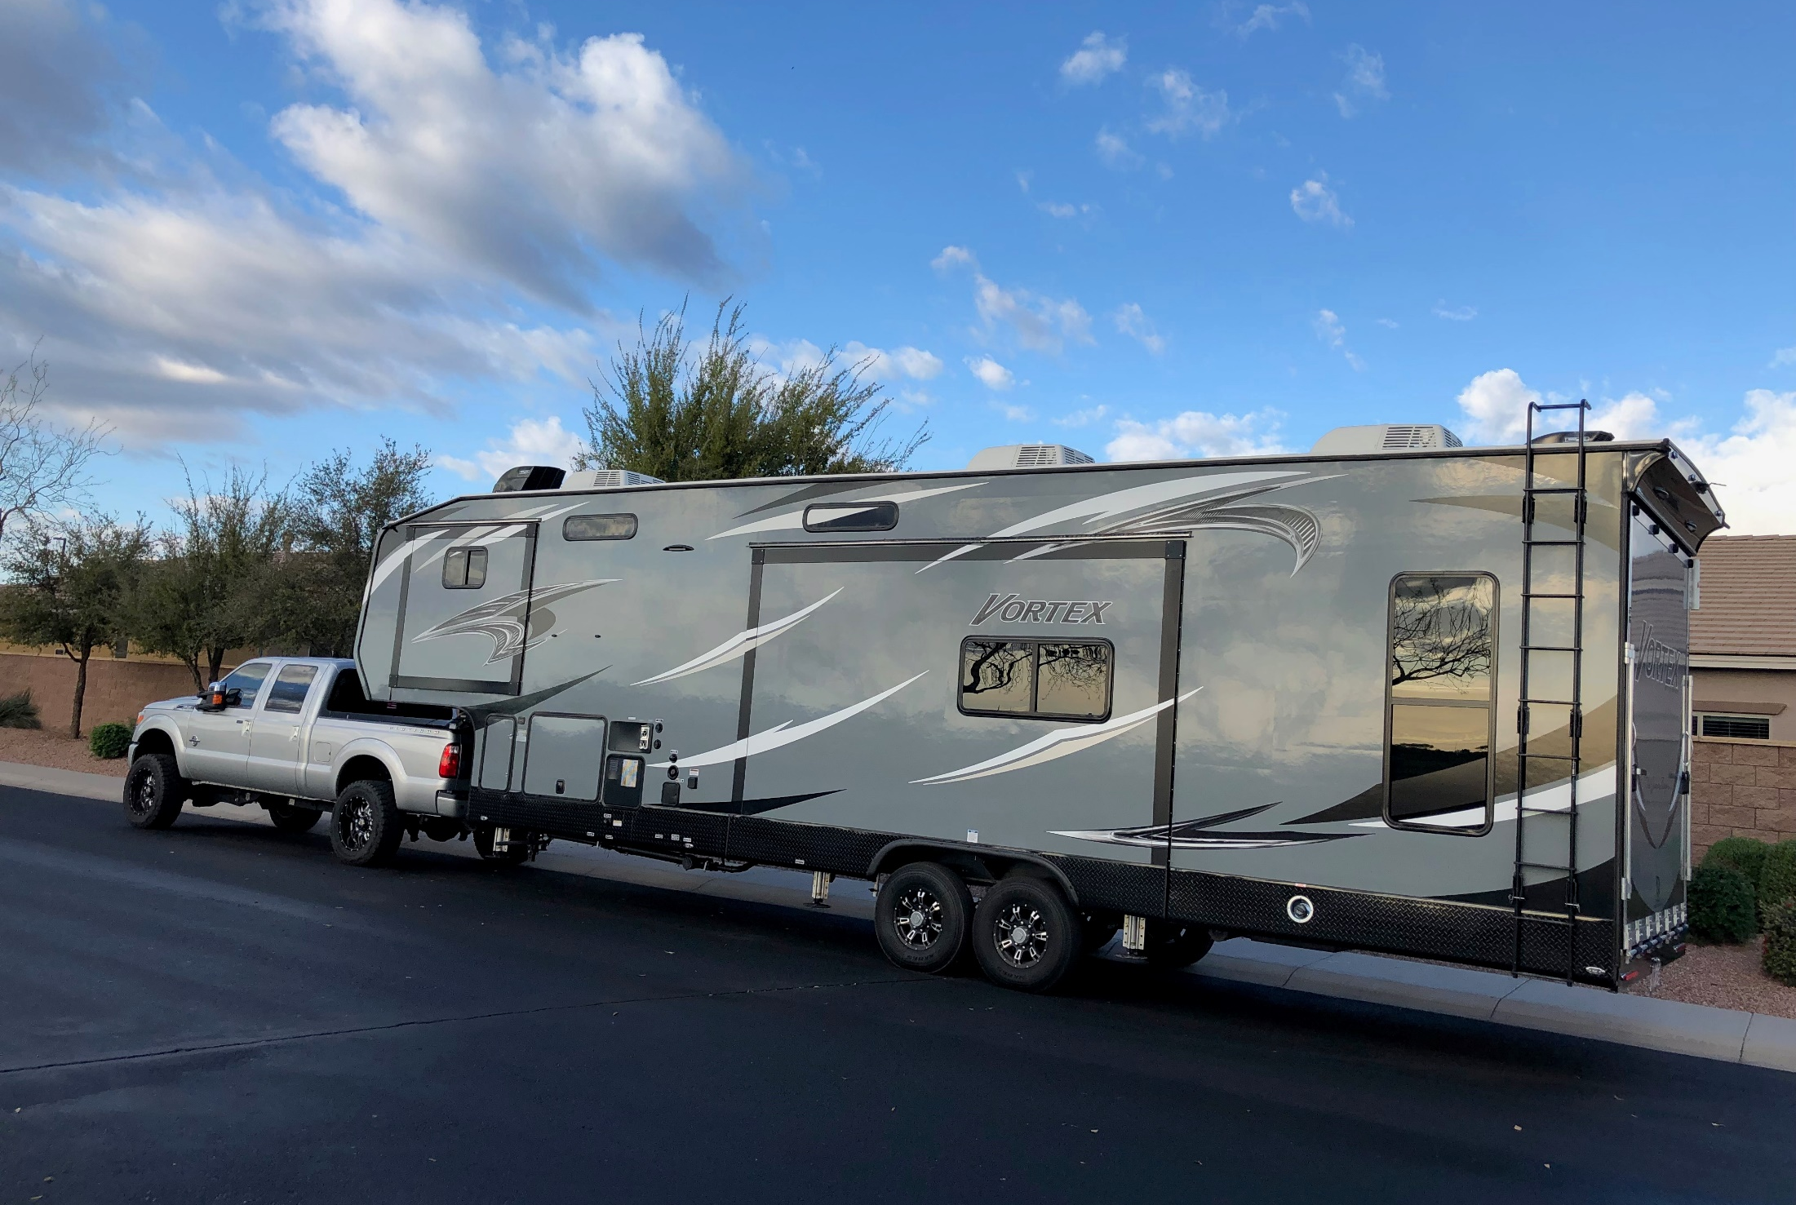
How to Protect Yourself
HITCHING/HAULING OVERVIEW
Hitching
Hauling
Notes:
How to Protect Yourself
HITCHING/HAULING OVERVIEW
Hitching
Try to do hitching and unhitching on level ground. If there is a risk of rolling, block wheels before unhitching.
Hitch trailed equipment only to the tractor drawbar. Hitching elsewhere may displace the centre of gravity on the tractor and can cause a backward overturn.
Connect each farm wagon or piece of equipment to the towing vehicle by two separate means of attachment. Most commonly this will be a draw pin and chains. It may also include a ball-hitch or three-point hitch. Use safety hitch pins (draw pins with cotter pins or other locking system) in every application.
Use properly rated safety chains with pins and balls of the proper size. The strength of a safety chain must be equal to the gross weight of the load being towed. Be sure no loose chains are dangling either from the drawbar or the implement.
Use locking pins on hydraulics.
Shut off the engine and wait for all moving parts to stop before un/hitching implements or when making adjustments or performing maintenance.
Make sure all shields and guards are in good condition and properly installed.
Hauling
When towing equipment without brakes, keep speeds under 40 km/hr.
Stopping distance increases with speed and with increased weight of towed loads. Reduce speed when hauling a load.
Make sure the tractor is properly counterweighted.
Before hauling, ensure your load is well secured. Avoid sudden starts / stops and excessive speed, especially when operating on a hillside or rough ground as it may cause your load to fall.
Check clearance before operating under overhead electric lines or before entering a building.
Always travel with the front-end loader or bucket in the lowest position possible.
Avoid operating attachments during road travel and keep the PTO disengaged unless absolutely necessary.
Transport winged and folding implements in their narrowest configuration.

Slide 8
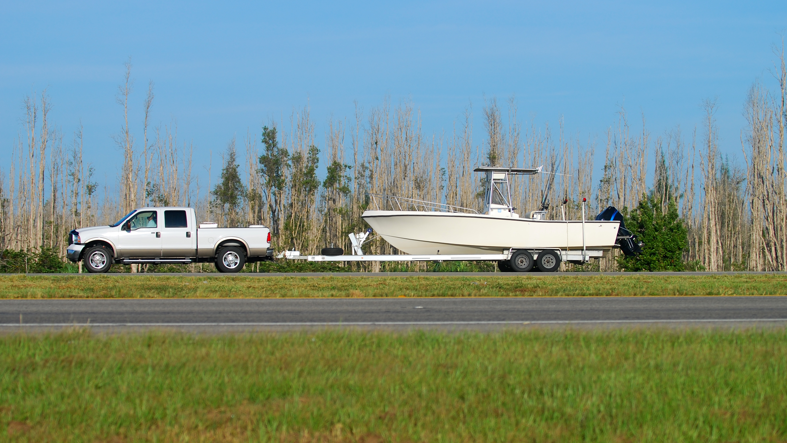
Final Word
Hitching and Hauling are common almost everyday occurrences on farms. Most of the time, they proceed without a “hitch”. The hitching process is fraught with dangers and risks if safety procedures are not followed with precision and passion. These requirements must be strictly applied and adhered to by all farm workers.
Notes:
Final Word
Hitching and Hauling are common almost everyday occurrences on farms. Most of the time, they proceed without a “hitch”. The hitching process than is fraught with dangers and risk if safety procedures are not followed with precision and passion. The requirements of Equipment and Machine capacity, purpose a dangers must be strictly applied and adhered to by all farm workers.

