Slide 1

Click anywhere to get started…

Slide 2

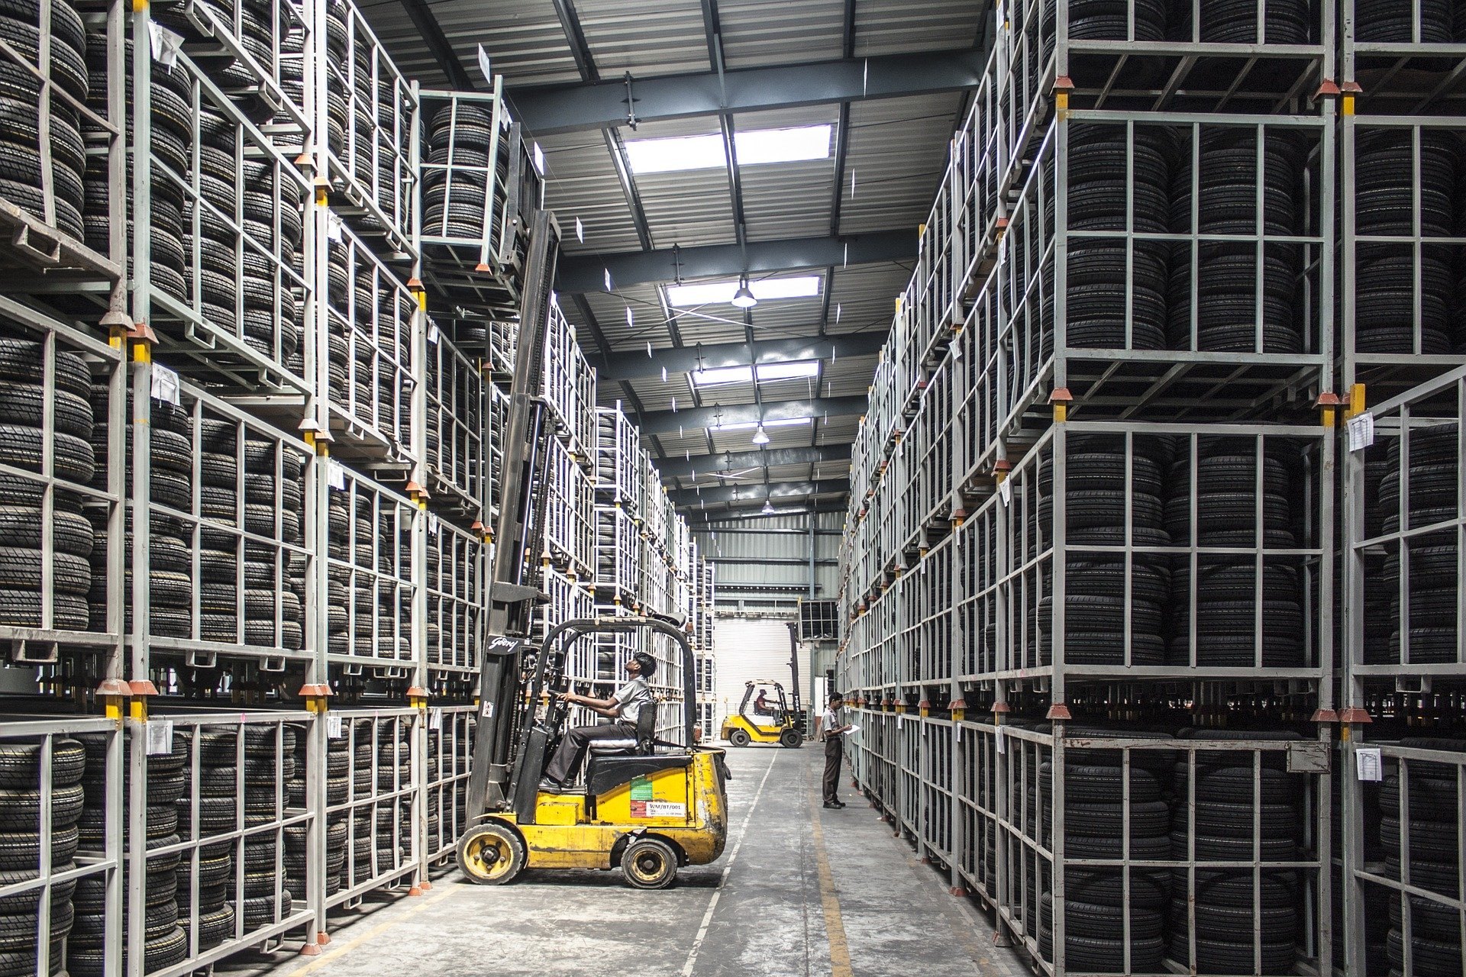

FORKLIFT SAFE WORK PRACTICES
Notes:
Forklift Safe Work Practices

Slide 3
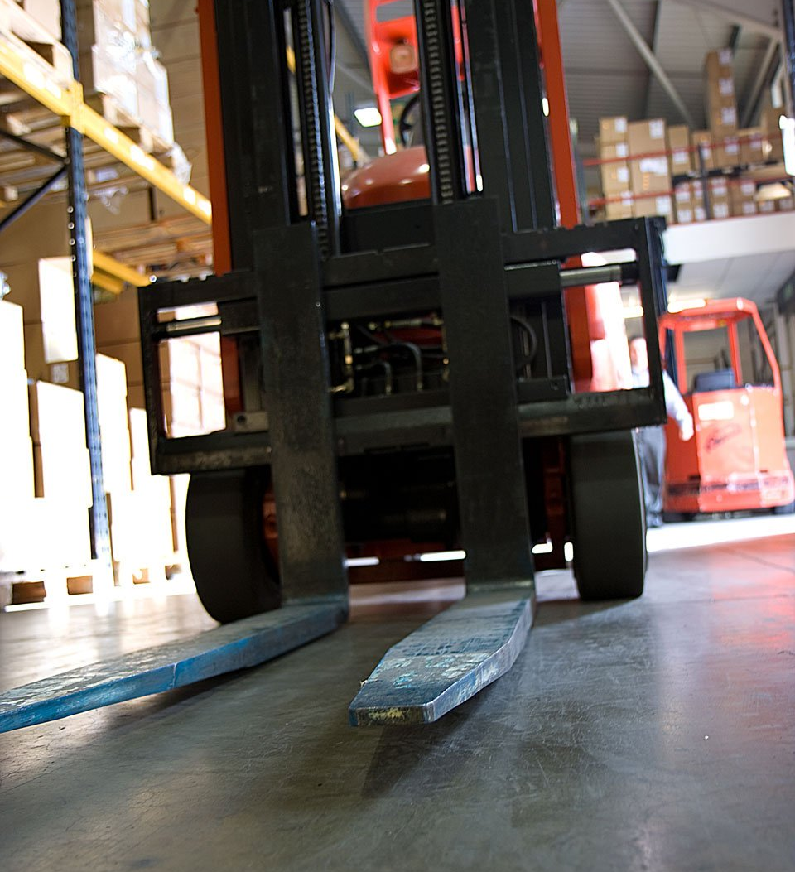
What’s at Stake?
Forklifts (also called industrial lift trucks) are used to lift, stack and transfer loads in many workplaces. However, every year they continue to cause workplace deaths and injuries resulting in substantial financial and human costs for workers, industry and the community.
Notes:
What’s at Stake?
The forklift is a commonly used tool that helps people lift and move heavy loads with very little physical effort and excellent precision. Using a forklift lessens the risk of injuries caused by lifting or carrying heavy items. For this reason, many companies employ forklifts and forklift operators to do this kind of labor. These machines are powerful, though, and there is always risk involved when they are used by people who have not been trained on operating them safely.
Forklifts (also called industrial lift trucks) are used to lift, stack and transfer loads in many workplaces. However, every year they continue to cause workplace deaths and injuries resulting in substantial financial and human costs for workers, industry and the community all forklifts fall.

Slide 4
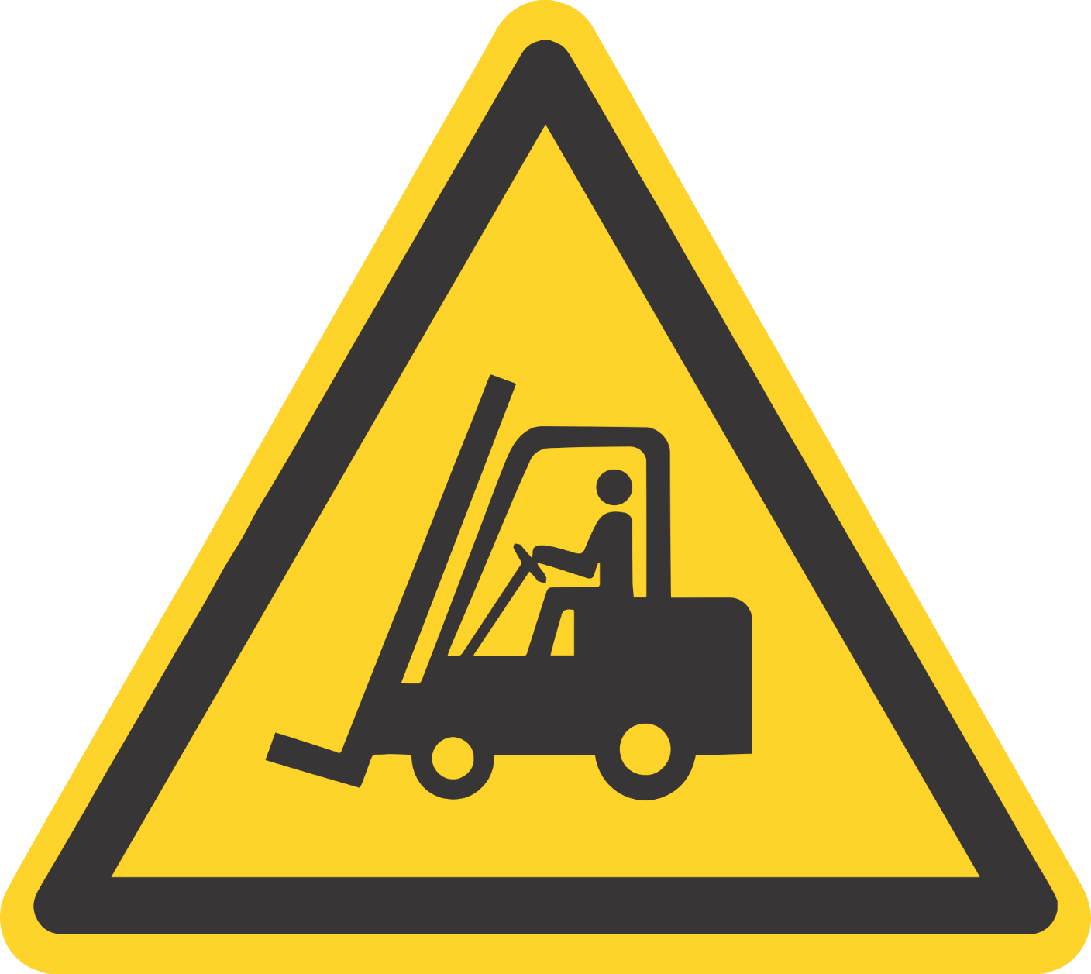
What’s the Danger?
With proper training and diligent forklift safety practices, most deaths can be prevented. If you work around forklifts or are a forklift operator, you should learn all you can about using these machines safely to prevent injury or death.
Notes:
What’s the Danger?
The National Traumatic Occupational Surveillance System registered 1,530 worker deaths from forklift accidents between 1980 and 2001. Of these accidents, the biggest portion, 22%, was caused by a forklift overturn. Collisions between forklifts and workers on the ground where the ground worker died accounted for 20% of deaths. Another 16% of deaths were caused by someone being crushed by a forklift, and 9% by an operator falling from a forklift. In fact, each year almost 100 people are killed and another 20,000 injured by forklift accidents.
With proper training and diligent forklift safety practices, most deaths can be prevented. If you work around forklifts or are a forklift operator, you should learn all you can about using these machines safely to prevent injury or death.

Slide 5
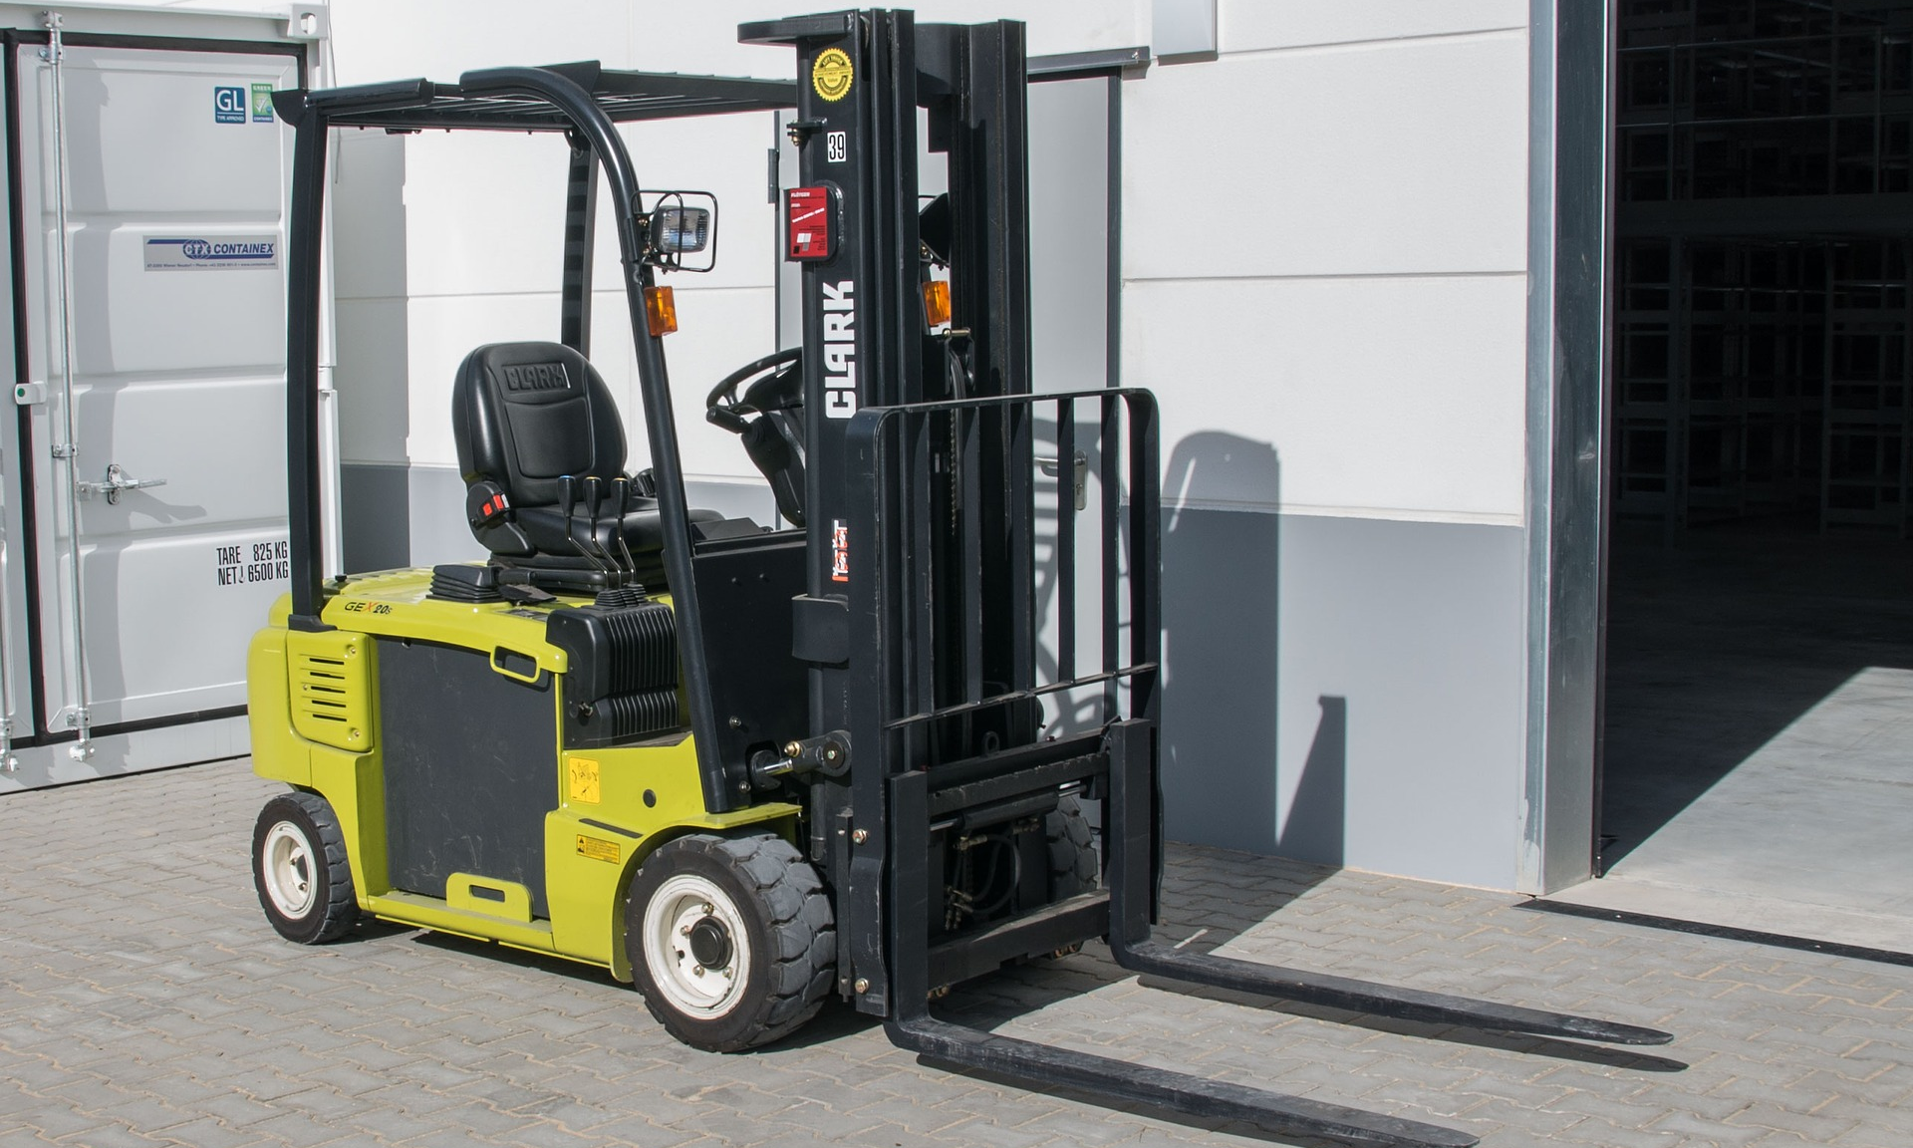
How to Protect Yourself
Safety Features of Forklifts
Operational Safety of Forklifts
FORKLIFT SAFE WORK PRACTICES
DO’s
DON’T
Notes:
How to Protect Yourself
Safety Features of Forklifts
Although you might think that driving a car would prepare you to operate a forklift, they do not work in the same way. In most automobiles the front wheels provide steering, but in a forklift the steering is done by the rear wheels. This allows the front end to be used to carry the load, but requires room for the rear of the forklift to swing around to make turns.
Forklifts are also not as quick to respond as cars. Stopping quickly and swerving are hard to do without losing control of the forklift. It is also very easy to lose control on inclines. In order to minimize risks, you should always keep the load on the uphill side, which requires the operator to drive in reverse, sometimes for long stretches.
Forklifts are equipped with a load backrest to keep the load from falling onto the operator. This backrest is required any time loads are lifted high and could fall to the rear when driving on uneven surfaces or in the case of acceleration or sudden stops. Forklifts that can be used to lift loads over the operator are also required to have an overhead guard. These guards are meant to protect the operator from small packages being dropped, but are not effective against the loss of a full load.
Restraints for operators are standard requirements for all forklifts built since 1992. Older forklifts can often be retro fitted with operator restraints. As a forklift operator, it is important to always use the restraint because it can prevent you from being thrown out of the protective cage should your forklift overturn. Many fatalities occur because operators attempt to jump from the machine when it overturns. The nature of forklifts causes them to turn very slowly at first. Then the center of gravity shifts, and the turn speeds up rapidly. The slow turn gives operators the false sense that they have time to jump out, when in reality they do not.
Safety Features of Forklifts
A horn to indicate when a forklift is coming through an intersection or when the operator’s vision is obscured. Forklifts also have backup alarms that will sound whenever the forklift operates in reverse.
All forklifts should have a re extinguisher on board (a), especially those that are gas powered.
The warning, directional, and brake light (b) must be in working order.
Mirrors are often used to help the driver maintain a visual of his surroundings to avoid collisions with other equipment and people.
Additional forward or rear-facing lighting may be present to assist with visibility in low light conditions (c).
Operational Safety of Forklifts
Along with maintaining the vehicle, any forklift operator must use safety precautions while driving it. You must remind yourself of how dangerous these vehicles can be and avoid situations that put you and other employees at risk. This includes any kind of horseplay on or around the equipment. There is always temptation to fool around and play games at work, but the potential for disaster is too great to give in to these temptations. Instead operators must remain completely focused on the vehicle and the job at hand.
At the end of the day, it is the forklift driver who holds the keys to avoiding disasters. He or she has to understand how the forklift works and how to react in a given situation in order to avoid an accident. These skilled drivers have to pay attention to many factors while operating their trucks. For example, they must pay close attention to the type of terrain. Any loose objects, holes, or bumps on the road surface can lead to a loss of control.
This can cause you to drop the load or sink and destabilize. The surface you drive on must be rated for four times the amount of weight you will carry. For example, if your forklift weighs 6,000 pounds and is carrying a 4,000 pound load, you multiply the total, 10,000 pounds, by four, which means the floor must be able to hold 40,000 pounds. Keep in mind that the weight on forklifts is not completely even, so if just one wheel goes off onto a surface that is not rated for that weight, it could cause the whole vehicle to destabilize.

Slide 6
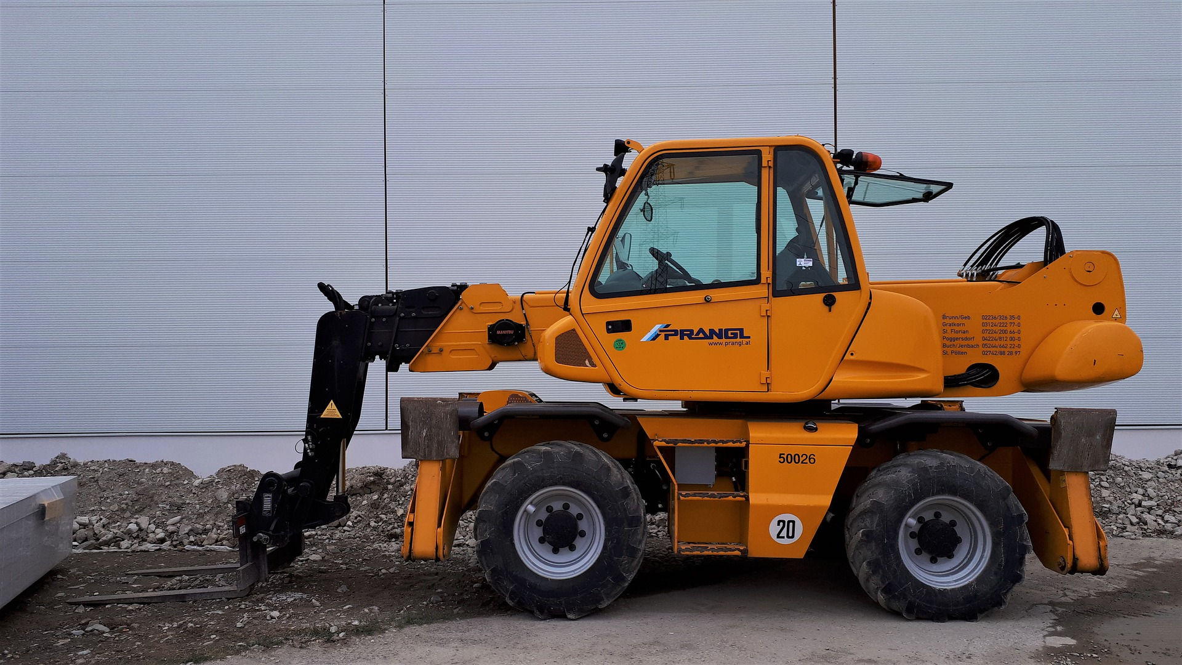
How to Protect Yourself
FORKLIFT SAFE WORK PRACTICES
DO’s
DON’T
Notes:
FORKLIFT SAFE WORK PRACTICES
What does it take to be safe in the modern industrialized plant/factory where the forklift is the prime driver of goods, merchandise??
DO’s
Perform a visual and operational check of the forklift at the start of the shift.
Buckle up as soon as you get on the forklift.
Place forks as far under the load as possible. Drive with load against heel of rack with mast tilted back. Be sure forks are spaced correctly to support load.
Operate a forklift smoothly when stopping, starting, lifting and tilting.
Carry load as low as possible.
Sound horn before moving forklift when other vehicles or worker may not be able to see forklift movement.
Match speed to driving surfaces, load and workplace conditions.
Know that overloading the forklift can cause loss of steering.
Check for adequate overhead clearance before raising the load.
Keep forks pointed uphill when traveling with a load on an incline.
Keep forks pointed downhill when traveling without a load on an incline.
Travel in reverse when load is blocking frontal vision.
Sound horn and slow down when approaching pedestrians, doorways, rows aisles, ramps and other forklifts.
Keep pedestrians away and raise and lower the load smoothly. Any elevated load is hazardous.
Stop when a group of people are waking across the route being traveled: lower the load to the floor, and wait until the people get by before proceeding.
Watch out for pedestrians, avoid driving a forklift up to anyone who is standing in front of a bench or other fixed object.
Stay constantly alert to changing or unusual conditions.
Always be prepared to stop.
Whenever anything develops that affects the normal operation of the forklift, tell the supervisor immediately.
Report any accidents promptly to supervisor, immediately.
Use only approved personnel platforms, securely fastened to the forks to elevate anyone. Reduce speed when doors, corners and elevations restrict vision. Keep to right unless plant conditions or layout dictate otherwise.
Park forklift with controls in neutral, brakes applied and forks in a down position with the motor switched off.
Keep hands, arms, head and feet and legs inside the confines of a moving forklift.
Observe and obey the load capacity of the forklift.
DON’T
Do not leave forklifts running inside for long periods of time without ventilation.
Do not handle steering wheel if your hands or gloves are greasy or slippery.
Do not try to move or adjust any part of the load, the forklift or the surroundings when on the forklift.
Do not move loads that are piled or stacked poorly.
Do not lift a load that extends above the load backrest unless no part of the load can possibly slide back toward the operator.
Do not allow anyone but the operator to ride on the forklift.
Do not use pallets elevated by forklifts as an improvised working platform.
Do not permit anyone to stand or walk under the elevated part of any forklift, whether loaded or unloaded.
Do not allow anyone to stand, walk or work under elevated forks.

Slide 7
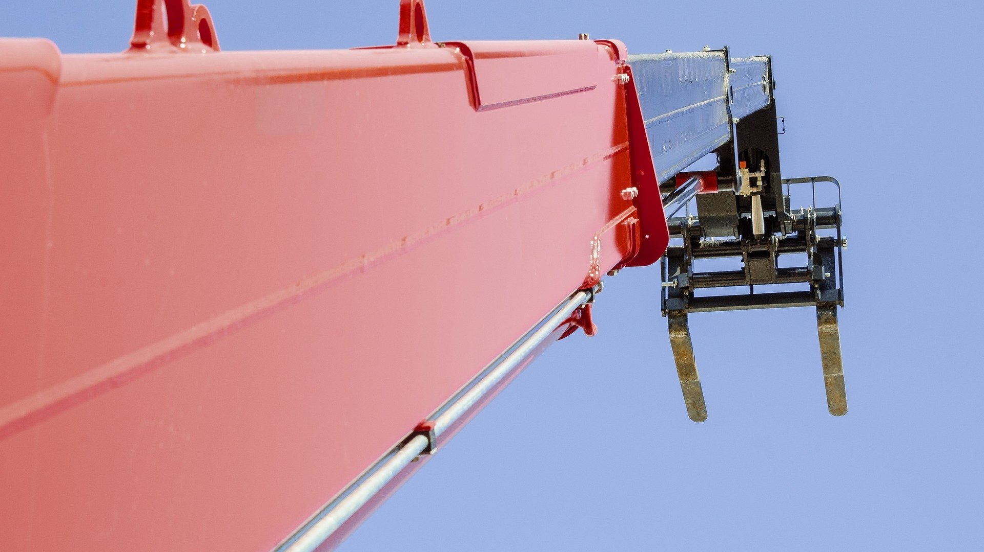
Final Word
Forklift incidents can be prevented, especially when workers and businesses work together to improve health and safety at work.
Notes:
Final Word
Forklift incidents can be prevented, especially when workers and businesses work together to improve health and safety at work.

