Slide 1

Click anywhere to get started…

Slide 2

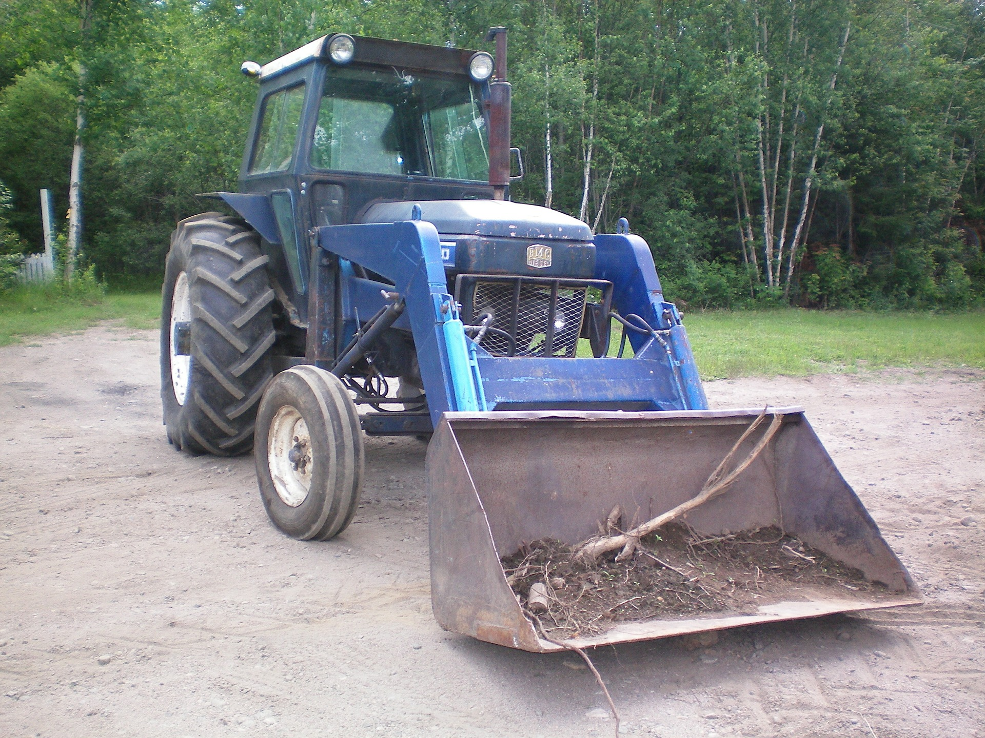

FRONT – END TRACTOR ATTACHMENTS
Notes:
Front-end Tractor Attachments

Slide 3
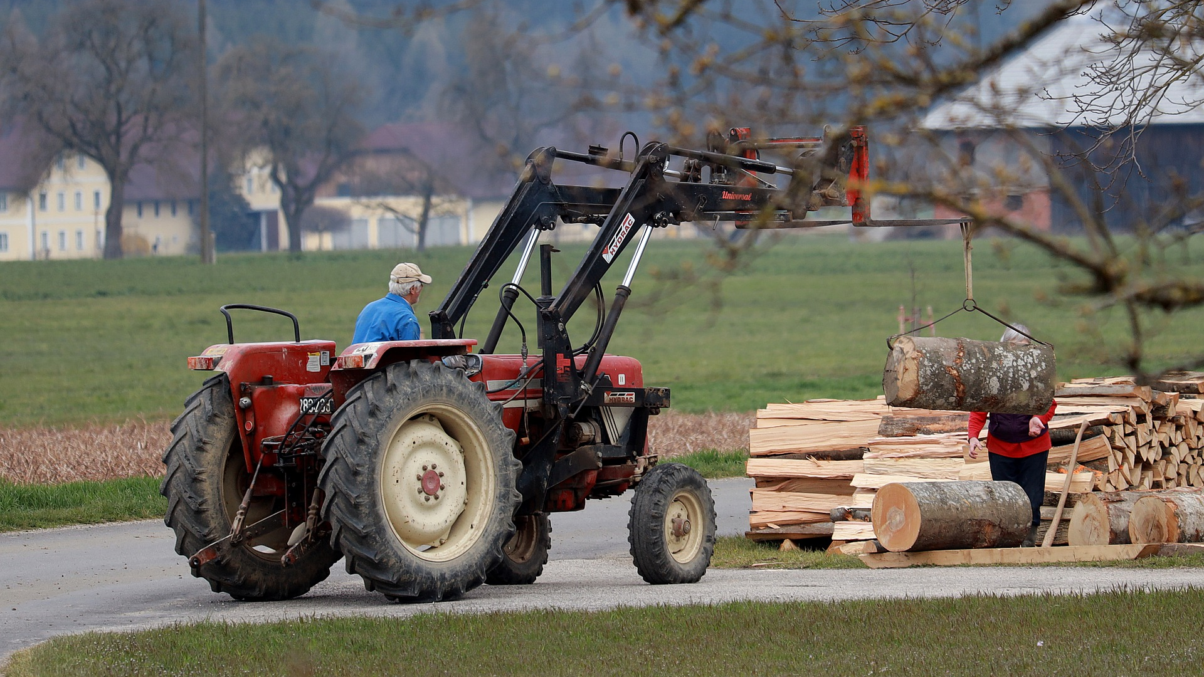
What’s at Stake?
One of the most popular and versatile attachments for any tractor is a front-end loader. For farmers in particular, who tend to tackle a wide variety of tasks from time to time, a front-mounted bucket is perfect many tasks, including:
moving compost and manure
digging and shifting dirt
clearing snow
transporting materials
grading driveways
Notes:
What’s at Stake?
One of the most popular and versatile attachments for any tractor is a front-end loader. For farmers in particular, who tend to tackle a wide variety of tasks from time to time, a front-mounted bucket is perfect many tasks, including:
moving compost and manure
digging and shifting dirt
clearing snow
transporting materials
grading driveways

Slide 4
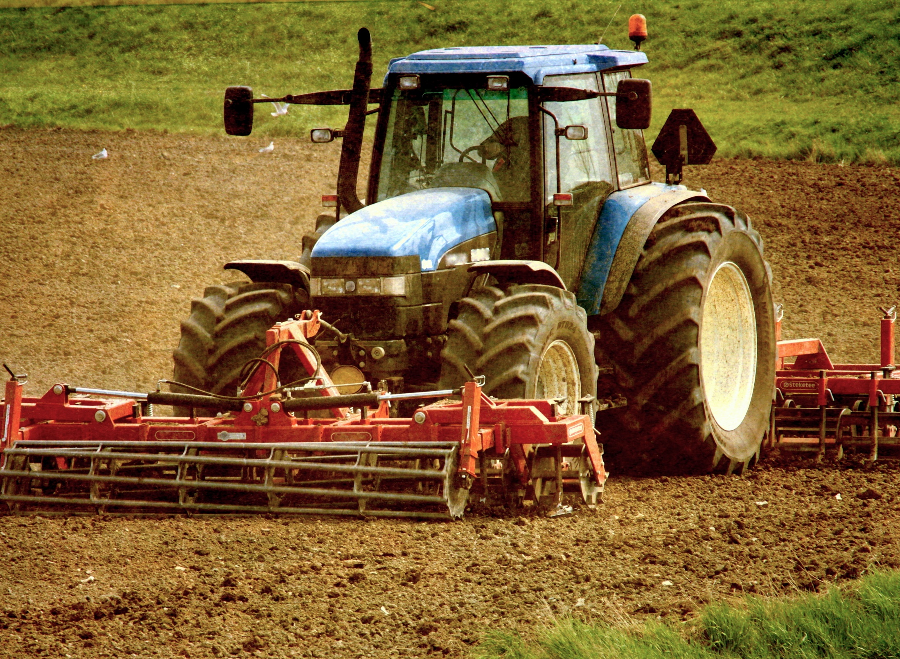
What’s the Danger?
The hydraulics that power the front loader can do a lot to make you work easier.
Some attachments can be installed directly on the bucket of your front-end loader.
Here are four:
1. Bucket teeth
2. Forks
3. Bale spear
4. Grapple
But there are Dangers/Risks
Front-end tractor attachments change the tractor’s centre of gravity. The higher the load is lifted, the more unstable the tractor becomes and this can result in the tractor tipping over onto its side.
Notes:
What’s the Danger?
The hydraulics that power the front loader can do a lot to make you work easier.
You can install many other useful attachments on the front of your tractor. They further expand its capabilities while making your farm chores easier and faster.
Some attachments can be installed directly on the bucket of your front-end loader. Others are installed in place of the bucket.
Here are four:
1. Bucket teeth
Adding a row of teeth to the bucket of your front-end loader can increase its capacity and—more importantly—its versatility as a digging tool. It literally gives it the teeth it needs to take powerful bites out of tough ground.
The shape of the teeth can be an art form in and of itself. Varying sizes and shapes offer ideal performance for working with rocks, clay soils, soft soils and more.
2. Forks
Forks can be installed on the bucket or in place of the bucket to quickly turn your tractor into a forklift. This offers you the ability to transport pallets of supplies, hay bales, logs, large branches and more.
As with a front-end loader, how much your forks can handle depends on the strength of your tractor. But even a utility tractor of modest size can handle a lot of material. I’ve moved multiple 8-foot pine logs at once with forks installed on a 40-horsepower diesel tractor.
In many cases, forklift attachments are adjustable, allowing you to change the width between the two forks. This is an important feature if you wind up working with pallets of different sizes, or if you’re moving something more obscure and need the forks to be set a specific distance apart.
3. Bale spear
A hay bale spear is a lot like a forklift attachment, except it’s specifically designed for transporting round hay bales.
Designs vary, but a typical bale spear uses a handful of tapered spears to penetrate a round bale in multiple locations. This provides a secure means for the tractor to lift and transport the bale to wherever it’s needed.
Since round hay bales are large and heavy, a bale spear is a must-have attachment for farmers feeding these bales.
4. Grapple
A grapple installs in place of the bucket and is the perfect tool for dealing with logs, branches, brush and more.
The hydraulic-powered jaws allow you to secure a tight grip on your load and lift it up for transportation to a more appropriate location, whether that’s a brush pile, a wagon or a sawmill.
A large grapple mounted on a strong tractor will significantly speed up your efforts to clean up tree debris on your farm. In turn, you will save a lot of time and manual labor.
But there are Dangers/Risks
Front-end tractor attachments change the tractor’s centre of gravity. The higher the load is lifted, the more unstable the tractor becomes and this can result in the tractor tipping over onto its side. Mounted tractor attachments make the tractor longer and this changes the amount of room needed when maneuvering.

Slide 5
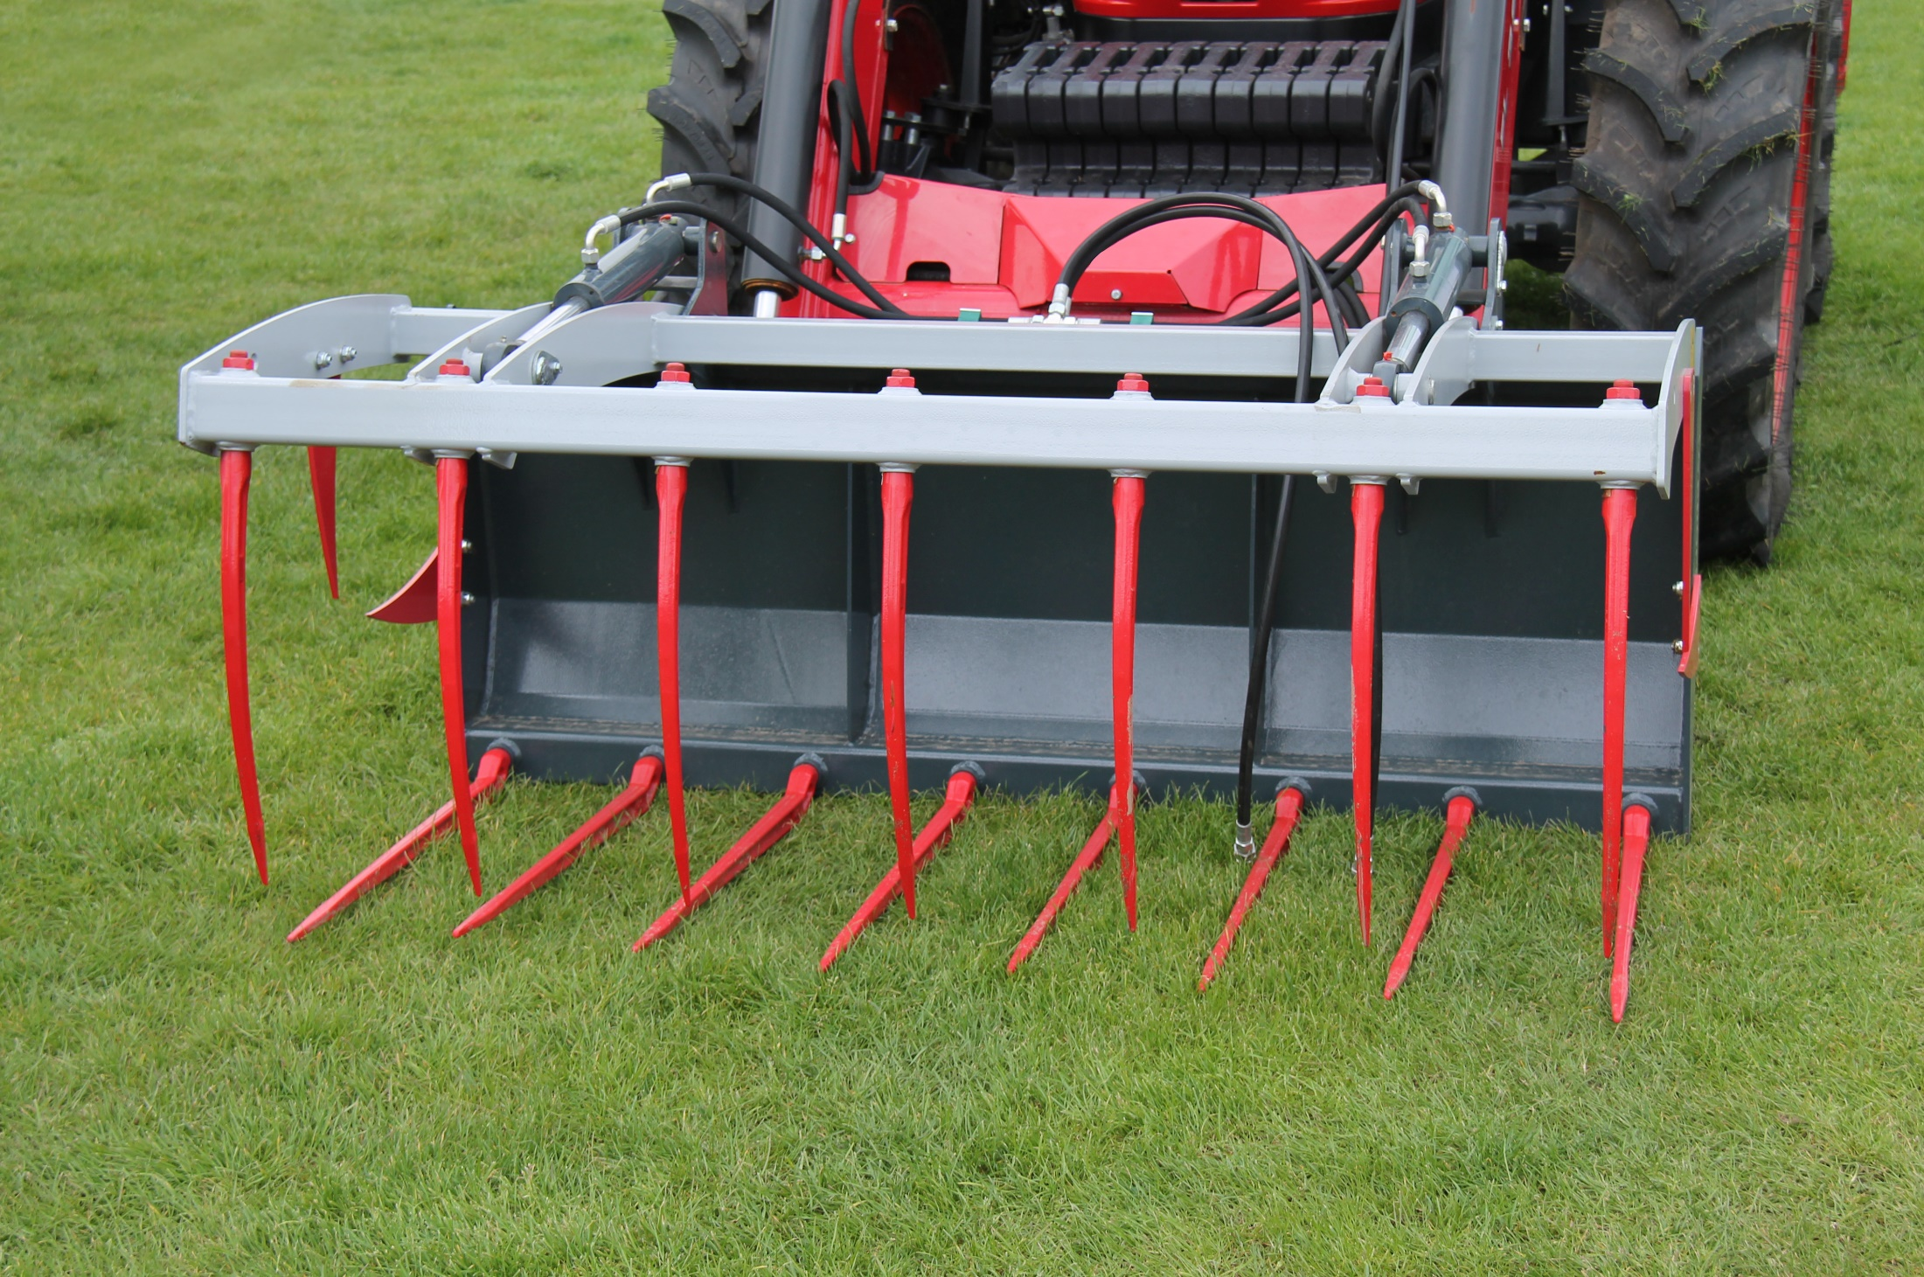
How to Protect Yourself
MAKE SURE ALL ATTACHMENTS ARE SECURE
THE BUCKET SHOULD BE KEPT AS LOW AS POSSIBLE WHEN TURNING AND TRANSPORTING
NEVER WALK OR WORK UNDER A RAISED LOADER
Notes:
How to Protect Yourself
MAKE SURE ALL ATTACHMENTS ARE SECURE
Front-end loader attachments can become unattached if they are not properly secured. Clear any debris from the coupling system and make sure that all locking mechanisms are engaged. Visually inspect the coupling system to verify that the attachment is secure, all locks are fully engaged and the centre of the attachment matches up to the coupler. Quick attach systems are quick, but they are not foolproof!
THE BUCKET SHOULD BE KEPT AS LOW AS POSSIBLE WHEN TURNING AND TRANSPORTING
It is important that you make sure you have enough clearance when driving that the bucket doesn’t touch or catch on the ground but carrying loads higher than needed can cause centre of gravity of the tractor to shift. If the tractor becomes unstable due to the gravity shift this can cause the tractor to tip or roll.
NEVER WALK OR WORK UNDER A RAISED LOADER
The loaders are attachments, and even though we make sure that they are properly attached, at times, mechanical or hydraulic issues can cause the loader to drop. Make sure that no one walks or works under the loader at any time.

Slide 6
How to Protect Yourself
A FRONT-END LOADER CHANGES THE CLEARANCE
FRONT-END LOADERS AREN’T PEOPLE TRANSPORTERS
FRONT-END LOADERS AREN’T REPLACEMENTS FOR POSTDRIVERS OR OTHER TOOLS
Notes:
How to Protect Yourself
A FRONT-END LOADER CHANGES THE CLEARANCE
A front-end attachment changes the amount of room the tractor needs to turn corners, maneuver through the yard and to park. Adjust for this and make sure you have enough clearance when operating a tractor with a front-end attachment.
FRONT-END LOADERS AREN’T PEOPLE TRANSPORTERS
Front-end loaders can haul many things, but never people. A sudden stop, lurch or bump can cause the rider to lose their footing and fall off.
FRONT-END LOADERS AREN’T REPLACEMENTS FOR POSTDRIVERS OR OTHER TOOLS
Even though front-end loaders are handy, please make sure you are using the proper tool for the job.

Slide 7
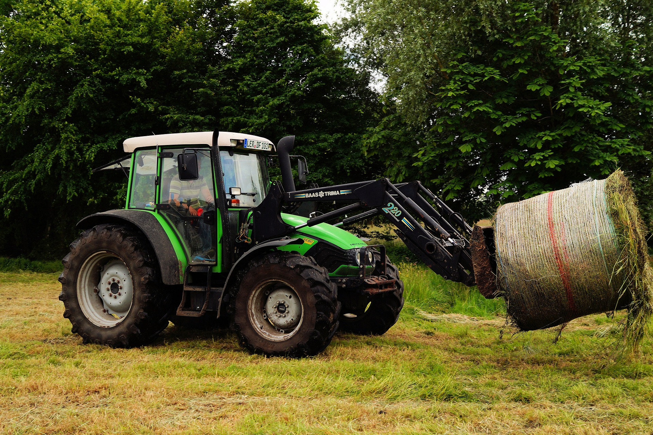
How to Protect Yourself
Here are some additional safety tips for working with front-end tractor loaders:
Loader controls should only be operated from the operator’s platform when the operator has a clear sight of what is around the machinery or is being guided by a spotter.
Never exceed the lifting capacity of the loader.
When handling large bales, make sure the bale is speared through the centre. Never lift the bale by sliding the fork under the bale as it might fall off.
Notes:
How to Protect Yourself
Here are some additional safety tips for working with front-end tractor loaders:
Loader controls should only be operated from the operator’s platform when the operator has a clear sight of what is around the machinery or is being guided by a spotter.
Never exceed the lifting capacity of the loader.
When handling large bales, make sure the bale is speared through the centre. Never lift the bale by sliding the fork under the bale as it might fall off.

Slide 8
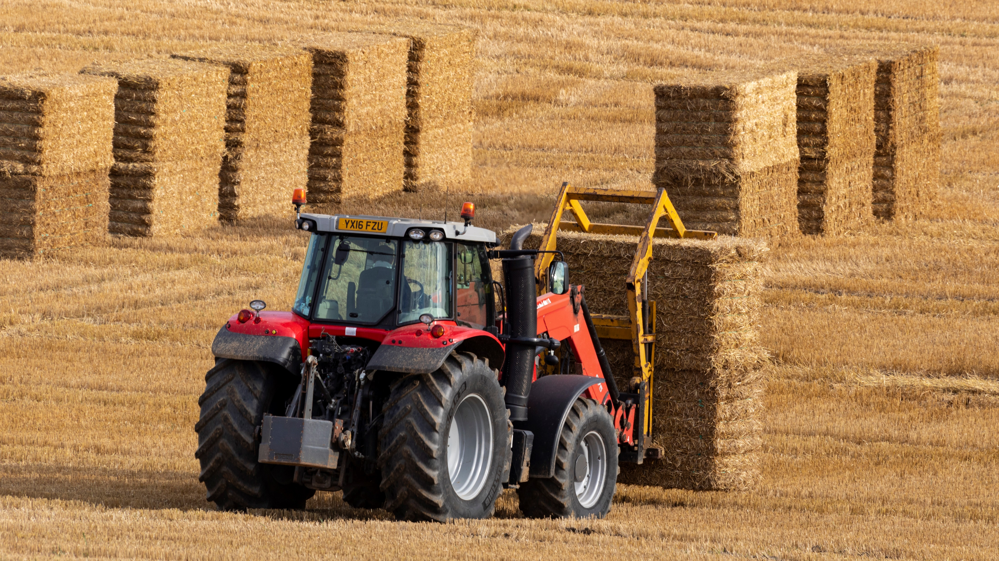
Final Word
Front-end tractor loaders and other attachments are used to transport bales, rocks and other objects, move debris and snow on yards and lanes, and are essential on the farm. However, there are safety considerations when it comes to using these attachments.
Notes:
Final Word
Front-end tractor loaders and other attachments are used to transport bales, rocks and other objects, move debris and snow on yards and lanes, and are essential on the farm. However, there are safety considerations when it comes to using these attachments.

