Slide 1

Click anywhere to get started…

Slide 2

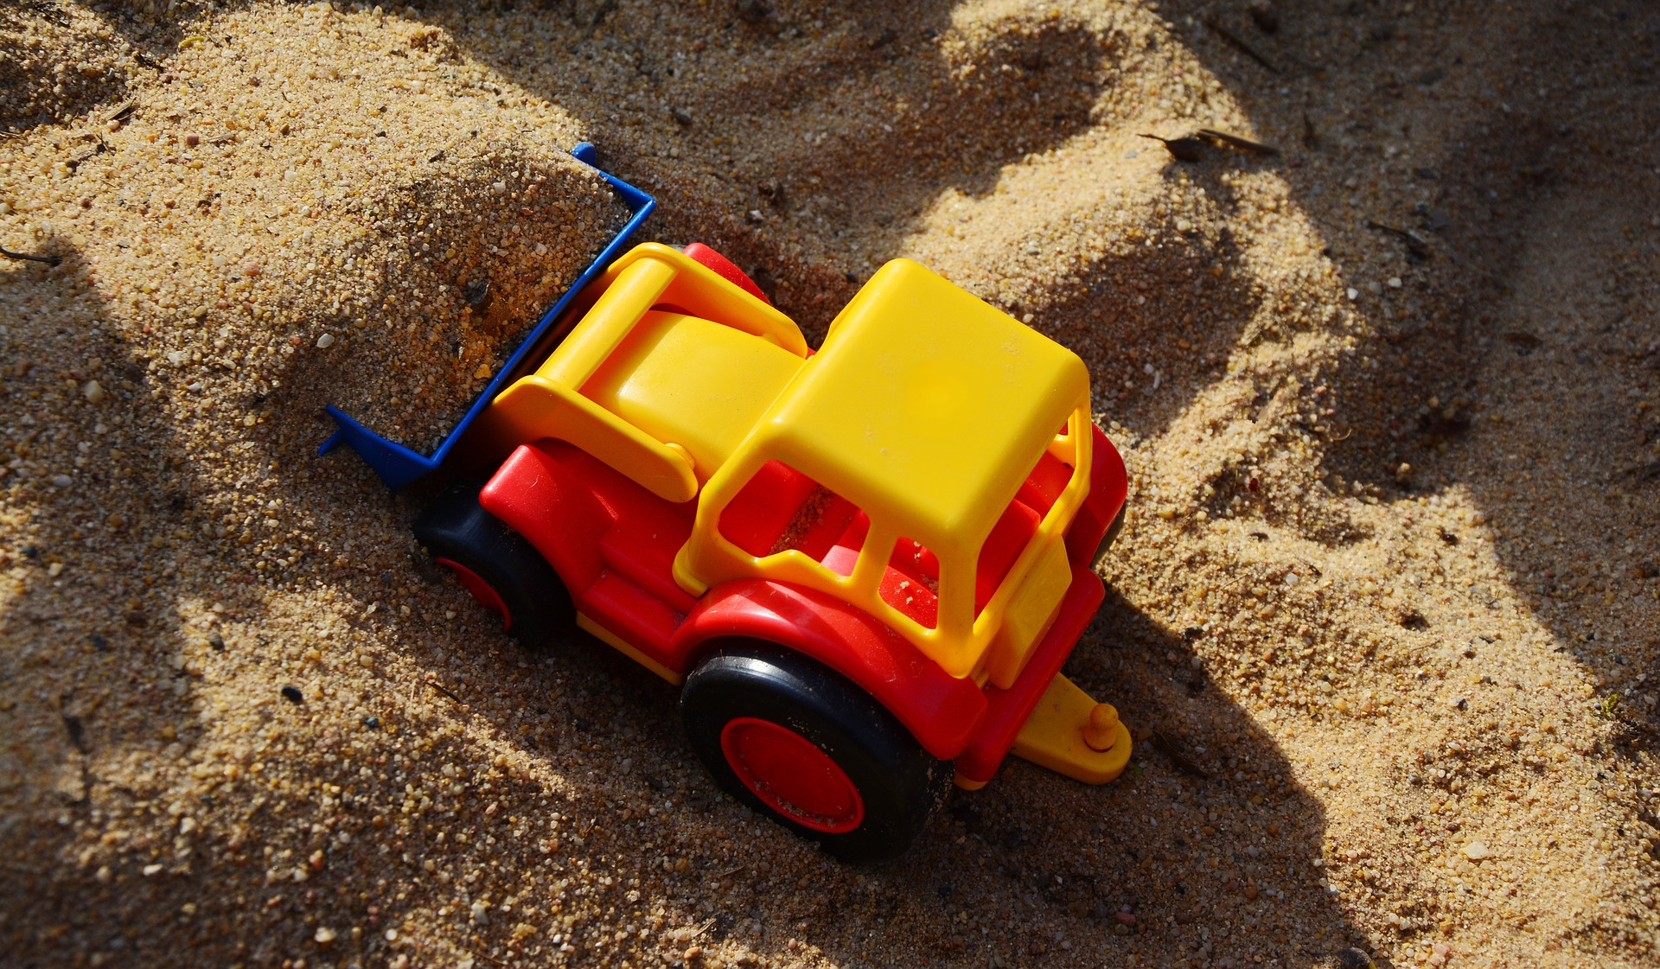

EXCAVATING AND SHORING GUIDELINES
Notes:
Excavating And Shoring Guidelines

Slide 3
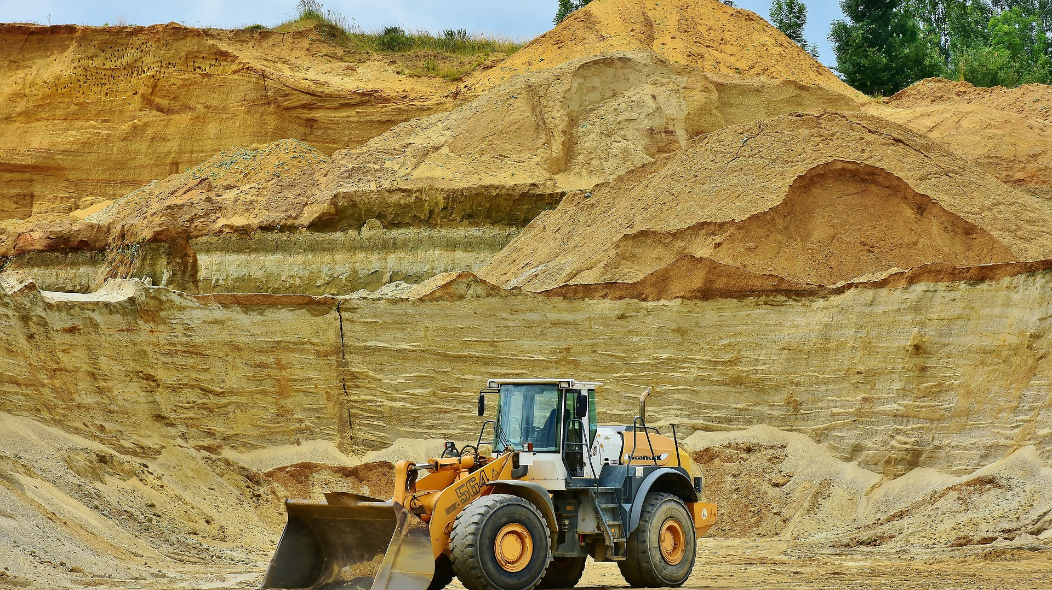
What’s at Stake?
Excavation work generally means work involving the removal of soil or rock from a site to form an open face, hole or cavity, using tools, machinery or explosives.
It is mandatory that any trench or excavation more than 1.2 m (4 feet) is properly sloped or shored to comply with the occupational health and safety regulations. No employee shall enter any trench or excavation that is not properly sloped or shored.
Notes:
What’s At Stake?
Excavation work generally means work involving the removal of soil or rock from a site to form an open face, hole or cavity, using tools, machinery or explosives.
It is mandatory that any trench or excavation more than 1.2 m (4 feet) is properly sloped or shored to comply with the occupational health and safety regulations. No employee shall enter any trench or excavation that is not properly sloped or shored.

Slide 4
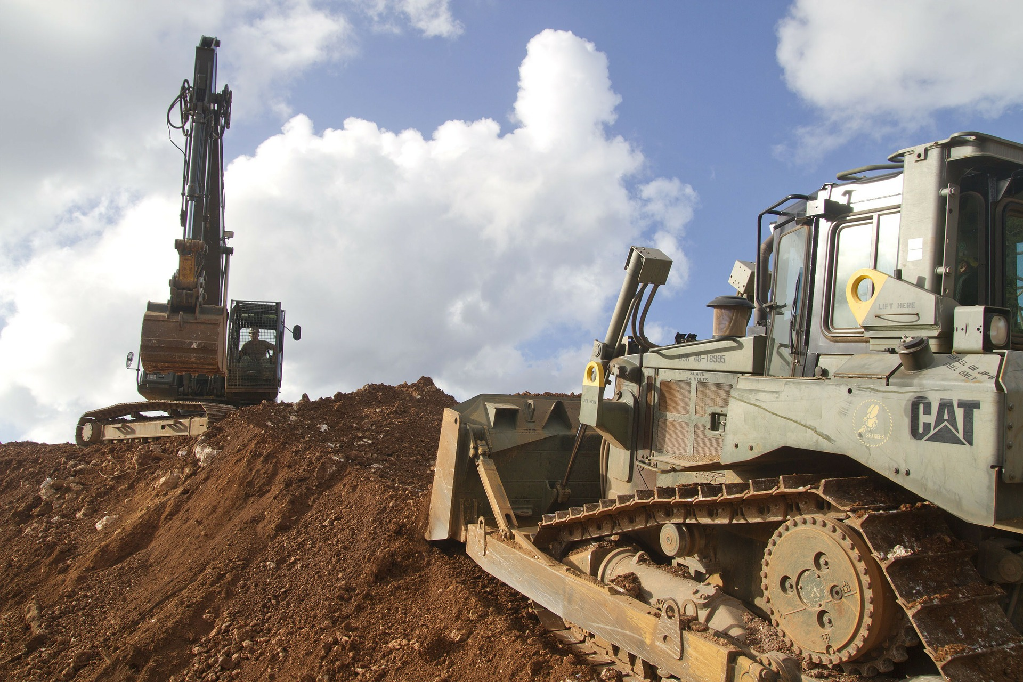
What’s the Danger?
EXCAVATION HAZARDS
TRENCHING/SHORING
Notes:
What’s The Danger?
Excavation Hazards
The main hazards associated with excavation work include:
Surface encumbrances.
Excavation collapse.
Loose rock or soil.
Contact with underground services and/or overhead power lines.
Falling loads - Materials falling onto people working in the excavation.
Mobile equipment - People and vehicles falling into the excavation.
Vehicular traffic - People being struck by plant machines.
Undermining of nearby structures.
Access/egress to/from excavation.
Hazardous atmospheres.
Ground wáter.
Accidents to members of the public.
Trenching and Shoring
One of the most dangerous forms of construction work is the excavation labor involved with trenching and shoring.
Thousands of employees are injured each year performing this type of work, and hundreds are killed. In fact, the fatality rate for trenching is twice that of deaths incurred from other forms of construction.
Cave-ins can result from many shifts in the earth that occur during the trenching and shoring process. For example:
The addition or removal of water
Vibrations from the excavation
Added or reduced weight of soil or adjacent structures
Reduction in frictional forces
Any amount of freezing or thawing
Once these cave-ins occur, death can result instantly, or workers can become trapped and be severely injured or suffer from asphyxiation.

Slide 5
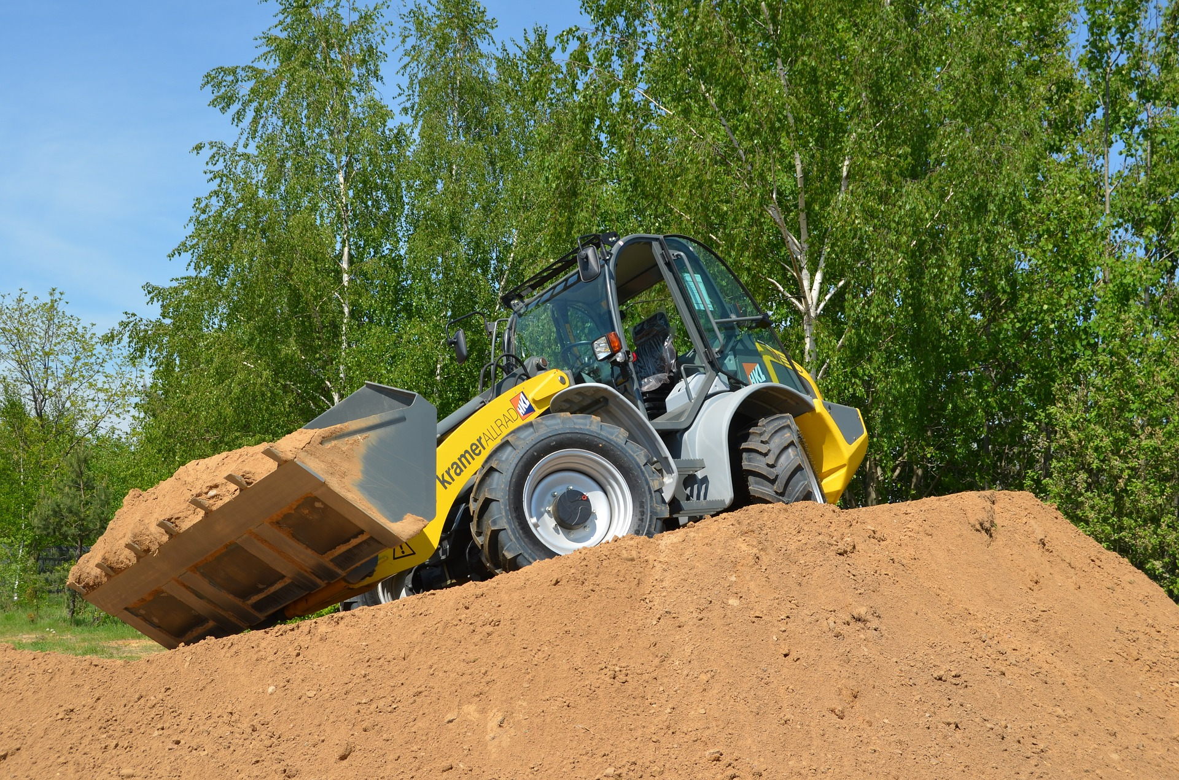
How to Protect Yourself
PROCEDURE BEFORE EXCAVATION WORK
Ongoing Safety Requirements
Be Aware of Your Environment
Be Aware of Your Environment
Shoring Types
There are two basic types of shoring, timber and aluminum hydraulic.
Notes:
How to Protect Yourself
Procedure Before Excavation Work
Investigate if a dangerous atmosphere is present or liable to be present?
See is the space adequately ventilated to maintain adequate oxygen content and prevent the accumulation of harmful substances?
Find out what the use and history of the location of work is when carrying out risk assessment. Buried underground pipe work or a leakage in sewage system may present a hidden hazard.
Investigate if a dangerous atmosphere is potentially present; the excavation must be treated as a confined space.
A safe system of work must be developed and put in place, including the making of appropriate emergency arrangements. The safe system of work may involve the provision of adequate ventilation, testing of atmosphere, or other precautions, as devised by a competent person.
Ongoing Safety Requirements
Throughout your trenching and shoring project it is vital that you ensure:
Employees wear proper protective Equipment.
Inspections are conducted prior to each work shift.
All spoilage is at least two feet from trench edges.
Employees do not travel under elevated loads.
And there are trench exits within 25 feet of workers who are in trenches more than 4 feet deep.
Be Aware of Your Environment
Be aware of all the different external factors (aside from the terrain itself) that could pose danger to your employees, such as:
Foot and vehicle traffic in the area, likes cars and pedestrians.
Surface hindrances, like telephone posts, fencing, and electrical boxes.
Underground installations, like utility lines.
Hazardous atmospheres, like areas that are flammable or oxygen deficient.
Shoring Types
Shoring is the provision of a support system for trench faces used to prevent movement of soil, underground utilities, roadways, and foundations. Shoring or shielding is used when the location or depth of the cut makes sloping back to the maximum allowable slope impractical. Shoring systems consist of posts, wales, struts, and sheeting. There are two basic types of shoring, timber and aluminum hydraulic.
Hydraulic Shoring
The trend today is toward the use of hydraulic shoring, a prefabricated strut and/or wale system manufactured of aluminum or steel. Hydraulic shoring provides a critical safety advantage over timber shoring because workers do not have to enter the trench to install or remove hydraulic shoring. Other advantages of most hydraulic systems are that they:
Are light enough to be installed by one worker
Are gauge-regulated to ensure even distribution of pressure along the trench line
Can have their trench faces "preloaded" to use the soil's natural cohesion to prevent
movement
Can be adapted easily to various trench depths and widths
All shoring should be installed from the top down and removed from the bottom up. Hydraulic shoring should be checked at least once per shift for leaking hoses and/or cylinders, broken connections, cracked nipples, bent bases, and any other damaged or defective parts.
Pneumatic Shoring
Works in a manner similar to hydraulic shoring. The primary difference is that pneumatic shoring uses air pressure in place of hydraulic pressure. A disadvantage to the use of pneumatic shoring is that an air compressor must be on site.

Slide 6
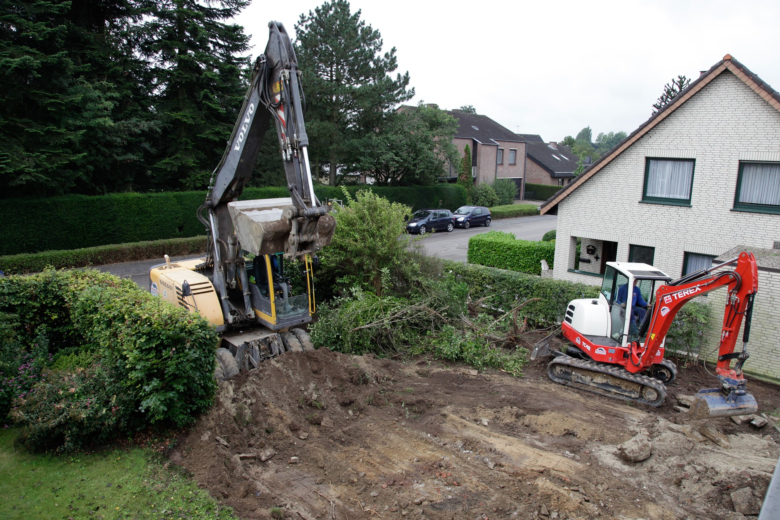
How to Protect Yourself
Screw Jacks
Screw jack systems differ from hydraulic and pneumatic systems in that the struts of a screw jack system must be adjusted manually.
EXCAVATION PRECAUTIONS
Notes:
How to Protect Yourself
Screw Jacks
Screw jack systems differ from hydraulic and pneumatic systems in that the struts of a screw jack system must be adjusted manually. This creates a hazard because the worker is required to be in the trench in order to adjust the strut. In addition, uniform "preloading" cannot be achieved with screw jacks, and their weight creates handling difficulties.
Excavation Precautions
According to the Construction Regulations, precautions must be taken that are adequate to:
Guard against danger to persons at work from a fall or dislodgement of earth, rock or other material by suitable shoring or otherwise
Guard against dangers arising from the fall of materials or objects or the inrush of water into the excavation, shaft, earthworks, underground works or tunnel
Secure adequate ventilation at all workplaces so as to maintain an atmosphere fit for respiration and to limit any fumes, gases, vapours, dust or other impurities to levels which are not dangerous or injurious to health
Enable persons at work to reach safety in the event of fire or an inrush of water or materials
Avoid risk to persons at work arising from possible underground dangers such as underground cables or other distribution systems, the circulation of fluids or the presence of pockets of gas, by undertaking appropriate investigations to locate them before excavation begins
Ensure that a safe means of access to and egress from each excavation

Slide 7
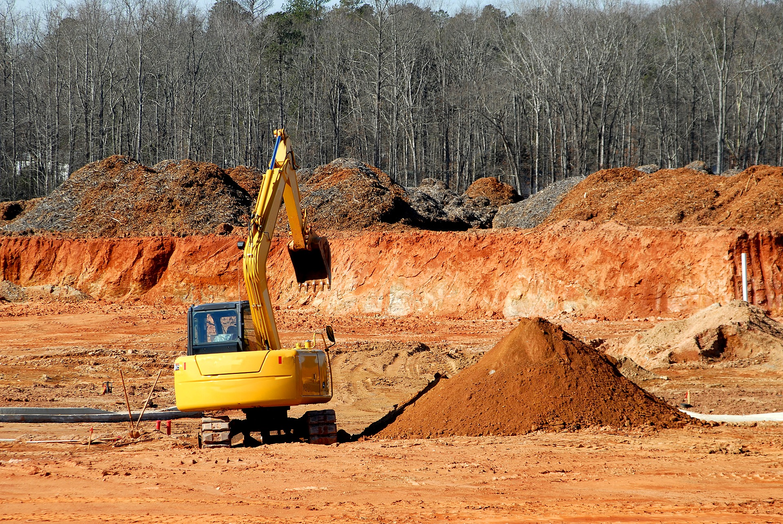
How to Protect Yourself
Many factors should be considered when designing trench systems, including the qualities of the soil, changes caused by weather or climate, materials that were taken out of or will be put into the trench, or other projects nearby. Planning and implementation of these systems should be done by a competent person.
Notes:
How to Protect Yourself
Cave – Ins
Employers can help reduce injuries and fatalities caused by cave-ins. 10 safety tips that will allow crews to work safer.
Never enter an unprotected trench.
Park heavy equipment as far from trench edges as possible. Keep soil or other materials at least two feet away from the sides of the trench. If the job site does not allow for two feet of distance, soil removed from the trench may need to be moved to another location until work is completed.
Find out where utilities are located underground before crews start digging.
Inspect trenches daily before work begins and after storms or other events that may cause changes to the trench. OSHA requires that these inspections are completed by a ‘competent person,’ someone with the knowledge to identify hazards in and around the excavation and who has the authority to promptly correct those hazards.
When exposed to traffic, workers can prevent accidents by wearing highly visible clothing such as traffic safety vests.
Educate workers on the dangers involved in excavation and on proper safety precautions. An affordable way to ensure workers receive thorough information is to use training videos and DVDs.
Never work beneath suspended loads of materials.
When the trench is more than four feet deep, test atmospheric conditions before work begins. If tests reveal low oxygen, toxic gases, or hazardous fumes, no one should enter the trench.
Create systems to protect workers and prevent collapses. Some of the most common and effective protective systems include:
Benching – Building steps into the sides of an excavation
Sloping – Angling the trench wall away from the excavation
Shoring – Installing supports such as aluminum hydraulics to prevent soil movement
Shielding – Protecting workers with trench boxes or other protective equipment
10. Provide safe entrances and exits to the trench. OSHA requires that ladders, steps, or ramps be used whenever a trench or excavation is more than four feet deep and that all employees work within 25 feet of these provisions at all times. When using ladders, they must extend a minimum of 3 feet above the surface of the trench.

Slide 8
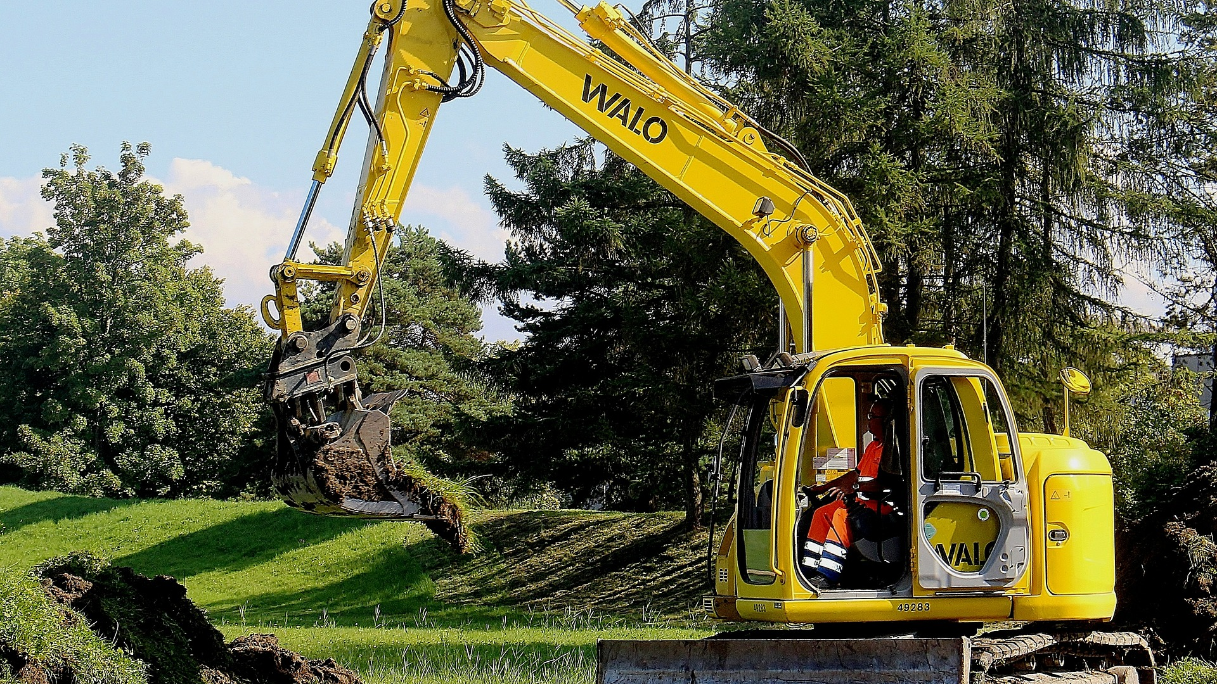
Final Word
Employers can help prevent injuries and deaths by frequently reminding workers of these guidelines and posting signs that stress the dangers of excavation. These warnings could be the difference between good and bad decision-making on the job site.
Notes:
Final Word
Employers can help prevent injuries and deaths by frequently reminding workers of these guidelines and posting signs that stress the dangers of excavation. These warnings could be the difference between good and bad decision-making on the job site.

