Slide 1

Click anywhere to get started…

Slide 2

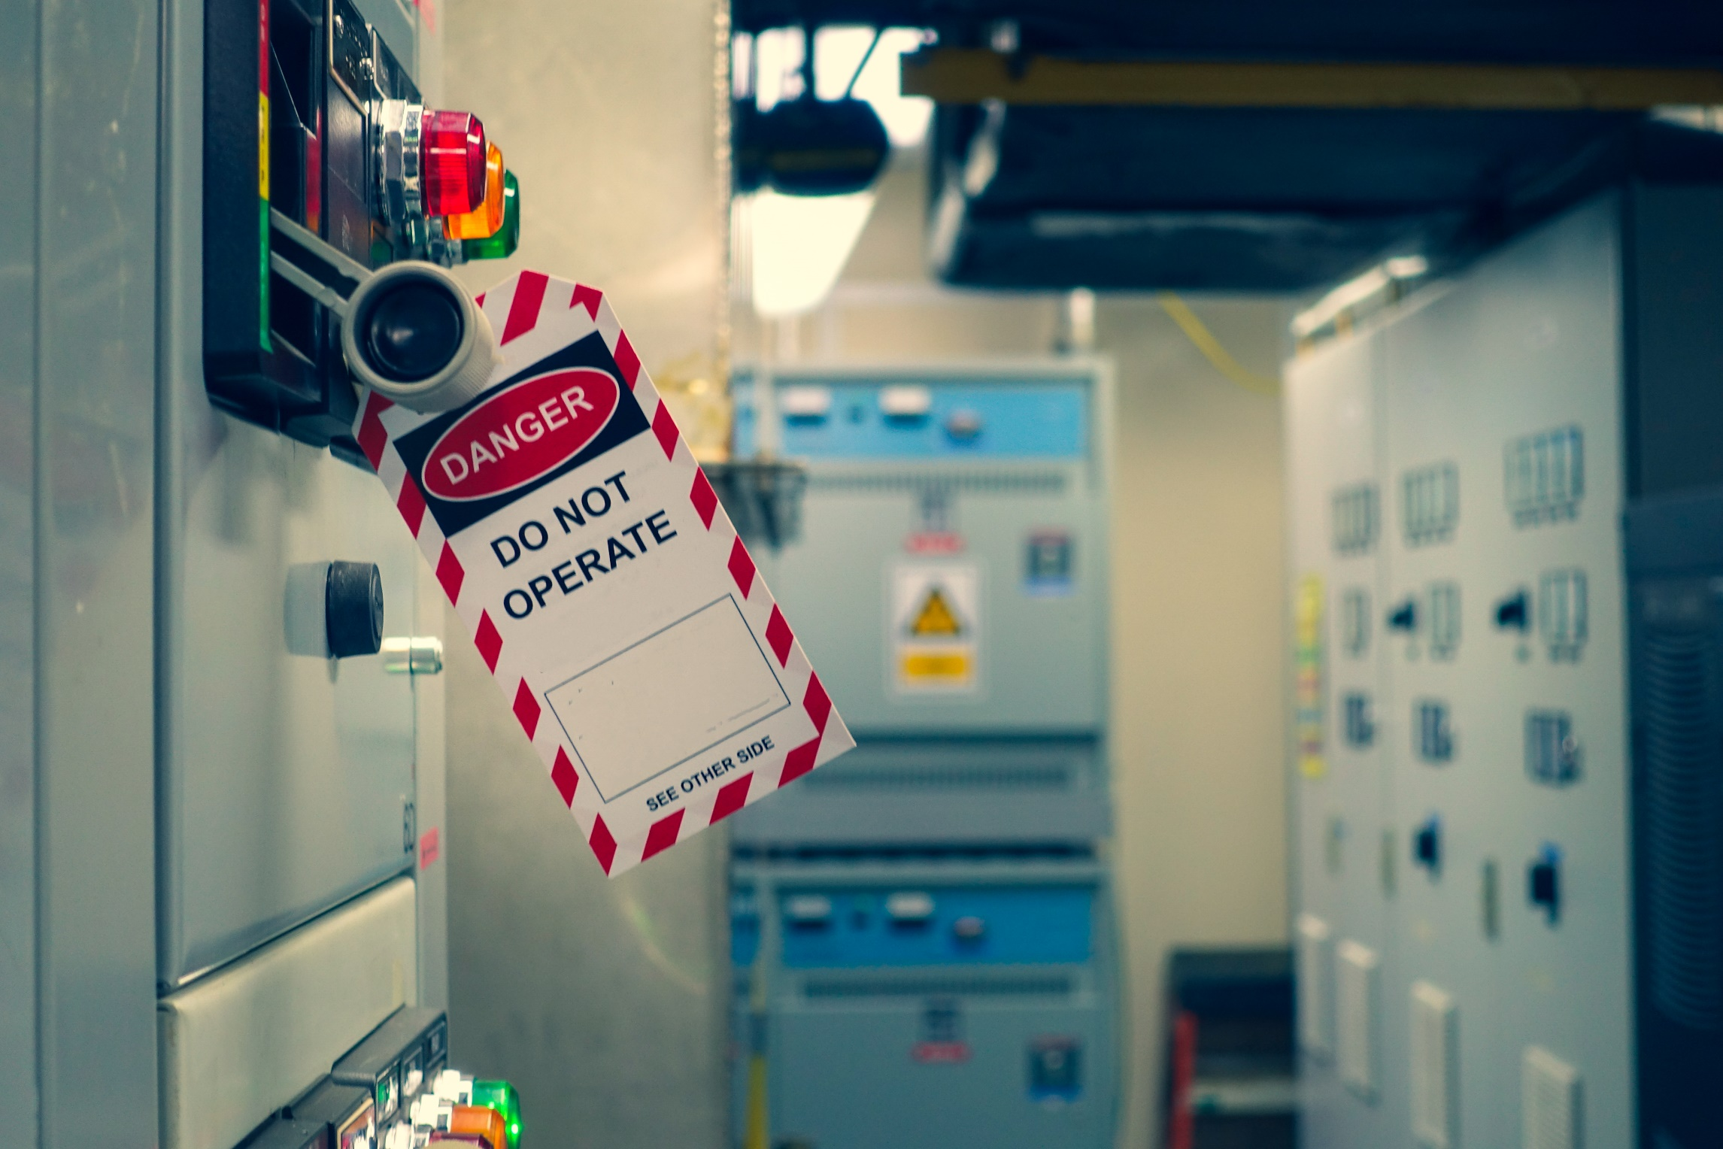

LOCKOUT
Notes:
Lockout

Slide 3
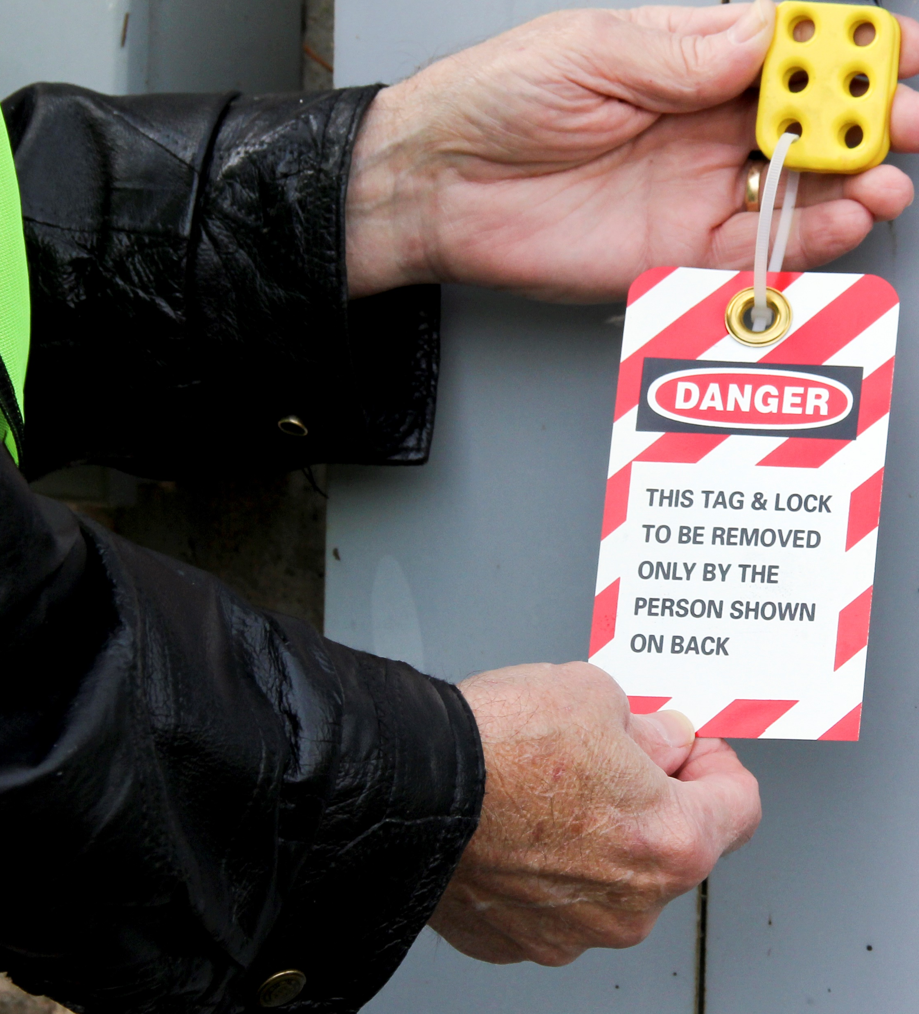
What’s at Stake?
Lockout procedures and lockout products are critical parts of any workplace safety program, especially in industries involving heavy machinery and equipment. Lockout tools such as padlocks and safety hasps prevent machines from being powered on while under repair or out of order.
Notes:
What’s at Stake?
Lockout procedures and lockout products are critical parts of any workplace safety program, especially in industries involving heavy machinery and equipment. Lockout tools such as padlocks and safety hasps prevent machines from being powered on while under repair or out of order. The addition of mandatory lockout tags is crucial in identifying the authorized personnel in charge of the equipment.

Slide 4
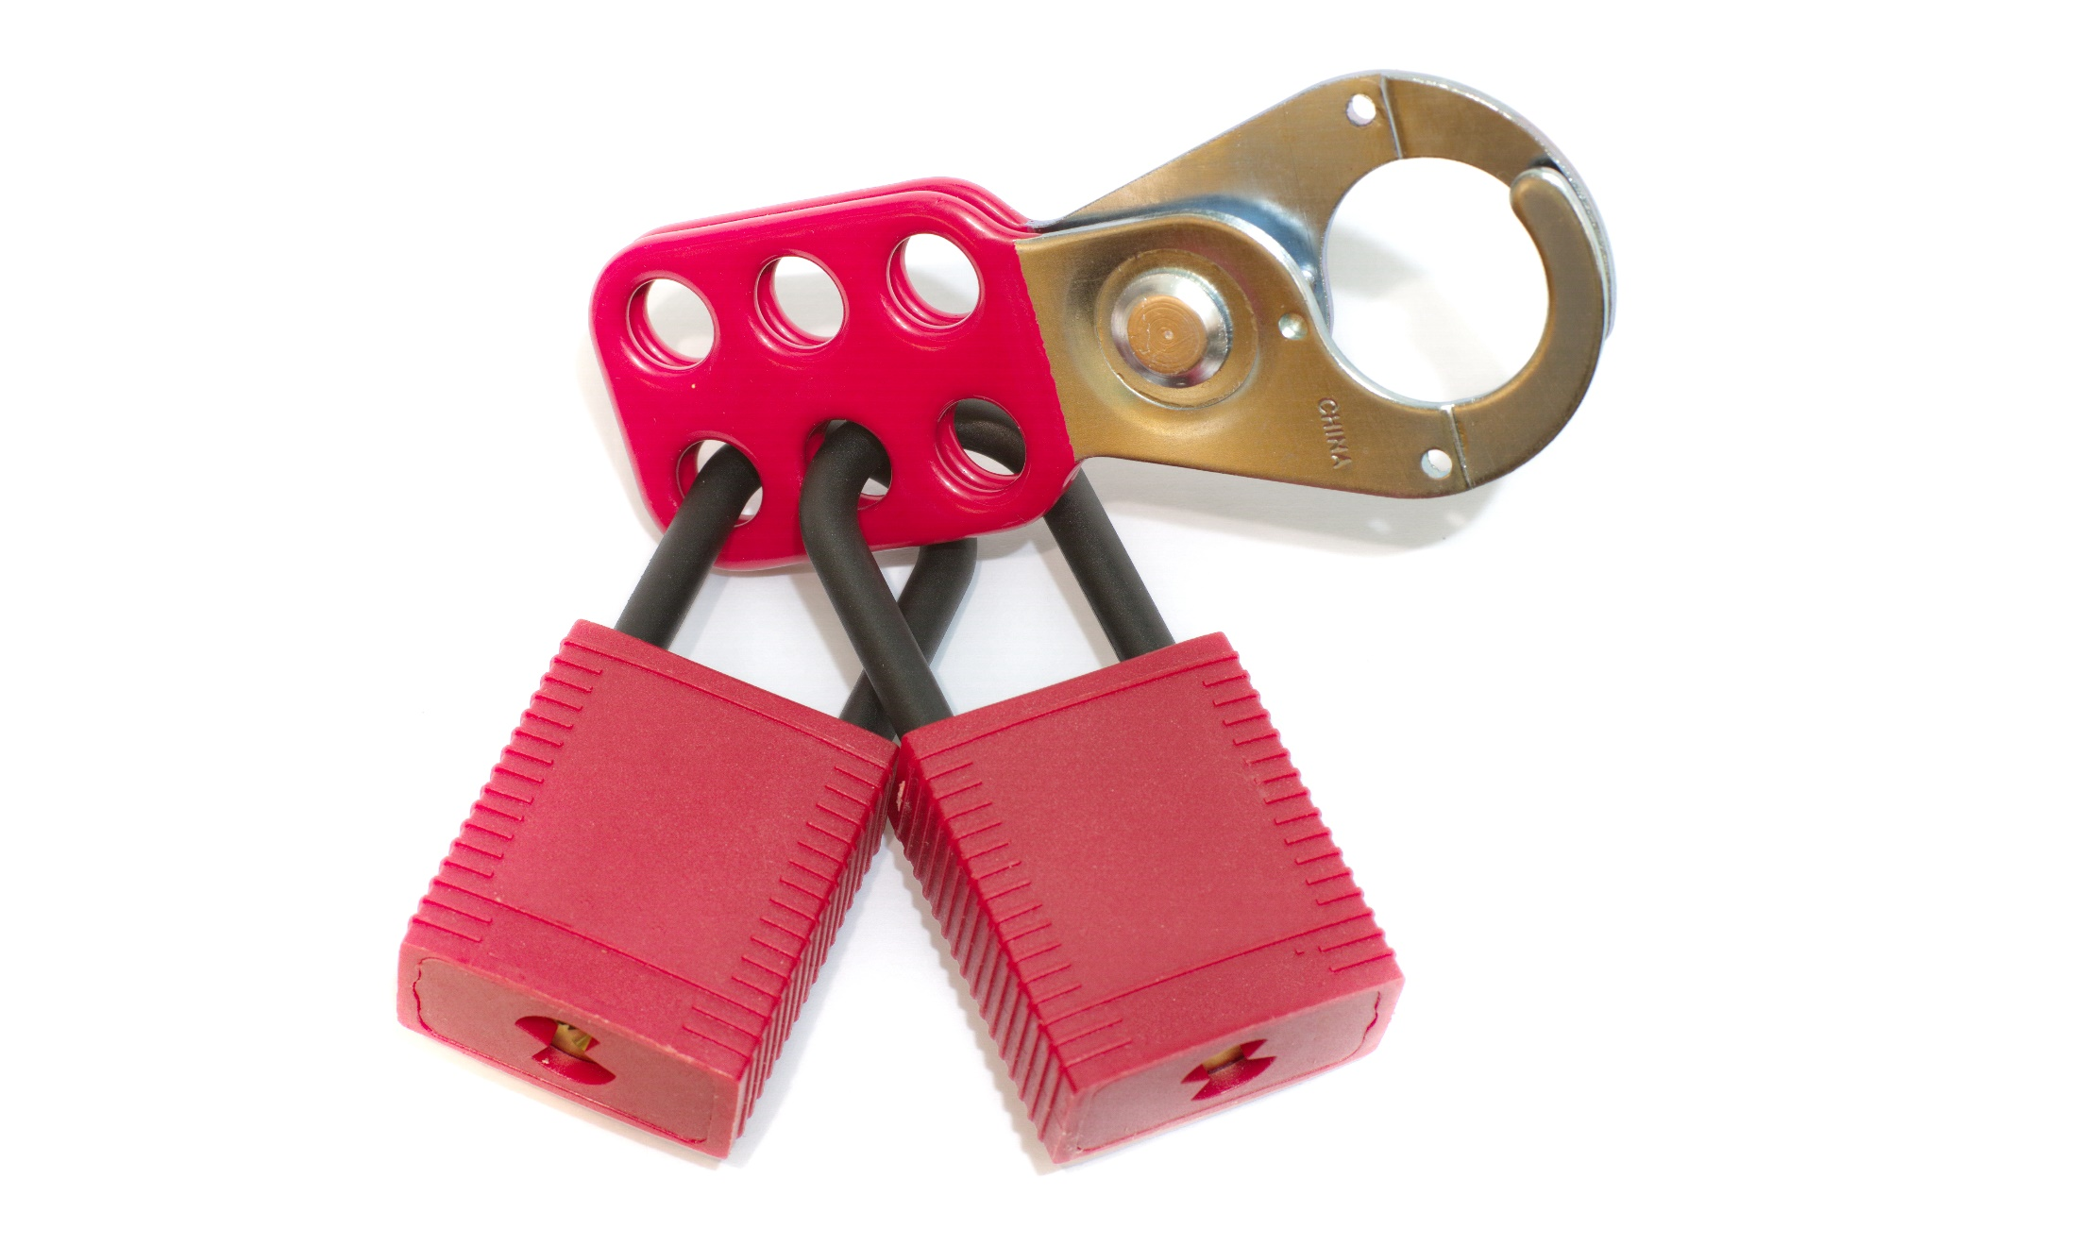
What’s the Danger?
It is dangerous to leave hazardous machines or equipment out on the industrial work floor with just a verbal warning to employees not to use it. The lock and tag are crucial to employee and visitor safety.
Lockout/Tagout is to protect employees and property from damage due to unexpected start-up and reenergization of machines during servicing.
Lockout/Tagout – Overview
Notes:
What’s the Danger?
It is dangerous to leave hazardous machines or equipment out on the industrial work floor with just a verbal warning to employees not to use it. Employees may forget or simply ignore warnings and become severely injured by an unexpected outburst of hazardous energy. This is why the lock and tag are so crucial to employee and visitor safety.
Lockout/Tagout is to protect employees and property from damage due to unexpected start-up and reenergization of machines during servicing. In other words, the intent is to keep someone from starting the equipment when an employee is inside it.
Lockout/Tagout – Overview
Safety while maintenance, cleaning or repairs are performed
Prevents injuries
Prevents damage
Prevents errors
Communicates risk in the workplace

Slide 5
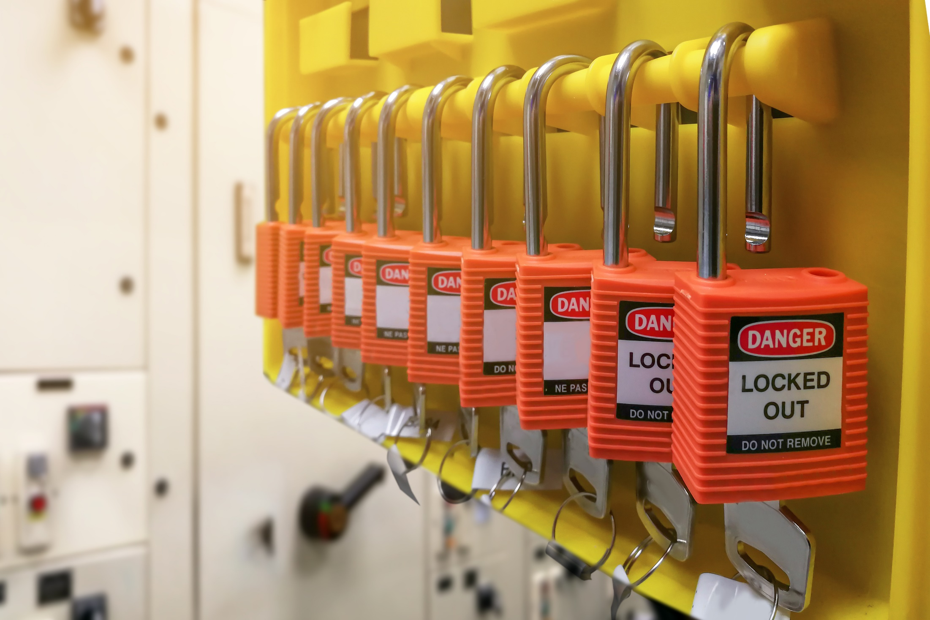
How to Protect Yourself
DEFINITIONS – EXPLAIN LOCKOUT TERMINOLOGY
Personal Lock:
Scissors:
Tag:
Zero Energy State:
Notes:
How to Protect Yourself
DEFINITIONS – EXPLAIN LOCKOUT TERMINOLOGY
Personal Lock:
A key type of padlock issued to a worker to be used only for locking energy sources in an inoperative or safe position. The company owns all personal locks and they are unique to the lockout system.
Scissors:
A multi-hole clamp device that is connected to a lockout point to allow more than one worker to lockout on a single system.
Tag:
A tag used to convey information about the individual, equipment or process involved in locked out. Tags without locks do not constitute lockout.
Zero Energy State:
State in which a machine, system or process has been rendered incapable of start-up or movement. Zero energy state means the elimination or control of:
Electrical power
Equipment balance).
Hydraulic fluids under pressure
Static electricity
Energy stored in springs
Unstable ground
Potential energy from suspended parts
Any other sources that might cause unexpected mechanical movement (e.g. freezing or thawing
Steam
Capacitors

Slide 6
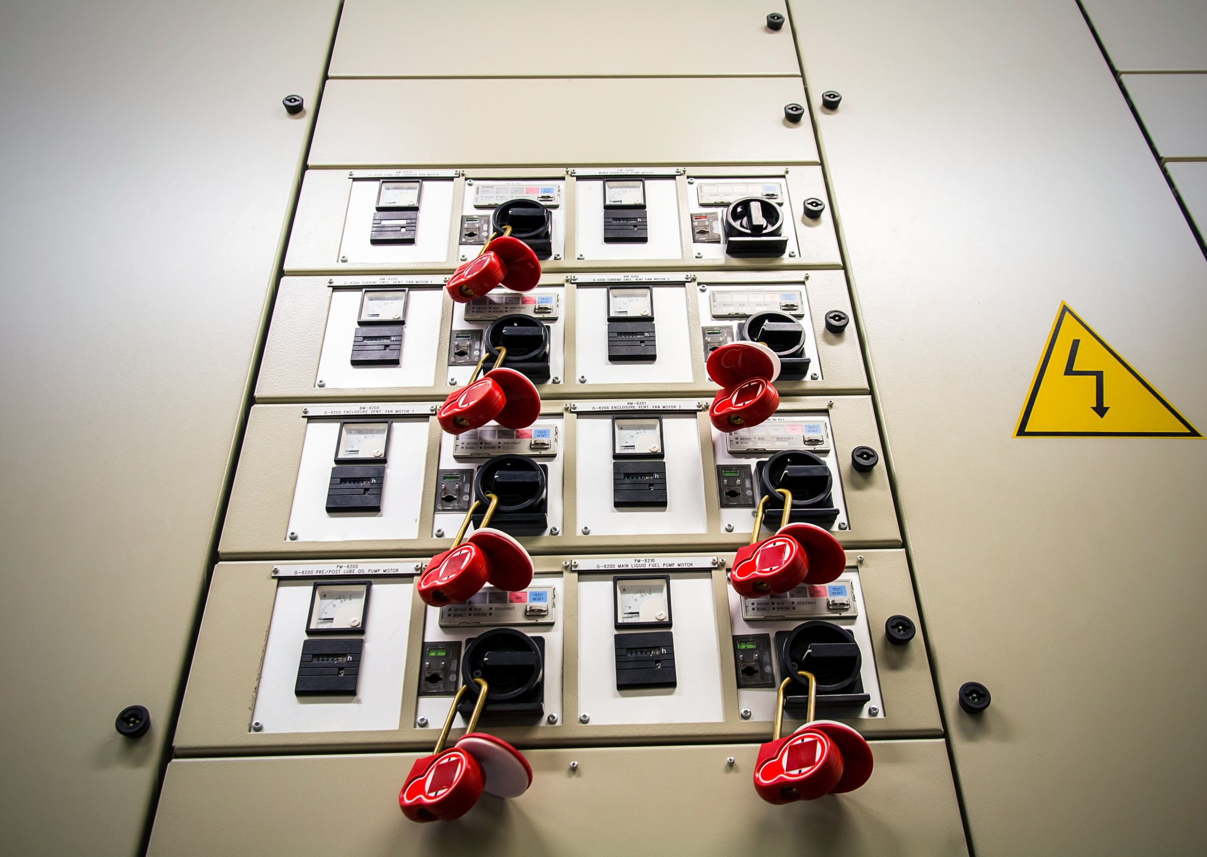
How to Protect Yourself
Three Steps to Ensure Employee Safety
Develop
Implement
Train
GUIDELINES – LOCKOUT
RESPONSIBILITIES – SUPERVISORS
Workers
LOCKOUT PROCEDURE – SUMMARY
Notes:
How to Protect Yourself
Three Steps to Ensure Employee Safety
Develop – create a lockout/tagout program specific to the machinery in your facility, including equipment that is not capable of being locked out
Implement – use lockout devices for equipment that can be locked out and tagout devices to identify who is performing maintenance
Train – teach employees the lockout/tagout procedures and be sure authorized employees can perform the procedure accurately
GUIDELINES – LOCKOUT
Personnel will not work on any equipment that represents a safety hazard unless that equipment is properly locked out.
All personnel who will be working on the equipment are required to place their personal lock on the isolating devices or lockout box. This includes supervisors.
The isolating device shall be secured in the inoperative position by the use of scissors and locks. Locks shall be identified with a tag indicating the name of the person applying them.
Locks issued to an individual worker shall be operable only by that worker’s key and by a master key for emergency use, which shall be securely kept by the company.
Locking a lock through another lock does not meet lockout requirements.
When inserting locks into scissors, do not insert a lock into the last scissor hole, instead attach another scissor and insert your lock on the second scissor.
Personnel must keep the key to their lockout locks on their person at all times.
Only locks owned by the company and designated for lockout are to be used for lockout.
Combination locks shall not be used at any time.
If a worker has left work (quit, terminated, or injured) their personal locks must be removed from service until the keys are recovered.
Personnel must remove their locks when they leave the work site or are no longer working on the equipment.
No personnel shall remove any personnel lock other than their own, unless the proper procedure with documentation is followed.
Shutting down the power generator without locking out the main disconnect does not fulfill the lockout requirements.
Switches must not be opened under load due to risk of arcing and explosion.
Components that feed into or out of, or are interlocked with the component to be repaired or serviced must be isolated and locked out.
RESPONSIBILITIES
Supervisors:
Educate all workers in the use of lockout procedure.
Identify all sources of energy that require control and lockout.
Control and administer the lockout locks.
Ensure the lockout procedure is followed.
Workers:
Follow the lockout procedure.
Only remove one’s own locks from the system.
Report any irregularities or non-conformance situations to their supervisor.
LOCKOUT PROCEDURE – SUMMARY
Identify the equipment or machine that needs to be locked out.
Ensure that the machine is stopped.
Identify and deactivate the main energy source.
Apply personal locks to the energy source.
Ensure that the lock out is effective.
When the work is complete or a worker is no longer required to work on the device, he must remove his own personal lock and return it to the lockout station. The worker with the last lock on the system must notify the supervisor that the work is complete and that he is ready to remove his lock.
The supervisor must verify that,
All workers are clear,
All equipment and tools are removed,
The machinery or process is clear to reactivate.
The worker must remove the last lock from the isolation points.

Slide 7

Final Word
Proper lockout procedures save lives of workers working on or near locked out machinery. Procedures are an important safety measure when isolating equipment from energy source.
Notes:
Final Word

