Slide 1

Click anywhere to get started…

Slide 2



FARM MACHINERY AND LEFT-HAND TURNS
Notes:
Farm Machinery and Left-Hand Turns

Slide 3
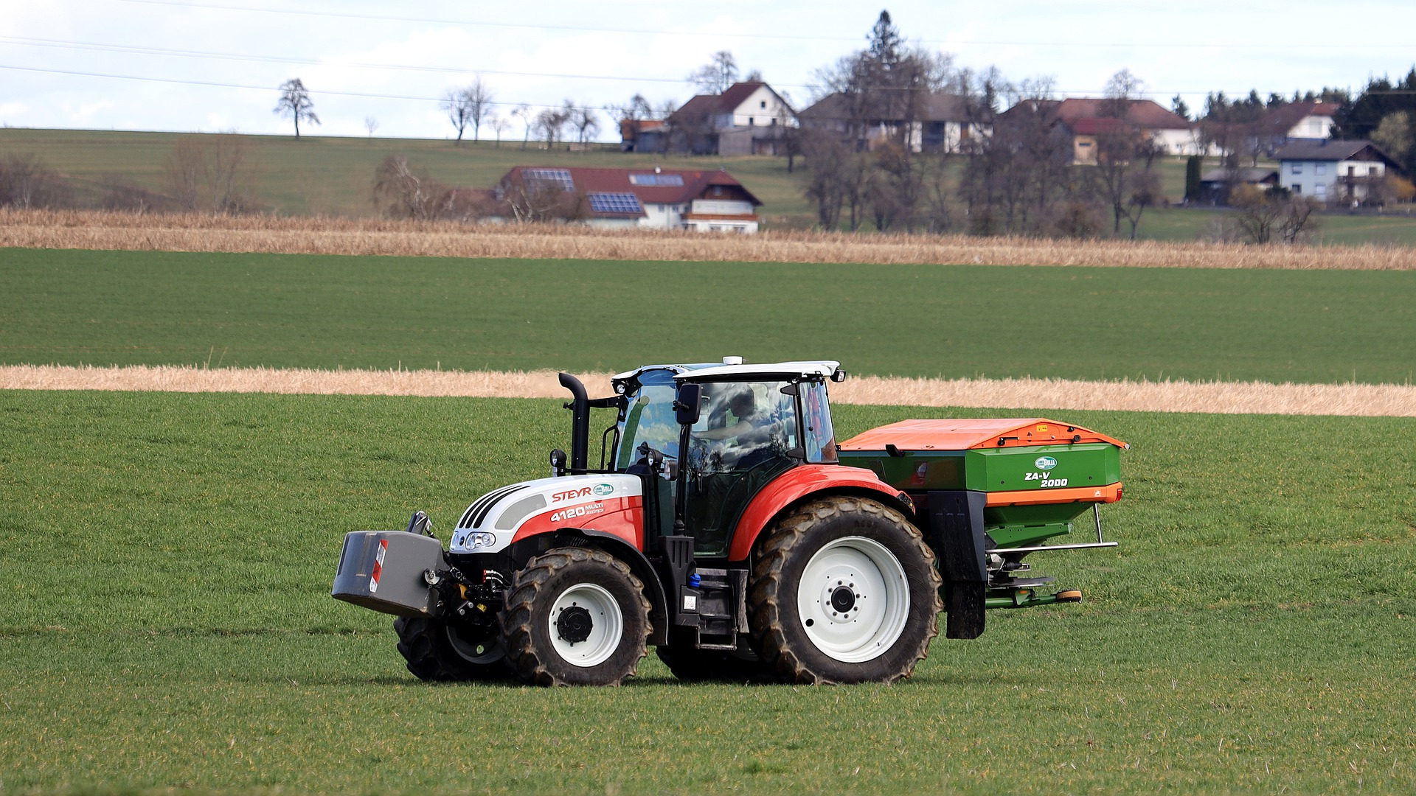
What’s at Stake?
Poorly used or faulty machinery is a major cause of death and injury on farms. Common tractor accidents involve roll-overs, run-overs and unguarded power take-off (PTO) shafts.
Notes:
What’s at Stake?
Poorly used or faulty machinery is a major cause of death and injury on farms. Common tractor accidents involve roll-overs, run-overs and unguarded power take-off (PTO) shafts. Other dangerous machinery includes quad (four wheel) bikes and motorbikes, chain and bench saws, harvesters, generators, augers and earth-moving equipment.
The left-turn collision is the most common type of farm machinery collisions on public roads. It happens when the farm vehicle is about to make a left turn; while, the motorist behind the farm vehicle decides to pass.

Slide 4
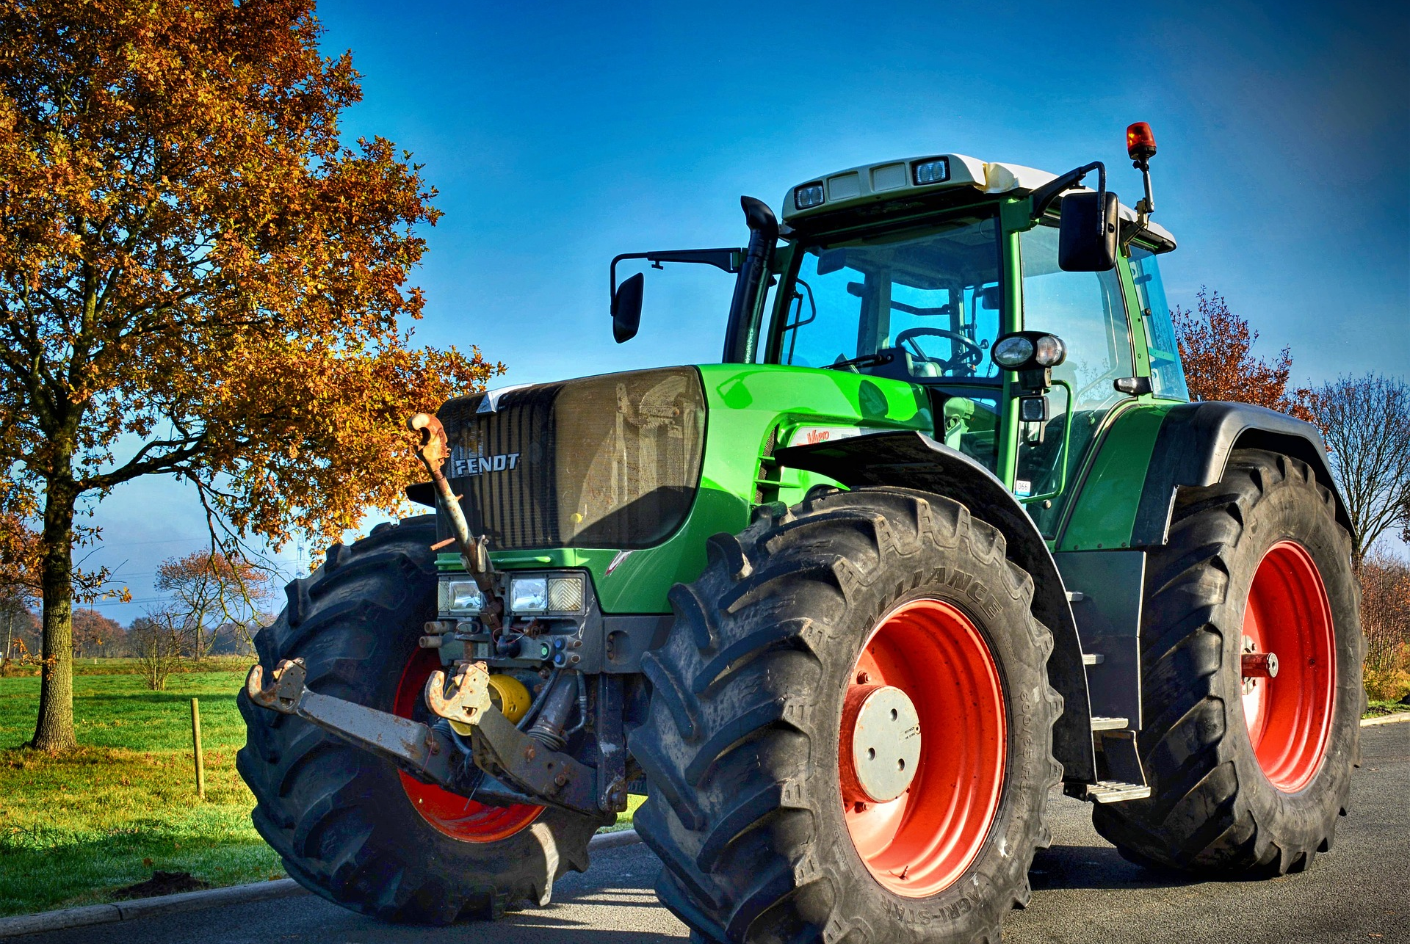
What’s the Danger?
You might not always be the one driving the farm equipment. Remember it’s easy to misjudge speed when you come upon a slow-moving vehicle. In most cases, you have only a few seconds to react and slow down.
Farm equipment is involved in more than one in three farm-related deaths.
Farms make up only 10 per cent of Victorian workplaces, but they account for between 25 and 50 per cent of all work-related deaths (fatalities) in any given year.
One in four unintentional farm deaths are caused by unsafe tractor operation.
Notes:
What’s the Danger?
CAUTION
You might not always be the one driving the farm equipment. Remember it’s easy to misjudge speed when you come upon a slow-moving vehicle. In most cases, you have only a few seconds to react and slow down. For example, if you’re driving 55 miles an hour and come upon a tractor that’s moving 15 miles an hour, it only takes five seconds to close a gap the length of a football field between you and the tractor.
Farm equipment is involved in more than one in three farm-related deaths. These machines are also involved in many accidents which result in life-changing injuries such as the loss of a limb.
Farms make up only 10 per cent of Victorian workplaces, but they account for between 25 and 50 per cent of all work-related deaths (fatalities) in any given year.
One in four unintentional farm deaths are caused by unsafe tractor operation. Tractors have a high centre of gravity and can flip and crush the driver if not fitted with a roll-over protection structure (ROPS). Hands, hair and clothing can be caught by unguarded PTO shafts or other unguarded moving parts such as pulleys and belts. People can be injured by front-end loaders, falling from a moving tractor or being struck by its wheels.
Modern tractors, telehandlers and other equipment have given farmers the ability to work more quickly and efficiently. But this machinery brings new dangers.

Slide 5
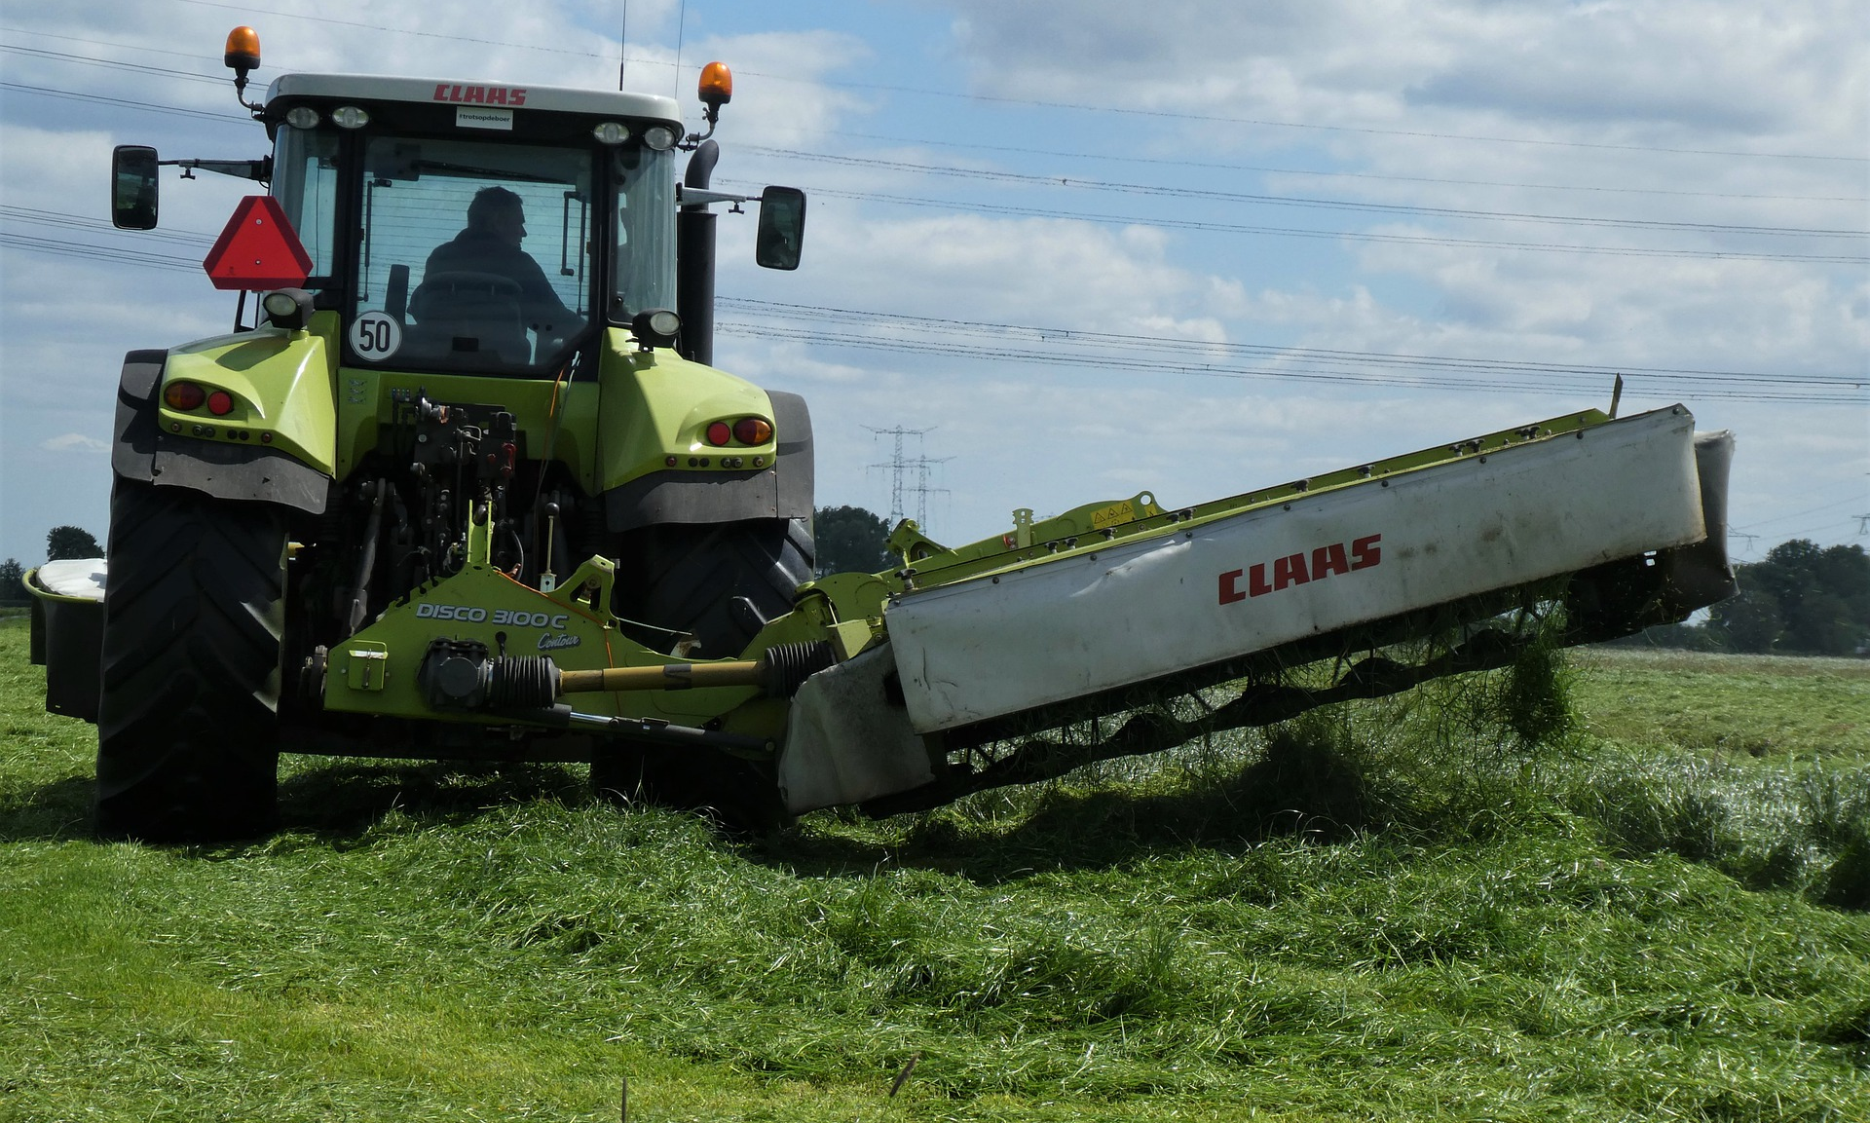
How to Protect Yourself
PRELIMINARY PROCEDURES
A. Think about the 'Safe Stop' procedure and always follow it. Complete four simple steps:
apply the hand brake
put the controls in neutral
turn off the engine
remove the key
B. Prevent loss of vehicle control
The driver must be trained and know how to operate the vehicle safely.
Notes:
How to Protect Yourself
PRELIMINARY PROCEDURES
Always take care when mounting or dismounting the vehicle. Only start the vehicle with a key when in the driving seat. Check brakes are working properly and keep them maintained.
Think about the 'Safe Stop' procedure and always follow it. Complete four simple steps:
apply the hand brake
put the controls in neutral
turn off the engine
remove the key
Think about all-round visibility. Drivers should be able to see around their vehicles to drive and manoeuvre safely. For a tractor this normally means having the side mirrors in place. Achieving all round visibility with telehandlers will depend on the design - is the boom front or side mounted? Your telehandler may require side mirrors and sometimes a fish eye mirror or camera at the back.
Think about added hazards. Other equipment that can be attached to a tractor, may bring additional dangers.
B. Prevent loss of vehicle control
The driver must be trained and know how to operate the vehicle safely. Before use, always check that the brakes are working and that they are interlocked. If the implement being trailed has hydraulic or pneumatic brakes, make sure they are connected. Check the surface that will be driven on and drive appropriately for the conditions.
If a driver loses control of a vehicle, a roll-over protective system (ROPS) will reduce the harm done. Make sure all your vehicles have the ROPS system in place. This means that all vehicles should have a safety cab, or at the very least an approved roll bar.
Seat belts must always be worn if they are fitted. If there is no safety cab and only a roll bar then ensure that seatbelts are retro-fitted.

Slide 6
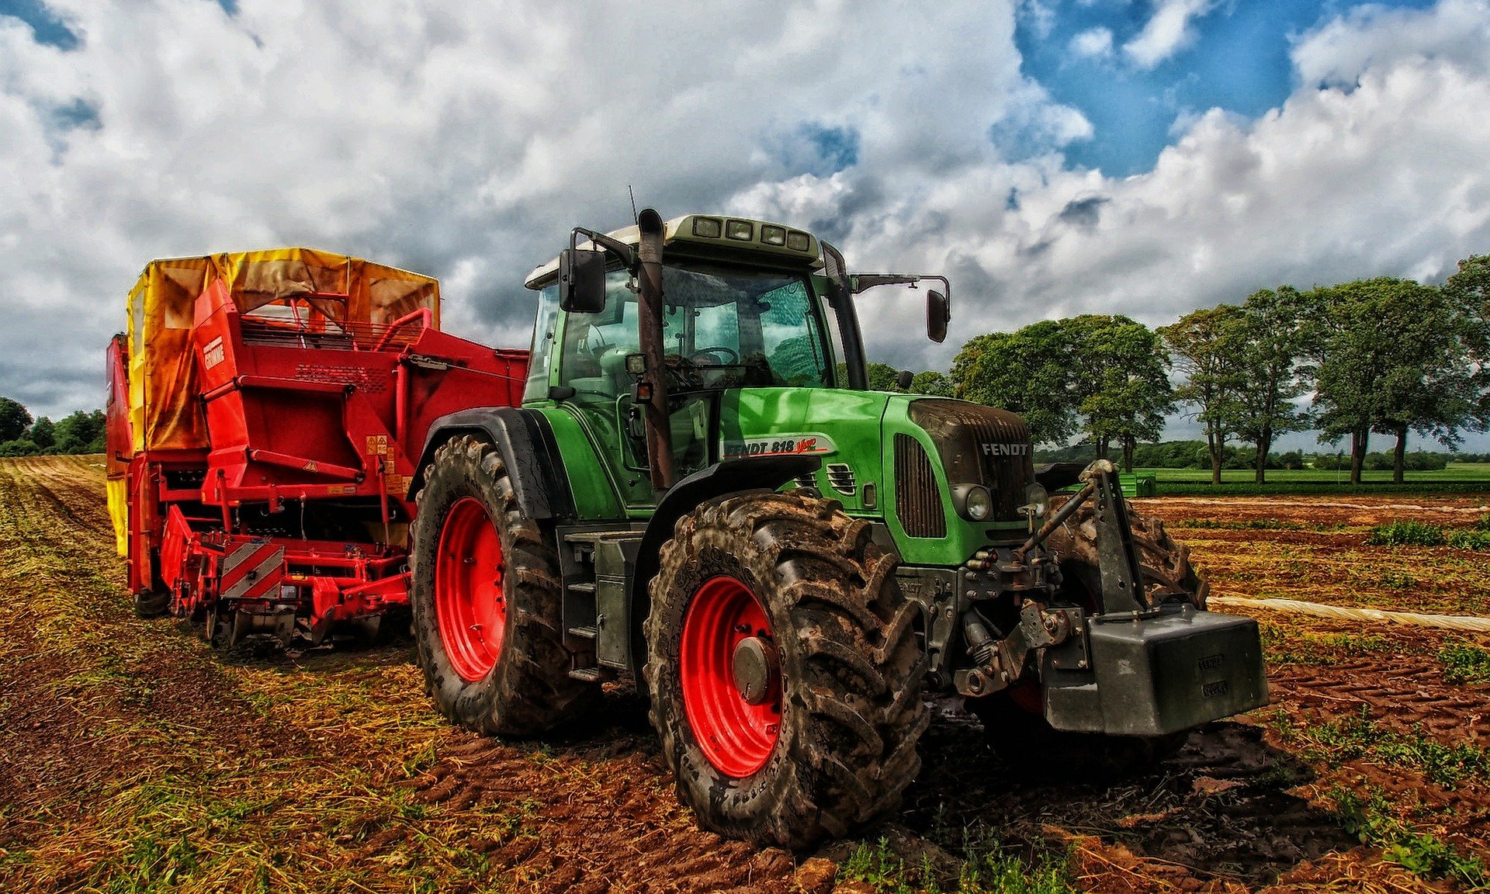
How to Protect Yourself
C. Guarding PTO shafts
Power-take-off shafts are the power source for many machines that are attached to and powered by tractors. The shaft can rotate at speeds up to 1,000 revolutions per minute (rpm).
D. Care around hydraulics
Many machines and attachments for tractors are powered by hydraulics.
Notes:
How to Protect Yourself
C. Guarding PTO shafts
Power-take-off shafts are the power source for many machines that are attached to and powered by tractors. The shaft can rotate at speeds up to 1,000 revolutions per minute (rpm). A PTO shaft must always be correctly guarded as shown in this diagram.
Broken, damaged or badly-fitting PTO guards are as dangerous as an unguarded PTO shaft, as a faulty guard can give a false sense of security. Repair or replacement is vital and could save lives.
Never wear loose clothes when operating machines powered by PTOs.
D. Care around hydraulics
Many machines and attachments for tractors are powered by hydraulics. Oil is pumped from the tractor to the equipment through pipes at very high pressures over 2,500 pounds per square inch (psi).

Slide 7
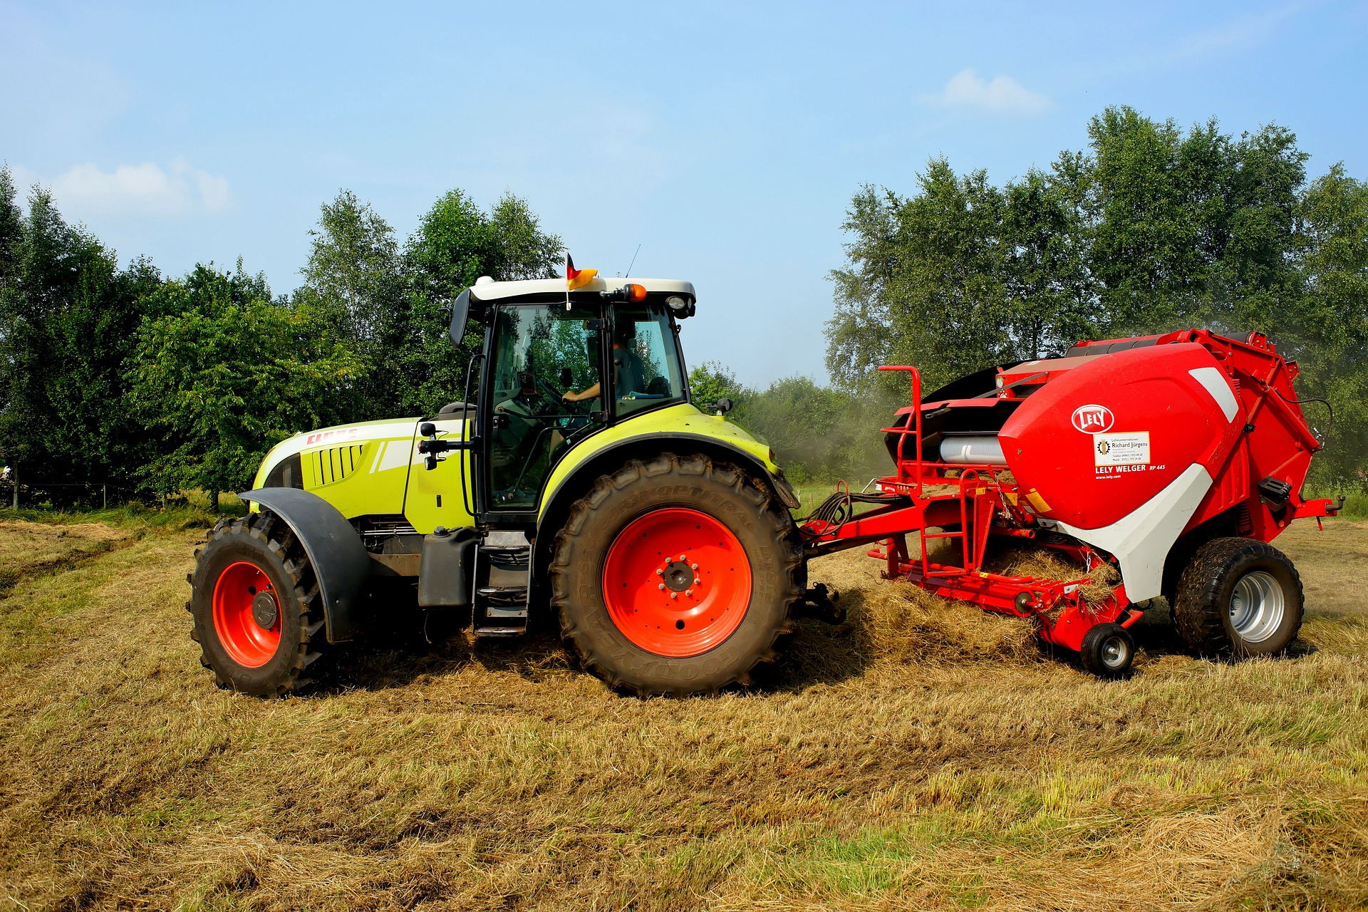
How to Protect Yourself
SAFETY PRECAUTIONS/FARM MACHINERY
General safety suggestions include:
Use All of Your Safety Equipment
Drive Defensively
Change Travel Times, If Possible, To Avoid Peak Roadway Use
Train workers thoroughly in farm machinery safety
Safe tractor operation
Safety Suggestions
Unguarded power take-off shafts are extremely hazardous
All moving machinery parts should be guarded so that clothing, hair or fingers can’t get caught.
Notes:
How to Protect Yourself
SAFETY PRECAUTIONS/FARM MACHINERY
General safety suggestions include:
Read and follow the manufacturers’ instructions for operation.
Don’t remove or modify safety features.
Ensure that everyone working on the farm is thoroughly familiar with operating procedures and safety requirements for any machinery they use.
If needed, replace and fit guards to cover the moving parts of machinery – for example, a PTO guard.
Make sure that tractors are correctly ballasted or weighted for particular jobs.
Fit falling object protective structures (FOPS) on front-end loaders.
Keep a well-stocked, up-to-date first aid kit in an accessible area.
Always wear appropriate protective and visible clothing.
Use All of Your Safety Equipment
Make sure you turn on your lights when moving your machinery. This becomes especially important when moving at night. Make sure to signal your intention when making a wide left turn. Signaling becomes very important especially when turning into a field approach.
Drive Defensively
All roadway travel is a team effort between yourself and other drivers. When driving, be aware that traffic behind you will be trying to pass and may not anticipate your movements, such as a wide left turn. Make sure you look behind you before starting to make a left-hand turn. This could prevent a collision if other drivers aren’t aware of your intention.
Change Travel Times, If Possible, To Avoid Peak Roadway Use
If you can, move machinery during slower times on the roadway. If possible, change your route to avoid large amounts of traffic.
Here are some additional safety tips for avoiding collisions on public roadways:
Use pilot vehicles when transporting very large equipment or during heavy traffic periods.
Occupy the full lane. Don’t straddle the shoulder.
Don’t drive with all of the field lights
Train workers thoroughly in farm machinery safety
Inexperienced workers are much more likely to be injured in farm accidents.
Prevent injuries by:
Supervise inexperienced workers at all times.
Make sure your workers are thoroughly trained in equipment operation and safety.
Keep all equipment in good repair.
Warn workers of potential hazards and insist they undertake training and use equipment safely.
Only allow a worker to perform a task when you are confident they can handle it.
Keep visitors and children well away from operating machinery and warn them of potential hazards.
Safe tractor operation
Keep your tractor in good repair and immediately fix or replace faulty parts. Make detailed notes on services and repairs in a logbook and conduct a general maintenance check on the tractor every day before use.
Safety Suggestions
Devise safety procedures that everyone on your farm must follow, such as only starting the tractor when sitting in the driver’s seat and turning the tractor engine off before leaving the driver’s seat.
Install ROPS and seatbelts on all tractors.
If using a front-end loader, install FOPS.
Don’t allow anyone to stand near the tractor when it’s being started.
Don’t operate your tractor close to dams, pipes, drains or powerlines, on steep slopes or near other potential hazards.
Remember that tractors have a high centre of gravity and are more likely to tip when riding over hilly ground.
Don’t carry passengers.
Make sure that steps and control pedals are non-slip and kept clean.
Unguarded power take-off shafts are extremely hazardous
All moving machinery parts should be guarded so that clothing, hair or fingers can’t get caught. Power take-off (PTO) shafts can cause serious injury and death. Safety suggestions for PTOs include:
Guard the entire length of the shaft.
Anchor the shaft guard to stop it from rotating.
Enclose the joints with a guard.
Keep shields in place when using the tractor.
Always make sure all guards and shields are re-attached if removed during maintenance.

Slide 8
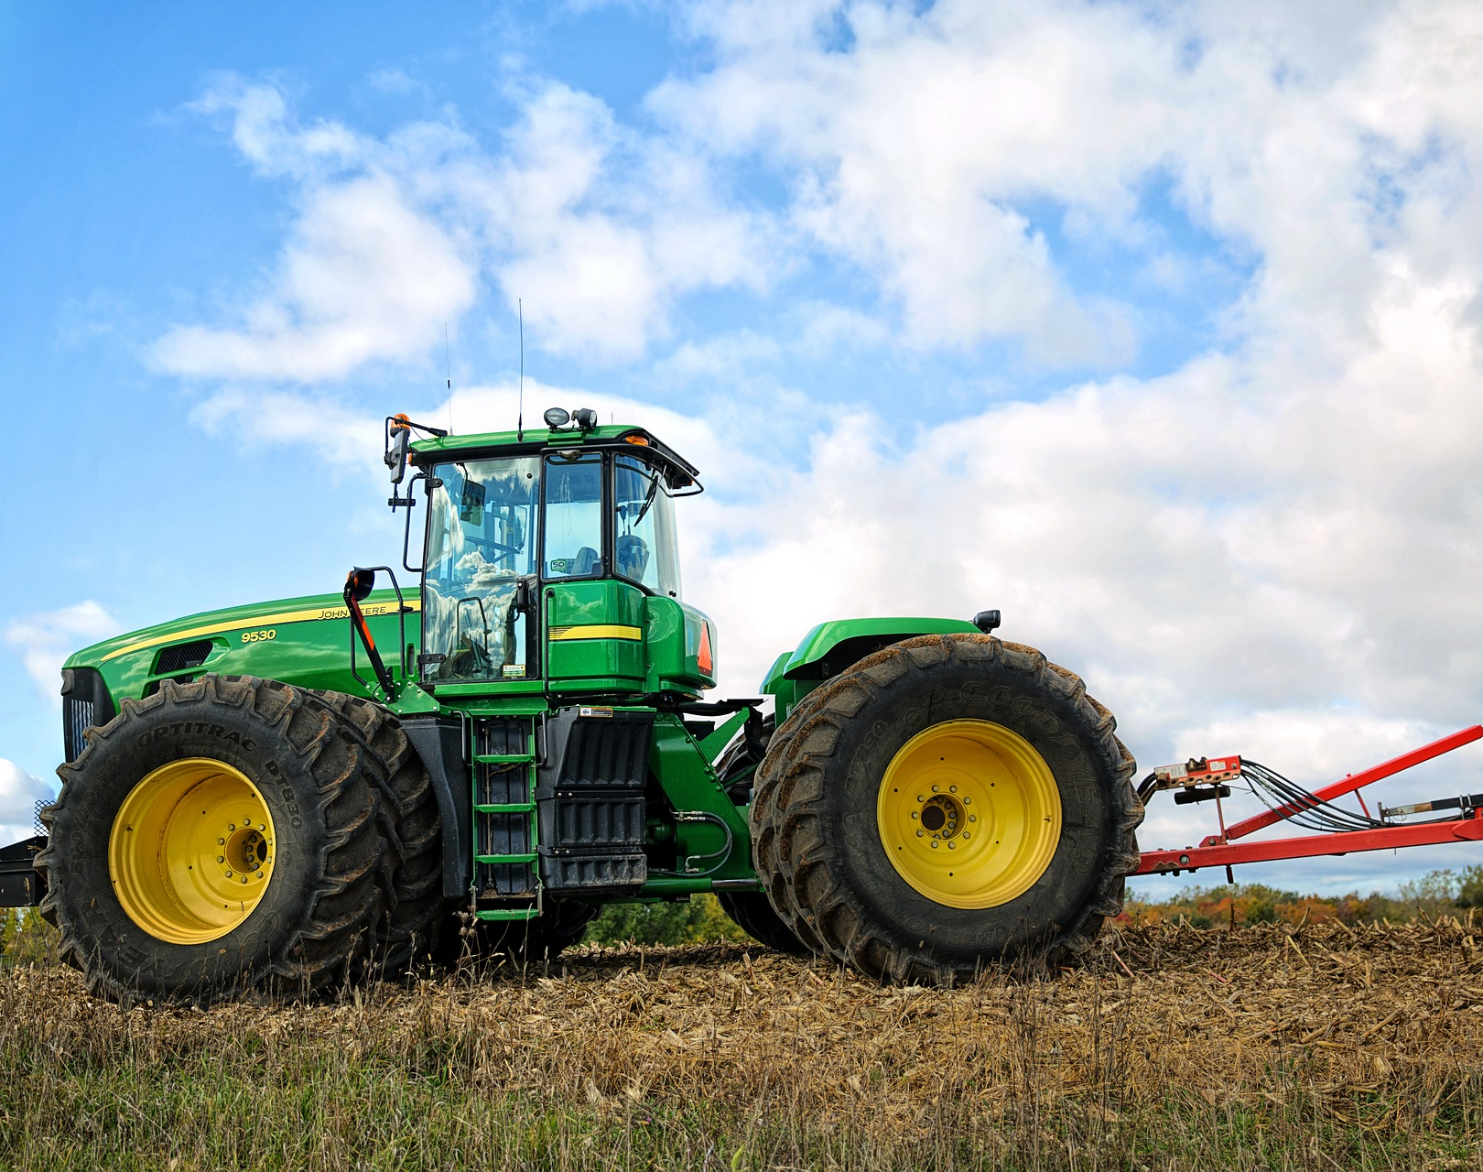
How to Protect Yourself
Protect children from tractor accidents
You can protect children from harm in many ways:
Warn children of the hazards and make them aware of safety issues.
Always remove keys from tractors.
Separate play areas from active farm working areas.
Make sure that equipment storage areas are securely locked and inaccessible.
Don’t leave running machinery unattended.
Lower your tractor’s front-end loaders or three-point linkages after use.
Don’t allow children to ride on or drive the tractor.
Make sure proper training is undertaken before allowing young adults to operate machinery.
Notes:
How to Protect Yourself
Protect children from tractor accidents
Children account for a high proportion of farm-related fatalities, and children under the age of fourteen account for one in four tractor-related deaths. You can protect children from harm in many ways:
Warn children of the hazards and make them aware of safety issues.
Always remove keys from tractors.
Separate play areas from active farm working areas.
Make sure that equipment storage areas are securely locked and inaccessible.
Don’t leave running machinery unattended.
Lower your tractor’s front-end loaders or three-point linkages after use.
Don’t allow children to ride on or drive the tractor.
Make sure proper training is undertaken before allowing young adults to operate machinery.

Slide 9
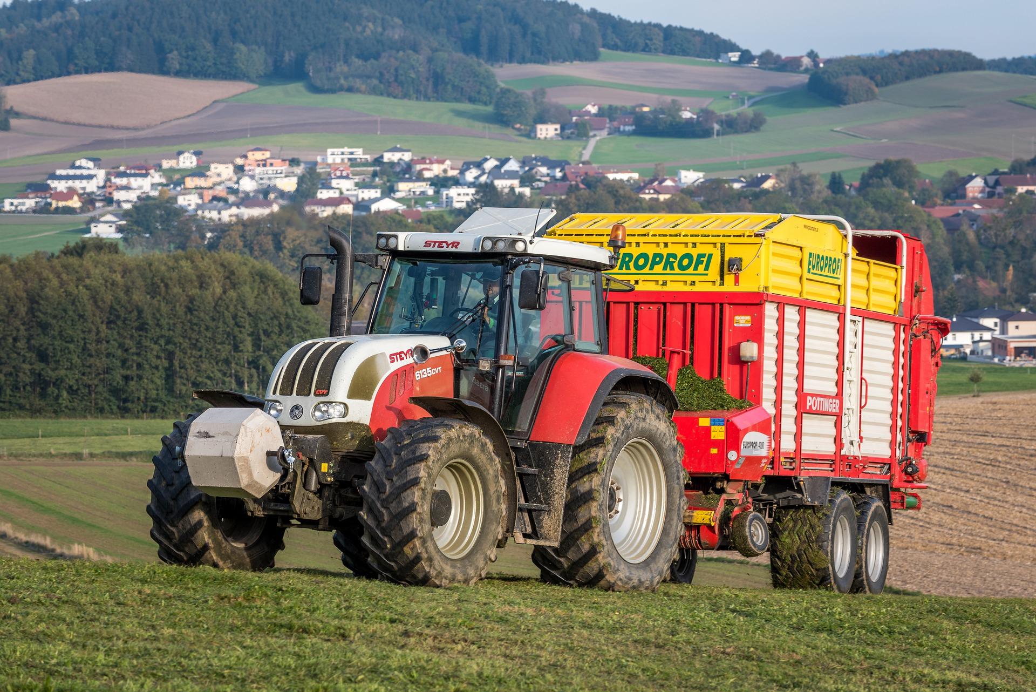
How to Protect Yourself
Draw up a farm safety emergency plan
Equipment safety checklist
DO’s:
DONTS:
Notes:
How to Protect Yourself
Draw up a farm safety emergency plan
An emergency plan is vital. Some suggestions include:
Ensure easy access to a suitable and well-stocked first aid kit.
Make sure at least one person on the farm is trained in first aid.
Keep emergency numbers and correct addresses next to the telephone.
Plan routes to the nearest hospital – make sure it has an operational emergency department.
Regularly talk through your emergency plan with your family and other workers.
Make sure your children understand what to do in an emergency.
Equipment safety checklist
DO’s:
keep all guards in place on tractors and equipment
ensure PTO shafts are fully guarded (O-guard, U-guard and shaft) and the safety chain is attached
make sure that all mirrors and cameras (if fitted) are clean and fully functional on tractors and telescopic handlers
keep all windows clean and make sure you check all round before carrying out any manoeuvre
ensure you have good all-round visibility on tractors and telehandlers
when pulling heavy machinery equipped with hydraulic brakes, make sure the brakes are connected to the tractor and work properly
keep the brakes on all your machines properly maintained, especially the parking brakes
operate tractors with enclosed safety cabs or roll bars
take care when mounting or dismounting tractors or telehandlers
only start your tractor from the driver’s seat and make sure that your tractor’s starter system works properly
check all hitches and linkages to ensure they are not worn or damaged
make sure equipment is stopped fully before clearing blockages, which need to be cleared by hand
DONTS:
attempt to repair machinery if you do not have the correct tools and equipment and are not competent to do so
run a tractor down a slope to start it
check hydraulic pipes for leaks by running your finger along them while they are connected and under pressure
work underneath a raised load or implement unless it is adequately propped
work near overhead power lines when tipping trailers or using high-reaching machinery

Slide 10
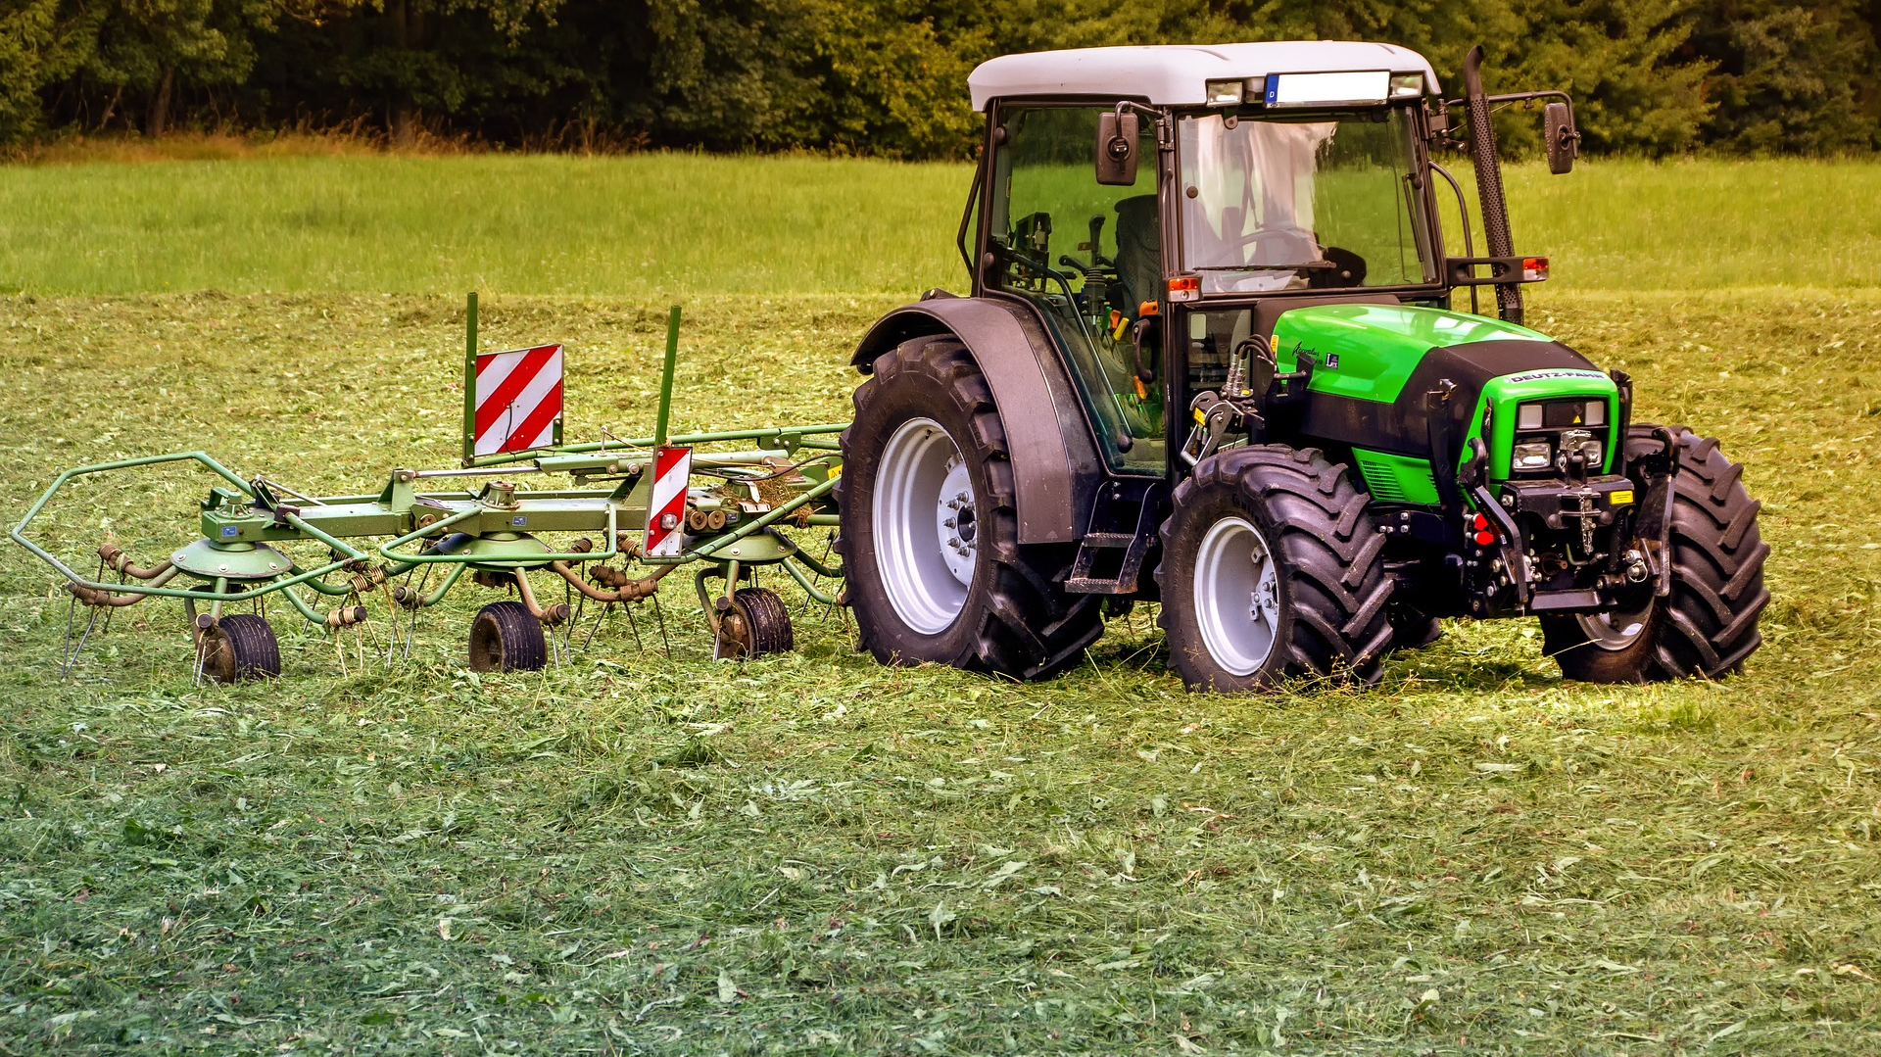
Final Word
Moving large farm machinery on public roadways is part of the business of farms.
The nature of our work means we are using public roadways to access fields and farm-yards. Driving defensively and being aware of other motorists on the roadways are the best ways to avoid collisions.
Notes:
Final Word
Moving large farm machinery on public roadways is part of the business of farms.
The nature of our work means we are using public roadways to access fields and farm-yards. Driving defensively and being aware of other motorists on the roadways are the best ways to avoid collisions.

