Slide 1

Click anywhere to get started…

Slide 2
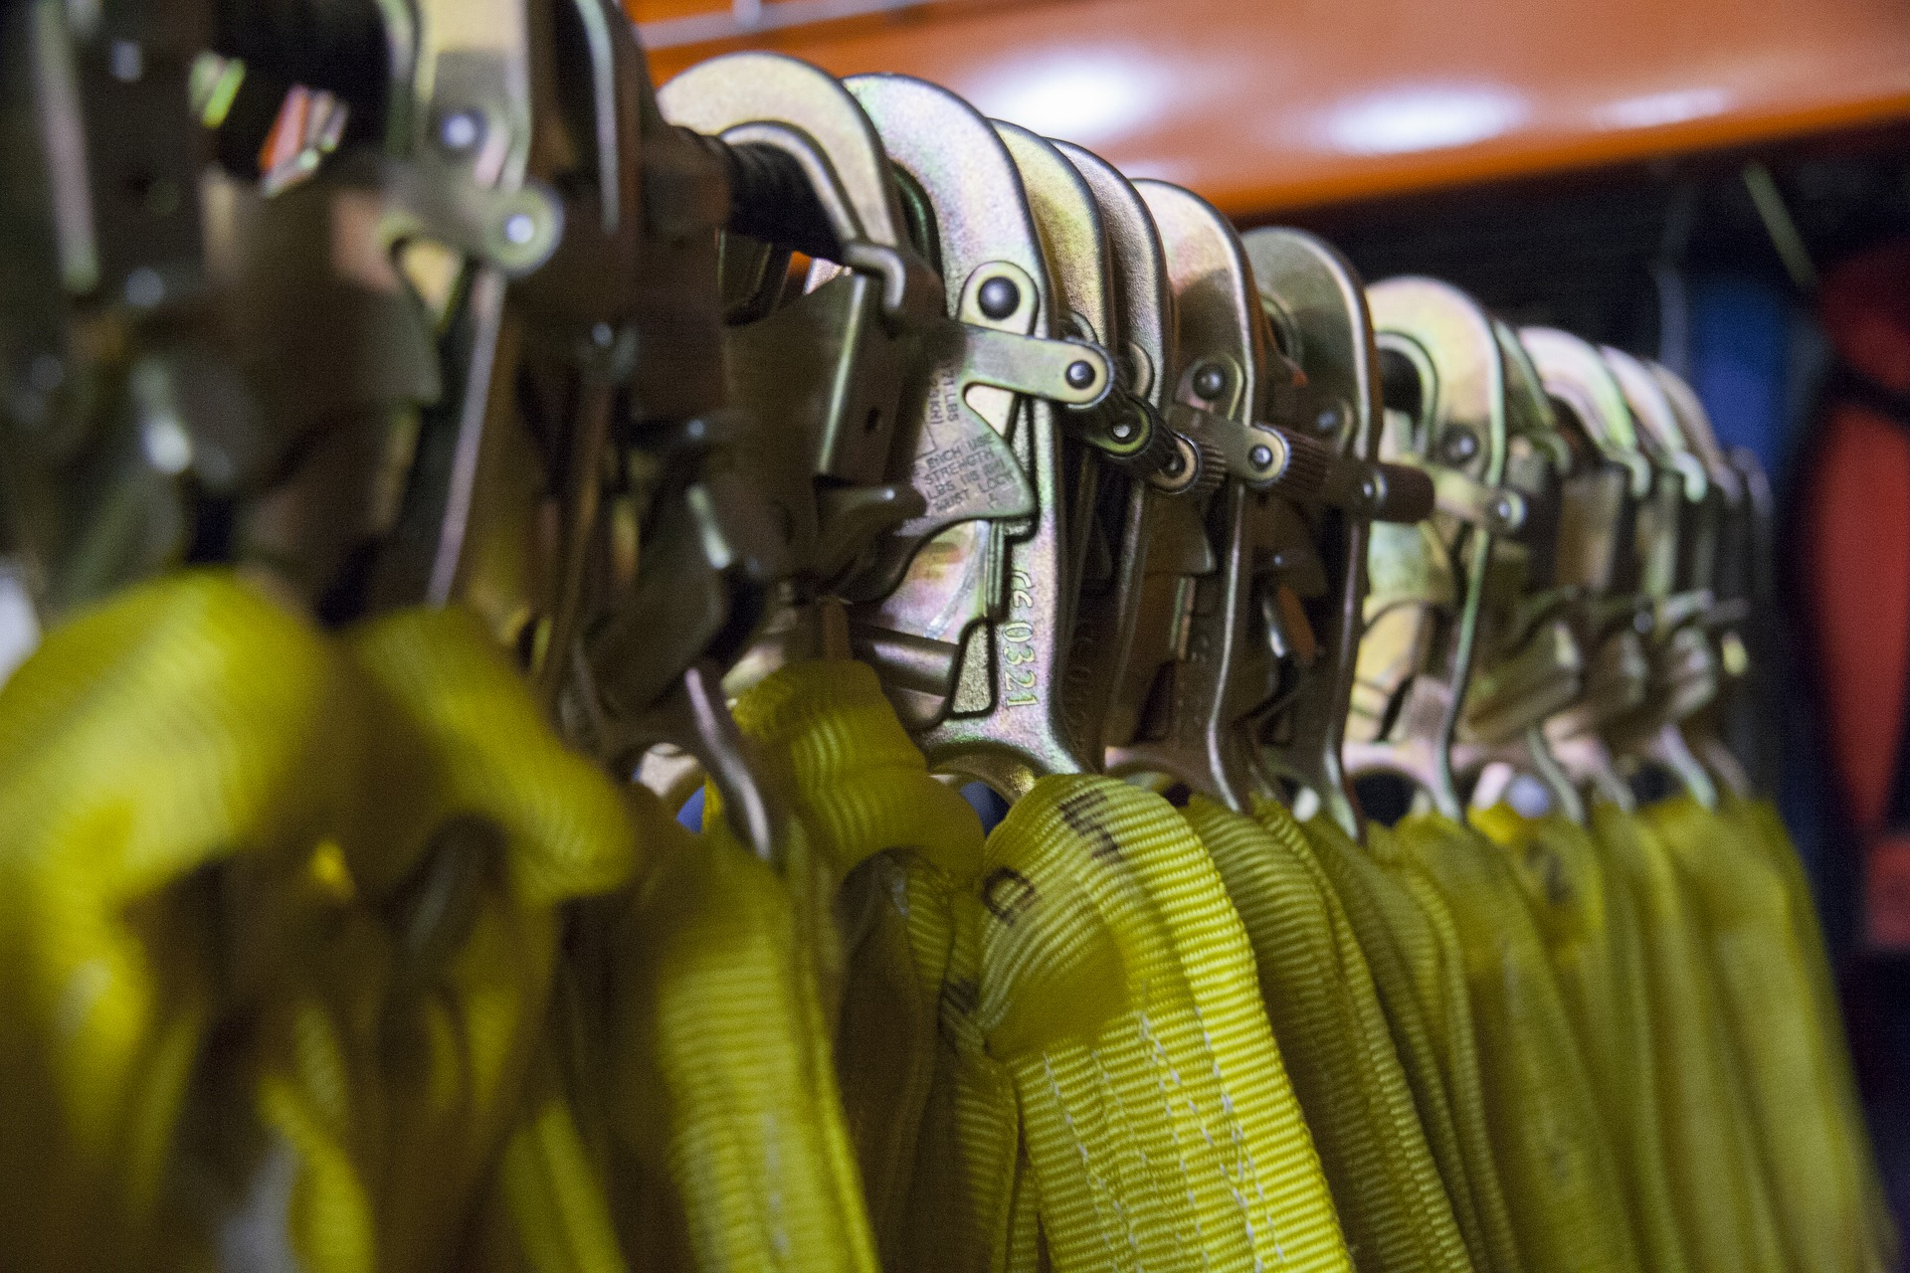


FALL PROTECTION
Notes:
Fall Protection

Slide 3
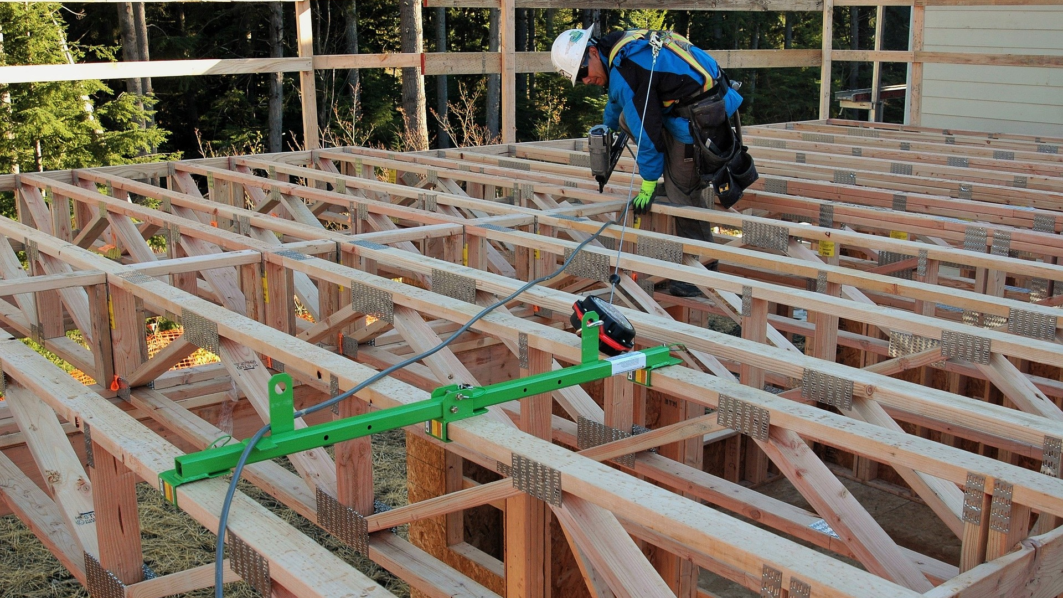
What’s at Stake?
Many workers receive little or no fall protection training, use the wrong fall protection, or, use the equipment improperly, and, sometimes do not use fall protection at all.
Notes:
What’s at Stake?
Many workers receive little or no fall protection training, use the wrong fall protection, or, use the equipment improperly, and, sometimes do not use fall protection at all.
Working at heights is any work where a person could fall a distance and be injured. Working at height of four feet or more is a risk. OSHA require employers to provide employees fall protection according to the fall hazards that exist on the job and at no cost to the employee.

Slide 4
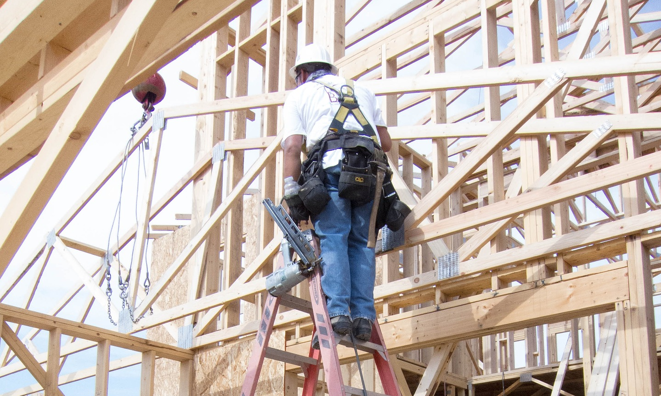
What’s the Danger?
Falls Risks
NIOSH Fatality and Control Evaluation program researches found fatality reports for 768 construction industry fatalities.
Researchers after analyzing the incidents concluded that between 1982 and 2015 that:
In 2016, 697 workers died in falls to a lower level, and 48,060 were injured badly enough to require days off of work.
Notes:
What’s the Danger?
Falls Risks
Falls are the most common causes of serious work related injuries and deaths.
A worker is most at risk if working at heights of four feet or more; above running machinery, water and hazardous liquids, or exposed to an opening in a work surface. Fall protection equipment can mean the difference between life and death.
Working at heights is any work where a person could fall a distance and be injured. This event might include, for example, falling from a step ladder, off of a roof, or through an unguarded hole in the ground or floor. Fall protection may also be required when working above an open-top tank, bin, hopper, or vat.
Personal Fall Arrest System (PFAS) are designed to prevent workers from falling off communication towers, scaffolds at high rise construction sites, or the roof of a house.
Many workers receive little no fall protection training, use the wrong fall protection, or, use the equipment improperly, and, sometimes do not use fall protection at all.
According to the Center for Construction Re-search and training (CPWR) in a 33yr period from 1982 to 2015, falls accounted for nearly half of all construction workers deaths. More than half of the workers killed lacked access to fall protection.
NIOSH Fatality and Control Evaluation program researches found fatality reports for 768 construction industry fatalities.
Researchers after analyzing the incidents concluded that between 1982 and 2015 that:
42 percent (325) of the fatalities involved falls.
54 percent of the workers killed had no access to a personal fall arrest system and 23 percent had access to a PFAS but did not use it.
Most of the workers with no access to PFAS worked for residential building contractors and contractors in the roofing, siding and sheet metal sectors.
107 of the 325 falls were from 30 feet or higher.
20 percent of the 768 deaths occurred in the victims first two months on the job.
In 2016, 697 workers died in falls to a lower level, and 48,060 were injured badly enough to require days off of work. A worker doesn't have fall from a high level to suffer fatal injuries; 134 workers were killed in falls on the same level in 2016, according to Injury Facts. Construction workers are most at risk for fatal falls from height – more than seven times the rate of other industries – but falls can happen anywhere, even at a "desk job."

Slide 5
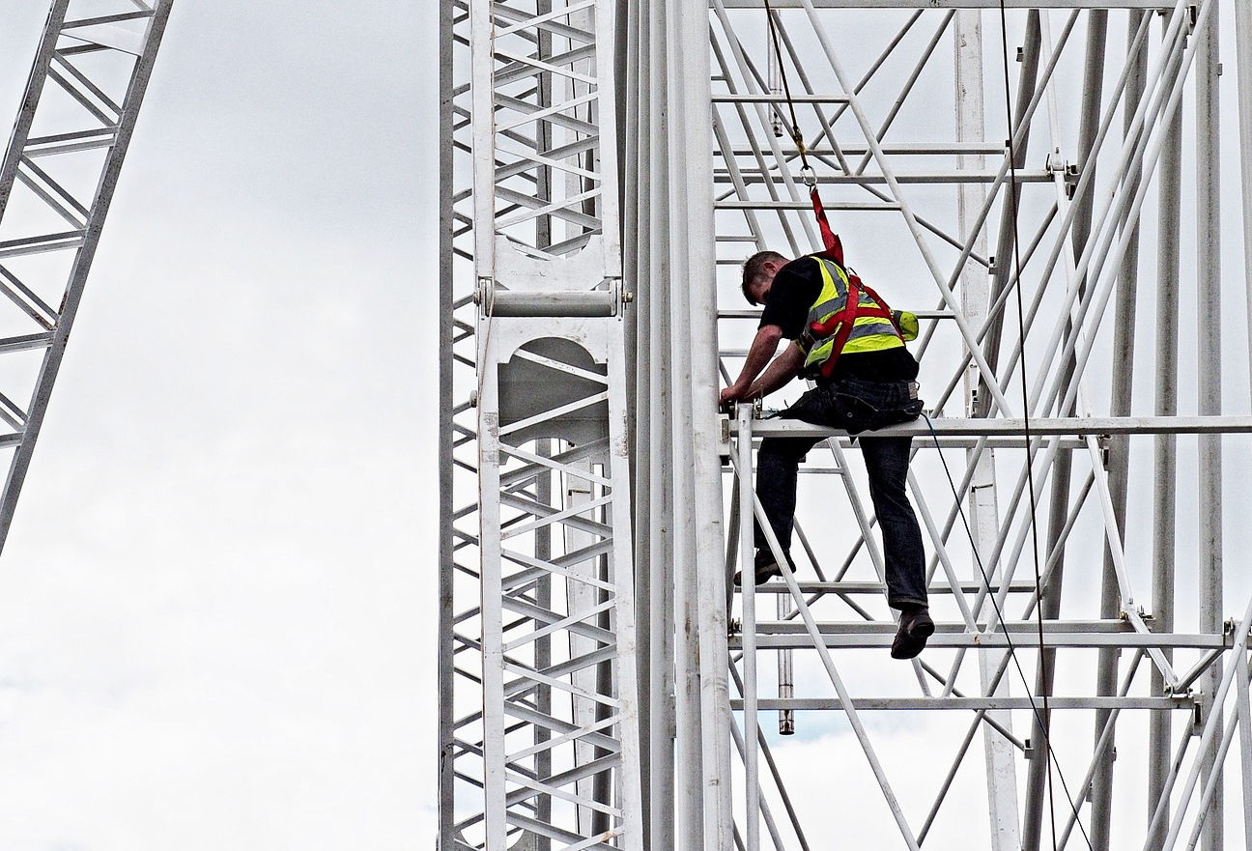
What’s the Danger?
NSC data for 2016 includes falls from height and falls on the same level, by industry:
Overview
When you learn that falls are, historically, the leading cause of fatalities in the construction industry, the reason for OSHA Fall Protection regulations becomes self-evident. But in addition to the direct effect of a hazard on a worker, the costs associated with workplace injury, including workers’ compensation payments, can be among the most devastating to an employer’s bottom line. These things come together to emphasize the need to prevent falls before they happen.
Notes:
What’s the Danger?
NSC data for 2016 includes falls from height and falls on the same level, by industry:
Construction: 24,700 injuries, 384 deaths
Manufacturing: 22,040 injuries, 49 deaths
Wholesale trade: 10,250 injuries, 21 deaths
Retail trade: 29,830 injuries, 29 deaths
Transportation and Warehousing: 23,490 injuries, 46 deaths
Professional and business services: 22,090 injuries, 111 deaths
Education and health services: 43,660 injuries, 18 deaths
Government: 63,350 injuries, 44 deaths
Overview
When you learn that falls are, historically, the leading cause of fatalities in the construction industry, the reason for OSHA Fall Protection regulations becomes self-evident. But in addition to the direct effect of a hazard on a worker, the costs associated with workplace injury, including workers’ compensation payments, can be among the most devastating to an employer’s bottom line. These things come together to emphasize the need to prevent falls before they happen.

Slide 6

How to Protect Yourself
Fall Reduction
Fall Elimination
Fall arrest
Hierarchy of Controls
All hazards are to be addressed by using the following hierarchy of controls:
If the first (1) to (4) controls are not adequate to protect against the fall hazard, then PFAS must be used.
If it has been determined that the employee must wear a harness and lanyard, there must be training in the hazards present when working at heights and at what heights fall protection is required. Then the employee must be trained to use and inspect this critical piece of personal safety equipment.
Notes:
How to Protect Yourself
Fall Reduction
Employers must set up the work place to prevent employees from falling off of overhead platforms, elevated work stations or into holes in the floor and walls. OSHA requires that fall protection be provided at elevations of four feet in general industry workplaces, five feet in shipyards, six feet in the construction industry and eight feet in longshoring operations. In addition, OSHA requires that fall protection be provided when working over dangerous equipment and machinery, regardless of the fall distance.
Fall Elimination
Fall elimination is often the preferred way of providing fall protection. This entails finding ways of completing tasks without working at heights.
Fall arrest
Fall arrest is the form of fall protection that stops a person who has fallen.
Hierarchy of Controls
OSHA requires employers to provide employees for fall protection according to the fall hazards that exist on the job.
All hazards are to be addressed by using the following hierarchy of controls:
Eliminate the hazard
Substitutions
Engineering Controls
Administration controls, and
Personal Protective Equipment
If the first (1) to (4) controls are not adequate to protect against the fall hazard, then PFAS must be used.
If it has been determined that the employee must wear a harness and lanyard, there must be training in the hazards present when working at heights and at what heights fall protection is required. Then the employee must be trained to use and inspect this critical piece of personal safety equipment.

Slide 7
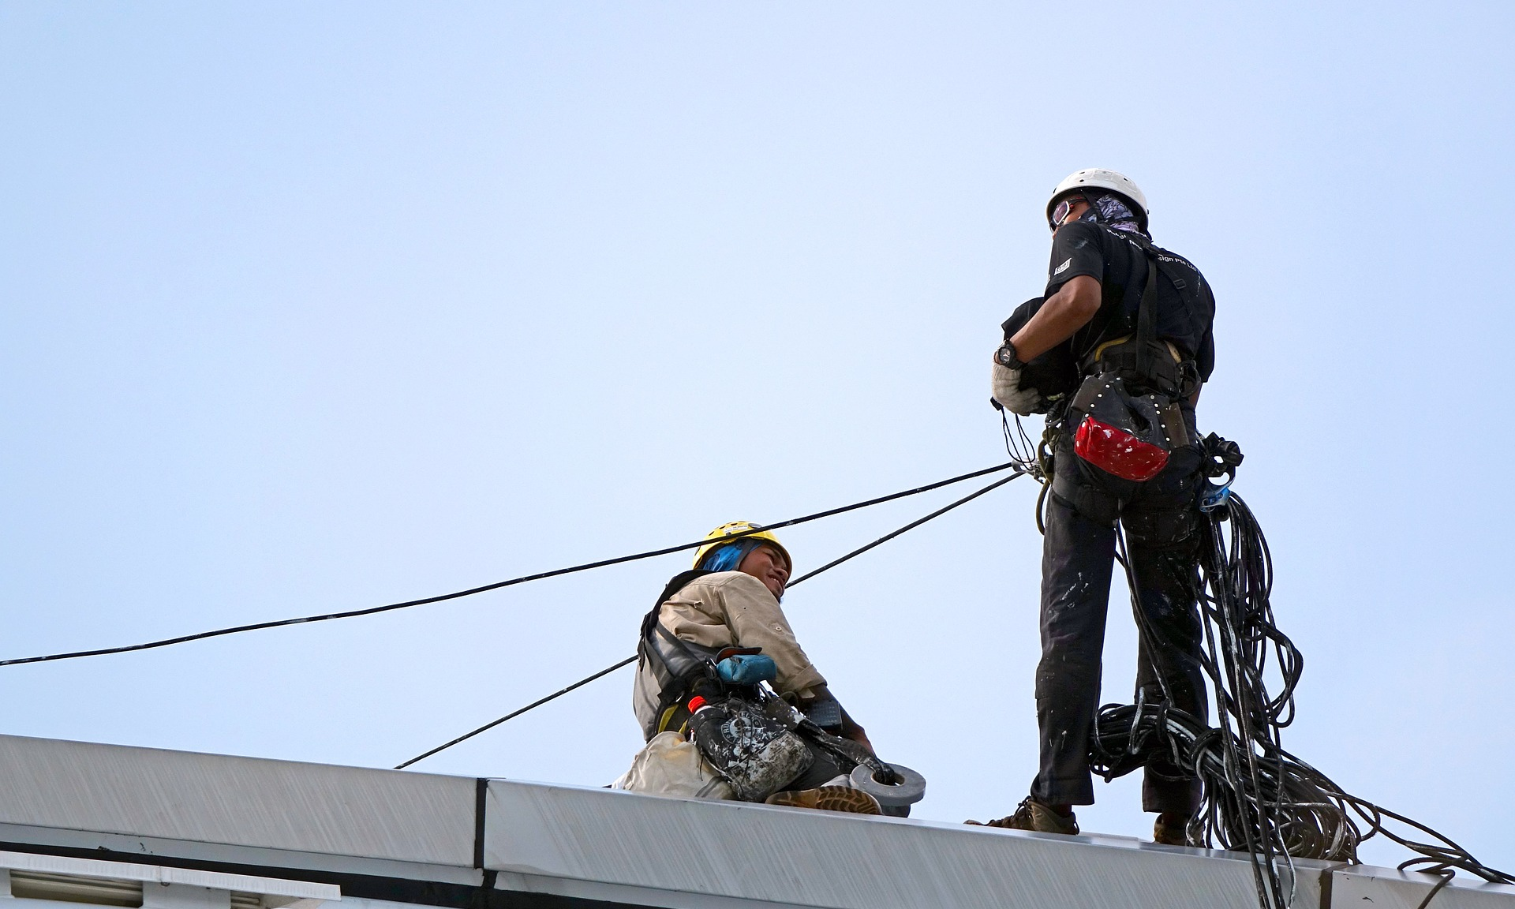
How to Protect Yourself
Employer Responsibility
FINAL PREVENTATIVE MEASURES
Plan
Provide
Train
The proper equipment doesn't provide much help if it's used incorrectly. Make sure all of your workers understand the proper set up and use of the ladders, scaffolds, PFAS, and other equipment they'll be using.
Notes:
How to Protect Yourself
Employer Responsibility
Employers must:
Guard every floor hole into which a worker can accidentally walk (using a railing and toe-board or a floor hole cover).
Provide a guard rail and toe-board around every elevated open sided platform, floor or runway.
Regardless of height, if a worker can fall into or onto dangerous machines or equipment (such as a vat of acid or a conveyor belt) employers must provide guardrails and toe-boards to prevent workers from falling and getting injured.
Other means of fall protection that may be required on certain jobs include safety harness and line, safety nets, stair railings and hand rails.
Provide working conditions that are free of known dangers.
Keep floors in work areas in a clean and, so far as possible, a dry condition.
Select and provide required personal protective equipment at no cost to workers.
Train workers about job hazards in a language that they can understand.
FINAL PREVENTATIVE MEASURES
There are three steps to implement to prevent falls:
Plan
As part of the planning on any job or project, decide what portions will require workers to be at heights, from ladders, scaffolds, roofs, or other means. Determine what safety equipment and training may be needed to keep workers safe for those portions of the job.
Provide
Fall protection gear and proper equipment, such as ladders and scaffolds, are required for workers who are six feet or more above a lower level. Different ladders and scaffolds are appropriate for different jobs, so make sure you are providing the correct kind. If your job requires the use of personal fall arrest systems (PFAS), make sure each worker has a harness. Be sure to inspect all of the equipment to make sure it's in good order before using it.
Train
The proper equipment doesn't provide much help if it's used incorrectly. Make sure all of your workers understand the proper set up and use of the ladders, scaffolds, PFAS, and other equipment they'll be using.

Slide 8

Final Word
When employees are working at heights greater than 4 feet, employers must educate them on the hazards of the job and train them how to use the appropriate equipment for the specific job. Employers must instill in workers never to take risks when it comes to fall protection safety.
Notes:
Final Word
When employees are working at heights greater than 4 feet, employers must educate them on the hazards of the job and train them how to use the appropriate equipment for the specific job. Employers must instill in workers never to take risks when it comes to fall protection safety.

