Slide 1

Click anywhere to get started…

Slide 2



DEVELOPING A SPRING CHECKLIST
Notes:
Developing a Spring Checklist

Slide 3

What’s at Stake?
Snow is still on the ground and plenty of it, but spring is just around the corner! Now is the opportune time to get ready for the growing season. This includes drawing tractor and equipment checklists relating to condition and working order.
Notes:
What’s at Stake?
Snow is still on the ground and plenty of it, but spring is just around the corner! Now is the opportune time to get ready for the growing season. This includes drawing tractor and equipment checklists relating to condition and working order. But more importantly, spring cleaning for workplace safety should take the top billing.

Slide 4

What’s the Danger?
Not being organized and thorough in getting your farm ready for the spring roll-out will cause dangers/risks for your wellbeing.
Notes:
What’s the Danger?
Your equipment, tractors, farm ATVs and all mechanized machinery enable you to operate successfully and efficiently. Not being organized and thorough in getting your farm ready for the spring roll-out will cause dangers/risks for your wellbeing.

Slide 5

How to Protect Yourself
THE CHECKLISTS
Step 1. Develop a Tractor and Equipment Checklist
Step 2. Develop a Basic Safety Checklist
Spring Cleaning
Here are seven key components that should be addressed and implemented for safety sake.
1. Take Stock Of Your Surroundings
2. AEDs
3. Checks
Notes:
How to Protect Yourself
THE CHECKLISTS
Step 1. Develop a Tractor and Equipment Checklist
If you haven’t already, adjust brakes, clutches and drives, according to the manual. Make sure they’re in working order.
Ensure steering, ignition and exhaust system are in top condition.
Check and/or change the fluids (differential, transmission and hydraulic fluids oil etc.) to ensure purity and removal of water that may have condensed.
Check the cooling system. Look for for cracks from freezing and leaks.
Check all rubber hoses and plastic parts like fans for cracks.
Belts may become brittle and crack. Replace them if they are worn. Check that belts and pulleys are at the proper tension. This reduces slippage.
Check that intake guards and shields on grain augers secure.
Check that all power take-off units have shields and are back in place if they were removed.
Step 2. Develop a Basic Safety Checklist
Choose a location, like a machine shed with a concrete floor and proper tools nearby, to service your farm equipment.
Stop the engine before refueling, servicing or greasing; if possible, wait for the engine to cool before refueling.
Never remove or replace belts while pulleys are under power.
Keep steps and working platforms free of grease and oil to avoid slips and falls.
Carry a communication system to call for help in emergencies.
Hydraulic lines can be under high pressure, do not check for leaks with your hands.
Use eye protection and other necessary personal protective equipment.
Spring Cleaning
Spring time cleaning should take top priority to ensure workplace safety.
Here are seven key components that should be addressed and implemented for safety sake.
Take Stock Of Your Surroundings
Take a good look at your environment. Make sure all work areas are clean and free from hazards. Confirm any spills or debris have been fully cleaned up and removed from the area. A safe work environment should have:
Fully organized, clean workspaces
Sufficient lighting
Properly labeled waste receptacles
A system for quickly and efficiently removing waste, debris, and spills
2. AEDs
Examine and update your supplies
Take stock of your safety supplies – specifically your Automated External Defibrillators (AEDs)
An AED is crucial in assuring that a workplace emergency doesn’t become a workplace tragedy. Studies have shown that victims of Sudden Cardiac Arrest (SCA) have a 90 percent chance of survival if a shock from an AED is received within the first two minutes.
3. Checks
Check the location of each AED. Is there a device on each floor, or in each designated work area? And further, is each device clearly visible? All employees should know exactly where the AEDs are located and how to operate one, should an emergency arise.
Check to see that everything is in working order.
Run a self-test to check the battery life by first taking the battery out and re-installing it. Follow the prompts on the AED to make sure batteries are up to date, and if you find they are not, better to replace them now than be caught off guard during an emergency.
Assuming the self-check goes well, now is also a good time to make sure spare batteries are available as an added safeguard. Store a backup battery by each AED, and don’t leave yourself in a greater emergency situation that could have been avoided.
Check the AED pads. There should be at least two sets of unused pads in a sealed package accessible for an emergency. Also, check the expiration dates on the pad packages, and make sure they’re not in danger of expiring before use. If that date is right around the corner – or before your next scheduled safety check – be sure to replace them now.
Check the device itself. Check the AED service light indicator to see if the device will be good to use over the next several months. Failure to do so could mean the AED won’t operate when necessary. Also, check to make sure there are no cracks or other outward damage to the device. These could also impact the function of the AED when the timing really counts.

Slide 6
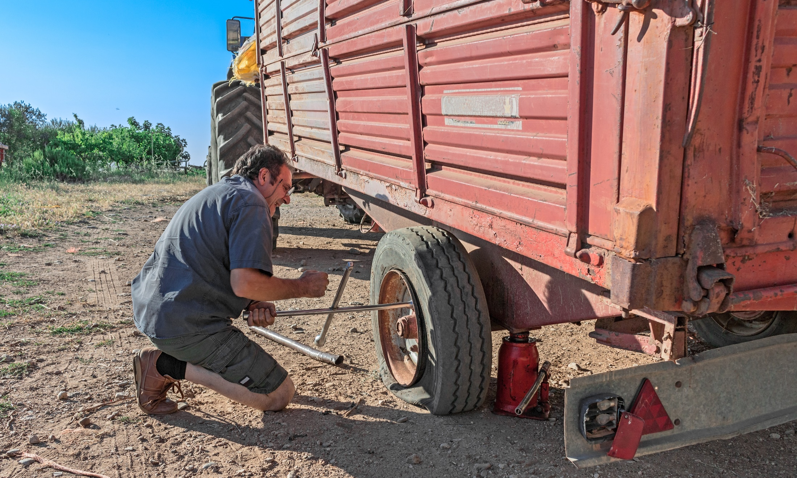
How to Protect Yourself
4. First Aid Supplies
5. Consider Employee CPR Training
6. Evaluate Communication And Documentation
7. Hazard Communication Training Program
Notes:
How to Protect Yourself
4. First Aid Supplies
First-aid supplies should be easily accessible in all areas of the workplace.
First, consider the location of the supply cabinet. It should be somewhere easily accessible for the entire workplace, and all employees should know exactly where it is located. Knowing that time is of the essence in an emergency, for larger companies, consider placing a full first-aid cabinet on each floor.
Next, it is imperative to check the supplies and keep track of when the last check was done. Get this on a schedule, and look the entire cabinet over, so you never risk not having an emergency supply easily accessible should an accident take place in the workplace. If you can’t remember when this last happened, now is the time.
5. Consider Employee CPR Training
Make it a point each year to review the number of current employees trained in administering CPR. At a minimum, each shift should have a supervisor or other team member who is qualified to perform CPR if the need arises. Offering CPR training on-site can help alleviate the strain and get many people certified on the job.
6. Evaluate Communication And Documentation
Look at how your employees receive safety communications and how safety issues and practices are documented. Even the best safety preparedness protocol is inefficient if it’s not properly communicated.
7. Hazard Communication Training Program
How are hazardous substances stored? For each substance, you must keep a clearly labeled container indicating the contents, as well as a health hazard warning.
All hazardous substances being used in the work environment must be documented. Put a schedule in place to regularly take stock of what hazardous substances are being used, taking care to ensure the list is accurate and up to date.
Create and maintain a detailed written plan that describes all hazard communication. Ensure each employee understands emergency procedures and can act appropriately following contact with hazardous chemical waste.
Make sure the workplace has Material Safety Data Sheets (MSDS) clearly accessible for employees, which detail all hazardous materials being used throughout the workspace. The MSDS should be placed in close proximity to where the work is being conducted.

Slide 7
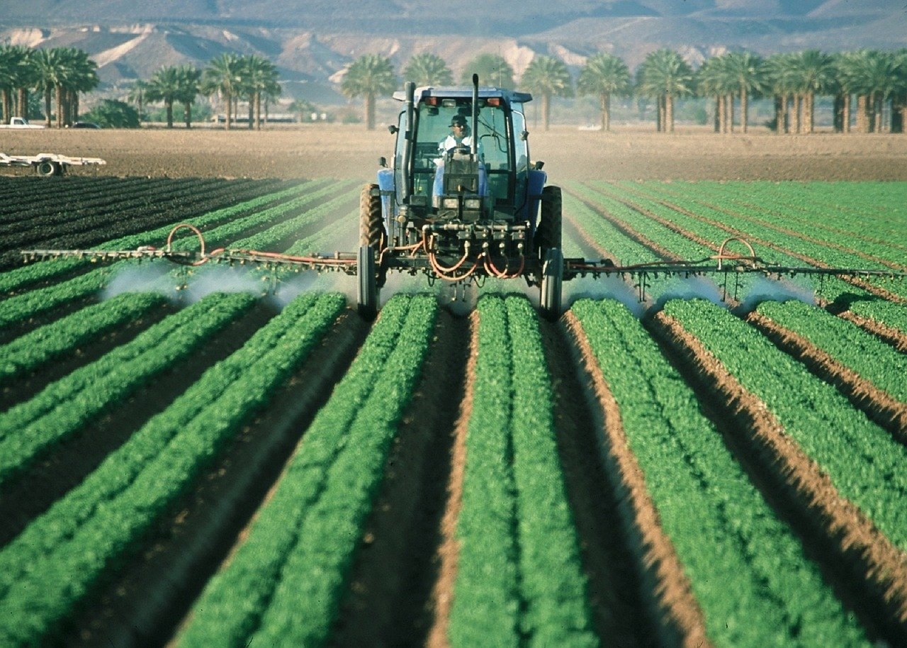
How to Protect Yourself
The Finale Checklist
This list tells farmers what to do before they put their equipment/tractors and mechanized equipment to work.
Lights and flashers.
Shields and guards.
Hydraulic systems and mechanical locks.
Tires.
Sprayer and planter.
Hitch pins.
Steps and platforms.
Getting your tractors and other equipment ready for spring doesn’t need to take a long time but it will pay off in the long run.
Notes:
How to Protect Yourself
The Finale Checklist
The following is the final checklist for the spring roll-out at your location.
This list tells formers what to do before they put their equipment/tractors and mechanized equipment to work.
1. Lights and flashers. Flashers and turn signals need to be tested to make sure they are working correctly. Emblems need to be clean and any worn down ones replaced.
2. Shields and guards. Check your PTO drive-line shields. Shields should turn freely and independently of the drive line. Further, to ensure maximum protection, the drive-line shields, tractor master shields and corresponding implement shields need to be in place.
3. Hydraulic systems and mechanical locks. Check all hoses, fittings and seals and replace worn pieces.
4. Tires. Check that all tires are inflated properly and that bearings are properly lubricated.
5. Sprayer and planters. Hoses, valves, fittings and all other components must be free of leaks. Any tanks should have tight covers so spills are avoided.
6. Hitch pins. The locking hitch pins on tractors and implements must be checked to guarantee that they are secure and in good working order.
7. Steps and platforms. Always keep equipment platforms and steps clean so that no one slips and falls when entering, exiting or standing on equipment.
Getting your tractors and other equipment ready for spring doesn’t need to take a long time but it will pay off in the long run. After all, there is nothing worse than being slowed down by a breakdown after work has begun in the fields and around the farm.

Slide 8
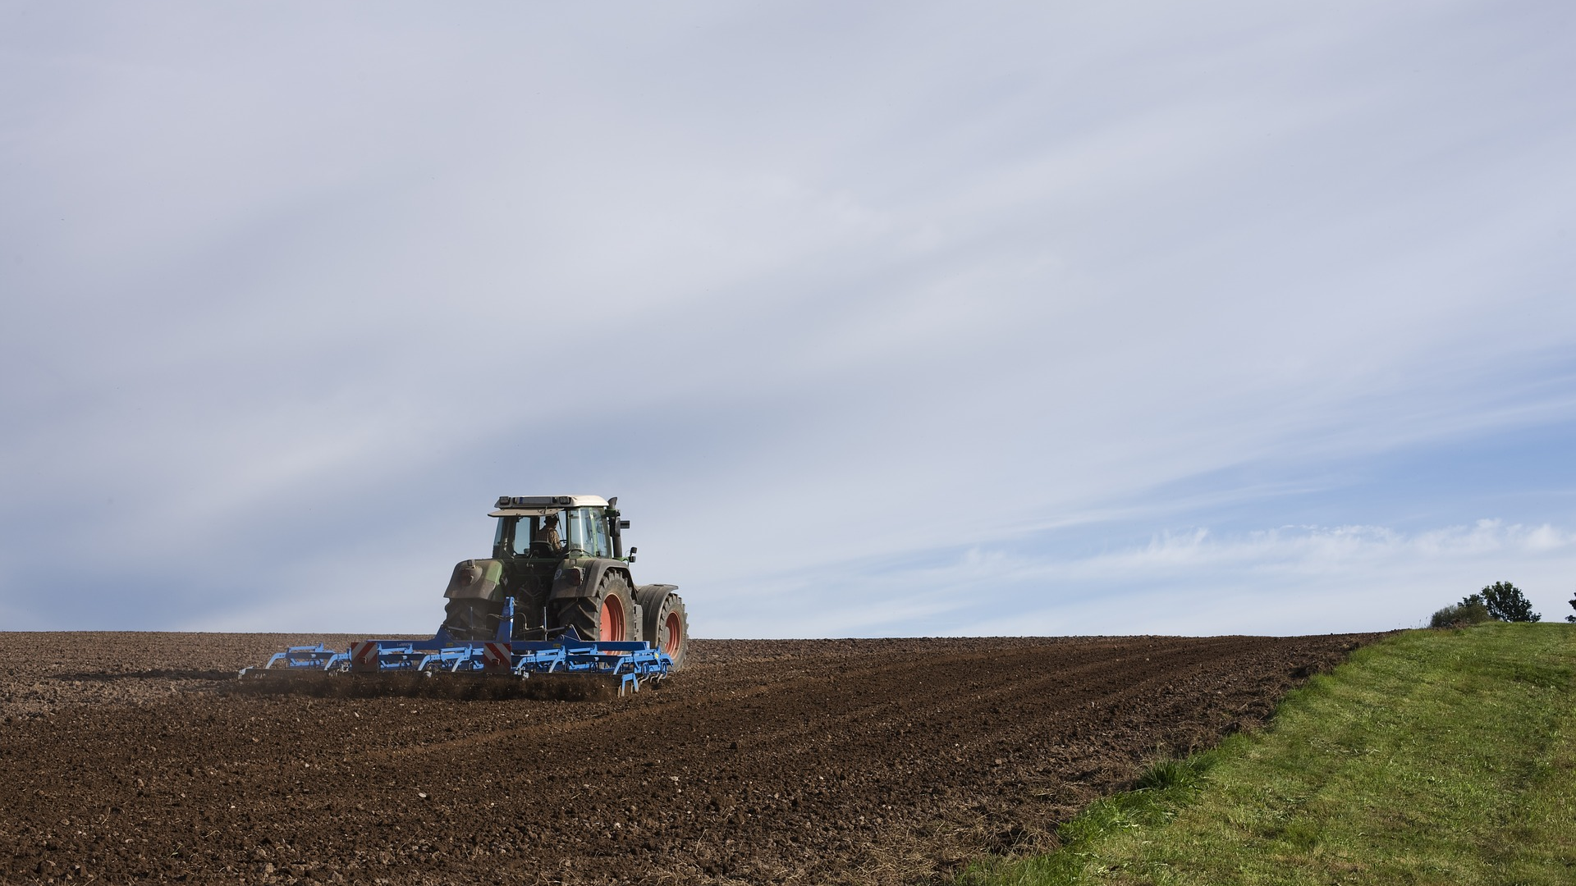
Final Word
Preparation. Preparation. Preparation is the key to a productive and profitable operation. Using checklists will help to ensure that your operation will have less downtime and less overall expense at the start of the busy spring season.
Notes:
Final Word
Preparation. Preparation. Preparation is the key to a productive and profitable operation. Using the checklists will help to ensure that your operation will have less downtime and less overall expense at the start of the busy spring season.

