Slide 1

Click anywhere to get started…

Slide 2



COMMON SAFETY MISTAKES
Notes:
Common Safety Mistakes

Slide 3
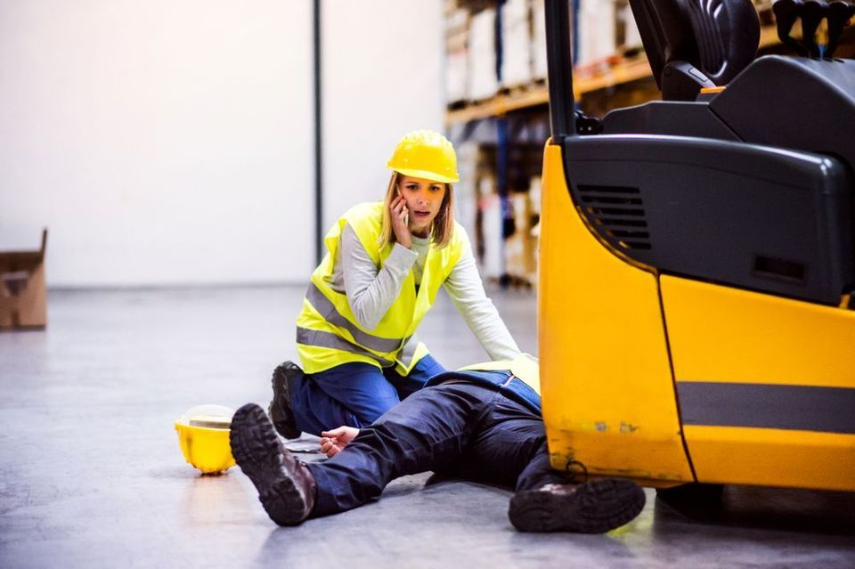
What’s at Stake?
Common mistakes can lead to dangerous situations in the workplace that could have been easily avoided.
Accidents can happen anywhere and anytime in spite of the best of intentions and the best safety programs.
Notes:
What’s at Stake?
Common mistakes can lead to dangerous situations in the workplace that could have been easily avoided.
Accidents can happen anywhere and anytime in spite of the best of intentions and the best safety programs. The test comes down to take certain strategic measures that prevent workplace injuries, accidents and illnesses.

Slide 4

What’s the Danger?
No Process or Plan
Failure to Communicate
Visual Connection Problems
When it comes to safety, communication is essential. It is important to have visual communication options in any loud workplace.
4. Overcomplicating Safety Instructions
When making a policy to improve the safety of one particular area in a facility, it is important not to overcomplicate things.
5. Lack of Housekeeping
One of the simplest yet most effective things that you can do to improve facility safety is keep it clean and organized.
6. Fail to Use Proper Personal Protective Equipment
The widespread use of personal protective equipment is one of the most important ways companies have improved safety over the years.
Notes:
What’s the Danger?
1. No Process or Plan
Most workplace injuries occur when work being done is not part of a normal process. It is important to have a work plan for non-process work. No matter how it is done, planning the work and asking ‘What if…?” questions will help identify hazards and implement controls to prevent injuries. Complete daily hazard assessments and review with your crew before commencing work.
2. Failure to Communicate
One of the easiest things to prevent unsafe conditions is to discuss what hazards or unsafe acts have been noticed. Communicating the hazards and failures in processes is an essential element of protecting ourselves and our co-workers from the hazards that potentially exist in our workplace.
3. Visual Connection Problems
The noise in many workplaces can be quite deafening at times, which can make it difficult to communicate. When it comes to safety, communication is essential. This is why it is so important to have visual communication options in any loud workplace.
Visual communication can come in many forms including signs, labels, floor markings, lights, and more. Taking the time to find ways to effectively communicate without relying on voices will take some effort, but it can dramatically increase the overall safety of a facility.
4. Overcomplicating Safety Instructions
When making a policy to improve the safety of one particular area in a facility, it is important not to overcomplicate things. Keep in mind that the safety efforts made will need to be followed by everyone in the facility, and making them too complex will only result in people bending or breaking the rules.
To the extent possible, all safety instructions given out in a facility should be short and to the point. In addition, these instructions should be in line with common sense so people won’t have difficulty understanding what they are doing and why.
5. Lack of Housekeeping
One of the simplest yet most effective things that you can do to improve facility safety is keep it clean and organized. Sadly, this is also one of the most common workplace safety mistakes people make. Rather than taking the time to clean and organize an area, many companies see this type of activity as a waste of time.
A clean and organized workplace, however, helps keep tools and equipment in good condition (and keeps them from being lost). A messy work area also presents an increased risk of tripping and other accidents.
6. Fail to Use Proper Personal Protective Equipment
The widespread use of personal protective equipment is one of the most important ways companies have improved safety over the years. Unfortunately, many employees either fail to use the PPE at all or they don’t use it properly. This leaves them exposed to the dangers they are supposed to be protected from.
Not only that, but when one person is not wearing the right personal protective equipment, it increases the risk for everyone around them. This type of compounding hazard can lead to very serious safety issues that

Slide 5

What’s the Danger?
7. The Wrong Tool for the Job Used
Using the right tool for the job is not only the most efficient way to get it done, but it is also the safest.
8. Maintenance & Inspection of Machinery Neglect
For many companies, keeping machines up and operating at all times is the most important thing.
Performing regularly scheduled maintenance and inspections is absolutely critical for workplace safety.
9. Fail to Track “Near Misses”
Keeping track of all near miss events and learning from them is an important part of any workplace safety strategy.
10. Education Treated as Optional
One of the biggest workplace safety mistakes a facility can make is treating safety education as optional.
11. Improper Handling of Hazardous Materials
These materials need to be stored properly at all times to avoid the risk of a spill or other accident, in addition to keeping them in safe containers.
years.
Notes:
What’s the Danger?
7. The Wrong Tool for the Job Used
Just about every task that needs to be done in a facility will require some type of tool. Using the right tool for the job is not only the most efficient way to get it done, but it is also the safest. When employees try to take a shortcut by just using whatever tool they have with them at the time, they are dramatically increasing the risk of an accident occurring.
Investing the time and money into making sure the right tools are available for a given job will help keep people safe and will also ensure a job is done quickly and correctly.
8. Maintenance & Inspection of Machinery Neglect
For many companies, keeping machines up and operating at all times is the most important thing. When machines are running, they are making money. This is why many facilities postpone or ignore many types of machine inspections and maintenance.
This can, however, cause machines to breakdown unexpectedly. Machine breakdowns are a big problem for productivity, but they can also cause many safety issues. Any machine that has issues will have unpredictable performance, which can put all the people who work with or around the machine at risk. Performing regularly scheduled maintenance and inspections is absolutely critical for workplace safety.
9. Fail to Track “Near Misses”
Just about everyone who has worked in any type of work environment has had a “near miss” at some point in their career. These are those instances when if something had happened just a little differently, it would have resulted in a serious injury or even fatality.
While it is certainly a relief when nobody is hurt, it does not mean that a safety incident did not occur! Keeping track of all near miss events and learning from them is an important part of any workplace safety strategy. Identifying the cause of a near miss so it can be fixed will help prevent the same thing from happening again in the future, but possibly with much worse results.
10. Education Treated as Optional
One of the biggest workplace safety mistakes a facility can make is treating safety education as optional. While safety education doesn’t provide any immediate return on investment, the long-term benefits are really incalculable. Making this type of training a priority may be the single best thing a company can do to avoid accidents and other safety mistakes in the future.
11. Improper Handling of Hazardous Materials
Facilities often have hazardous materials used for different tasks. These materials need to be stored properly at all times to avoid the risk of a spill or other accident. In addition to keeping them in safe containers, those containers need to be properly labeled so everyone knows what they contain.
A properly labeled hazardous material container will make an accident much less likely. If there is an accident, however, everyone will know what to do based on the information provided on those labels.

Slide 6
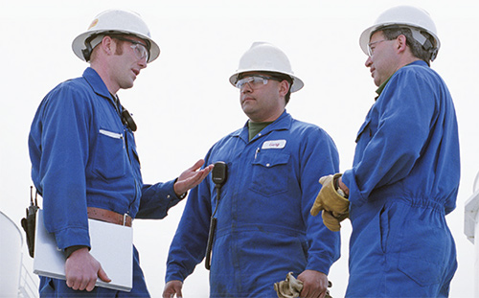
How to Protect Yourself
When thinking about safety mistakes, the things that come to mind are usually dangerous accidents or exposure to hazards. Five areas illustrate problems and prevention.
Safety Mistake #1: Inadequate or rushed training
In matters of workplace health and safety, detailed and thorough training can set a strong standard and example from an employees’ very first day on the job.
Safety Mistake #2: Near-Misses/Close Calls
When employees and management are not sure whether or how to report near-misses, it affects not just that single case, but the overall quality of incident reporting data.
Notes:
How to Protect Yourself
When thinking about safety mistakes, the things that come to mind are usually dangerous accidents or exposure to hazards. The following five areas illustrate problems and prevention.
Safety Mistake #1: Inadequate or rushed training
It makes sense that employers would want to onboard new employees as efficiently as possible. From a financial standpoint, hiring and training is a costly process. The more efficient the training, the sooner the employee can become a productive contributor to the company. While expedited training might seem appealing, taking the time to train and onboard properly can have numerous health and safety benefits.
In matters of workplace health and safety, detailed and thorough training can set a strong standard and example from an employees’ very first day on the job. Not only does it help arm employees with the knowhow to prevent workplace safety mistakes, but it also communicates that safety is a priority.
Although employees and employers commonly agree that training is important, most people don’t enjoy sitting through lengthy training sessions, whether in a classroom or in front of a computer. All of this can harm the quantity and quality of information that employees absorb. A strong health and safety system maximizes employee time and attention to deliver training that is timely, hands-on, and relevant. Lower load – To lower the load downward, the signal person will extend their arm horizontally, pointing their index finger towards the ground, once in this position they will make a circle motion with their finger.
Safety Mistake #2: Near-Misses/Close Calls
A near-miss incident can feel like a relief, and it is easy to move on and forget what happened once the threat has passed. However, neglecting to follow up on a near-miss is a major risk factor, because it increases the chances that the issue will come up again. How do you ensure that a near-miss doesn’t snowball into a serious incident?
Near-miss reporting requires clear and seamless communication throughout the organization. When employees and management are not sure whether or how to report near-misses, it affects not just that single case, but the overall quality of incident reporting data. In a near-miss scenario, it might be tempting to sigh with relief and move on, thankful that the worst outcome was avoided. However, follow-through should never stop here.
Over time, proper near-miss reporting results in a trove of accurate and potentially life-saving data. To achieve this level of reporting, it’s important to communicate a clear, straightforward policy on the reporting process. One of the first and simplest steps is to define exactly what is meant by a near-miss. For example, The National Safety Council defines a near miss as “an unplanned event that did not result in injury, illness, or damage – but had the potential to do so”. The definition can be tailored to make it relevant to the organization and industry, and it should be made known to all personnel involved in safety reporting.
Most importantly, regular discussion of near-misses normalizes reporting and creates a clear line of communication between workers and management. For example, asking about near-misses in daily meetings or through reporting dashboards can turn attention to recurring issues that need to be addressed. The organization should establish a clear chain of command and protocol for addressing near-misses, including reporting, analysis, prioritization, and finding solutions.

Slide 7
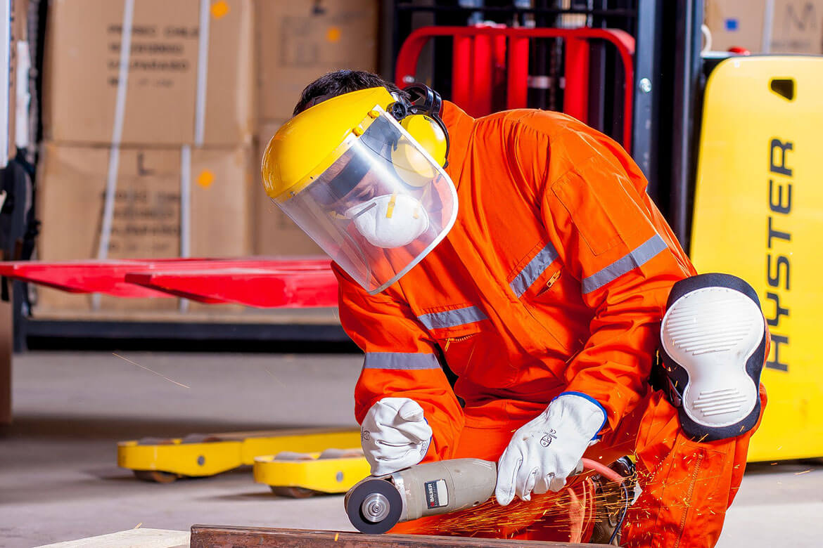
How to Protect Yourself
Safety Mistake #3: Missing Regular Maintenance and Inspection
The best answer to this vicious cycle of scheduling and rescheduling is regularly scheduled maintenance checks. This can be simplified by building this into your workplace health and safety software.
Safety Mistake #4: Failure to use proper tools and protective equipment
Employees should have the right tools to do their job, and they should also be instructed on the proper handling of these tools.
Safety Mistake #5: Fail to prioritize a health and safety system
A robust health and safety system is made up of so many moving parts: incident reporting, standards, hazard management, regulatory compliance, and training.
Notes:
How to Protect Yourself
Safety Mistake #3: Missing Regular Maintenance and Inspection
Equipment maintenance is extremely important, but doesn’t it always seem to come up at the most inconvenient time? If maintenance and upkeep are done on the spur of the moment, it’s easy to think of all of the reasons why the equipment is needed and cannot be turned off, even briefly. Putting it off longer or adding “equipment maintenance” to a mental to-do list might make us feel better in the moment. Unfortunately, the delay only increases the chances of a completely preventable cause of equipment failure and poses a major safety hazard to employees.
The best answer to this vicious cycle of scheduling and rescheduling is regularly scheduled maintenance checks. This can be simplified by building this into your workplace health and safety software, like Donesafe. This can help address one of the biggest reasons for putting off maintenance, which is a loss of productivity. Scheduling maintenance regularly can help prepare and account for a temporary dip in productivity. The alternative, doing maintenance only when the equipment malfunctions, is a surefire way to lose productivity. Planning maintenance ahead of time—and abiding by the plan—helps accommodate any downtime resulting from the inspection. Regular maintenance is also crucial for preventing safety incidents resulting from faulty equipment.
Safety Mistake #4: Failure to use proper tools and protective equipment
Improvisation and creative thinking are valuable skills in any workplace. In the interest of time and efficiency, a worker might choose to improvise or use the available tools to complete a task, especially if the task is urgent. Unfortunately, taking shortcuts to get the job done can result in entirely preventable workplace safety mistakes. Substituting an imperfect tool for the correct tool might get the job done, but it’s also likely to pose a higher risk of injury. Likewise, completing a task “on the fly” might mean that proper safety equipment, such as hard hats or reflective clothing, is inaccessible.
Avoiding this issue is a matter of preparation as well as communication. Employees should have the right tools to do their job, and they should also be instructed on the proper handling of these tools. The issue also needs to be addressed through communication that centers teamwork. Why? It’s as simple as the fact that a fall from an improperly placed ladder will injure both the person on the ladder as well as those beneath it. Misusing equipment and failing to protect oneself pose risks not just to the individual, but anyone working alongside them. Team-oriented communication promotes a shared responsibility towards oneself and others. Workers who engage in risky behavior may change their behavior if they realize that their actions endanger others as well as themselves.
Safety Mistake #5: Fail to prioritize a health and safety system
A robust health and safety system is made up of so many moving parts: incident reporting, standards, hazard management, regulatory compliance, training, just to name a few things. Many of these areas are subject to continuous updates and changes and require ongoing monitoring and maintenance. Luckily, these tasks can be managed in one place by investing in comprehensive health and safety management software. By choosing to bring the entire health and safety system under a single umbrella also sends a clear message that “health and safety” is more than just a slogan, but rather an organizational priority.

Slide 8
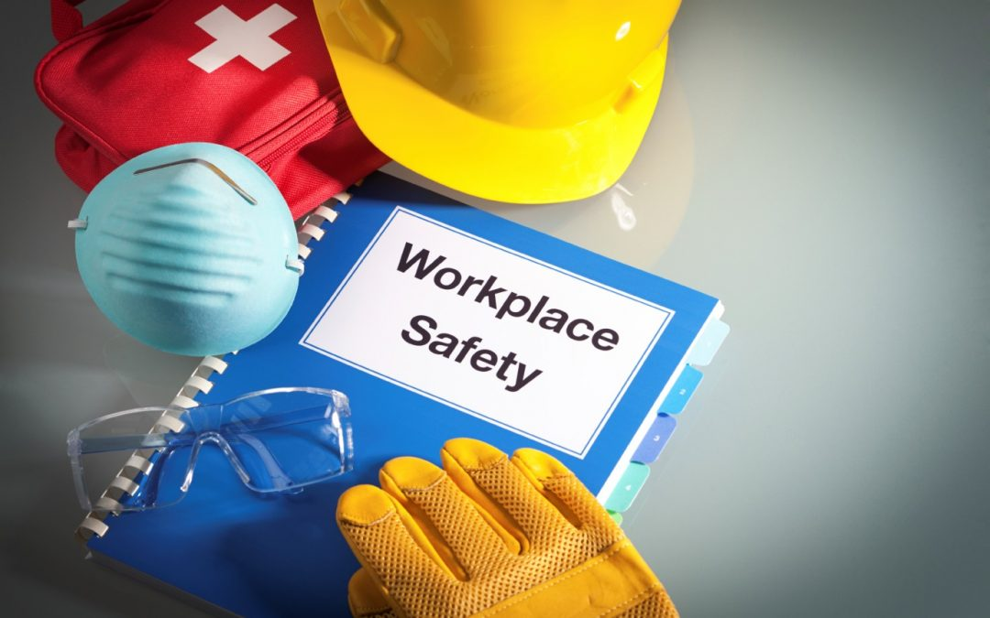
Final Word
Knowing the rules and following them is one piece of the puzzle: think recordkeeping, incident tracking, and regulatory compliance. Just as important, though, is avoiding major safety mistakes. Although this sounds obvious, some of the biggest workplace safety mistakes can be difficult to recognize and prevent.
Notes:
Final Word
Knowing the rules and following them is one piece of the puzzle: think recordkeeping, incident tracking, and regulatory compliance. Just as important, though, is avoiding major safety mistakes. Although this sounds obvious, some of the biggest workplace safety mistakes can be difficult to recognize and prevent.

